Slide 1


Differentiation in
Learning
Prynhawn da

Slide 2

At the end of the session you should be able to:
Discuss Differentiation
Explain the types of differentiation
Create a differentiated lesson

Slide 3
Reading

Slide 4
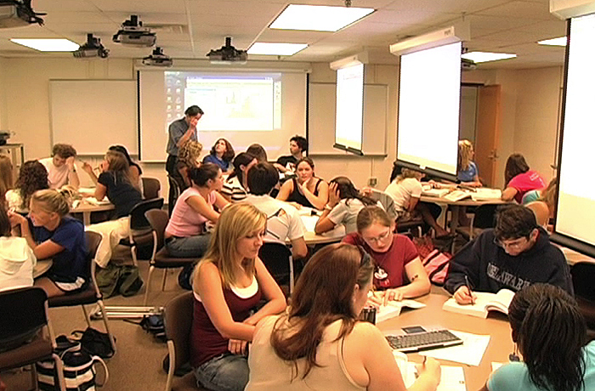

What word do you associate with Differentiation / Differentiated classroom ?

Slide 5



Is differentiation a Ladder or a Sieve ?

Slide 6
Old

Slide 7
New

Slide 8
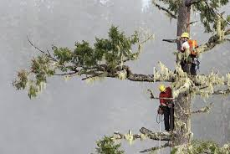
Activity 1: What is Differentiation?
Discuss and agree a definition of differentiation
Notes:
Differentiation in the classroom means anything which a teacher does which helps in personalising learning.
For example, providing sentence starters is differentiation. This is because it helps students who struggle with extended writing to begin their work.
Similarly, using super-extension questions on a given topic or concept is differentiation. This is because it helps to stretch and challenge the thinking of more-able students who finish their work before the rest of the class.
Image of climbing a tree – chosen as a metaphor that we need to step back and consider how to support students on each stage of their learning and how students might navigate it, to maximise learning of groups and individuals.
With any learning task or challenge:
Some learners will find it relatively easy, others will lack confidence
Some learners will thrive when faced with a challenge, others will need great support
Some learners will think logically about the best way to approach the task, some will go full steam ahead while others will freeze with uncertainty
Some learners will emerge as leaders
Different approaches required for different needs – supporting differentiation for individual learners and their needs – personalising learning to create a positive learning climate – impacting on students affective and cognitive learning and development.

Slide 9
Differentiation Definitions
It is an approach to teaching that advocates active planning for student differences in classrooms (Carol Tomlinson (www) 2008-13)
Accommodating differences between students (Petty, 1998)
Differentiation is by challenge – not by ability (… ability is an alluring but dead-end concept educationally speaking) (Boyd et al., 2015)

Slide 10
Differentiation Definitions:
Differentiation is a process whereby teachers ... [select] appropriate teaching methods to match the individual student’s learning strategies, within the group (Visser, 1993)
Getting the best out of every student so that they are able to show what they know, understand and what they can do (University of Aberystwyth)
Notes:
We have to know that what we do and plan for will have a positive impact on learning and for individual learning needs …. It is a holistic process.
Differentiation in the classroom means anything which a teacher does which helps in personalising learning. For example, providing sentence starters is differentiation. This is because it helps students who struggle with extended writing to begin their work.
Similarly, using super-extension questions based around philosophical concepts is differentiation. This is because it helps to stretch and challenge the thinking of more-able students who finish their work before the rest of the class.
There is no need for us to continue with a vague, ambiguous understanding of differentiation in the classroom. It can simply be defined as anything the teacher does which helps in personalising the learning.
Differentiation focuses on:
– Things the teacher can do
– Things you can ask students to do or use
– Activities
– Questioning
– Words and Writing
When planning lessons, and while teaching, you can take these categories and ask yourself what you are doing in relation to each one in order to personalise the learning.
In the next slides we will examine theories and practices to develop differentiated practice in a differentiated way to meet individual and whole group needs, supporting inclusion and equality of opportunity.

Slide 11
Differentiation by …… ?
In the chat how do you differentiate in your classroom ?

Slide 12
What are the challenges of differentiation ?

Slide 13
What are the challenges of differentiation ?
Time teacher – for differentiation to meet every student
Knowledge of differentiation / training
Mindset – Teacher
Finance
Content – Awarding Body
All the same in the stream group

Slide 14
What are the Challenges of Differentiation?
According to inspection reports and academic research, well planned and effective differentiation remains remarkably elusive.
Why?
Because teachers are so conscious of covering the curriculum with all students that they provide them with the same learning experience?
Because very few teachers were ever trained to use a range of different strategies?
Because of the lack of practical guidance on differentiation strategies and how to use them?
Because the workload of teachers means that they simply do not have time to pause to reflect on strategies that they use?
Because setting and streaming led teachers into the trap of thinking of their classes as homogenous groups?
Because there is such a focus on standards, accountability and following schemes of work/learning that teachers are being less creative?
Notes:
Differentiation the aims is to get to know our students to help them become more self directing in their learning, to build confidence and self esteem, to get to know them as individuals (build trust) and to develop learning opportunities that capture their attention (hooks), engage them in their own learning in meaningful ways (linked to their interests) that they may make links between their existing knowledge and experiences and the new learning – in a way they can make sense of their own learning, it is authentic, motivating and engaging for all – encompassing affective and cognitive learning needs.
To discuss the benefits of differentiation and the importance of a more personalised learning that students are engaged, motivated and successful
There is no one model or framework if differentiation, it is about what we do in our classroom, the principles and practices we use in our everyday planning and teaching and how we adapt to different learning groups with the aim of quality learning, resulting in
Better student motivation
Better student behaviour
Deeper active learning
Greater student progress
Knowing your learners: When evaluating student progress – all judgements or evaluations is based in individual students making appropriate progress based on their starting points
This cannot be the same for very student.

Slide 15
Differentiation: Developing Teachers’ Mindsets and Creating Positive Learning Climates
Mindsets are the assumptions, expectations, and beliefs that guide our behaviour and our interactions with others.
We develop mindsets about many things … about politics, religion, our jobs and futures, family members, and those we interact with regularly. Adult mindsets are so well established, they are difficult to change ie, media of news events can lead to stereotyping of people of colour, women etc.
Notes:
Discussion on moral, ethical and professional standards – how do students’ mindsets impact in their learning on this course? Do they see themselves as students? Student Teachers? How does perspective change our mindsets and affect others?
Explanation on mindsets: how we are shaped by our experiences – cognitively and affectively:
Mindsets form at an early age. Our brain’s frontal lobe, where cognitive processing is carried out, reviews these summaries regularly and co-ordinates with the emotional (Limbic) areas to determine how we should response in similar situations in the future. Over time, these summaries are stored in the cerebral networks – developing and strengthening neural pathways. New experiences strengthen and expand these networks. Over time, these networks become so engrained we react almost reflexively when similar situations arise. Students fears and responses in a classroom are determined by their past experiences, that through trust, getting to know your learners, creating new and positive learning experiences, gradually build their confidence, self esteem, motivation and readiness to learn (Carol Dweck – video later on)
For example:
When we meet a good friend, neural circuits fire in the emotional and motor areas for the brain , causing us to spontaneously smile, greet warmly – difficult to resit these responses in lockdown! We instinctively want to move forward towards people when talking to them, it is difficult to change these learned behaviours. To do so we need to increase our awareness of our own behaviours and be more mindful in the moment.
In a different situation, such as when feeling uncomfortable in our surroundings, or with people such as a difficult boss, different circuits will fire to be cautious, fearful, defensive, based on prior experiences in a similar situation.

Slide 16
Teachers have mindsets about their jobs, colleagues, students and may not be aware of some assumptions and beliefs they hold in their mindsets, yet these attitudes can affect behaviour and be communicated to their learners and others.
Robert Brooks and Sam Goldstein (2008) suggest effective teachers have a characteristic mindset that guides their behaviour through the teaching and learning processes.

Slide 17
Understanding social and emotional needs of learners – impact of positive and negative experiences on learners
EMOTIONS
Associated with
The learning environment
(Classroom Climate)
Positive Environment Leads to:
Endorphins in the bloodstream, which:
Generate a feeling of euphoria
Raise the pain threshold
Stimulate the frontal lobe so students remember the situation and the learning objective
Negative Environment leads to
Cortisol in the bloodstream, which:
Raises the anxiety level
Shuts down the processing of low-priority information (for example lesson objective)
Focuses on the frontal lobe of the cause of the stress so students remember the situation but not the learning.
Notes:
How do we change the mindset of students who have had negative past experiences in their learning?
A positive mindset has a profound impact on the way teachers respond in the classroom, especially for struggling students
When students lose faith in their ability to learn, they often resort to counterproductive ways of coping … such as being disruptive or withdrawing.
This situation is less likely to happen in a differentiated classroom in which:
Teachers understand and meet the social / emotional needs of their students …. They are not just learning the curriculum, they are learning about themselves, how they interact with their peers, and how they chose their friends. They are also learning how to deal with their emotions, how to respond to peers in their learning group.
Empathy is very important: For teacher/student relationships to be effective, teachers must be empathetic and attempt to perceive the world through their student's eyes. Students who have caring relationships with their teachers perform better academically than students who do not.
Empathy can foster openness, attentiveness and positive relationships, especially in culturally diverse classrooms.
Being open and flexible helps teachers to adjust to varying contexts and improves their ability to differentiate instruction and curriculum to fit their students’ needs (Carter, 2015; Gay, 2010; McAllister & Irvine, 2002). What discussion and activities can be applied to gain trust, gain a student’s interest and increase their readiness to learn?

Slide 18
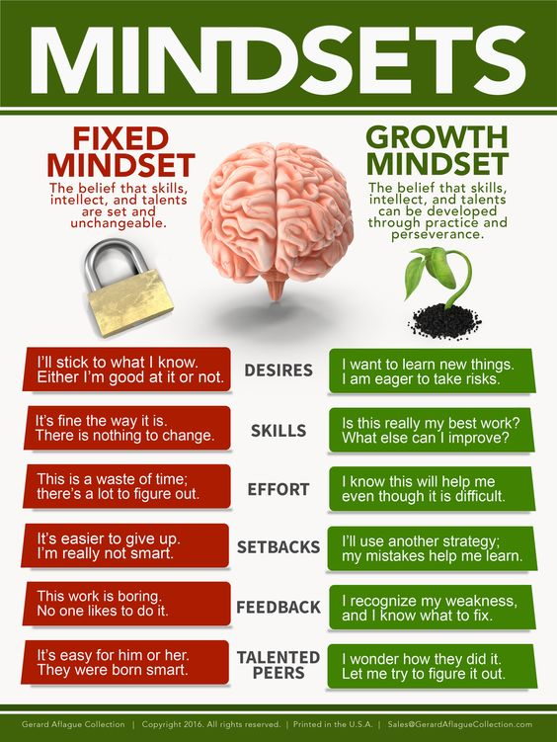
Notes:
Developing Growth mindsets for our students to enhance cognitive and emotional needs
Changing their meaning of effort and difficulty …
Differentiated instruction helps students not only master content, but also form their own identities as learners

Slide 19
Developing Growth Mindsets: Possible combinations of fixed and growth mindsets
Student | Growth Mindset | Teacher may underestimate the student’s capacity and willingness to work hard and may teach down because of the student’s economic status, language, culture, and other factors. | Both teacher and student study student growth, set goals and additional progress and look for ways to continue development. Students at all readiness levels have maximum opportunity for challenge, growth and success.
 | Fixed Mindset | Both teacher and student accept the student’s difficulties as a given and neither exerts the effort necessary for high levels of student achievement. Both also accept good grades on grade-level material as adequate for advanced learners. | Teachers encourages and insists on student effort and growth. Over time, with evidence that effort leads to success, the student’s mindset can change to a growth orientation. Students at all readiness levels have opportunity for challenge, growth and success.
 |  | Fixed Mindset | Growth Mindset
 |  | Teacher
Notes:
Discussion on how getting to know learners occurs over time, through discussion, interaction, wider information/data, the observations of interactions in the classroom, approach to tasks, engagement and collaboration with others etc. Requires reflections and experimentation in our practice as we develop relationships, build trust, through conversations, and learning activities to engage and motivate learners.
Here is a Tes article on the critique, in collaboration with Carol Dweck: https://www.tes.com/news/growth-mindset-where-did-it-go-wrong
The article also has – which I have added all three to the directed study task:
Quick read: Is growth mindset the new learning styles?
Quick listen: Carol Dweck discusses her research on the Podagogy podcast

Slide 20
Developing a student’s interest as a catalyst for learning
Interest refers to a feeling or an emotion that causes a student to focus on or attend to something because it matters to that individual.
‘Interest-based instruction suggests a teacher’s desire to capitalise on those things students care about to facilitate learning and help learners discover who they are and who they aspire to become (Kallick & Zumda 2017)
Ensuring a focus on student interest in learning clears the way for young people to pursue creativity, make sense of the world around them, establish or extend a sense of purpose, grow in agency, and feel a sense of control in life (Csikszentmihalyi (1990, 2013) – Creating ‘Flow’ and enabling learning to flow.
Notes:
Links to padlet walls to see ideas from last week – and continue to add to this ….

Slide 21
Differentiation based on interest
Cognitive psychologies tend to describe interest in learning as a set of behaviours a person displays when involved in an activity. These behaviours include increased attention, greater concentration, pleasant feelings applied of applied effort, increased willingness to learn , engagement with persistence, energy, and intensity.
Any group of students at a given time is likely to have common and varied interests – to establish and link learning to their interests engages the brain’s attention systems and captures their attention thereby stimulating cognitive involvement.
Notes:
Differentiating instruction based on student interest:
Does not suggest a teacher should develop lessons and attend to all students interests all the time.
Does not suggest a student’s interests are static.
Does not suggest all lessons must be interest focused.
Does not suggest essential content takes a back seat to students’ interests.
What interest-based differentiation does suggest is:
When teachers know both their students and content well, they have many opportunities to enhance teaching and learning by linking what matters most in a topic or discipline to what matters most to learners.
Seen in that light, differentiation based on student interests has a great potential to enhance learner efficacy and academic outcomes.

Slide 22
When teachers know and address their students’ interests in the context of curriculum and instruction , students are more likely to engage with the content.
Attention to student interest can focus students on essential knowledge understanding and skills while simultaneously opening broader horizons of learning.

Slide 23
Instructional approaches which support personalised learning (such as problem-based learning, project-based learning, and inquiry-based learning) tend to increase student voice to pursue questions and topics that reflect their interests.
The use of choice, novelty, and prior knowledge can help students who do not have strong personal interest in particular academic contents engaged with important content. For example, when students are encouraged to pick reading material of interest to them it enhances their academic engagement. outcomes. (Tomlinson (2018)

Slide 24
Contributes to a positive, student-focused environment
(National Research Council, 2000)
Contributes to a culturally relevant classroom for students from non majority backgrounds by allowing them to construct meaning, beginning with their own experiences
(National Research Council, 2000)
Promotes positive connections between student and teacher
(Willingham, 2009)

Slide 25
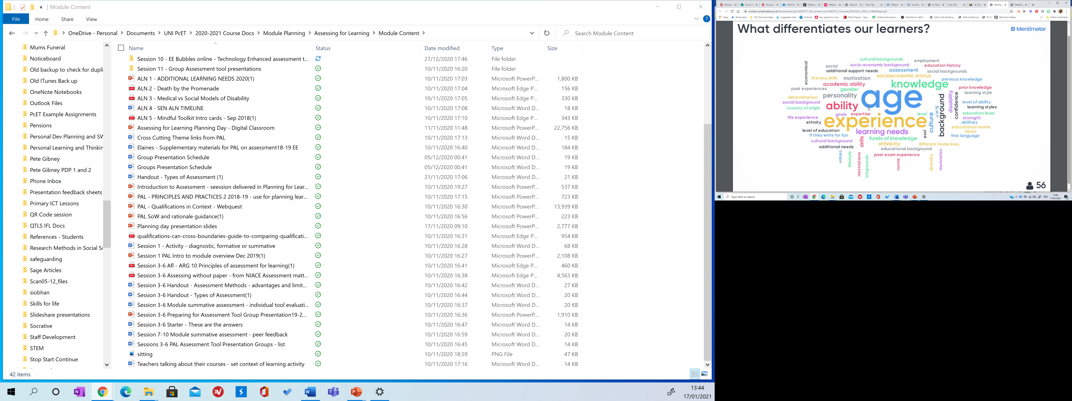
Benefits of Differentiation
Differentiation in teaching and learning assists teachers in addressing the issue of dealing with learners of varied abilities and responding to their individual needs (Konstantinou-Katzia, 2013).
Notes:
Not just about knowledge, highlight the key words …
The diversity of differentiation
Journal article for references…………

Slide 26
Effective use of differentiation has been associated with increased learner motivation, higher academic achievement and greater collaboration among students with similar ability (McNamara and Moreton, 1997; Gentry and Owen, 1999; Hertberg-Davis, 2009).

Slide 27
Educators are increasingly recognising the use of effective differentiation to fulfil the needs of each learner. Moreover, successful differentiation can fulfil the varied needs and abilities of students in the same classroom (Haelermans et al., 2015).
It is argued that differentiation can play an influential role in nurturing identified talent in gifted learners (Hertberg-Davis, 2009).

Slide 28
Differentiation allows students to progress at a pace suitable for them regardless of their knowledge, skills or previous understandings (Wu, 2013 and Valiande et al., 2011).
Differentiation, it is held, can provide a platform for innovation and ongoing reflection that boosts teaching and learning that would not be readily available in the form of ‘one size fits all lessons’ (Valiande et al., 2011).

Slide 29

Wouldn’t teaching be easy if
All students :
  arrived with same skills
  arrived with same area for development
  learnt at the same speed
  same interest for us to connect with
  had the same experience
  for us to build upon

Slide 30

Discuss
How are your
students different ?
2 Does your teaching differ
for these different students or
is everyone taught the same ?

Slide 31
References
Amabile, T. M. (1983). The social psychology of creativity, New York: Springer-Verlag.
Boyd, P., Hymer, B., Lockney, K. (2015). Learning Teaching Becoming an inspirational Teacher. Northwich: Critical Publishing.
Brooks, R., & Goldstein, S. (2008). The mindset of teachers capable of fostering resilience in students. Canadian Journal of School Psychology, 23(1), 114-126.
Csikszemtmihalyi, M. (1990). Flow: The psychology of optimal experience. New York: Harper Collins.
Csikszentmihalyi, M., Rathunde, K., & Whalen, S. (1993). Talented teenagers: The roots of success and failure. New York: Cambridge University Press.
Csikszentmihalyi, M. (2013). Creativity: Flow and the psychology of discovery and invention. New York: Harper Perennial.
DeCaro, D. A., DeCaro, M. S. & Rittle-Johnson, B. (2015). Achievement motivation and knowledge development during exploratory learning. Learning and Individual Differences, 37,13-26.
Collins, M. A. & Amabile, T. M. (1999). Motivation and creativity. In R.J. Sternberg (ED.), Handbook of creativity (pp.297-312). New York: Cambridge University Press.
Fulk, B. M., & Montgommery-Grimes, D. J. (1994). Strategies to improve student motivation. Intervention in school and clinic, 30(1), 28.33.
Kallick, B., & Zumda, A. (2017). Students at the centre: Personalized learning with habits of mind. Alexandria, VA: Association for supervision and Curriculum Development.

Slide 32
References
National Research Council, (2000). How people learn: Brain, mind, experience, and school (Expanded ed.). Washington DC: National Academies Press.
Sharan, Y., & Sharan, S. (1992). Expanding cooperative learning through group investigation. New York: Teachers College Press.
Sousa, D. A. & Tomlinson, C. A. (Differentiation and the Brain: How Neuroscience supports the learner-friendly Classroom, 2nd Ed. (2018)Bloomington: Solution Tree Press.
Tomlinson, C. (2014). The Differentiated Classroom; responding to the needs of all learners (2nd ed) Alexandria,VA: ASCD.
Tomlinson, C. (2008 – 2013). Differentiating Instruction (www) http://www.caroltomlinson.com/index.html accessed 20 October 2015
Torrance, E. P., (1995). Insights about creativity: Questioned, rejected, ridiculed, ignored. Educational psychology Rewiew, 7(3), 313-322.
Visser, J (1993) Differentiation and the Curriculum Birmingham: University of Birmingham
Willingham, D. T. (2009). Why don’t student like school? A cognitive scientist answers questions about how the mind works and what it means for the classroom. San Francisco: Jossey-Bass.

Slide 33


