Slide 1

Finding the details for referencing .
Where to look for information in books and on websites.

Slide 2
Referencing from a book.
The details needed for a book are:
The author (we put the author’s surname first , then initial/s)
The title
The year published
The name of the publisher
The place (country or city) of publication.

Slide 3

The author, title (and often the publisher) are found on the cover and the spine of the book.
Here I have found a book which I think is useful for my work.
The author is Steven Pinker.
The title is ‘The Language Instinct’.
I cannot see the publisher, so I will look inside. See next slide.

Slide 4

The publisher can be found on the inside pages, so look here if you cannot see it on the outside of the book.
Here the publisher is ‘Penguin Books’.

Slide 5
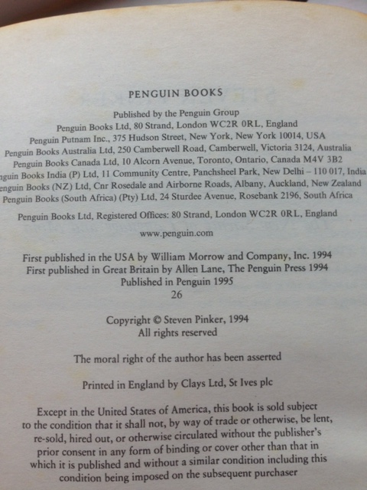
The year published and the place published are also found in the first pages.
Here, the publisher has lots of offices. Choose the one closest to Britain if non is specified. Here you can see that the ACTUAL place this particular book was published is the London address.
Choose the most recent year. Here you can see that the year this was published in Penguin is 1995.

Slide 6
You now have all the details. These go in a particular order on a separate sheet called a bibliography.
The details for this book are:
Pinker. S – (1995) – ‘The Language Instinct’ – Penguin – London.
So, first you have the author, then the date in brackets, then the title in quote marks, then the publisher, then the place of publication.
Have a look at any book you have and you should be able to find all this information and write it in this order.

Slide 7
Referencing from a website.
The details needed for a website are:
The author (we put the author’s surname first , then initial/s). REMEMBER: if you cannot find a person’s name, the author is the company / organisation.
The title
The year / date posted online (or ‘last updated’)
The website address (always copy and paste to avoid mistakes).
The date accessed (this just means the date you looked at it).

Slide 8
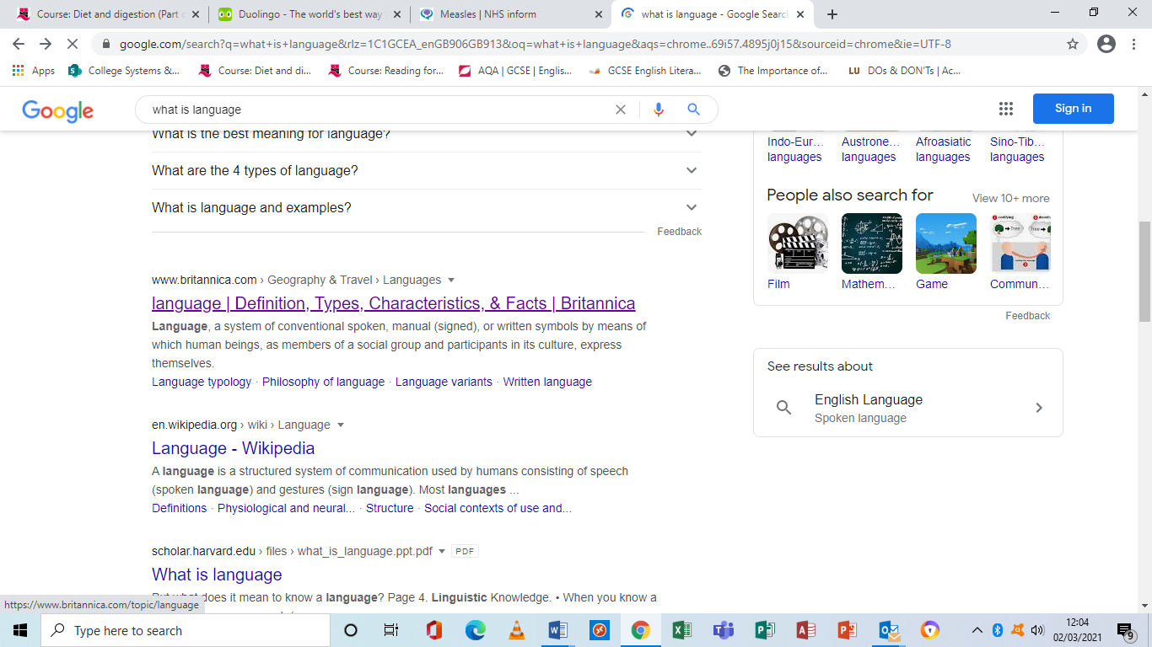
First find a website that seems to be a reliable source.

Slide 9
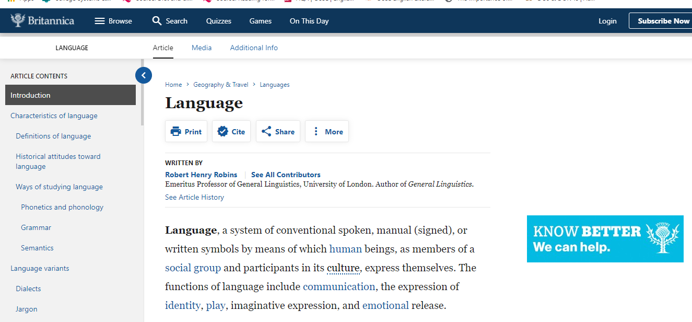
You can see here that the site is the Encyclopaedia Britannica. However, there is a named author so we will use his name.
So I have the author and the title.
Robins R.H.
‘Language’.

Slide 10
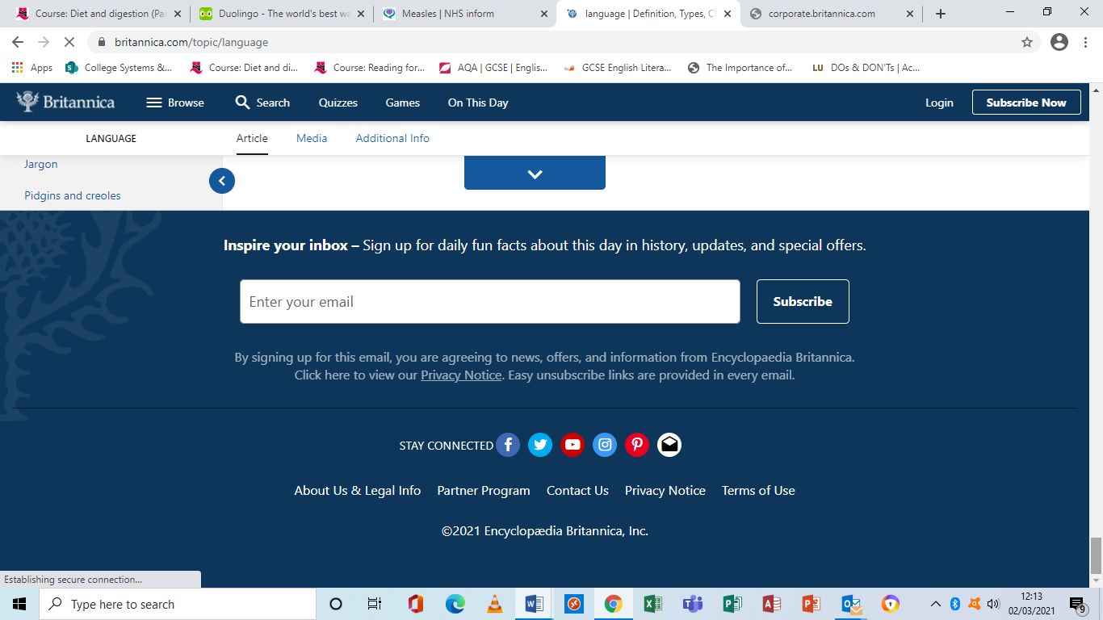
The date of posting / updated is often at the bottom. I had to scroll all the way down to find this.
The copyright date is 2021.

Slide 11
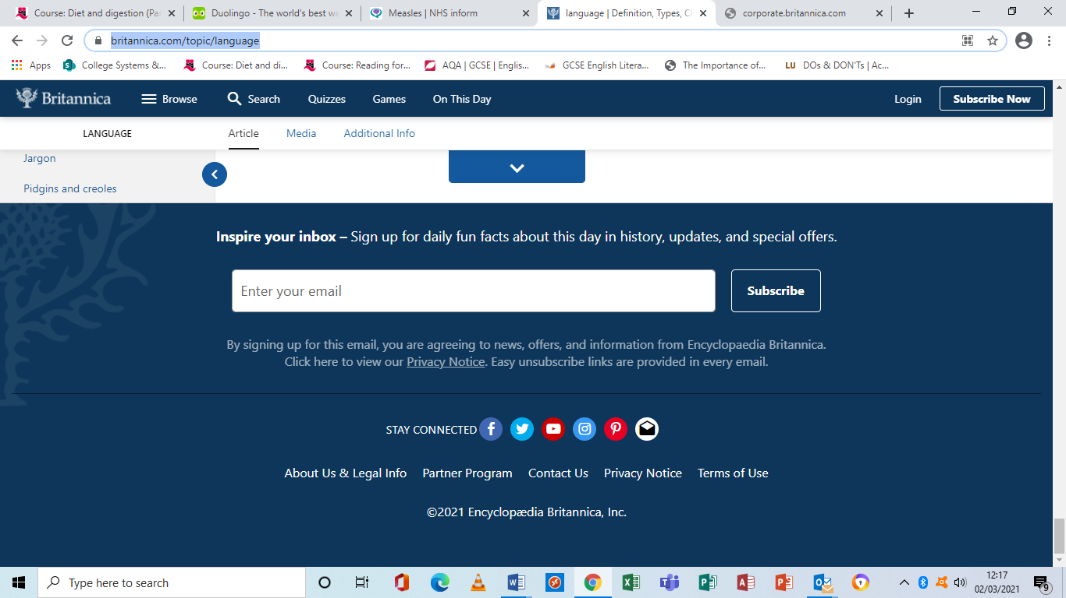
Copying the webpage address.
Highlight the whole address and ‘copy’. Then ‘paste’ it into a word document or straight into your bibliography.

Slide 12
You now have all the details you need. These go in a particular order on the bibliography.
Robins R.H. – (2021) – ‘Language’ – available from: brittanica.com/topic/language
Date accessed – 2/3/2021
So you have the author, the year in brackets, the title in quote marks, the website address and the date you looked at it.
NOTE: the way to lay out the bibliography details is to write them across the page as shown in the examples. DON’T start a new line for each detail as this makes it more difficult to see, and is not the way it is supposed to be done. Sometimes the length of the web address will mean it automatically goes on the next line, which is OK.

Slide 13
Now my bibliography looks like this.
Bibliography
Pinker. S – (1995) – ‘The Language Instinct’ – Penguin – London.
Robins R.H. – (2021) – ‘Language’ – available from: brittanica.com/topic/language
Date accessed – 2/3/2021

Slide 14
What next?
As well as giving the full details in the bibliography, you need to show in your writing where you have used the sources.
As you write your paragraphs, you need to give the author surname and the date. These should be put in brackets.
Below is part of a paragraph I could have written using the sources shown above.
E.g. …the features of language include the communication of facts, emotions and ideas as well as being a way to ‘play’(Robins 2021). It has been noted that the way the single words combine can be likened to the DNA in a person’s genes (Pinker 1985). These views approach the study of language in different, yet complimentary ways.

Slide 15
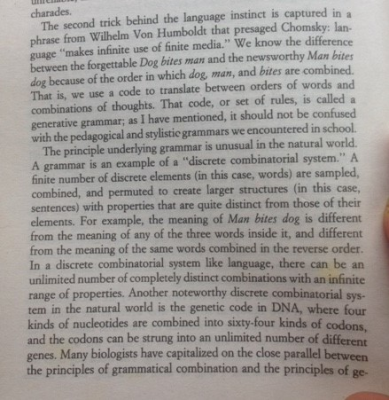
This is the page I looked at in ‘The Language Instinct’. I have put it here for reference only.
Page numbers should be noted if using a book, but I didn’t want to overcomplicate things.

Slide 16
What about other sources?
There are differences in the details for other sources. These will be made available.
The important thing to remember is that in your paragraphs you will always need only a name and date (and page number if using a book).
The full reference goes in the bibliography.

