Slide 1
Illnesses
Some images and points for discussion.

Slide 2
Points you will need to consider in your essay.
What type of ‘germ’ causes the illness?
How is the illness spread?
What are the visible symptoms? What are other symptoms? Is there a temperature – if so how high?
What are the treatments?
What are the complications (other problems or conditions that result from the illness)?
Is the illness preventable by vaccine?

Slide 3
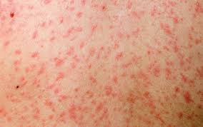
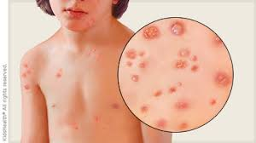
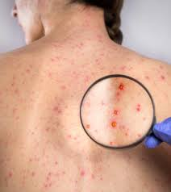
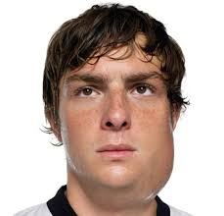

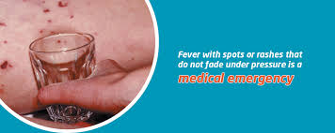
Look at the images. Can you see what illness each shows?

