Slide 1
Harbin Day 1 Day one Remote micro teach presentation Prepare, plan and deliver a 20 minutes remote presentation
On a topic of your choice

Slide 2
Harbin
As we are moving more towards remote teaching and learning we need to be ready and confident to teach off site, remotely.
Too ensure that we can use online teaching successfully we need to be well equipped.

Slide 4
Online teaching Innovative approaches to learning, teaching and assessment.
To be able to plan, prepare and deliver a Micro teaching session based on an agreed topic
Presentation to last 20 minuet's
Using Voov as a learning platform
Producing a lesson plan to accompany the session
Planning and organising your session using SMART targets
Complete an Evaluation from the Micro teach

Slide 5
Micro teaching presentations
Plan?
Prepare the lesson.
2 groups to present on Friday the 15th groups A & B
2 groups to present on Friday the 22nd groups C & D
Invite members for groups C & D
20 minutes for each student
Set up, questions and evaluate.
If you can use the English language that would be great, if not you can use your choice of language, but you will need to have the lesson plans translated to English Please.
Have fun

Slide 6
You can include
Chat rooms
Interactive White board
Share screen
Hands up
Chat
Moodle
Clips (YouTube)
Work sheets
Assessment materials (Quiz's, Kahoot, Padlet.)

Slide 7
Topic of your choice
Work related
Safety online
How to use an online tool
Interest to you (Hobby)
Online teaching?
??

Slide 8
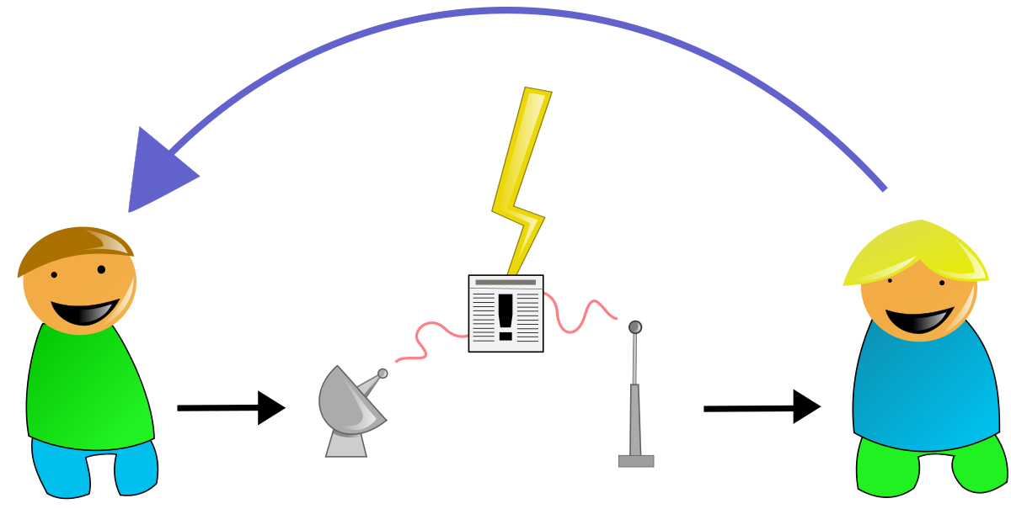
HAPPY CLASS

