Slide 1
Harbin Day 1 Day one第一天 Remote micro teach presentation远程微教学演示 Prepare, plan and deliver a 15 minutes remote presentation 准备，计划和交付一个15分钟的远程演示
On a topic of your choice
用你选择的主题

Slide 2
Harbin哈尔滨
As we are moving more towards remote teaching and learning we need to be ready and confident to teach off site, remotely.随着我们越来越倾向于远程教学，我们需要准备好并有信心在现场远程教学。
Too ensure that we can use online teaching successfully we need to be well equipped.为了确保我们能够成功地使用在线教学，我们需要配备良好的设备。

Slide 3
在线课堂

Slide 4
Online teaching 在线教学 Innovative approaches to learning, teaching and assessment. 创新的学习、教学和评估方法。
To be able to plan, prepare and deliver a Micro teaching session based on an agreed topic 能够根据商定的主题计划、准备和提交微教学
Presentation to last 20 minuet's 演讲持续20分钟
Using Voov as a learning platform 使用Voov作为学习平台
Producing a lesson plan to accompany the session 制作一份伴随这节课的课程计划
Planning and organising your session using SMART targets 使用SMART目标计划和组织你的课
Complete an Evaluation from the Micro teach 完成微教学的一次评估（300个词）

Slide 5
Micro teaching presentations 微教学演示
Plan? 计划？
Prepare the lesson. 备课
2 groups to present on Friday the 15th groups A & B 15号星期五有两组人演示，A组和B组
2 groups to present on Friday the 22nd groups C & D 22号星期五有两组人演示，C组和D组
Invite members tomorrow for groups A & B 明天邀请成员参加A组和B组
20 minutes for each student 每个学生20分钟
Set up, questions and evaluate. 设置、提问和评估。
If you can use the English language that would be great, if not you can use your choice of language, but you will need to have the lesson plans translated to English Please. 如果你能使用英语语言那就太好了，如果不能，你可以使用你选择的语言，但请你把教案翻译成英语。
Have fun 玩的开心

Slide 6
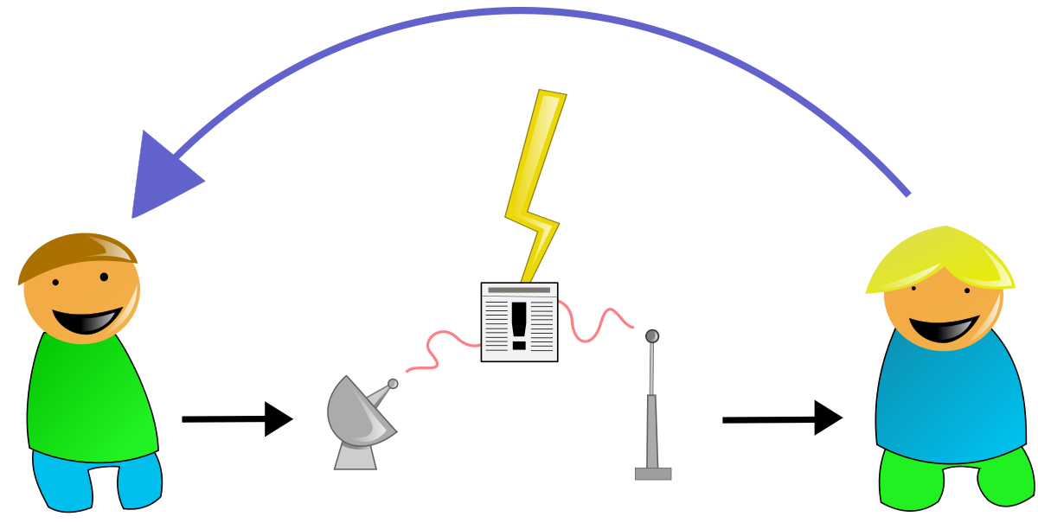
HAPPY CLASS 快乐班级

