Slide 1

第2周第6 天 教师培训
Day 8 Week 2 Teacher Training

Slide 2
Assessment for Learning
学习过程评估

Slide 3
Prynhawn da
下午好 (Xiàwǔ hǎo)
Good afternoon

Slide 4
At the end of today’s session you will be able to:
你将在今天的课程中学到：
Define the term ‘Assessment for Learning’(AfL)
定义“学习过程评估”（AfL）这个术语
Explain the difference between ‘Assessment for Learning’ and ‘Assessment of Learning’
解释“学习过程评估”和“学习成果评估”的差别
Discuss the major aspects of Assessment for Learning
讨论学习过程评估涉及的重要方面
Examine the work of Professor Dylan Wiliam and Professor Paul Black
考察迪伦·威廉教授和保尔·布莱克教授的研究工作
Analyse the evidence from Robert Marzano and John Hattie which supports AfL
分析罗伯特·马扎诺和约翰·海蒂支持 “学习过程评估”的研究证据
Create lesson plans that incorporate “Assessment for Learning”
制定一份包含“学习过程评估”的教案

Slide 5

Task 1 (5 min)
任务1（5分钟）
Discuss Summative and Formative assessment.
讨论总结性和形成性评估
  What do you understand by these two types of assessment ?
  你对这两种评估的理解是什么？
  Think of examples of how you have used these assessments.
  想想你曾经使用这些评估的例子
  Share with the group
  与小组分享

Slide 6
Task 1 Summative Assessment
任务1 总结性评估
It is designed to provide evidence of achievement to parents, the students themselves and to outside groups e.g. employers, other educational institutions
目的是为家长、学生本人以及外部机构如公司和其他教育机构提供学生成绩认定。

Slide 7
Summative Assessment
总结性评估
Gaokao 高考
Advanced Level Examination高级水平考试
College Scholastic Ability Test (CSAT)
大学学术能力测试（CSAT）
Scholastic Assessment (Test SAT)
学术评估测试 （SAT）

Slide 8
Task 1 Formative Assessment
任务1 形成性评估
A wide variety of methods use to conduct in-process evaluations of student comprehension, learning needs, and academic progress during a lesson, unit, or course.
在一节课、一个单元或一整门课程中有多种方法对学生的理解、学习需求、以及学习进步进行过程性的评估。

Slide 9
Task 1 Formative Assessment
任务1 形成性评估
Helps teachers identify concepts that students are struggling to understand, skills they are having difficulty acquiring, or learning standards they have not yet achieved so that adjustments can be made to lessons, instructional techniques, and academic support.
帮助老师发现学生难以理解的概念、学生难以掌握的技能或是目前还未达到的学习标准，以便对课程、指导方法及学习支持做出调整。

Slide 10
Assessment of Learning
学习成果评估
The purpose of this kind of assessment is usually SUMMATIVE and is mostly done at the end of a task, unit of work etc.
这种评估的目的通常是总结性的，且一般都在任务或工作单元结束时给出评估。

Slide 11
Assessment of Learning
学习成果评估
“Assessment of Learning is the assessment that becomes public and results in statements or symbols about how well students are learning.
It often contributes to pivotal decisions that will affect students’ futures.
学习成果评估是公开的、以文字或标记的形式标明学生的学习成果。
通常会对事关学生未来的重要决定起作用。

Slide 12
Teachers’ Roles in Assessment of Learning
老师在学习成果评估中扮演的角色
“Teachers have the responsibility of reporting student learning accurately and fairly, based on evidence obtained from a variety of contexts and applications.
老师有责任基于从多种环境及应用中获取的证据，准确公平地报告学生的学习效果。
a rationale for undertaking a particular assessment of learning at a particular point in time
在特殊时间点进行特定学习评估的准则
clear descriptions of the intended learning
明确描述学习目的
processes that make it possible for students to proceed to next stage of education or employment
使学生能够进入下一阶段的教育或就业过程

Slide 13
Teachers’ Roles in Assessment of Learning
老师在学习成果评估中扮演的角色
a range of alternative mechanisms for assessing the same outcomes
可选择多种机制评估同样的成果
public and defensible reference points for making judgements
作出判断的公开和可辩护的参考点
transparent approaches to interpretation
解读方法透明
descriptions of the assessment process
描述评估过程
strategies for recourse in the event of disagreement about the decisions.
对评估结果有异议时采取的回旋策略

Slide 14

Assessment for Learning
学习过程评估
The emphasis shifts from summative to FORMATIVE assessment in Assessment for Learning.
评估的重点从总结性评估转到形成性评估。
为什么？

Slide 15
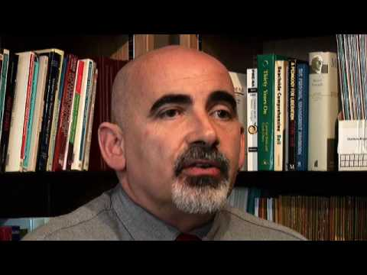
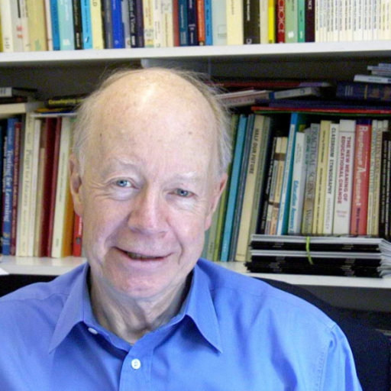
Professor Dylan Wiliam
迪伦·维利亚姆教授
Professor Paul Black
保罗·布莱克教授

Slide 16

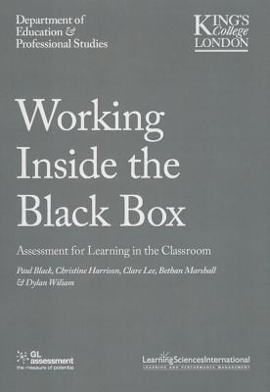

Slide 17

比尔还是希德？
Bill or Sid ?

Slide 18
比尔还是希德？
Bill or Sid ?

Slide 19
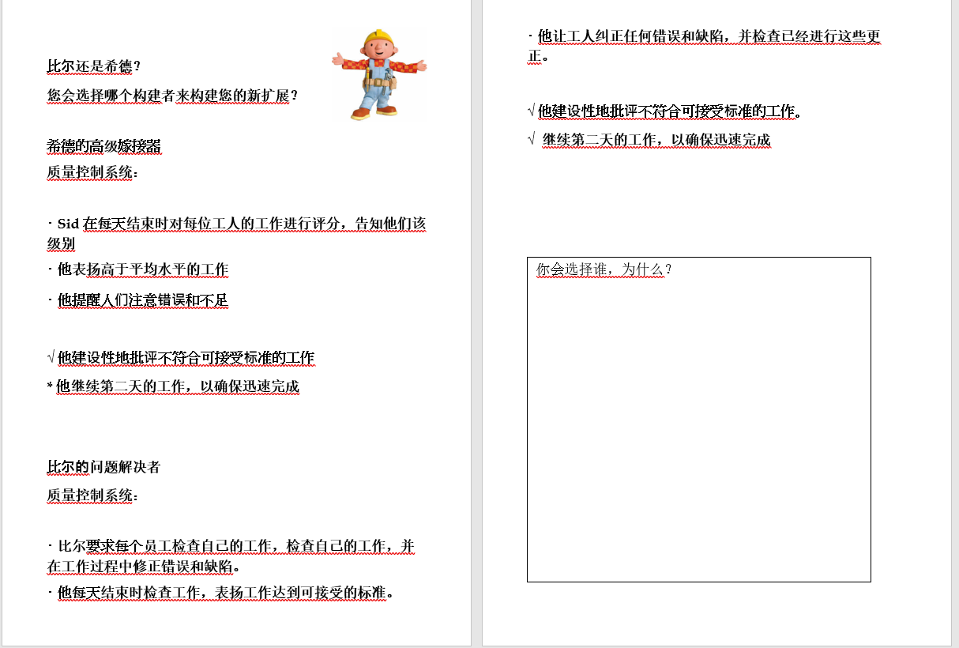
比尔还是希德？
Bill or Sid ?

Slide 20
比尔还是希德？
Bill or Sid ?

Slide 21
Bill or Sid ?
Whom did you choose ?
80 – 90 % Teachers choose Bill. Why ?
80 ~ 90% 教师选择法案。为什么？

Slide 22
Bill or Sid ?
  Self assess
  自我评估
  Problems fixed before they cause more problems
  自我评估
  Don’t need to be above average to earn praise (motivation)
  不需要高于平均水平即可获得表扬（激励）

Slide 23
Bill or Sid ?
Whom did you choose ?
  Finds error & deficiencies, gets them put right and checks (Sid only points them out)
  查找错误和缺陷，纠正和检查（Sid 只指出它们）
  Find, fix & follow up
  查找、修复和跟进
  Workers feel responsible and accountable for their own work
  员工对自己的工作感到负责和负责

Slide 24
Most teachers choose Bill
大多数教师选择比尔
Unfortunately many teachers work like Sid
不幸的是，许多老师像希德一样工作
  Point out errors but don’t require the learner to fix these or check these fixes
  指出错误，但不要求学员修复这些错误或检查这些修复程序
  Give even formative (practice) work grades/marks, no clear missions as how to improve
  给甚至形成（实践）工作成绩/分数，没有明确的任务，如何提高
  Always mark work themselves, rather than self marking/peer marking
  始终标记工作本身，而不是自标记/对等标记

Slide 26
Black and Wiliam 1998
4 year study by 2 leading Professors at King’s College London
伦敦国王学院2位著名教授4年学习
Trawled world wide for effective classroom based research
在世界各地进行拖网，进行有效的课堂研究
Considered 700 studies, but chose only those with large effect sizes, classroom environment, and good design.
考虑700项研究，但只选择那些具有大效果尺寸，教室环境和良好的设计。

Slide 27
Black and Wiliam 1998
They calculated the effect size is how much better the Experimental Group was than the Control Group
他们计算出的效果大小是实验组比对照组好多少
The strategies they found:
他们发现的策略：
  had the greatest effect on the weakest learners
  对最弱的学习者的影响最大
  could yield an effect size equivalent to a two grade leap at 16 years of age
  可以产生相当于两个等级飞跃在16岁的效果大小

Slide 28
The five key strategies are:五大策略的内容：
• clarifying and understanding learning intentions and criteria for success
•明确理解学习意图和成功标准。
• engineering effective classroom discussions, questions and tasks that elicit evidence of learning
•设计有效的课堂讨论、问题和任务，以获取学习证据。
• providing feedback that moves learners forward
•提供反馈，帮助学生进步。
• activating students as instructional resources for each other, and
•激励学生成为彼此的教学资源，以及
• activating students as owners of their own learning
•激励学生成为学习的主人。

Slide 29
Assessment for learning
(effect size 0.81)
Medal and Mission feedback
Make the goals very clear: criteria are explained and illustrated with examples
Ask the student for a self-assessment (they will be helped if you give them criteria to self-assess against) Give non-judgmental feedback:
accept the student’s present standard
avoid competition or comparison with others, instead let them compete with:
  the task, and
  with themselves, (i.e. with previous work)
Feedback should be
Forward looking, positive, & constructive
task centred not ego centred
medal and mission

Slide 30
Assessment for learning
(effect size 0.81)
学习评估（效果大小 0.81）
Medal and Mission feedback
奖章和特派团反馈
Make the goals very clear: criteria are explained and illustrated with examples
明确目标：用示例解释和说明标准
Ask the student for a self-assessment (they will be helped if you give them criteria to self-assess against) Give non-judgmental feedback:
要求学生进行自我评估（如果你给他们自我评估的标准，他们会得到帮助）给予非判断性反馈：
accept the student’s present standard
avoid competition or comparison with others, instead let them compete with:
  the task, and
  with themselves, (i.e. with previous work)

Slide 31
Assessment for learning
(effect size 0.81)
学习评估（效果大小 0.81）
accept the student’s present standard
接受学生目前的标准
avoid competition or comparison with others, instead let them compete with:
  the task, and
  with themselves, (i.e. with previous work)
  避免与他人竞争或比较，而是让他们与：
  任务，和
  与自己，（即与以前的工作）

Slide 32
Assessment for learning
(effect size 0.81)
学习评估（效果大小 0.81）
Feedback should be
Forward looking, positive, & constructive
task centred not ego centred
medal and mission
反馈应为：
前瞻性、积极性、建设性
任务为中心，而不是自我中心
奖牌和使命

Slide 33
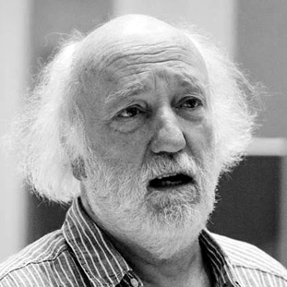
Feedback / Feedforward 反馈 / 前 馈
goals
mission
medal
mission
medal
奖章 Medal
任务 Mission

Slide 34
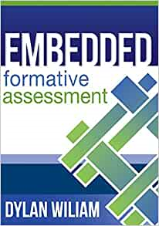
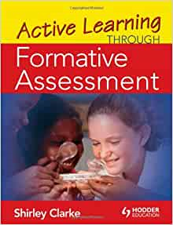

Slide 35
Assessment for Learning
学习过程评估
Assessment for Learning happens during the learning, often more than once, rather than at the end.
学习过程评估在学习过程中而非结束时进行，通常不止一次。

Slide 36
Assessment for Learning
学习过程评估
Students understand exactly what they are to learn, what is expected of them and are given feedback and advice on how to improve their work.
学生充分理解他们要学什么、老师对他们的期待，并且会收到反馈和建议，告诉他们如何提高。

Slide 37
Assessment for Learning
学习评估
“In Assessment for Learning, teachers use assessment as an investigable tool to find out as much as they can about what their students know and can do, and what confusions, preconceptions, or gaps they might have.
在学习评估过程中，老师将评估作为一种调查工具，以此尽可能发现学生的知识和能力，以及学生可能存在的困惑、偏见或是差距。

Slide 38
Assessment for Learning
学习评估
The wide variety of information that teachers collect about students’ learning processes provides the basis for determining what they need to do next to move student learning forward.It provides the basis for providing descriptive feedback for students and deciding on groupings, instructional strategies, and resources.”
老师在学生学习过程中收集到的一系列信息，为老师决定接下来如何让学生取得进步提供了基础。这些信息也是给学生描述性反馈，及决定分组、指导性策略及资源的基础。

Slide 39
Teachers’ Roles in Assessment for Learning:
老师在学习过程评估中扮演的角色
“Assessment for learning occurs throughout the learning process. It is interactive, with teachers:
学习过程评估贯穿整个学习过程，是与老师的互动：

Slide 40
Teachers’ Roles in Assessment for Learning:
老师在学习过程评估中扮演的角色
Aligning instruction
调整指导
Identifying particular learning needs of students or groups
发现学生或小组的特殊学习需求
Selecting and adapting materials and resources
挑选并调整学习材料和资源
Creating differentiated teaching strategies and learning
创造差异化的教学策略和学习
Opportunities for helping individual students move forward in their learning
有机会帮助个别学生在学习上取得进步
Providing immediate feedback and direction to students
为学生提供及时的反馈和方向指导

Slide 41
Assessment for Learning
学习过程评估
“Teachers also use assessment for learning to enhance students’ motivation and commitment to learning.
When teachers commit to learning as the focus of assessment, they change the classroom culture to one of student success.”
老师也可以利用学习过程评估增强学生的学习动机以及对学习的投入。如果老师将学习本身变成评估的中心，就可以改变课堂的氛围，促进学生的成功。

Slide 42
Assessment for Learning
学习过程评估
Task: Think about when you use assessment for learning in your classroom. Is the kind of feedback you provide to students furthering their learning?
任务：思考你在课堂上使用学习过程评估的情况。你提供的反馈是否促进了他们的学习？
Discuss
讨论

Slide 43
Assessment for Learning
学习过程评估
Through this process students are able to learn about themselves as learners and become aware of how they learn – become megacognitive (knowledge of one’s own thought processes).
在这个过程中，学生可以作为学习者了解自己，同时意识到自己如何学习-认知变化（了解自己的思维过程）。
Students reflect on their work on a regular basis, usually through self and peer assessment and decide (often with the help of the teacher, particularly in the early stages) what their next learning will be.
学生有规律地对自己的学习进行反思，通常是自我评价或同学评价（经常是在老师的帮助下，特别是早期阶段），并决定下一阶段的学习内容。
Assessment as learning helps students to take more responsibility for their own learning and monitoring future directions.
学习评估帮助学生为自身的学习及监控未来方向承担更多责任。

Slide 44
Assessment of Learning
学习成果评估
Monitoring Metacognition
监控元认知
感知元认知
What is the purpose of learning these concepts and skills?
学习这些概念和技能的目的是什么？
What do I know about this topic?
我对这个主题知道些什么？
What strategies do I know that will help me learn this?
我知道哪些策略可以帮助我学习这个主题？
Am I understanding these concepts?
我在理解这些概念吗？
What are the criteria for improving my work?
衡量我学习提升的标准是什么呢？
Have I accomplished the goals I set for myself?
我完成了自己设定的目标吗？

Slide 45
Teachers’ Roles in Assessment for Learning
老师在学习评估中扮演的角色
“The teachers’ role in promoting the development of independent learners through assessment as learning is to:
老师通过学习评估促进独立学习者发展所起的作用是：
model and teach the skills of self-assessment
以身作则并传授自我评价的技能
guide students in setting their own goals, and monitoring their progress toward them
指导学生自行制定目标，并监督自己的进步
provide exemplars and models of good practice and quality work that reflect curriculum outcomes
给出反映课程成果的良好实践和高质量作业的示范和模型
work with students to develop clear criteria of good practice
和学生一起制定良好做法的清晰标准

Slide 46
Teachers’ Roles in Assessment for Learning
老师在学习评估中扮演的角色
guide students in developing internal feedback or self-monitoring mechanisms to validate and question their own thinking, and to become comfortable with ambiguity and uncertainty that is inevitable in learning anything new
指导学生制定自我反馈及自我监督机制，以证明并质疑自己的思考，同时接受学习新知识时无可避免的模糊及不确定性。
provide regular and challenging opportunities to practise, so that students can become confident, competent self-assessors
提供规律且挑战性的练习机会，让学生成长为自信能干的自我评价者
monitor students’ megacognitive processes as well as their learning, and provide descriptive feedback
监督学生的元认知过程及他们的学习，并提供描述性反馈
Create an environment where it is safe for students to take chances, make mistakes and support is available.”
创建一个学生可以安全无忧地冒险、犯错、同时得到支持的环境

Slide 47
Assessment for Learning Feedback
学习过程评估：反馈
“Complex skills, such as monitoring and self-regulation, become routine only when there is constant feedback and practice using the skills.
只有当有连续的反馈并练习使用这些技能时，复杂的技能如监督及自我调节，才会变成习惯。
Effective feedback challenges ideas, introduces additional information, offers alternative interpretations, and creates conditions for self-reflection and review of ideas…
有效的反馈会挑战观点，引入额外的信息，提供不同的解释，并创造自我反思和回顾的条件……

Slide 48
Assessment for Learning Feedback
学习过程评估：反馈
If all feedback does is provide direction for what students need to do- that is, the feedback doesn’t refer to students’ own roles in moving forward to the next learning-they will perpetually ask questions like Is this right? Is this what you want?
如果反馈的目的只是提供学生必须怎么做的方向，那么反馈并不涉及学生走向下个学习阶段的角色-他们就会一直问一些类似于“这么做对吗？”、“这是您想要的吗？”的问题。
Rather, feedback in assessment as learning encourages students to focus their attention on the task, rather than on getting the answer right. It provides them with ideas for adjusting, rethinking, and articulating their understanding, which will lead to another round of feedback and another extension of learning.”
相反，学习评估中的反馈鼓励学生将重点放在任务上，而非得到正确的答案。这样学生就会调整、重新思考和表达自己的理解，这会催生新一轮的反馈及学习的另一次延伸。

Slide 49
Assessment for Learning
学习过程评估
Think about when you use assessment as learning in your classroom. Do you encourage students to take risks associated with making their thinking visible?
思考你在自己的课堂上使用学习评估的情况。你是否鼓励学生去冒险，让他们的思维变得清晰可见？
Discuss
讨论

Slide 50
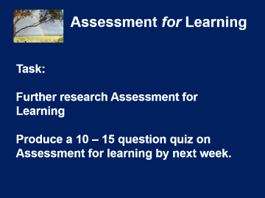
Assessment for Learning
学习过程评估
Task:
任务：
Further research Assessment for Learning
对学习过程评估作进一步研究
Produce a 10 – 15 question quiz on Assessment for learning by next week.
下周之前制作一个关于学习过程评估的10-15个问题的测验。

Slide 51
Recap
Evidence Based Teaching
循证教学

Slide 52
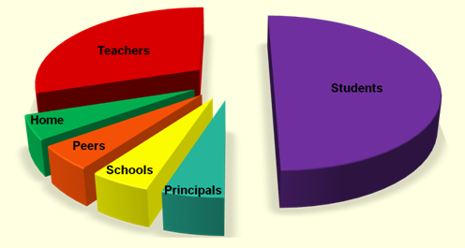
Activity 1 活动 1
What does this graph show? 此图表明了什么？
Write your
answer on the
ShowMe Boards
在自我展示板
写下你的答案
教师
学生
家
同伴
学校
校长

Slide 53
Answer 答案
The pie-chart represents all the influences on the student at the end of their course. That is, all the things that influenced their results.
饼图代表了课程结束时对学生的所有的影响。也就是说，所有影响他们结果的东西。

Slide 54
So how do we know what works ?
那么我们如何知道什么有效呢？
In education, about 150 different things have been tried to improve learning, 142 of them seem to work!
在教育中，大约150种不同的事物被尝试用来提高学习，其中的142种似乎有效！
So we need some measure of effectiveness.
所以我们需要一些有效的措施。

Slide 55

Effect size 效应量
测试前

Slide 56
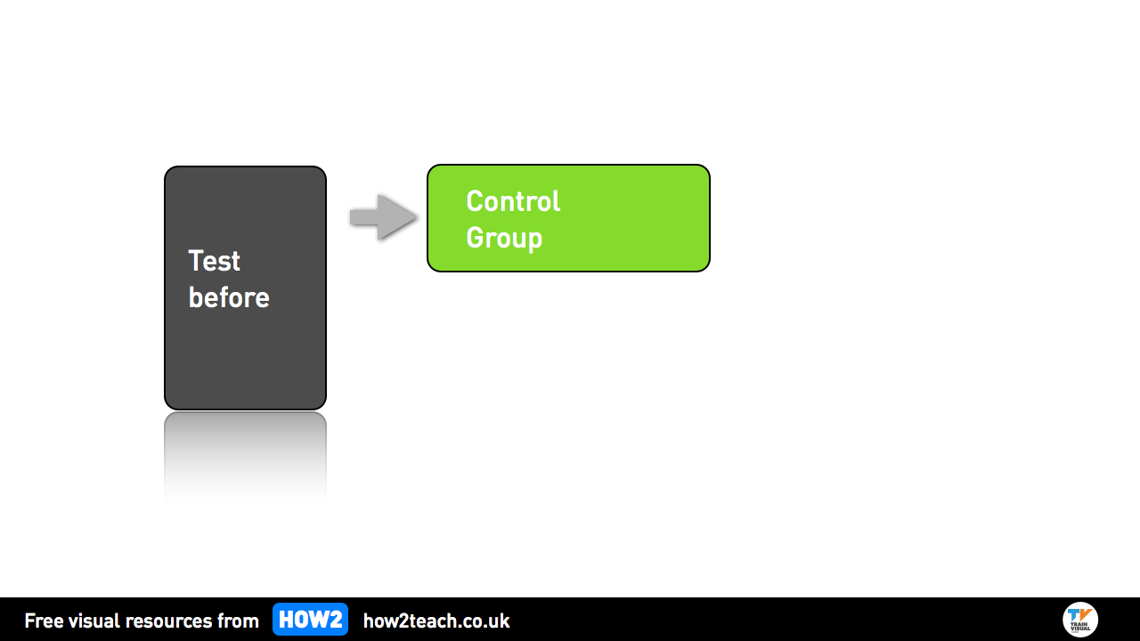
Effect size 效应量
对照组
测试前

Slide 57
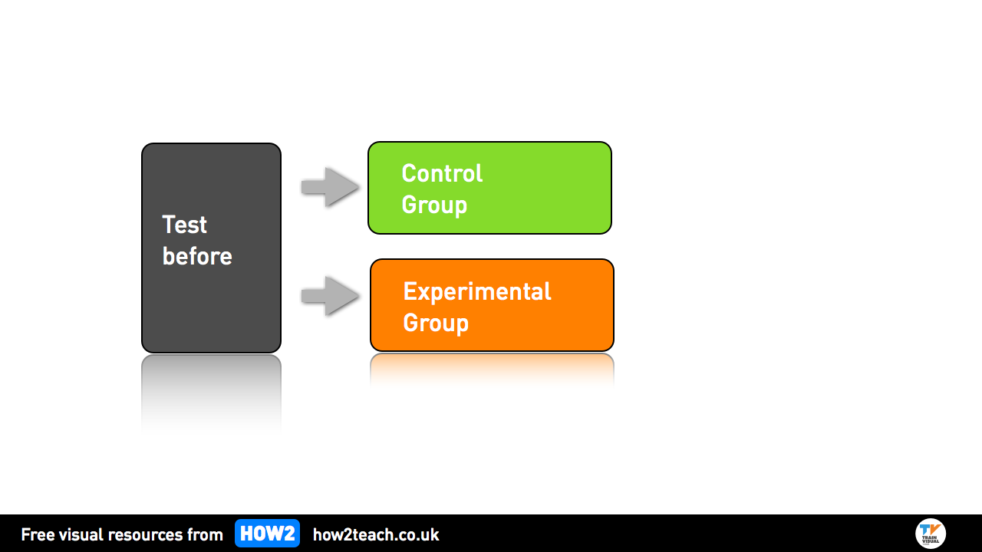
Effect size 效应量
对照组
测试前
实验组

Slide 58
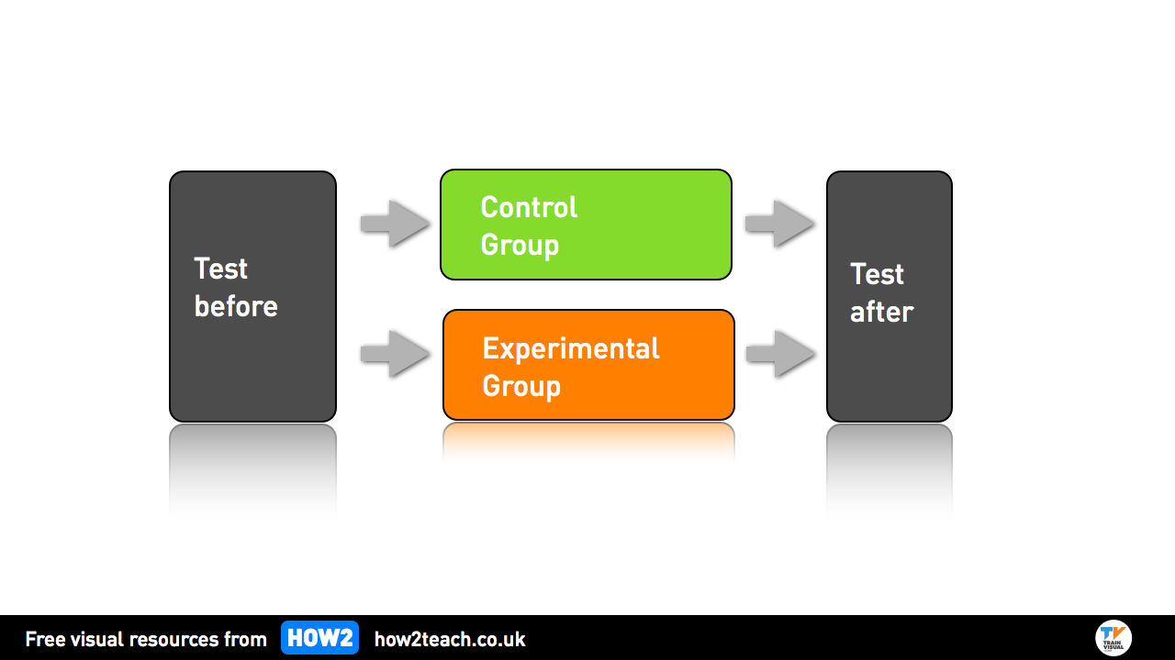
Effect size 效应量
对照组
测试前
测试后
实验组

Slide 59
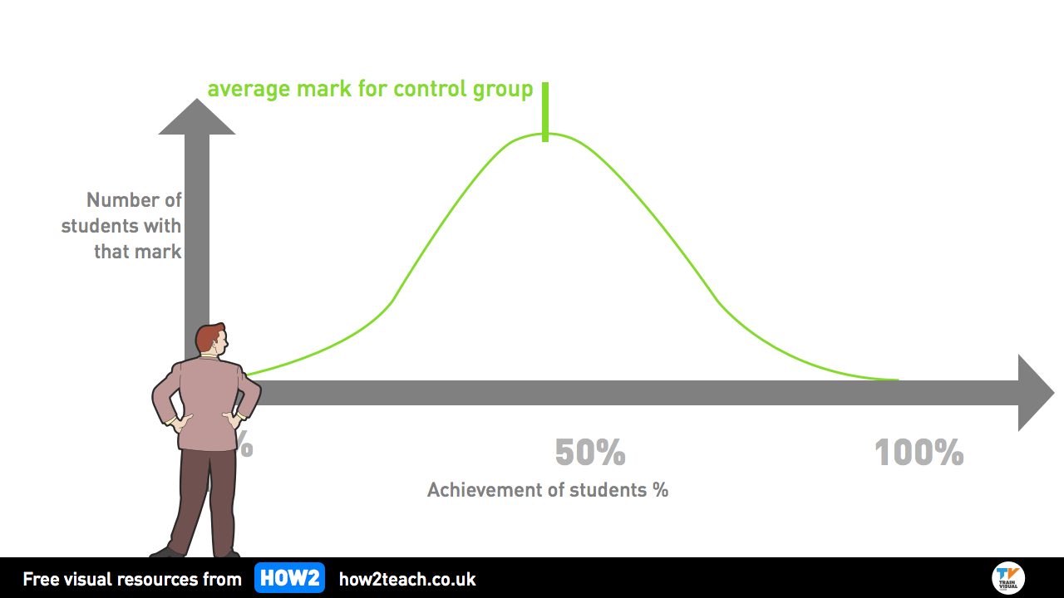
对照组平均成绩
得到
成绩
的
学生
数量
学生成就百分比

Slide 60
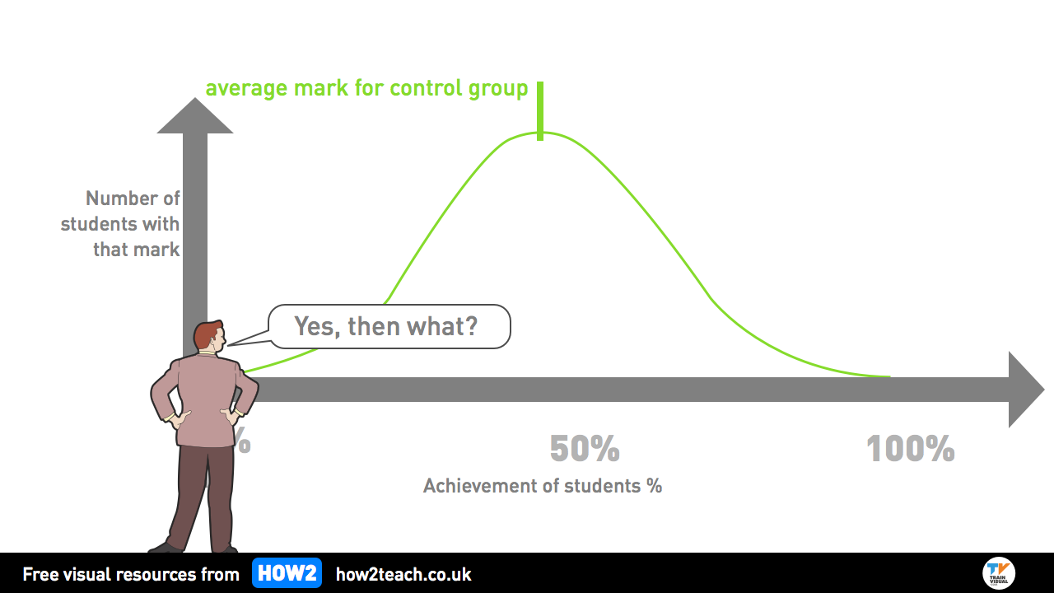
对照组平均成绩
得到
成绩
的
学生
数量
是的，那又怎样？
学生成就百分比

Slide 61
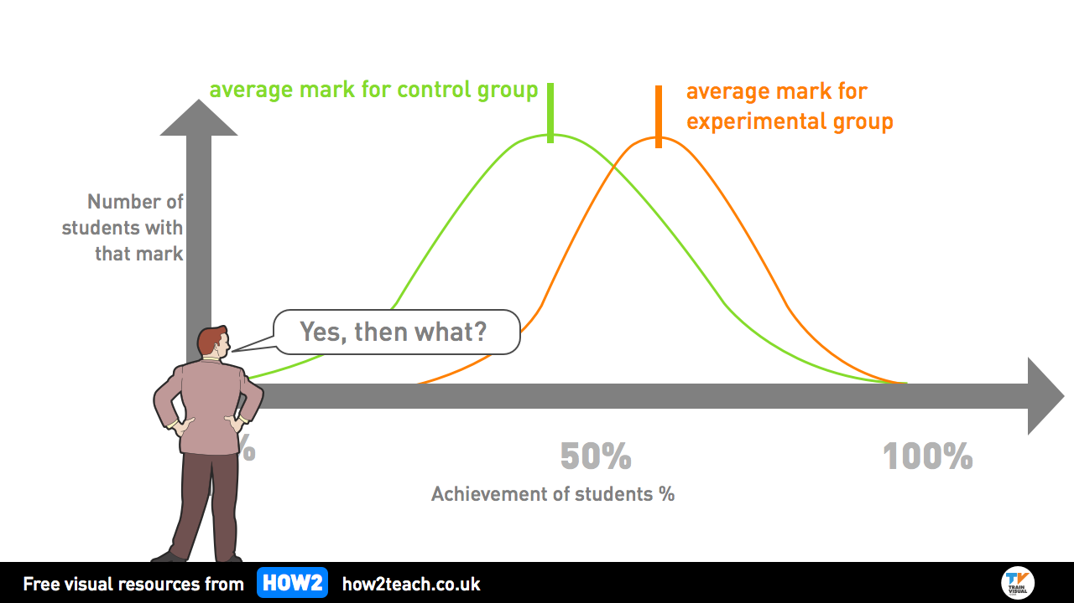
对照组平均成绩
实验组平均成绩
得到
成绩
的
学生
数量
是的，那又怎样？
学生成就百分比

Slide 62
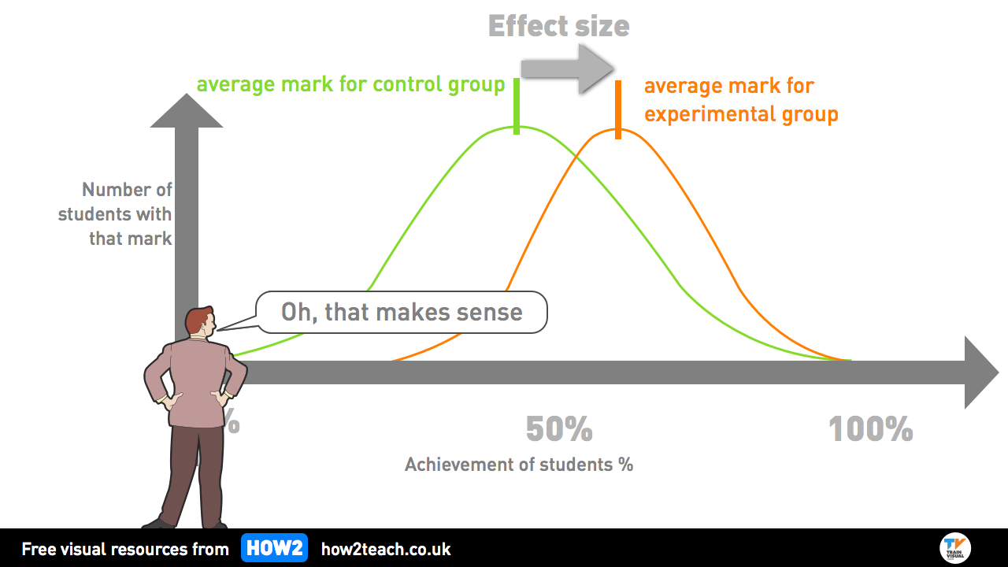
效应量
对照组平均成绩
实验组平均成绩
哦，这说得通
学生成就百分比

Slide 63
Effect size 效应量
0.1
Normal annual maturation, no teaching
年正常成熟，无教学
0.25
Average effect of a teacher 一名教师的平均效应
Average effect of all educational interventions
所有教育干预的平均效应
0.42
0.5
Minimum standards for new intervention
新干预的最低标准
0.8
Significant effects 显著效应

Slide 64
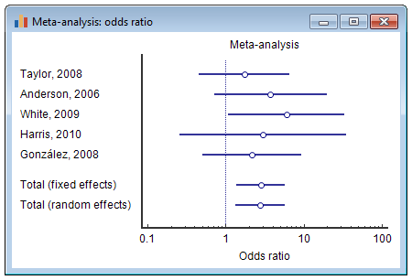
Meta analysis 元数据分析
元数据分析：让步比
元数据分析
总体(固定效应)
总体(随机效应)
让步比

Slide 65
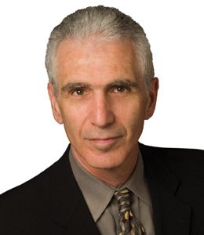



Two largest Meta Analysis of Teaching Techniques
教学技术的两大元数据分析

Slide 66
Activity
 | Effect size 效应量 | Top Ten effective Classroom Methods十(From Marzano 2012) 十大有效的课堂教学方法（出自马扎诺 2012）
1 | 1.60 | Identifying similarities and differences, using similes & analogies 使用比喻和类比，找出异同
2 | 1.00 | Summarizing and note-making 总结和记笔记
3 | 0.80 | Developing a growth mindset 形成一种增长的心态
4 | 0.77 | Repetition and practice 重复和实践
5 | 0.77 | Non-linguistic representation (Graphical methods) 非语言呈现（图示法）
6 | 0.73 | Cooperative learning 合作学习
7 | 0.68 | Goals and feedback 目标和反馈
8 | 0.61 | Generating and testing hypotheses 生成和检验假说
9 | 0.59 | Activating prior knowledge 激活原有知识
10 | 0.59 | Advance organisers 先行组织者

Slide 67


