Slide 1
Fault Diagnosis

Slide 2
Lesson Objectives
To be able to identify the four main types of fault diagnosing
To be able to recognise fault finding aids and how to use them

Slide 3
Fault Diagnosis

Slide 4
Fault Diagnosis in Mechanical and Electrical Systems
In Industry you will be expected to be able to diagnose faults on system failures in a timely manner and be able to rectify them in a way that ensures that they will not fail again in the future.
This is not always an easy thing to do as the system that you have to work on may be complex with many components and not always in a suitable environment to work on.

Slide 5
The Four Industry Recognised Methods of Diagnosing Faults
Emergent Problem Sequence
The Half Split Technique
The six-point method of fault diagnosis
Input to output technique

Slide 6
Emergent Problem Sequence
Identify that the machine/process is functioning differently than normal or not at all.
Example: a process line is running out of sync
Identify what has changed
Example: one conveyer belt is running slower than normal

Slide 7
Emergent Problem Sequence
Identify why that belt is running slower
Example: check bearing temperatures, look for obstructions
Establish the fault
Example: the cowling on the drive motor had been bent and was rubbing on the cooling fan

Slide 8
Emergent Problem Sequence
Rectify the fault
Example: remove the cowling, straighten it and replace it
Test the system.

Slide 9
The Half-Split Technique
Half Split technique is used when fault finding on an electrical circuit.
This can be used on all systems but for this example its on an electrical system!
If you have power at a supply and ground but nothing at the consumer then check for a reading from halfway along the circuit and ground.

Slide 10
The Half Split Technique
If a reading is present, there then pick a point about halfway between your present position and ground and check again.
If a reading is still not present, then repeat the process from halfway of that and for every subsequent half until you had located the problem.

Slide 11
The Six-point Method of Fault Diagnosis
Test the system, i.e., take measurements or collect other evidence (data logs)
Analyse the readings (study trends, missing data)
Locate fault based on analysis (step 2)
Determine the original cause of the fault. ( i.e., find a method to prevent recurrence)
Repair the fault (bearing in mind step 4)
Restart the system (test)

Slide 12
Input to Output Technique
Start by looking for a reading between the start and the first point
If the reading is ok, then test from the start to the next point
Continue this routine until the reading is lost
This will then give you a working area to look at, between the last known position with a reading and the point where the reading was not present.
Move the start point to the point of the last known reading and use the same method in more detail until the fault is found.

Slide 13
GROUP ACTIVITY
IN YOUR GROUPS DISCUSS THE FAULT DIOGNOSIS TECHNIQUE YOU HAVE BEEN ALLOCATED.
GIVE THREE ADVANTAGES AND THREE DISADVANTAGES
YOU HAVE 15 MINUTES!

Slide 14
Any Questions?

Slide 15
Fault Finding Aids
Fault finding charts
Functional system charts
Algorithms
Maintenance records
Probability charts

Slide 16
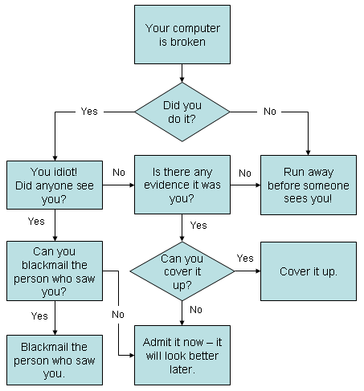
Flow Charts
A flow chart is a series of simple questions you ask about the system and fault by simply following simple Yes or No answers leads you to the fault and its cure.

Slide 17
Functional System Chart
A Functional System Chart is a diagram of a working system. Other common Functional Charts could be….
Schematic diagram
Wiring diagram
Sequence of operations diagrams

Slide 18
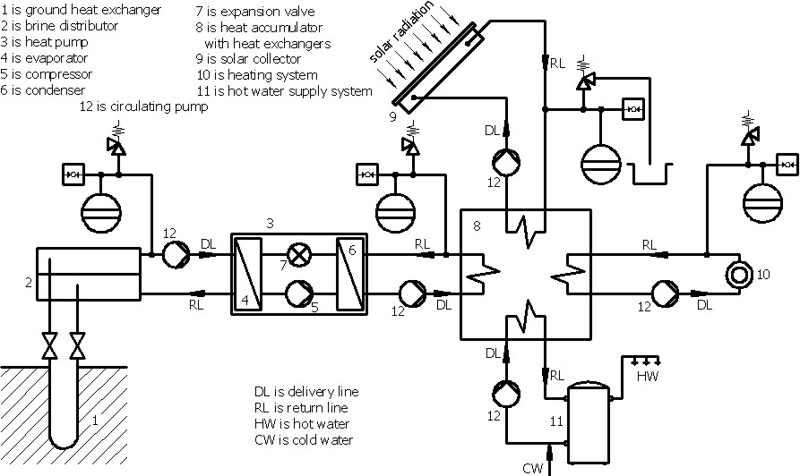
Functional System Chart

Slide 19
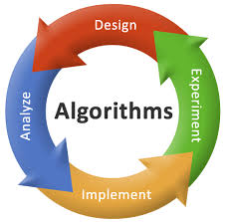
Algorithm's
An Algorithm is a simple procedure or formula for solving a problem

Slide 20
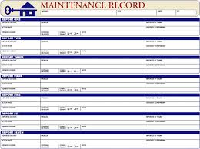
Maintenance Records
Maintenance records are written notes that provide documentation about the upkeep of a certain piece of equipment
These will show all work carried out
The first place to look in the event of a break down
Official documents can be handwritten but more commonly stored on computer

Slide 21
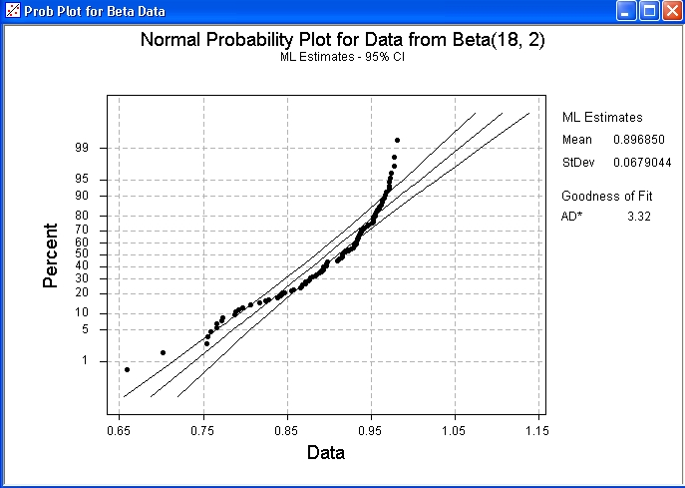
Probability Charts
The normal probability plot is a graphical technique to identify substantive departures from normality
Deviations from a straight line suggest departures from normality
These are then used to see where and when the system started to break down

Slide 22
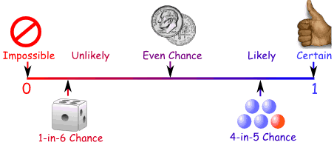
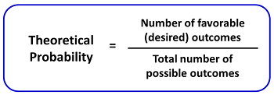
Probability
Probability is the measure of the likeliness that an event will occur.
Always measured between 0 and 1
The higher the probability of an event, the more certain we are that the event will occur.

Slide 23
Probability
A simple example is the toss of a coin. Since the two outcomes are equally probable, the probability of "heads" equals the probability of "tails", so the probability is 50% chance of either "heads" or "tails".

Slide 24
Quiz Time !!!
A dice is thrown once. What is the probability that the score is a 6?
Answer = 1/6 = 0.17

Slide 25
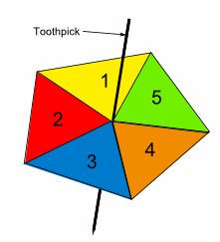
Quiz Time !!!
The diagram shows a spinner made up of a piece of card in the shape of a regular pentagon, with a toothpick pushed through its centre. The five triangles are numbered from 1 to 5.
The spinner is spun until it lands on one of the five edges of the pentagon. What is the probability that the number it lands on is odd?
Answer = 3/5 = 0.6

Slide 26
Quiz Time !!!
Each of the letters of the word MISSISSIPPI are written on separate pieces of paper that are then folded, put in a hat, and mixed thoroughly.
One piece of paper is chosen from the hat. What is the probability it is an I?
Answer = 4/11 = 0.36

Slide 27
Any Questions?

