Slide 1
Seals & Gaskets

Slide 2
Lesson Aim:
To recognise the purpose of Seals.
To introduce the variety of seal configurations, give guidelines for the selection of seals
Learning objectives:
be able to identify the different types of sealing devices,
be able to select a seal type for rotating, reciprocating or static conditions,

Slide 3
Introduction
The purpose of a seal is to prevent or limit flow between components.
Seals are an important aspect of machine design where pressurised fluids must be contained within an area of a machine such as a hydraulic cylinder, contaminants excluded, or lubricants retained.

Slide 4
Static and Dynamic Seals
Seals fall into two general categories.
Static Seals:
where sealing takes place between two surfaces that do no not move relative to each other.
Dynamic Seals
where sealing takes place between two surfaces that move relative to each other by, for example, rotary or reciprocating motion.

Slide 5
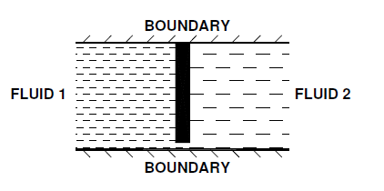
Leakage
Any clearance between two components will permit the passage of
fluid molecules in either direction, the direction depending on the pressures and momentum associated with the fluid.

Slide 7
Considerations in Seal Selection
Some of the considerations in selecting the type of seal include:
the nature of the fluid to be contained or excluded
pressure levels either side of the seal
the nature of any relative motion between the seal and mating components
the level of sealing required
operating temperatures
life expectancy, serviceability
total cost.

Slide 9
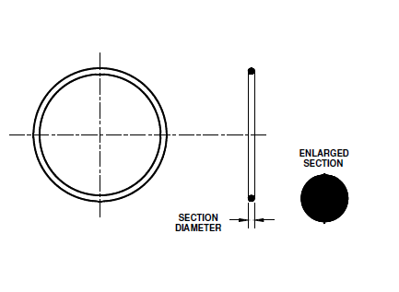
O - Rings
The ‘O’ ring is a simple and versatile type of seal with a wide range of applications for both static and dynamic sealing.
An ‘O’ ring seal is a moulded elastomeric ring ‘nipped’ in a cavity in which the seal is located.

Slide 10
O - Ring Operation
The principle of operation for an ‘O’ ring sealing against a fluid at various pressures is illustrated below.
Elastomeric seal rings require the seal material to have an interference fit with one of the mating parts of the assembly.

Slide 11
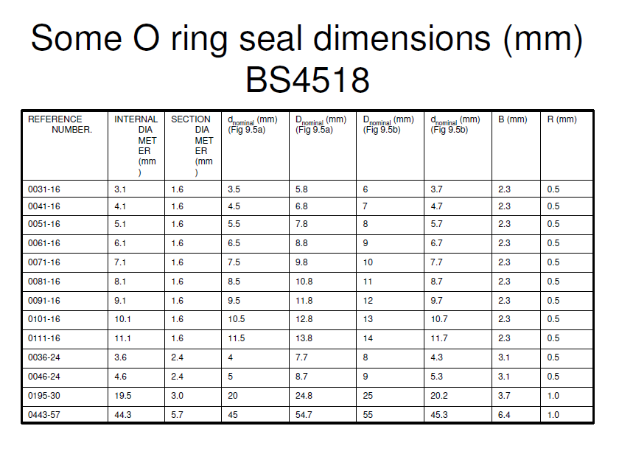

Slide 12
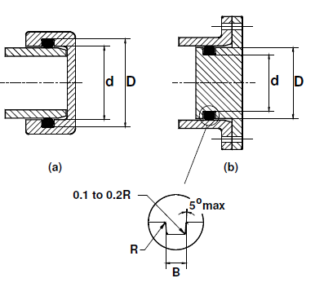
Example
Specify suitable groove dimensions for an 0195-30 ‘O’ ring to seal against a solid cylinder.

Slide 13
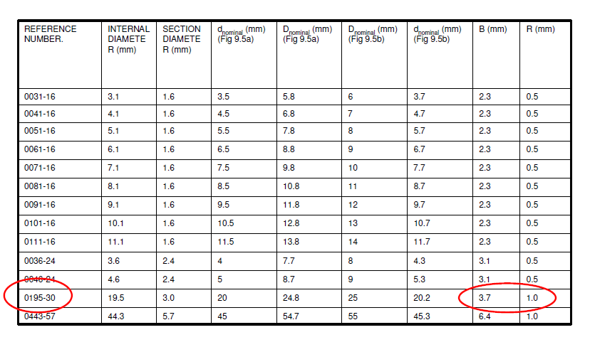
Solution
Specify suitable groove dimensions for an 0195-30 ‘O’ ring to seal against a solid cylinder.
B = 3.7 mm
R = 1 mm
Groove fillet radius = 0.2 mm.

Slide 14
Movement
A particular problem associated with O rings is ability to cope with small movements of the housings and sealing faces.
A range of solutions have been developed to produce seals that are resistant to flow, for instance rotation, within the seal groove.
An X ring, also known as a quadring, and a rectangular seal are illustrated opposite.

Slide 15
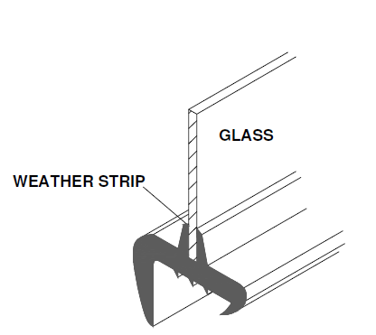
Aperture Seals
Aperture seals used, for example, for doors, windows and cabriolet bodies are typically made from elastomeric extrusions as production costs are low relative to fabricated mechanical seals and as their assembly can be automated.
In the case of automobiles the requirements are demanding with the need to seal against differential pressure, exclude dust, air, water and noise.

Slide 16
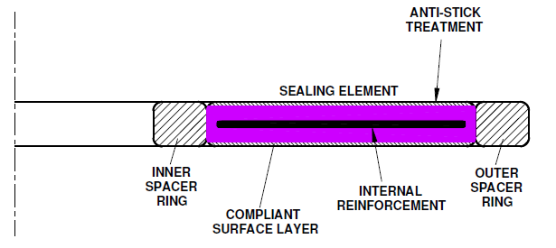
Gaskets
A gasket is a material or composite of materials clamped between two components with the purpose of preventing fluid flow.
Gaskets are typically made up of spacer rings, a sealing element, internal reinforcement, a compliant surface layer and possibly some form of surface anti-stick treatment as shown

Slide 17
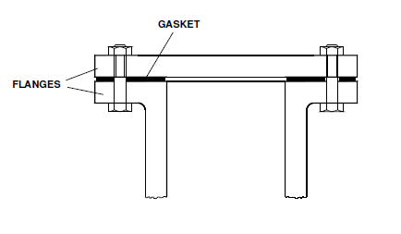
Gasket Seal
The drawing shows a typical application for a gasket seal.
When first closed a gasket seal is subject to compressive stresses.
Under working conditions, however, the compressive load may be relieved by the pressures generated within the assembly or machine.

Slide 18
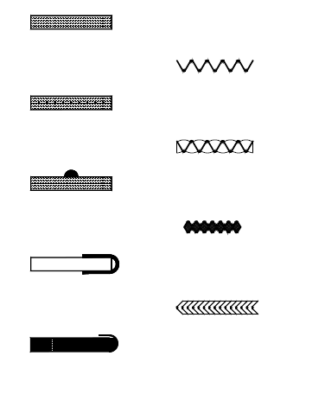
Gasket Designs
Typical gasket designs are illustrated.
The choice of material depends on the temperature of operation, the type of fluid being contained and the leakage rate that can be tolerated.

Slide 20
Dynamic seals
The term ‘dynamic seal’ is used to designate a device used to limit flow of fluid between surfaces that move relative to each other.
The range of dynamic seals is extensive with devices for both rotary and reciprocating motion.
The requirements of dynamic seals are often conflicting and require compromise.
Effective sealing may require high contact pressure between a stationary component and a rotating component, but minimal wear is also desired for long seal life.

Slide 21
Rotating shaft Seals
The functions of seals on rotating shafts include retaining working fluids, retaining lubricants and excluding contaminants such as dirt and dust.
The selection of seal type depends on the shaft speed, working pressure and desired sealing effectiveness.

Slide 22
Seals for rotary motion
Seals for rotary motion include:
‘O’ rings,
lip seals,
face seals,
sealing rings,
compression packings and
non-contacting seals such as bush and labyrinth seals.

Slide 24
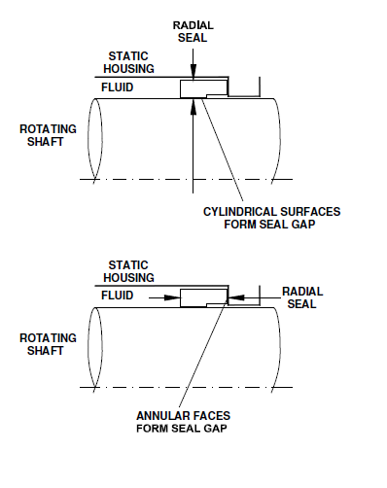
Mechanical Face Seals
A mechanical face seal consists of two sealing rings, one attached to the rotating member and one attached to the stationary component to form a sealing surface, usually perpendicular to the shaft axis.

Slide 25
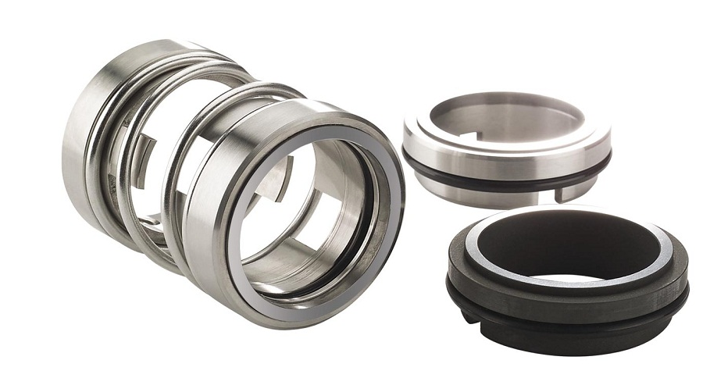
Mechanical Face Seals
A mechanical face seal consists of two sealing rings, one attached to the rotating member and one attached to the stationary component to form a sealing surface, usually perpendicular to the shaft axis.

Slide 26
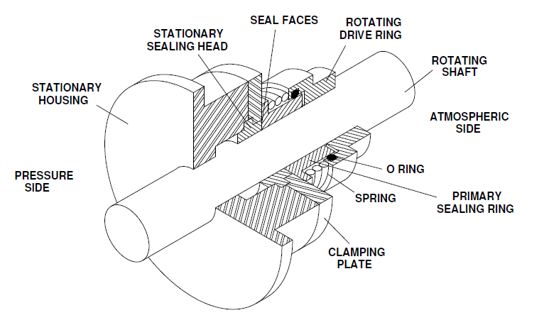
Mechanical Face Seals

Slide 27
Labyrinth seals
A labyrinth seal in its simplest form consists of a series of radial fins forming a restriction to an annular flow of fluid.
For the fluid to pass through the annular restriction it must accelerate.
Just after the restriction the fluid will expand and decelerate with the formation of separation eddies
These turbulent eddies dissipate some of the energy of the flow reducing the pressure.

Slide 28
Labyrinth seals
Labyrinth seals are a non-contact seal that makes a tougher path for contaminants to enter while operating with little or no friction.
The labyrinth rings are made of steel and have two radially arranged labyrinth steps that form a narrow sealing gap with the housing grooves.
Labyrinth seals allow for some misalignment, high speeds, a wide temperature range, and do not limit axial movement due to thermal expansion.

