Slide 1
Transmissions
Transmissions can be used to :
Connect two shafts to allow one to drive the other.
Change the speed of one shaft compared to another.
Change the direction of a shaft relative to another.
Convert rotary motion to linear or vice versa.

Slide 2
Where Does the Power Come From?
Muscle and (where possible) assisted power.
Hydraulic, pneumatic and electrical power.
External and internal combustion engines.
This power is moved by devices such as Belts, Gears and Chains and Sprockets

Slide 3
Belts and Pulleys
Flat belts use friction to transmit power from one shaft to another. They are prone to slipping.
To reduce the slippage ‘V’ section belts were devised. The ‘V’ section increases the contact area between belt & pulley.
More recently the serrated or toothed belts and pulleys have been developed to give a more positive, engaged drive.
Mainly used on piston engines or light aircraft pumps.

Slide 4
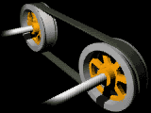
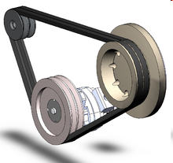
Belts and Pulleys
Flat Belt Mechanism
Friction V Belt Mechanism
V Section Groove cut into Pulley
V Section Belt
Flat Belt runs over top of Pulley
Pulley

Slide 5
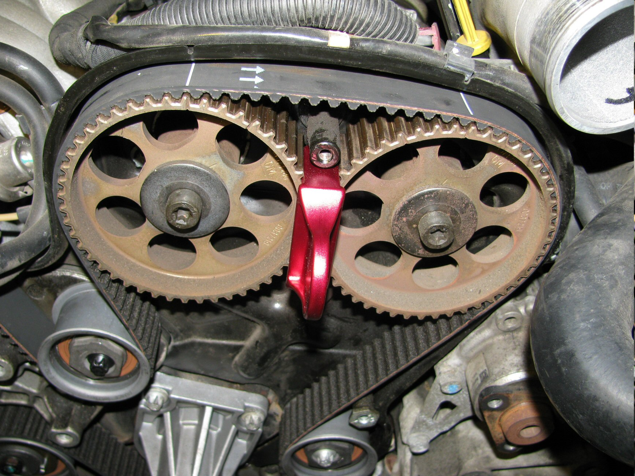
Toothed Belt and Pulley System

Slide 6
More Than One Belt Drive
When using more than one ‘Vee’ belt it is important to match the belts to ensure they are :-
The same length
Made of the same material
If they are unmatched, they will wear unevenly and stretching will occur causing failure
Never replace an individual belt as this would certainly be shorter than the original and would take most of the drive resulting in premature failure.

Slide 7
Simple Belt and Pulley
DOR
The belt and pulley system can be used as a gearing system.
If the small pulley is half the diameter of the large one, then a 2:1 ratio is achieved ( step-up or step-down depending on which is driven) .

Slide 8
Belt Tension Adjustment
It is important that V-belts run with the amount of tension recommended by the manufacturer. If tension is insufficient then the belt will slip and overheating, and wear will result. If the belt is too tight it will also cause overheating as well as damage to bearings.
There are several ways in which belt tension can be checked. The most common is to depress the belt and measure the deflection using a ruler and straight edge as shown in Fig. 7-13.
To check the amount of deflection is correct, measure the distance in mm between the centres of the two pulleys. Fenner states its belts operate at 16mm deflection per metre of distance between centres.

Slide 9
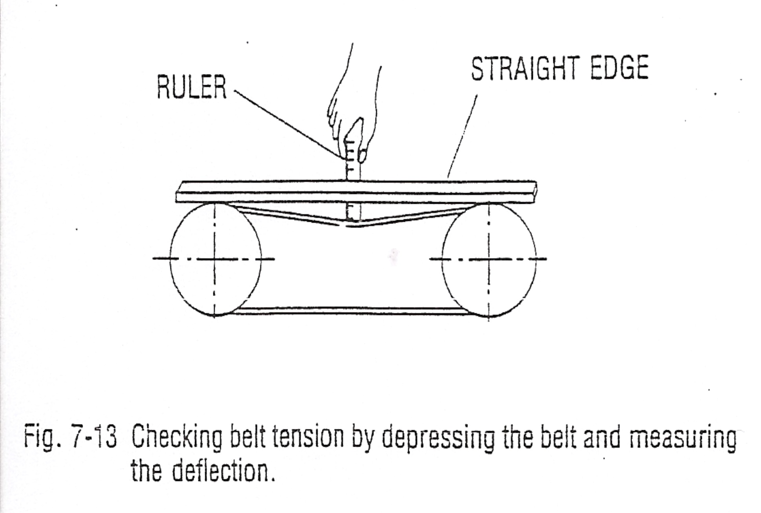
Belt Tension Adjustment

Slide 10
Vee Belt Drive On a Compressor

Slide 11
Self Tensioning Belt Drive

Slide 12
Simple Belt and Pulley
DOR
Possible problems :-
Over tensioning would cause slippage
Over tensioning would result in premature belt stretch
Misalignment would cause belt wear.

Slide 13
Alignment
Alignment of components is a critical part of the assembly process.
Misalignment can cause excessive noise and vibration and can lead to premature failure of equipment in service as bearings and other components are overloaded.
The alignment relates mainly to rotating components (but could just as easily be reciprocating/linear action components) which could be arranged either end to end or parallel with each other.

Slide 14
Alignment Tolerance
As with most assembly processes there are tolerances which should be worked to.
In basic terms, The faster the equipment is running, the more accurately it needs to be aligned.
Tolerances may also vary between different types of equipment, so manufacturers guidance should be sought for components such as couplings etc.

Slide 15
Misalignment

Slide 16
Checking Alignment
The method of checking the alignment of components will depend on the size of the components/equipment being aligned, the equipment available to carry out the alignment and the orientation of the components.
The tools used to align components may include:
Straight edge, Feeler gauges, DTI, Rule/Vernier caliper, Spirit level, Laser alignment tool, Feeler bar.

Slide 17
Checking Alignment

Slide 18
Ensure Correct Alignment

Slide 19
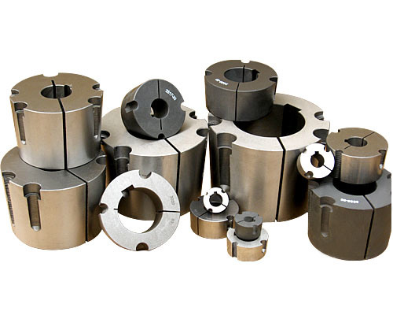
Taperlock Bushes
Taper bushes provide a low cost, simple, quick method of securing sprocket, pulleys and couplings to a wide range of standard metric and imperial dimensioned shafts.
The taper surfaces on the bush and mating hub are driven together by high tensile screws, causing the split bush to be firmly contracted onto the shaft. The strong clamping force which can be achieved enables transmission of high torque without fretting associated with simple key-seated drives.
The design ensures quick, easy installation of sprockets and pulleys onto shafts with simple positioning for alignment. Positive jacking-off of the bush during removal ensures quick disassembly without normal problems of seizure between shaft and pulley.

Slide 20
Installation
Remove protective coating from the bore, outside of the bush and bore of hub. After ensuring the mating tapered surfaces are completely clean, insert bush in hub so that holes line up.
Oil the thread and point of grub screws, or thread and under head of cap screws. Place screws loosely in holes threaded in hub, shown thus in diagram.
Clean shaft and fit hub and bush to shaft. Locate in position, remembering bush will nip the shaft first and then hub will be drawn on to the bush.

Slide 21
Installation
Using a hexagon Allan key, tighten screws gradually and alternately until all are pulled up very tightly.
When a key is not used, knock against large end of bush using a block or sleeve to prevent damage. Screws will now turn a little more. Repeat this alternate knocking and screw tightening once or twice. After drive has run under load for a short time, check tightness of screws.
Fill empty holes with grease to exclude dirt.

Slide 22
Taperlock Bush Removal
Slacken all screws by several turns, remove one or two according to number of jacking off holes thus in diagram. Insert screws in jacking off holes after oiling thread and point of grub screws or thread under head of cap screws.
Tighten screws alternately until bush is loosened in hub and assembly is free on the shaft.
Remove assembly from shaft.

Slide 23
