Slide 1
ENGINEERING MAINTENANCE

Slide 2
Engineering Maintenance Procedures and Techniques
Aim: To recognise the types of maintenance associated with engineering plant, equipment and systems
Learning Objectives:
To list and describe types of maintenance
To explain the need of maintenance on an engineering equipment within a plant

Slide 3
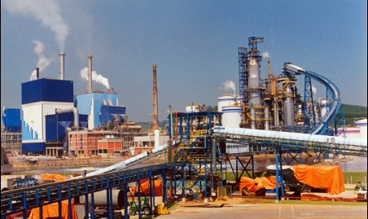
What is Maintenance ?
Maintenance is:
Keeping plant, machinery, equipment, in working or serviceable order
Restoring plant, machinery, equipment, to an acceptable condition
Taking care of valuable assets
Changes made to a system to fix or enhance its functionality.

Slide 4
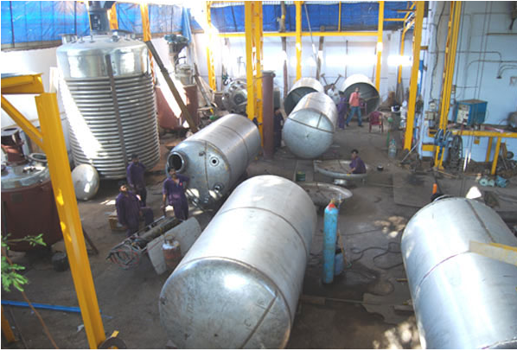
The Need for Maintenance
Safety / Legal Requirements
Reliability / Availability
Prolong life of equipment and keep plant running for longer
Improved product quality
Environmental considerations

Slide 5
Other Maintenance Considerations
Efficiency of plant, machinery & equipment
Energy management
Optimum operation and running costs
Visual effects – lighting systems, retail shopping complexes, display facilities
Hygiene – Hospitals, Medical facilities & laboratories, hazardous areas

Slide 6
Types of maintenance
In industry maintenance procedures have been categorised into many different types
Breakdown Maintenance or No Scheduled Maintenance - an Equipment Maintenance Strategy, where no routine maintenance tasks are performed on the equipment. Also described as a Run-to-Failure strategy
Corrective Maintenance - Any maintenance activity which is required to correct a failure that has occurred .This activity may consist of repair, restoration or replacement of components

Slide 7
Types of maintenance
Planned Maintenance - any maintenance activity for which a pre-determined job procedure has been documented,
for which all labour, materials, tools, and equipment required to carry out the task have been estimated, and their availability assured before commencement of the task.
Preventive Maintenance (PM) - an equipment maintenance strategy based on replacing, overhauling or remanufacturing an item at a fixed interval, regardless of its condition at the time

Slide 8
Types of maintenance
Proactive Maintenance - Any tasks used to predict or prevent equipment failures.
Shutdown Maintenance - Maintenance that can only be performed while equipment is shutdown
Reliability Centred Maintenance (RCM) - A structured process, originally developed in the airline industry and commonly used in all industries to determine the equipment maintenance strategies required for any physical asset to ensure that it continues to fulfil its intended functions in its present operating context.

Slide 9
Types of maintenance
Condition Based Maintenance (CBM) - an equipment maintenance strategy based on measuring the condition of equipment in order to assess whether it will fail during some future period, and then taking appropriate action to avoid the consequences of that failure
Unscheduled Maintenance - any maintenance work that has NOT been included on an approved Maintenance Schedule prior to its commencement.

Slide 10
Class Exercise
Look at different services on a car and select a maintenance type for the following
Brake service
Lights
Air conditioning service
Brake fluid replacement
MOT
Manufacturer's service/lubrication
Electric window fault
Interior seats

Slide 11
Class Exercise
Breakdown Maintenance
Preventive Maintenance
Proactive Maintenance
Shutdown Maintenance
Reliability Centred Maintenance (RCM)
Condition Based Maintenance (CBM)
Unscheduled Maintenance

Slide 12
ANY QUESTIONS?

Slide 13
ENVIRONMENTAL CONSIDERATIONS

Slide 14
Health & Safety Environmental Considerations
Legislation – The Environmental Protection Act
Maintenance related aspects:
Plant & equipment to be maintained to ensure that there are no discharges of toxic and/or hazardous materials into the atmosphere, water courses, etc

Slide 15
Safe Disposal of Materials
Waste arising from the maintenance activity to be disposed of safely. This is particularly important where toxic and/or hazardous materials are being used in maintenance operations.
Appropriate procedures and waste handling / disposal equipment may be necessary. Where safe disposal procedures are to be implemented then this should carried out effectively under strict control.

Slide 16
Examples of Possible Hazardous Materials
Chemicals & solvents used for cleaning
Oils & petroleum-based waste products after engine, machinery and equipment maintenance
Fluorescent / discharge lamps contain materials such as mercury and sodium and these must be disposed of safely. Sometimes special ‘lamp crushing’ equipment is used.

Slide 17
Examples of Possible Hazardous Materials
Some adhesives / glues contain hazardous compounds
Materials containing asbestos or asbestos by-products

Slide 18
ENVIRONMENTAL VIDEOS
world environment

Slide 19
ANY QUESTIONS?

Slide 20
MAINTENANCE COSTS

Slide 21
Maintenance Costs
What could be considered as Maintenance Costs?

Slide 22
Labour Costs
In-house labour involved in the maintenance process:
(a) Management / Supervisory
(b) Craftsmen / Fitters / Electricians, etc.
(c) Operational staff carrying out ‘front line
maintenance’ activities
(d) Support and Administration staff
External labour (a) Contractors
(b) Specialists

Slide 23
Equipment Hire & Replacement
Examples are:
Specialist tools & instruments
Welding equipment
Specialist lifting & handling aids
Industrial cleaning equipment
Scaffolding

Slide 24
Safety & Environmental Costs
Administration / Documentation including record holding systems
Provision & maintenance of personal protective equipment
Accident / medical / emergency facilities
Safety & Environmental audits & inspections, risk assessments

Slide 25
Downtime / Loss of Production
Costs related to the ‘time’ equipment is out of production
The costs to the company in respect to loss of production

Slide 26
Storage & Spares Holding
Storage Space
Security
Extent of spares holding

Slide 27
Equipment & Materials Costs
Maintenance workshop machinery & equipment
Tools & instruments
Consumables
Lifting & handling aids

Slide 28
Maintenance Costs Related to Company Expenditure
Often the overall cost of maintenance is considered as a proportion of a given company’s total annual expenditure. Such a comparison enables the ‘cost effectiveness’ of the overall maintenance activity to be assessed and budgeted for during the next forthcoming financial year.

Slide 29
Keeping Basic Maintenance Records
Maintenance records are important.
Why do you think keeping maintenance record is important?
They can help technicians spot recurring problems and ensure that work meets the manufacturer’s guidelines.
Records also can help keep departments out of court. Even the smallest departments should keep some basic maintenance records.

Slide 30
Which items need to be maintained?
First, every piece of apparatus and equipment should have its own maintenance record.
This includes vehicles, generators, rescue tools, hose , compressors, conveyors, and even ground ladders.
If something needs to be inspected, maintained, tested or repaired, it needs a separate record.

Slide 31
Keeping Basic Maintenance Records
Second, the maintenance records need to be written or kept in a computer memory with a back-up copy.
Undocumented maintenance histories have little or no value in tracking problems, proving warranty claims or defending your department in court.
The records should show what work was performed, when it was done and who did the work.

Slide 32
Keeping Basic Maintenance Records
Third, all the inspections, maintenance and testing must follow the procedures specified by the manufacturer and must be performed as required by the manufacturer.
Accurate maintenance records can help show this was done.
Keeping good records of tests also can help establish and maintain a department’s Insurance Services Office rating
It can be a requirement

Slide 33
Keeping maintenance records can help in other ways
They can help mechanics spot recurring problems on the same or similar apparatus and equipment
Provide a point to begin troubleshooting, It also may point to a specific solution.
A periodic review of maintenance records can also help identify escalating maintenance costs for a certain piece of apparatus or equipment and may be a basis for budgeting a replacement.

Slide 34
Keeping maintenance records can help in other ways
5. The records can provide written proof of the labour, parts and outside services required to keep an older item in service and
6. Also can demonstrate the amount of time the item was out of service and not available.

Slide 35
ANY QUESTIONS?

