Slide 1
Condition Monitoring

Slide 2
Objectives of the lesson
To understand the use of condition monitoring methods

Slide 3
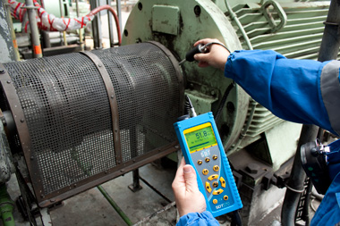
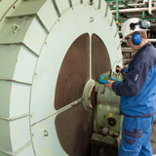
Condition Monitoring
Condition Monitoring can be defined as the use of advanced technologies in order to determine equipment condition, and potentially predict failure
ultrasound detector for industrial predictive maintenance

Slide 4
The Need for Monitoring
Improved safety
Reduction of environmental hazards
Improved product quality
Reduction of downtime
Reduced costs
Extended equipment life
Comprehensive database
Improved communication between operations/ maintenance

Slide 5
Safety
Continuous monitoring of plant and equipment can enable alarms and possibly automatic safe shutdown to occur in the event of catastrophic failure.
This can thereby avoid potential imminent danger and injury.
Also, operations and maintenance personnel can become aware of trends to failure before problems arise.

Slide 6
Environmental Hazards
As in the case of safety, early warning of the potential release of hazardous materials to the atmosphere or water courses can be detected through monitoring systems e.g.
Emissions from boilers, fluids from pumps, etc.

Slide 7
Product Quality
Product quality control can be greatly enhanced through monitoring each stage of the production process, e.g.
Assembly line products can be monitored during manufacturing processes.
The quality of steam, oil, fluids, chemical products etc. can be monitored in the process industries.

Slide 8
Downtime
Reduced downtime of plant, equipment and systems through early warning of potential failure or loss of performance can be provided.
WHAT IS DOWNTIME?
DOWN TIME IS…….
“THE LENGTH OF TIME A MACHINE IS OUT OF PRODUCTION DUE TO MAINTENANCE”.

Slide 9
Costs
Given the benefits outlined in the previous slides, significant savings can be made in both operational and maintenance costs.
For Example;
Better quality control
Plant & equipment out of service for less time
Reduced maintenance activity etc

Slide 10
Extended Equipment Life
Continuous monitoring together with proactive maintenance checks can enable plant and equipment to remain running within design specification for longer periods thereby extending equipment life.

Slide 11
Comprehensive Database& Improved Operations /Maintenance Communication
Continuous monitoring of data from plant and equipment enables a comprehensive database to be established.
This may have significant benefits when analysing operational performance and associated maintenance activity in the future.
This in turn improves communication between operations and maintenance personnel.

Slide 12
Any Questions?

Slide 13
Objectives of Condition Monitoring
Prevent catastrophic failure through shut down and alarms
Reduce ‘downtime’ of equipment and systems through early warning of potential failure or loss of performance
Provide a basis upon which preventive maintenance requirements may be better organised and optimised

Slide 14
Condition Monitoring
All condition monitoring techniques rely on monitoring some physical characteristic that reflects the condition of the machine.
A normal running level for that characteristic is established when the machine is in good condition and then any significant deviation from that level gives warning that a fault may be developing.

Slide 15
Methods of condition Monitoring
Before the development of these techniques, condition monitoring was carried out by the operator of a machine who observed the running condition using the senses of sight, hearing, touch and smell.
In modern industry however, the majority of machines run unattended and although inspection by personnel is still an important element in the monitoring process, mechanised techniques are essential if constant surveillance is to be achieved.

Slide 16
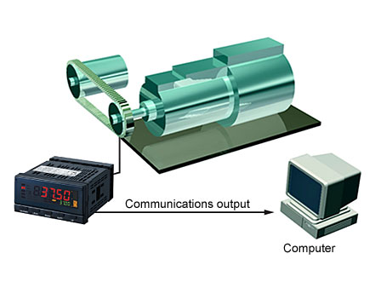
Methods of condition Monitoring
Temperature monitoring This is one of the simplest methods available and involves the use of thermocouples or resistance thermometers to measure bearing temperatures.
Temperature Monitoring for Power Generators and Motor Bearings

Slide 17
Temperature monitoring

Slide 18
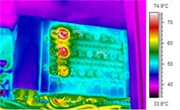
Temperature monitoring
This is a method of thermal photography and needs to be completed while the machine is running
It gives an indication to the maintenance team Hazards in the machine and the likelihood of the machine failing

Slide 19
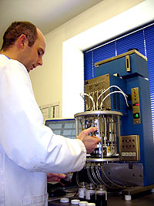
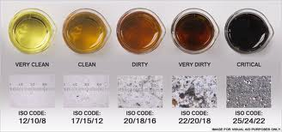
Methods of condition Monitoring
Spectrographic oil analysis Samples of lubricating oil can be analysed using a spectrometer and the proportions of metal elements present can be determined.
The oil samples used must be representative of the total contents of the system and should be taken under normal operating conditions

Slide 20
Particle retrieval
This technique analyses the wear debris present in the lubricating oil but instead of measuring metal levels it is more concerned with the physical size of the particles.
Wear debris can be collected by installing magnetic plugs in the system downstream of bearings to catch ferrous particles and by backwashing the oil filter element to collect non-ferrous particles.
Because this method is based on intermittent sampling, it is not suitable for automatic alarm and shutdown.

Slide 21
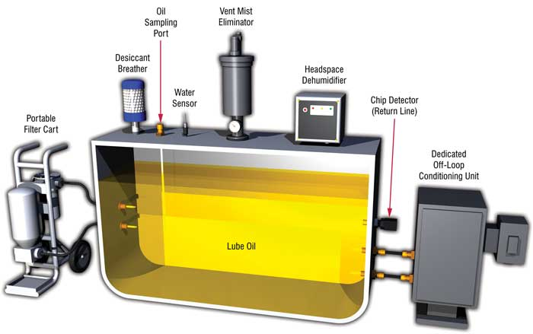
Particle retrieval
Contamination Control and Oil Analysis

Slide 22
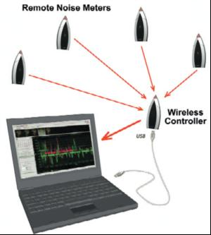
Noise monitoring
The noise produced by a machine has traditionally been used as one of the key sources of information about its operating condition.
This simple process can now be systematised using a microphone, amplifier, meter, and continuous recording equipment.

Slide 23
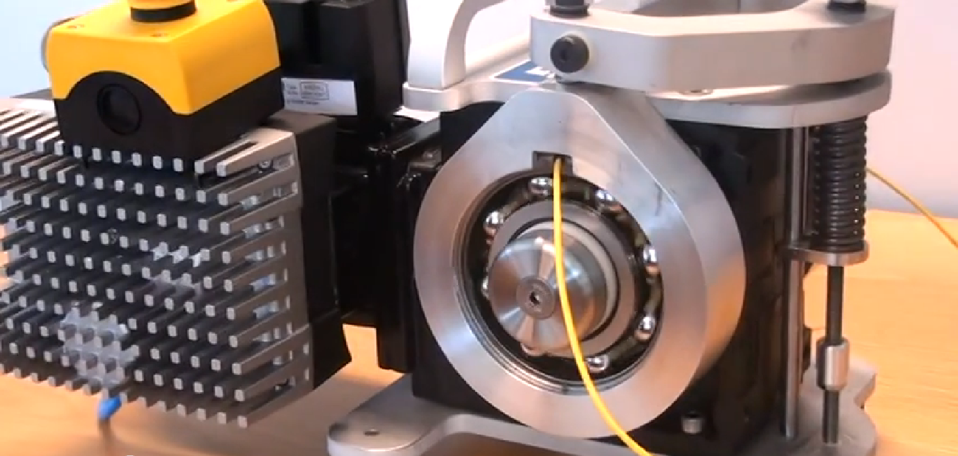
Bearing Monitoring http://www.youtube.com/watch?v=1N_2k_qzX6Y

Slide 24
Vibration monitoring
The most widely adopted form of condition monitoring, which involves the recording and analysis of machine vibration patterns.
Excessive vibration is a reliable indicator of malfunction and by analysing vibration levels at different frequencies accurate diagnosis of the source of vibration is possible.
The monitoring equipment may be tuned to record vibration levels at all frequencies
This method is ideal for continuous monitoring and vibration sensors can be used to initiate automatic alarm and shutdown devices.

Slide 25
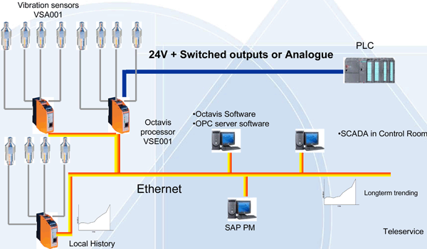
Vibration monitoring
Continuous, Intelligent Vibration Monitoring

Slide 26
SKF bearing monitoring http://www.youtube.com/watch?v=GS3Kc4HbeXM

Slide 27
Advantages of Condition Monitoring
• Safety is improved by avoiding the development of dangerous situations that may be hazardous to personnel and other plant and equipment.
• Disruption of production schedules can be reduced by preventing unexpected breakdowns.
• By detecting faults before serious failure occurs, damage to plant and equipment is reduced.

Slide 28
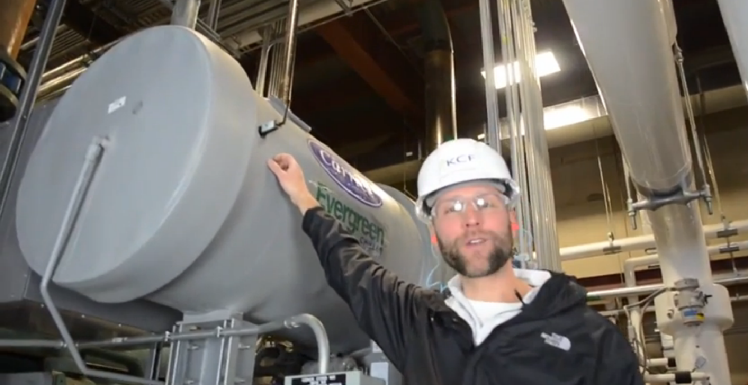
Wireless Condition Monitoring System Chiller Facility http://www.youtube.com/watch?v=SWHgoWtxtO0

Slide 29
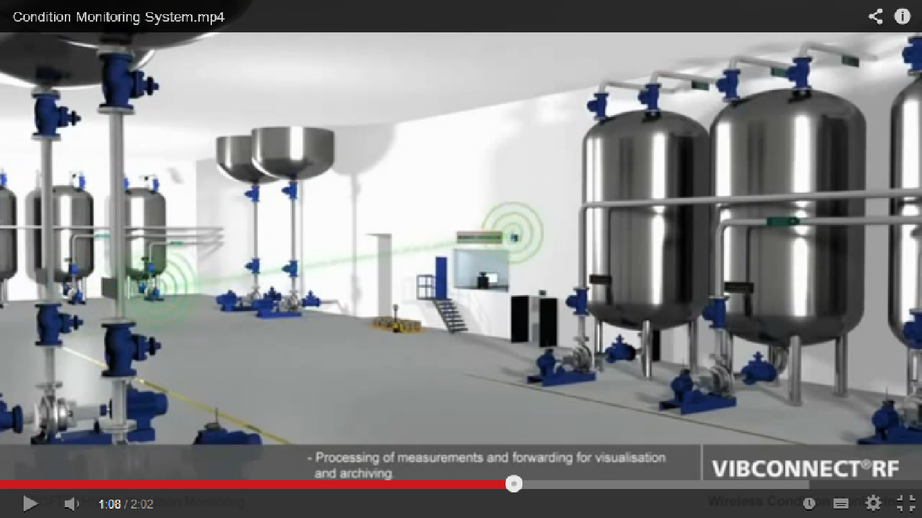
Wireless Condition Monitoring http://www.youtube.com/watch?v=LBoIsJaDBAk

Slide 30
Advantages of Condition Monitoring
• Condition monitoring eliminates the need to strip down equipment during annual overhaul. As well as indicating when a machine is becoming unserviceable, monitoring also confirms that a machine is operating satisfactorily.
• The equipment can also be used to assist in troubleshooting and to help identify failed components when breakdown does occur.

Slide 31
Condition Monitoring

Slide 32
Monitoring Techniques
Vibration
Lubricant analysis
Temperature (Thermography)
Leak detection
Corrosion detection
Crack detection
Insulation
Electrical resistance

Slide 33
Example of Monitoring Techniques on a Large Diesel Engine
Piston ring monitoring
Temperature monitoring
Vibration monitoring
Bearing wear down monitoring
Performance monitoring

Slide 34
Any Questions?

