Slide 1
Chain Drive Transmission
Transmissions can be used to :
Connect two shafts to allow one to drive the other.
Change the speed of one shaft compared to another.
Change the direction of a shaft relative to another.
Convert rotary motion to linear or vice versa.

Slide 2
Where does the power come from?
Muscle and (where possible) assisted power.
Hydraulic, pneumatic and electrical power.
External and internal combustion engines.
This power is moved by devices such as Belts,Gears and Chains and Sprockets

Slide 3
Roller Chains & Sprockets

Slide 4
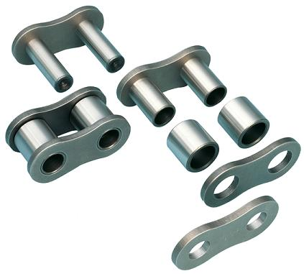
Typical Terminology
Chain Linkage Assembly
A bush assembly is fitted inside of each of the rollers to allow for articulation
Pins
Roller
Inner Link
Outer Link
Chains consist of simple rollers made up of inner and outer plates, rollers, bearing pins and bushes.
They are identified by part numbers laid down in the IPC.

Slide 5

Chain size
Chains are measured by the size of the ‘pitch’, this is simply the distance from the centre of one pin to the next.
Common pitch sizes:
Imperial size | Metric size
3/8” | 9.5 mm
½” | 12.7 mm
5/8” | 15.9 mm
¾” | 19.0 mm
1” | 25.4 mm

Slide 6
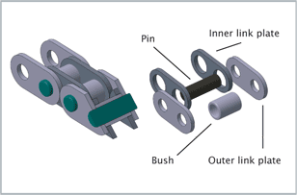
Bush chains
Bush chains are like a standard chains, but they have had the rollers omitted. They have good wear and strength properties in high load applications

Slide 7
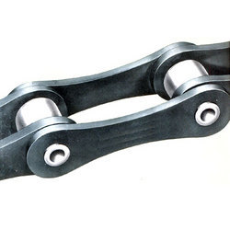
Extended Pitch chains
These have bearing pins, bushes and rollers but unlike a standard chain the length of the plates is twice the pitch. They are used in less onerous applications of speed and load, where the centre distance between sprockets is great and there is a need to keep weight and cost to a minimum.

Slide 8
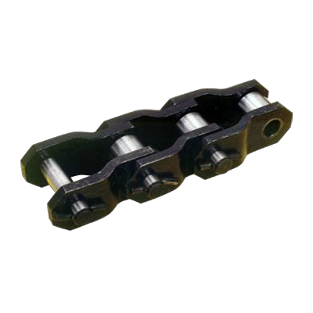
Cranked Link chains
These are heavy duty chains designed to run at low speeds under a great load. They are often used on exposed drives open to the elements.

Slide 9
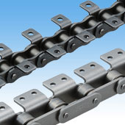
Conveyor chains
These come in a wide range of sizes and designs, both as standard and extended pitch. They have a tab which can be attached as necessary to the conveyor system.

Slide 10
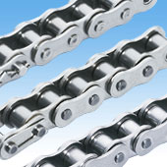
Corrosion Resistant chains
Again, of standard construction, these chains are manufactured using corrosion resistant materials such as aluminium or stainless steel. They are ideal for use in the handling of foodstuffs and pharmaceuticals

Slide 11
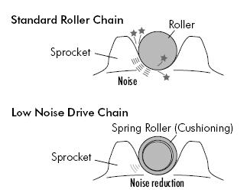
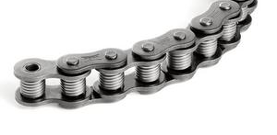
Low Noise chains
These have a spring coil around the bush, as the coil hits the sprocket it deforms and absorbs the force of impact therefore reducing the noise. This type of chain can typically reduce noise by 6-8dB.

Slide 12
Chains and Sprockets
The chain is used to transfer motion from one point, to another remote one.
A typical example would be transferring the input of the pedal to the bike wheel.
Although there are four standard sizes of chain, the type and size used is determined by the manufacturer.
They come complete and proof-loaded to three times the working load ( length and strength checked under tensile loads).

Slide 13
Installation Checks
Normally the chains are connected to cables if they need to travel over long distances.
These connections need inspecting for correct assembly (safety holes in the connectors).
The chain should not be twisted as this puts excessive strain onto it.
The alignment of the chain will need checking to ensure it runs straight onto any sprockets.

Slide 14
Typical arrangements
90⁰
180⁰
Bi-planer
Block
End-connectors
Chains and sprockets are used for a variety of tasks such as:
1) Changing a rotary motion into a linear one.
2) Changing direction of a cable.
3) Changing the plane using a bi-planer block.

Slide 15
Maintenance and Inspection of Chains
Chains are subjected to periodic checks laid down in the AMM (Aircraft Maintenance Modification) handbook.
They are inspected for nicks, wear, lubrication, cleanliness and corrosion.
Wear is confirmed by trying to lift the chain off the pulley and checking for looseness of the links.

Slide 16
Maintenance and Inspection of Chains
A chain can be checked for stretching, by removing it and applying a set tensile load.
If its length is 2% or more longer than when it was fitted, it is replaced in many industries.
One of the most common tasks carried out is checking the tension of the chain…care must be taken not to twist the end fittings when re-tightening the lock nuts.

Slide 17
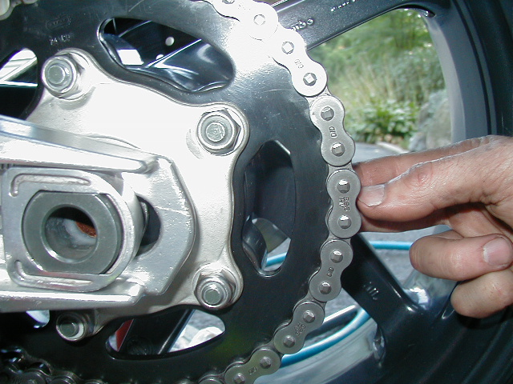
Maintenance and Inspection of Chains
Whilst the chain is on the sprocket, gently lift the chain in the middle point of engagement (obviously do this whilst the drive is stationary!).
If there is anything more than a minimal amount of movement then the chain is possibly too worn.

Slide 18
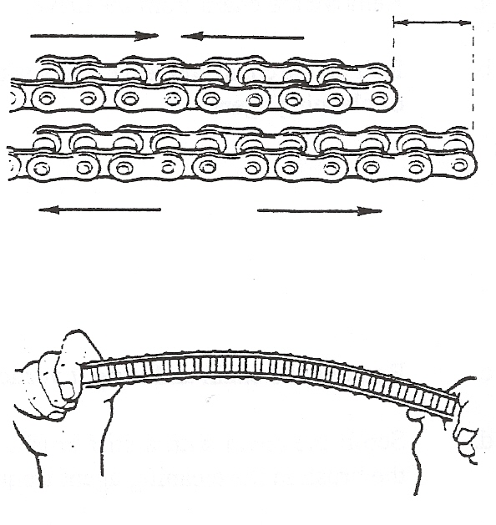
Maintenance and Inspection of Chains
Compare the compressed and stretched lengths of chain. The difference between the lengths indicates the amount of wear.
Compare the stretched-out chain to a new one.
Bend the chain on it’s side, a large amount of bend will indicate excessive wear. (This test is only suitable for simplex chains).

Slide 19
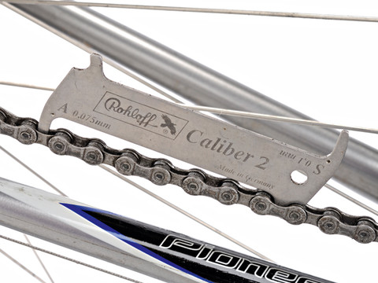
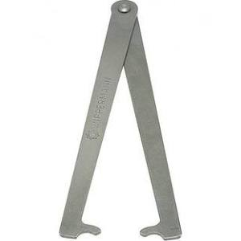
Maintenance and Inspection of Chains
Without the experience of knowing when a chain is worn the only way to truly establish if it needs replacing is to measure it.
There are various chain measuring devices available on the market. These devices are simply compared to the chain in situ and will immediately indicate if a chain is worn or not.

Slide 20
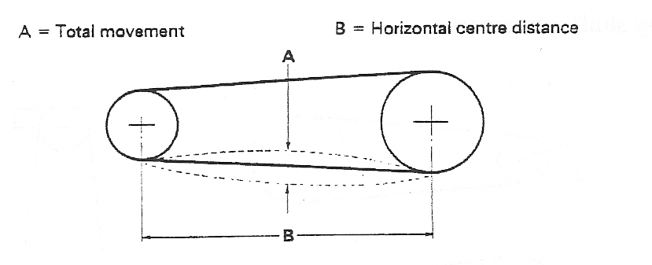
Chain tension
The chain should be adjusted regularly so that with one strand tight the slack strand can be moved a distance' A' at mid point - see diagram below.
Total movement A (mm) = Horizontal centre distance (mm)
K
Where K =25 for smooth drives
=50 for shock drives

Slide 21
Calculate:
The total movement of a smooth drive chain when the centre of the shafts (Horizontal centre distance ) is 850mm.
Total movement A (mm) = Horizontal centre distance (mm)
K
= 34mm
Total movement = 850 mm
25

Slide 22
To work out :
Speed of driven gear in RPM = Speed of driver (RPM) x Number of teeth on driver/ Number of teeth on driven
Calculate:
The ratio when the:
Driver sprocket is 20 tooth
Driven sprocket is 38 tooth
Answer = Ratio 20/38= 10/19
Calculate:
The speed of the driven shaft when the:
Motor is running at 800 rpm
Answer =10/19 x 800 = 416rpm

Slide 23
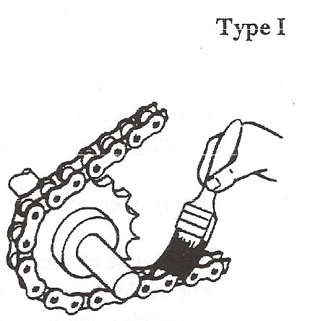
Manual lubrication
Oil is applied periodically with a brush or oil can, preferably once every 8 hours of operation. Volume and frequency should be sufficient to just keep the chain wet with oil and allow penetration of lubricant into the chain joints.

Slide 24
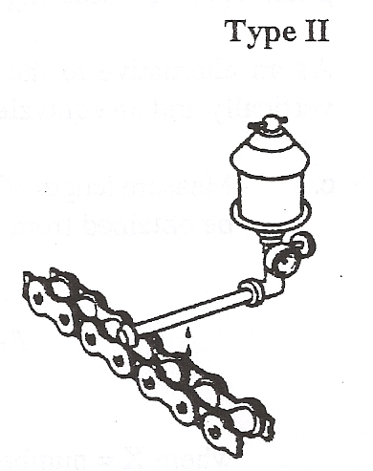
Drip lubrication
Oil drips are directed between the link plate edges from a drip lubricator. Volume and frequency should be sufficient to allow penetration of lubricant into the chain joints.

Slide 25
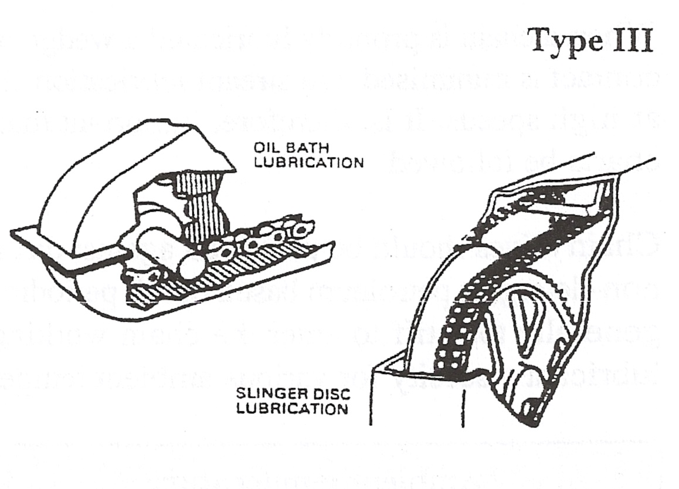
Bath or Disc Lubrication
With oil bath lubrication the lower strand of chain runs through a sump of oil in the drive housing. The oil level should cover the chain at its lowest point whilst operating.

Slide 26
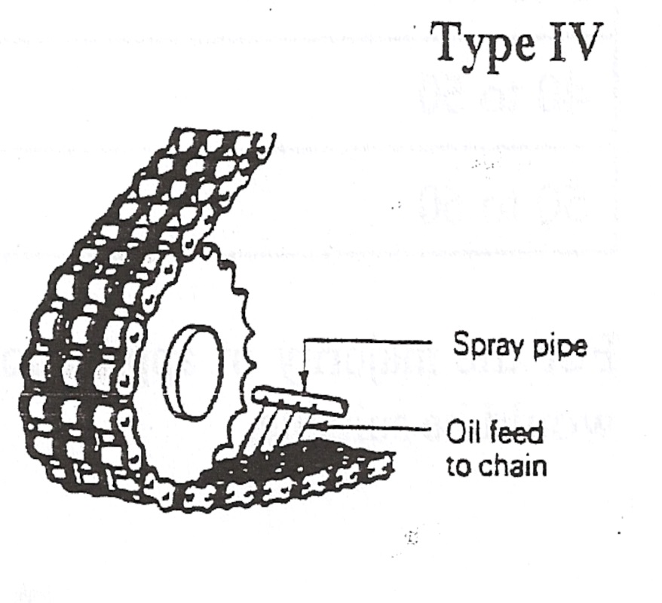
Oil stream lubrication
A continuous supply of oil from a circulating pump or central lubricating system is directed onto the chain.
It is important to ensure that the spray pipe holes, from which the oil emerges, are in line with the chain plate edges.
The spray pipe should be positioned so that the oil is delivered onto the chain just before it engages with the drive wheel. This ensures that the lubricant is forced centrifugally through the chain and assists in cushioning roller impact on the wheel teeth.

Slide 27
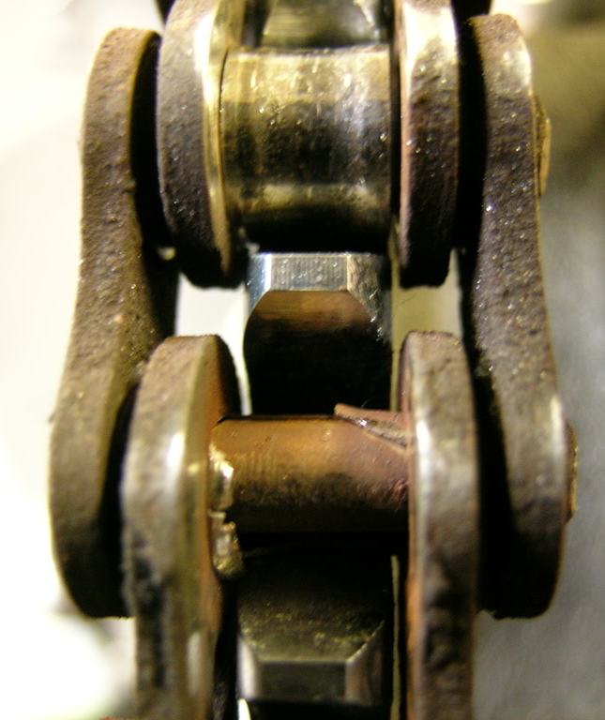
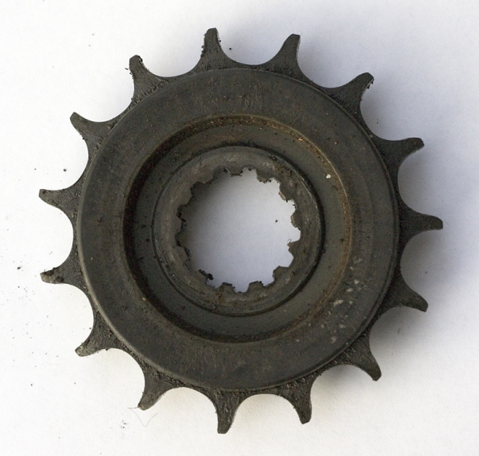
The main cause of chain wear and failure is?
Lack of lubrication

Slide 28
Any Questions
?

