Slide 1
Clutches and Couplings
Couplings and Clutches are power and motion transmission elements.
They’re used to transmit power from one shaft to another shaft.
The brake is a frictional device which is used to control the motion.

Slide 2
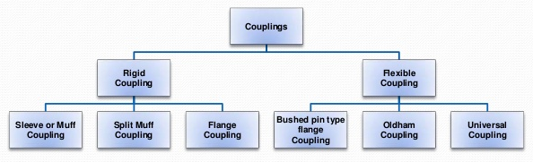
Classification of Couplings

Slide 3
Rigid Couplings
Rigid Couplings are used to connect two shafts which are perfectly in axial alignment.
Sleeve or Muff Coupling
It Is the simplest type of rigid coupling which is made from cast iron.
The hollow cylinder (muff) is fitted over the ends of the two shafts with the help of tapered sunk key.
Difficult to assemble when there is no perfect alignment.

Slide 4
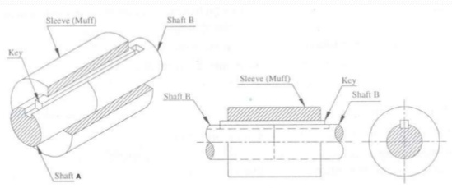
Sleeve or Muff Couplings

Slide 5
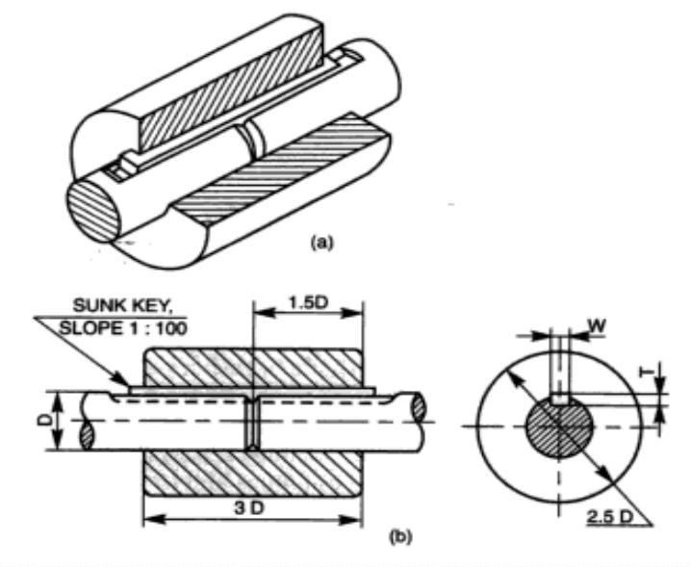

Slide 6
Split Muff Coupling
The muff or sleeve is made into two halves of cast iron.
Both are joined by a nut and bolt.
Assembly and disassembly of the coupling is possible without changing the position of the shaft.
This coupling is used for heavy power transmission at moderate speed.

Slide 7
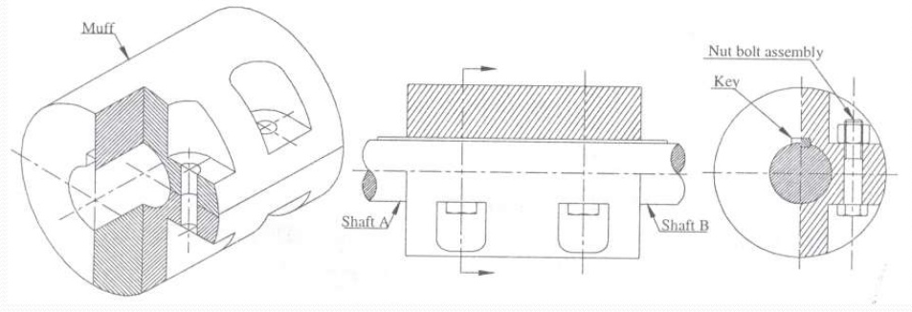
Split and Muff Coupling

Slide 8
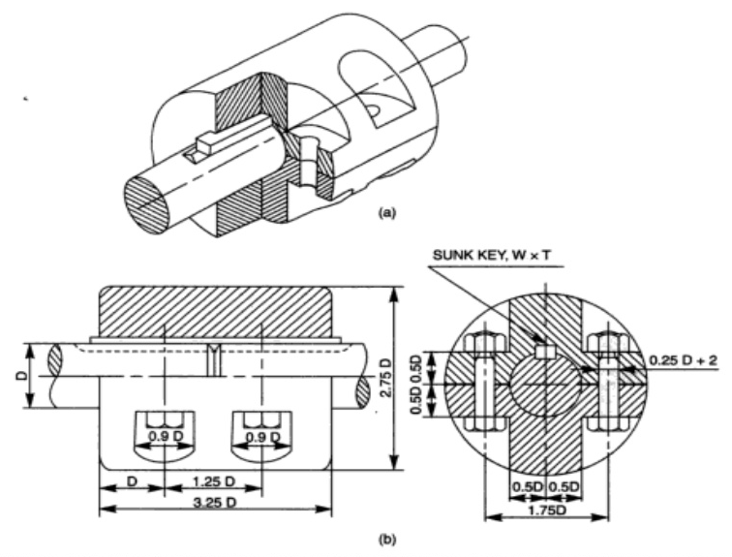

Slide 9
Flange Coupling
This coupling is having two separate cast iron flanges.
The flanges can be of protected type or unprotected type.
The flange couplings are rigid and accurate.
It is used for heavy power transmission at low speed.

Slide 10
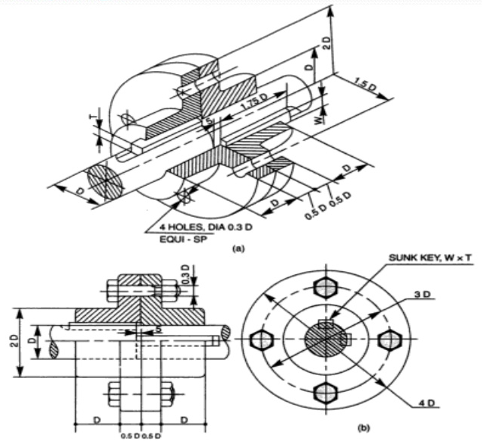
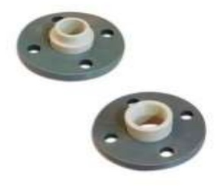

Slide 11
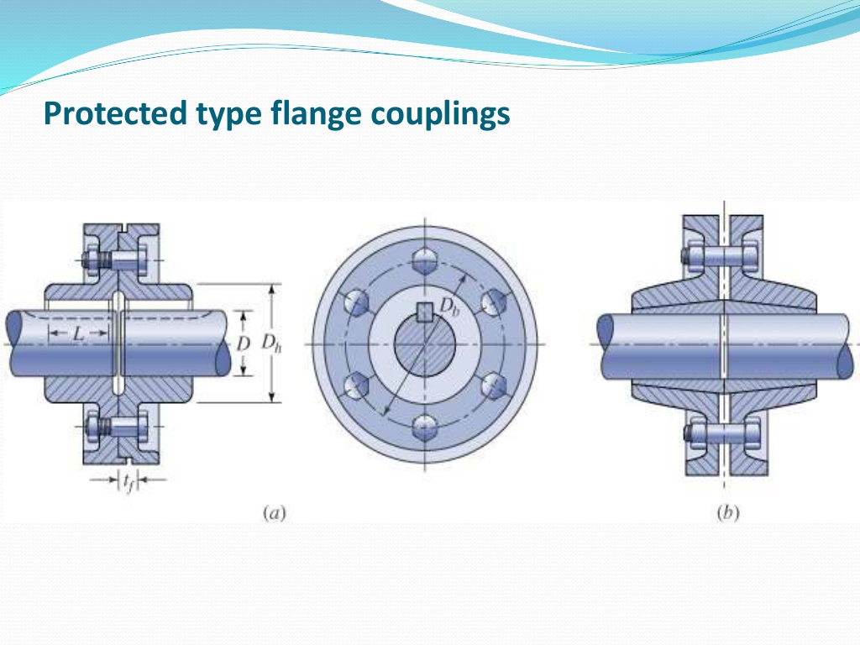
Protected Type Flange Coupling

Slide 12
Flexible Couplings
Flexible couplings are used to protect the driving and driven machines from effect of shocks, excessive stresses due to deflection and vibration which may arise from misalignment of shafts.
Bushed pin type flange coupling
This type of coupling allows for imperfect alignment of two joining shaft.
This coupling has pins which works as a coupling bolt. The rubber or leather bushes are used over pins.
Rubber bush absorbs shocks and vibrations during operation.
It is generally used to couple electric motor and machine.

Slide 13
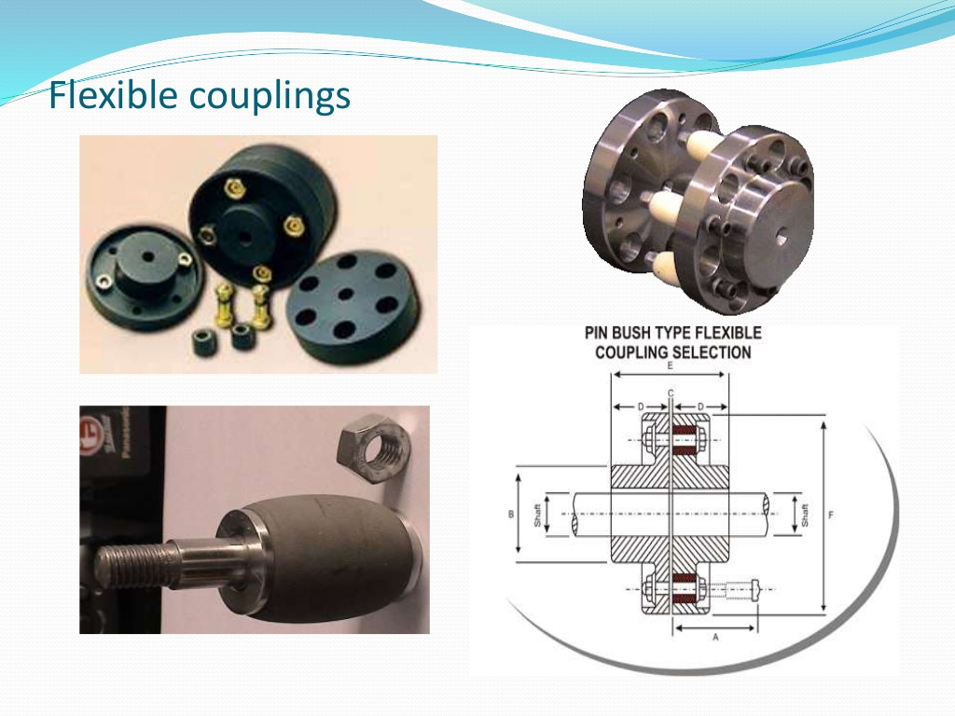
Pin Bush Type Coupling

Slide 14
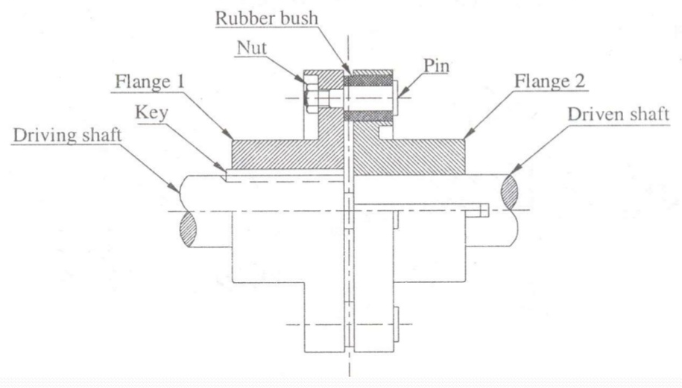
Pin Bush Type Coupling

Slide 15
Oldham’s Coupling
Used to connect two parallel shafts whose axis are a small distance apart.
The flanges have projections and a disc is provided with two slots on both sides which are right angle to each other.
The rotation of the drive shaft causes the rotation and sliding of the disc which transmits the motion and power to the driven shaft.

Slide 16
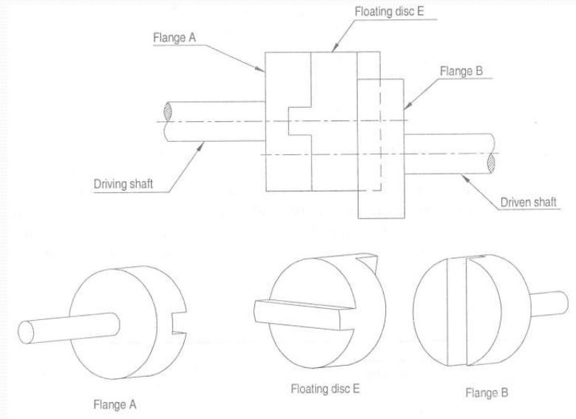

Slide 17
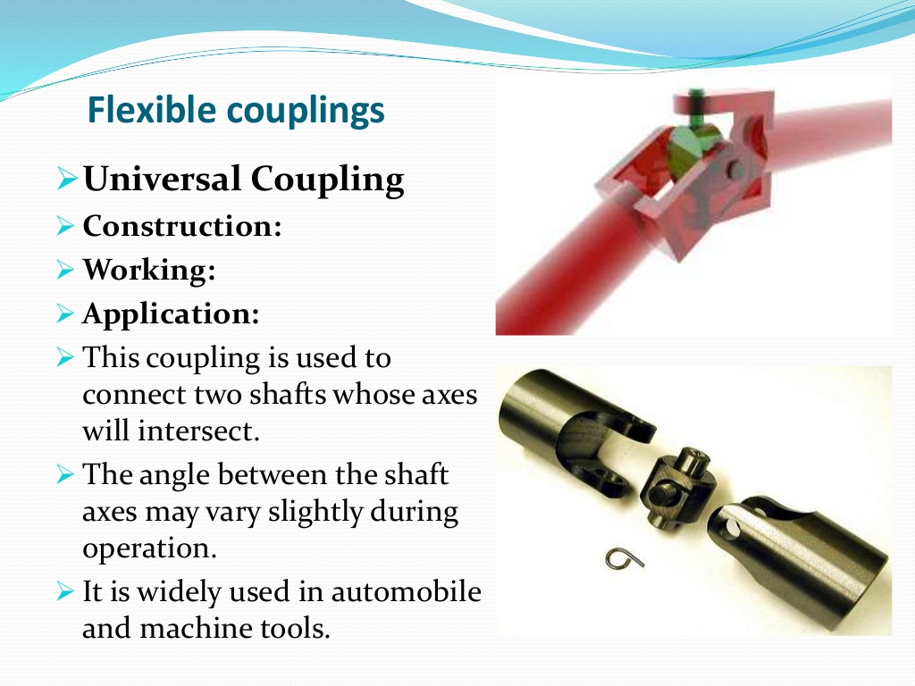
Universal Coupling
This coupling is used to connect two shafts whose axis will intersect.
The angle between the shaft axis may vary slightly during operation.
It is widely used in automobile and machine tools.

Slide 18
