Slide 1
UNED 003
Ymarfer Proffesiynol fel Gweithiwr Blynyddoedd Cynnar a Gofal Plant
UNIT 003
Professional Practice as an Early Years and Childcare Worker

Slide 2
Partneriaethau gwaith effeithiol
Partneriaethau gwaith effeithiol
Uned 003 Ymarfer Proffesiynol fel Gweithiwr Blynyddoedd Cynnar a Gofal Plant
Deilliant dysgu 2
Gwybod sut i feithrin a chynnal partneriaethau gwaith effeithiol ag eraill ym meysydd y blynyddoedd cynnar a gofal plant.
Effective working partnerships
Unit 003 Professional Practice as an
Early Years and Childcare Worker
Learning outcome 2
Know how to develop and maintain effective partnership working with others in early years and childcare.

Slide 3
Yn yr adnodd yma byddwch chi’n dysgu am:
In this resource you will learn about:
MEINI PRAWF
2.1 egwyddorion gweithio mewn partneriaeth ag eraill
2.2 amrywiaeth a rolau gweithwyr a gweithwyr proffesiynol eraill ym meysydd y blynyddoedd cynnar a gofal plant
2.3 pwysigrwydd gwaith amlasiantaethol
2.4 pwysigrwydd meithrin perthnasoedd effeithiol wrth weithio gyda gweithwyr a gweithwyr proffesiynol eraill, gofalwyr a theuluoedd yn ogystal â'r unigolyn
2.5 sut i weithio mewn ffyrdd sy'n meithrin ymddiriedaeth
2.6 pwysigrwydd parchu amrywiaeth a chydnabod gwahaniaethau diwylliannol, crefyddol ac ethnig wrth weithio mewn partneriaeth.
LEARNING OUTCOMES:
2.1 principles of partnership working with others
2.2 the diversity and roles of other early years and childcare professionals and professionals
2.3 the importance of multi-agency working
2.4 the importance of building effective relationships when working with other professionals and professionals, carers and families as well as the individual
2.5 how to work in ways that build trust
2.6 the importance of respecting diversity and recognising cultural, religious and ethnic differences when working in partnership.

Slide 4
ADRAN 1
SECTION 1
Meini Prawf 2.1
egwyddorion gweithio mewn partneriaeth ag eraill
Assessment Criteria 2.1
principles of working in partnership with others

Slide 5
Rhannu gwybodaeth â theuluoedd/gofalwyr
Wrth weithio yn sector y blynyddoedd cynnar a gofal plant, bydd angen mabwysiadu dull o weithio lle mae’n ofynnol i rannu gwybodaeth am anghenion plant a’u teuluoedd/gofalwyr. I sicrhau bod hyn yn digwydd yn effeithiol, bydd angen i bawb ddeall eu rôl a'u cyfrifoldeb er mwyn sicrhau tîm sy’n cyfathrebu’n dda.
Ewch i Adnodd Dysgu gan CBAC ar wefan Dysgu Iechyd Cymru i ddysgu mwy:
Ymarfer Proffesiynol fel Gweithiwr Gofal Plant: Egwyddorion gweithio mewn partneriaeth ag eraill a phwysigrwydd gwaith amlasiantaethol
When working in the early years and childcare sector, it will be necessary to adopt a working method which includes sharing information about the needs of children and their families/carers. In order to ensure that this is effective, everybody will need to understand their role and responsibility to ensure a team that communicates well.
Go to a Learning Resource by WJEC on the Health and Care Learning Wales website to learn more:
Professional Practice as a Childcare Worker: The principles of working in partnership with others and importance of multi-agency working

Slide 6
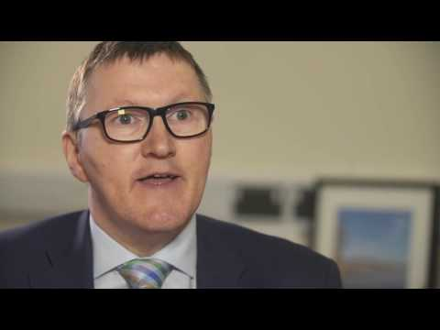
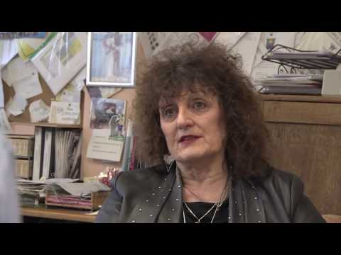
Gweithio gydag asiantaethau eraill
Working with other agencies
The following video clip from the Welsh Government shows the importance of multi-agency team work in supporting children with additional learning needs.
Mae'r clip fideo canlynol gan Lywodraeth Cymru yn dangos pwysigrwydd gwaith tîm aml-asiantaethol wrth gefnogi plant ag anghenion dysgu ychwanegol.

Slide 7
Tasg ar gyfer meini prawf 2.1
Tasg ar gyfer meini prawf 2.1
Disgrifiwch egwyddorion gweithio mewn partneriaeth (principles of working in partnership) ag eraill.
Task for assessment criteria 2.1
Describe the principles of working in partnership with others.

Slide 8
ADRAN 2
SECTION 2
Meini Prawf 2.2
Amrywiaeth a rolau gweithwyr a gweithwyr proffesiynol eraill ym meysydd y blynyddoedd cynnar a gofal plant
Assessment Criteria 2.2
The range and roles of other workers and professionals in early years and childcare

Slide 9
Gweithwyr Proffesiynol
Mae amrywiaeth o weithwyr proffesiynol yn gweithio gyda phlant a’u teuluoedd/gofalwyr. Efallai y gellir gweld mwy nag un ohonynt mewn un lleoliad tra bydd eraill mewn canolfannau arbenigol neu ysbytai.
Ewch i Adnodd Dysgu gan CBAC ar wefan Dysgu Iechyd Cymru i ddysgu mwy:
Ymarfer Proffesiynol fel Gweithiwr Gofal Plant:
Amrywiaeth o rolau gweithwyr a gweithwyr professiynol
A variety of professionals work with children and their families/carers. More than one of these may be seen within the same setting, but others will be based in specialist centres or hospitals.
Go to the Learning Resource by WJEC on the Health and Care Learning Wales website to learn more:
Professional Practice as a Childcare Worker: Range and roles of workers and professionals

Slide 10
Astudiaeth Achos
Case Study
Mae gan Blake, sydd ym Mlwyddyn 6, anawsterau dysgu dwys a lluosog (PMLD) ac anghenion iechyd cymhleth. Yn ei ysgol arbennig ac yn y cartref, mae Blake yng nghanol tîm amlasiantaethol, sy'n cefnogi ei anghenion ac yn ei alluogi i gyflawni a gwneud cynnydd. Yn y clip ar y sleid nesaf, mae gofalwr Blake, staff yr ysgol a'i ffisiotherapydd yn esbonio pam ei bod yn bwysig bod pawb yn gweithio gyda'i gilydd er lles Blake.
Blake, who is in Year 6, has profound and multiple learning difficulties (PMLD) and complex health needs. In his special school and at home, Blake is at the centre of a multi-agency team, which supports his needs and enables him to achieve and make progress. In the clip on the next slide, Blake's carer, school staff and his physiotherapist explain why it is important that everybody works together in Blake's best interest.

Slide 11
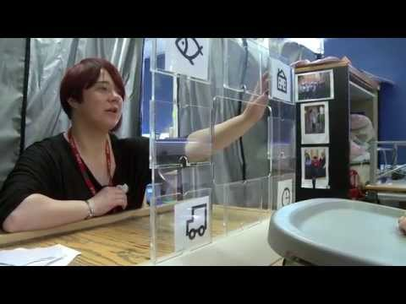
Gwyliwch y clip fideo canlynol gan nasen sy'n dangos y tîm amlasiantaethol sydd yn gweithio gyda Blake.
Watch the following video clip by nasen which shows the multi-disciplinary teams working with Blake.

Slide 12
Tasg ar gyfer meini prawf 2.2
Tasg ar gyfer meini prawf 2.2
a)Esboniwch amrywiaeth (range) a rolau gweithwyr a gweithwyr proffesiynol eraill ym meysydd y blynyddoedd cynnar a gofal plant.
b)Rhestrwch yr holl ymarferwyr allai fod ynghlwm â gofal ac addysg plentyn fel Blake.
Nodwch pwy ydynt a beth yw eu rôl wrth weithio gyda phlentyn. Ymchwiliwch ac ystyriwch eich arsylwadau o’ch profiadau lleoliad gwaith.
Task for assessment criteria 2.2
a)Explain the diversity (range) and roles of other workers and professionals in the areas of the
early years and childcare.
b)List all practitioners who may be involved in the care and education of a child such as Blake.
Identify who they are and what their role is when working with a child Research and explore your observations of your work placement experiences.

Slide 13
ADRAN 3
SECTION 3
Meini Prawf 2.3
Pwysigrwydd gwaith aml-asiantaethol
Assessment Criteria 3.3
The importance of multi-agency working

Slide 14
Cliciwch yma i ddod o hyd i wybodaeth berthnasol ar wefan Dysgu Iechyd Cymru
Gwefan Dysgu Iechyd Cymru
Click here to find relevant information on the Health Learning Wales website
Health Learning Wales website
Defnyddir y term aml-asiantaethol i ddisgrifio'r modd mae lleoliadau gofal plant yn gweithio’n agos gydag eraill i ddiwallu anghenion plant a’u teuluoedd/gofalwyr. Yn ogystal â datblygu sgiliau i weithio gyda phlant, mae angen datblygu strategaethau i allu gweithio gyda rhieni/gofalwyr, cyd-weithwyr a chyd-weithwyr proffesiynol eraill.
Ystyriwch eto’r wybodaeth a gawsoch yn yr adnodd dysgu
Ymarfer Proffesiynol fel Gweithiwr Gofal Plant: Egwyddorion gweithio mewn partneriaeth ag eraill a phwysigrwydd gwaith amlasiantaethol
cyn symud ymlaen i gwblhau’r dasg.
The term multi-agency is used to describe the way childcare settings work closely with others to meet the needs of children and their families/carers. As well as developing skills to work with children, strategies need to be developed to be able to work with parents/carers, colleagues and other professionals.
Consider again the information you received in the learning resource Professional Practice as a Childcare Worker: Principles of working in partnership with others and the importance of multi-agency working before moving on to complete the task.

Slide 15
Tasg ar gyfer meini prawf 2.3
Tasg ar gyfer meini prawf 2.3
a)Esboniwch bwysigrwydd gwaith aml-asiantaethol (multi-agency working).
b)Pam mae hi'n bwysig bod cydweithio da rhwng pob ymarferydd sy'n gweithio gyda phlentyn a’r teulu?
Task for assessment criteria 2.3
a)Explain the importance of multi-agency working.
b)Why is it important that there is good collaboration between all practitioners working with a child and the family?

Slide 16
ADRAN 4
SECTION 4
Meini Prawf 2.4
pwysigrwydd meithrin perthnasoedd effeithiol
wrth weithio gyda gweithwyr a gweithwyr
proffesiynol eraill, gofalwyr a theuluoedd yn
ogystal â'r unigolyn
Assessment Criteria 2.4
the importance of building effective relationships when working with professional workers and other professionals, carers and families as well as the individual

Slide 17
Meithrin Perthnasoedd Effeithiol
Mae datblygu cydberthnasau effeithiol yn caniatáu i bawb weithio gyda’i gilydd yn llwyddiannus gyda’r nod o ddiwallu anghenion plant a’u teuluoedd/gofalwyr.
Mae'r adnodd dysgu ganlynol gan CBAC ar wefan Dysgu Iechyd Cymru yn edrych ar bwysigrwydd meithrin perthnasoedd effeithiol wrth weithio gyda gweithwyr a gweithwyr proffesiynol eraill, gofalwyr a theuluoedd yn ogystal â'r unigolyn
Meithrin perthnasoedd effeithiol wrth weithio gydag eraill a sut i weithio i feithrin ymddiriedaeth
Developing effective relationships allows everybody to work together successfully with the aim of meeting the needs of children and their families/carers.
The following WJEC learning resource on the Health Learning Wales website looks at the importance of building effective relationships when working with professional workers and other professionals, carers and families as well as the individual
Developing good relationships when working with other workers and families/carers in ways that build trust

Slide 18
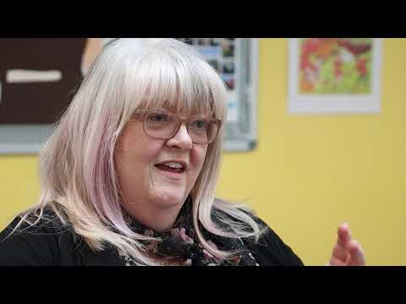
Mae'r fideo byr canlynol yn dangos sut mae Ysgol Palmerston yn Lerpwl, y DU yn defnyddio Tystiolaeth ar gyfer Dysgu gyda’r Dull Ffynnu i ddatblygu plant iach, hapus a hyderus sy'n barod ac yn agored i ddysgu. Mae'r fideo'n edrych ar sut mae Tystiolaeth ar gyfer Dysgu yn hwyluso dull amlasiantaethol gwirioneddol o gefnogi dysgwyr sy'n seiliedig ar ymgysylltu a phroses o Ymchwilio a chydweithredu. Mae'n cynnwys cyfweliadau gyda rhieni yn rhannu eu profiadau ac yn pwysleisio eu safbwyntiau ar ddysgu a lles eu plant a'u dyheadau ar gyfer iechyd ac annibyniaeth gymdeithasol, emosiynol a meddyliol y plentyn.
The following short video shows how Palmerston School in Liverpool, UK is using Evidence for Learning with the Thrive Approach to develop healthy, happy, confident children who are ready and open to learning. The video looks at how Evidence for Learning facilitates a genuine multi-agency approach to supporting learners that is built on engagement and a process of Inquiry and collaboration. It includes interviews with parents sharing their experiences and emphasising their perspectives on their children's learning and well-being and their aspirations for the child's social, emotional and mental health and independence.

Slide 19
Tasg ar gyfer Meini Prawf 2.4
Tasg ar gyfer meini prawf 2.4
Gan ystyried y clip fideo yn ogystal â’ch profiadau o'ch lleoliadau gwaith, beth ydy pwysigrwydd meithrin perthnasoedd effeithiol wrth weithio gyda gweithwyr a gweithwyr proffesiynol eraill, gofalwyr a theuluoedd yn ogystal â'r unigolyn?
Ysgrifennwch eich ateb yn y Llyfryn Gwaith
Task for assessment criteria 2.4
Taking into account the video clip and also your experiences of your work placements, what is the importance of building effective relationships when working with employees and other professionals, carers and families as well as the individual?
Write your answer in the Work Booklet

Slide 20
ADRAN 5
SECTION 5
Meini Prawf 2.5
sut i weithio mewn ffyrdd sy'n meithrin ymddiriedaeth
Assessment Criteria 2.5
how to work in ways that build trust

Slide 21
Bod yn Broffesiynol
Mae’n bwysig bod yn gwrtais a dangos parch gan ystyried teimladau eraill. Yn sgil hyn, bydd gweithwyr yn ennyn ymddiriedaeth eraill. Mae angen bod yn gyfeillgar ond hefyd yn broffesiynol wrth ddelio gyda materion sy’n ymdrin â phlant, pobl ifanc a’u teuluoedd/gofalwyr.
Mae'n hanfodol na fydd unigolion sy’n defnyddio gwasanaethau iechyd a gofal cymdeithasol yn colli'r gallu i ymddiried yn y gweithwyr maen nhw’n dibynnu arnynt nac yn teimlo eu bod wedi'u bradychu.
Ewch i Adnodd Dysgu gan CBAC ar wefan Dysgu Iechyd Cymru i ddysgu mwy:
Ymarfer Proffesiynol fel Gweithiwr Gofal Plant Meithrin perthnasoedd effeithiol wrth weithio gydag eraill a sut i weithio i feithrin ymddiriedaeth
It is important to be polite and to show respect whilst considering other people's feelings. By doing so, workers will gain the trust of others. Workers should be friendly but also professional when dealing with matters concerning children, young people and their families/carers.
It is vital that individuals using health and social care services don’t lose the ability to trust in the workers on whom they depend, and that they don’t feel betrayed by them.
Go to a Learning Resource by WJEC on the Health and Care Learning Wales website to learn more:
Professional Practice as a Childcare Worker Developing good relationships when working with other workers and families/carers in ways that build trust

Slide 22
Tasg ar gyfer meini prawf 2.5
Tasg ar gyfer meini prawf 2.5
Esboniwch sut i weithio mewn ffyrdd sy'n meithrin ymddiriedaeth (build trust)?
Ysgrifennwch eich ateb yn y Llyfryn Gwaith
Task for assessment criteria 2.5
Explain how to work in ways that build trust?
Write down your answer in the Workbook

Slide 23
ADRAN 6
SECTION 6
Meini Prawf 2.6
Pwysigrwydd parchu amrywiaeth a chydnabod gwahaniaethau diwylliannol, crefyddol ac ethnig
wrth weithio mewn partneriaeth.
Assessment Criteria 2.6
The importance of respecting diversity and recognising cultural, religious and ethnic differences when working in partnership

Slide 24
Perthnasau Adeiladol a Chydweithredol
Mae angen i'r berthynas rhwng gofalwyr, teuluoedd/gofalwyr, gweithwyr a phobl broffesiynol fod yn berthynas adeiladol a chydweithredol. Gellir meithrin hyn drwy sicrhau parchu amrywiaeth a chydnabod gwahaniaethau diwylliannol, crefyddol ac ethnig.
The relationship between carers, families, workers and professionals needs to be a constructive and cooperative relationship. This can be developed by ensuring that diversity is respected and acknowledging cultural, religious and ethnic differences.

Slide 25
Nodweddion Angenrheidiol
Mae yna nifer o nodweddion sydd angen i weithwyr eu mabwysiadu megis:
Hunanymwybyddiaeth
Empathi
Sgiliau rhyngbersonol
Adfyfyrio
Diddordeb
Hyblygrwydd a gweithio’n agored
Dibynadwyedd
Ewch i Adnodd Dysgu gan CBAC ar wefan Dysgu Iechyd Cymru i ddysgu mwy: Ymarfer Proffesiynol fel Gweithiwr Gofal Plant
Parchu amrywiaeth a chydnabod gwahaniaethau diwyllianol, crefyddol ac ethnig
Specific characteristics need to be adopted such as:
Self-awareness
Empathy
Interpersonal skills
Reflection
Interest
Flexibility and working openly
Reliability
Go to the Learning Resource by WJEC on the Health and Care Learning Wales website to learn more:
Professional Practice as a Childcare Worker
Respecting diversity and recognizing cultural, religious and ethnic differences

Slide 26
Tasg ar gyfer meini prawf 2.6
Tasg ar gyfer meini prawf 2.6
Esboniwch bwysigrwydd parchu amrywiaeth a chydnabod gwahaniaethau diwylliannol, crefyddol ac ethnig wrth weithio mewn partneriaeth.
Dylech gynnwys arsylwadau a allai fod gennych o'ch lleoliad gwaith.
Ysgrifennwch eich ateb yn y Llyfryn Gwaith
Task for assessment criteria 2.6
Explain the importance of respecting diversity and recognising cultural, religious and ethnic differences when working in partnership.
Include observations you may have from your work placement.
Write your answer in the Workbook

Slide 27
Wrth ddilyn yr adnodd hwn roedd cyfle i chi ddysgu am:
In following this resource there was an opportunity for you to learn about:
2.1 egwyddorion gweithio mewn partneriaeth ag eraill
2.2 amrywiaeth a rolau gweithwyr a gweithwyr proffesiynol eraill ym meysydd y blynyddoedd cynnar a gofal plant
2.3 pwysigrwydd gwaith amlasiantaethol
2.4 pwysigrwydd meithrin perthnasoedd effeithiol wrth weithio gyda gweithwyr a gweithwyr proffesiynol eraill, gofalwyr a theuluoedd yn ogystal â'r unigolyn
2.5 sut i weithio mewn ffyrdd sy'n meithrin ymddiriedaeth
2.6 pwysigrwydd parchu amrywiaeth a chydnabod gwahaniaethau diwylliannol, crefyddol ac ethnig wrth weithio mewn partneriaeth.
2.1 principles of partnership working with others
2.2 the diversity and roles of other early years and childcare professionals and professionals
2.3 the importance of multi-agency working
2.4 the importance of building effective relationships when working with other professionals and professionals, carers and families as well as the individual
2.5 how to work in ways that build trust
2.6 the importance of respecting diversity and recognising cultural, religious and ethnic differences when working in partnership.

