Slide 1
Uned 003 ymarfer proffesiynol
UNED 003
Ymarfer Proffesiynol fel Gweithiwr Blynyddoedd Cynnar a Gofal Plant
UNIT 003
Professional Practice as an Early Years and Childcare Worker

Slide 2
Gweithio fel tim
Gweithio fel Tîm
Uned 003 Ymarfer Proffesiynol fel Gweithiwr Blynyddoedd Cynnar a Gofal Plant
Deilliant dysgu 3
Gwybod sut mae gwaith tîm effeithiol yn cefnogi ymarfer da ym meysydd y blynyddoedd cynnar a gofal plant, chwarae ac iechyd a gofal cymdeithasol (mae elfennau cyfarfodydd tîm yn cyfeirio at y rheini sy'n gweithio mewn tîm ac ni fyddai'n cynnwys y rheini sy'n gweithio ar eu pen eu hunain, e.e. gwarchodwyr plant).
Teamwork
Unit 003 Professional Practice as an Early Years and Childcare Worker
Learning outcome 3
Know how effective team working supports good practice in early years and childcare, play and health and social care (team meeting elements refer to those working within a team and would not include those working alone, e.g. childminders).

Slide 3
Yn yr adnodd yma byddwch chi’n dysgu am:
In this resource you will learn about:
MEINI PRAWF
3.1 Mathau o weithio mewn tîm a strwythur.
3.2 Yr egwyddorion craidd sy'n sail i waith tîm effeithiol
3.3 Y ffordd mae gwaith tîm effeithiol yn cyfrannu at les plant a’u teuluoedd/gofalwyr.
LEARNING OUTCOMES
3.1 Types of team working and structure.
3.2 Core principles that underpin effective team working
3.3 The way effective team working contribute to the well-being of children and their families/carers.

Slide 4
Adran 1 Meini prawf 3.1
ADRAN 1
SECTION 1
Meini Prawf 3.1
mathau o weithio mewn tîm a sut mae timau'n gallu bod yn wahanol o ran strwythur, pwrpas a chyfansoddiad
Assessment Criteria 3.1
types of team working and how teams can be different in regards structure, purpose and composition

Slide 5
Testun deilliant dysgu 3.1
Beth bynnag fo rôl gweithiwr yn y sector blynyddoedd cynnar a gofal plant, bydd yn cynnwys gweithio fel rhan o dîm. Mae angen i weithwyr gofal plant allu gweithio gydag eraill fel aelod o dîm er mwyn i’r lleoliad weithredu'n effeithiol.
Ewch i Adnodd Dysgu gan CBAC ar wefan Dysgu Iechyd Cymru i ddysgu mwy: Mathau o weithio mewn tîm o ran strwythur, pwrpas a chyfansoddiad. Egwyddorion craidd sy’n sail i waith tîm a sut mae’n cyfrannu at les plant, eu teuluoedd/gofalwyr
Whatever the role of a worker in the early years and childcare sector, it will include working as part of a team. Childcare workers need to be able to work with others as a team member for the setting to operate effectively.
Go to a Learning Resource by WJEC on the Health and Care Learning Wales website to learn more: Types of team working and structure, core principles that underpin effective team working and the way they contribute to the well-being of children and their families/carers

Slide 6
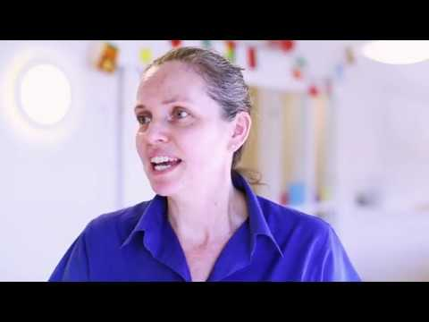
Gweithio gydag asiantaethau eraill
Working with other agencies
Mae'r clip fideo canlynol yn dangos Lizzie sy'n Arweinydd Ystafell Babanod, yn gweithio i Bright Horizons fel rhan o dîm mawr . Mae'n sôn am ei hangerdd, yn gweithio ym maes gofal plant ac yn disgrifio sut beth yw gweithio i Bright Horizons.
The following video shows Lizzie who is a Baby Room Leader, working for Bright Horizons as part of a large team . She talks about her passion, working in childcare and describes what is it like to work for Bright Horizons.
Consider the kind of team Lizzie is part of and make note of who Lizzie would work with.
Ystyriwch y fath o dîm mae Lizzie yn rhan ohono a nodwch pwy fyddai Lizzie yn cydweithio â nhw.​

Slide 7
Clip fideo ar gyfer deilliant dysgu 3.1
Mae'r clip fideo nesaf yn dangos
Canolfan Merched a Theulu Shantona.
Mae'r ganolfan hon yn grymuso merched ac yn cryfhau teuluoedd mewn cymunedau amrywiol yn Leeds.
Gwyliwch y fideo a cheisio nodi’r timau sy’n gweithio gyda’r teuluoedd yn y gymuned.
2020 GSK IMPACT Awards: Shantona Women's and Family Centre - YouTube
The next video clip shows the
Shantona Women’s and Family Centre .
This centre empowers women and strengthens families in diverse communities in Leeds.
Watch the video clip and note down the teams that work with these families in the community
2020 GSK IMPACT Awards: Shantona Women's and Family Centre - YouTube

Slide 8
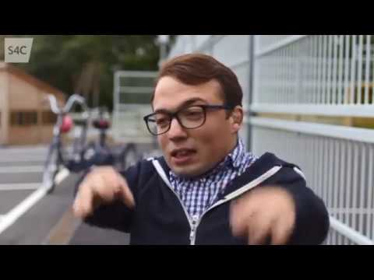
Mae’r drydedd fideo yn dangos Ysgol Hafod Lon. Mae hon yn ysgol ddyddiol ar gyfer plant gydag ystod eang o anghenion ychwanegol. Mae ystod oedran y plant rhwng 3 a 19 mlwydd oed. Mae'r disgyblion sy'n mynychu'r ysgol yn destun datganiad neu yn y broses o gael asesiad statudol ar gyfer datganiad.
The third video shows Ysgol Hafod Lon. This is a daily school for children with a wide range of additional needs.
The age range of children is from 3 to 19 years old. Pupils attending school are subject to a statement or are in the process of obtaining a statutory assessment for a statement.

Slide 9
Tasg ar gyfer 3.1
Tasg ar gyfer meini prawf 3.1
Disgrifiwch fathau o weithio mewn tîm a sut mae timau'n gallu bod yn wahanol o ran strwythur, pwrpas a chyfansoddiad.
Task for assessment criteria 3.1
Describe types of team working and how teams can be different in terms of structure, purpose and composition.

Slide 10
ADRAN 2
SECTION 2
Meini Prawf 3.2
yr egwyddorion craidd sy'n sail i waith tîm effeithiol
Assessment Criteria 3.2
the core principles underpinning effective teamwork

Slide 11
Egwyddorion gweithio mewn tîm
The principles of team working
Mae nifer o egwyddorion i’w hystyried wrth weithio fel rhan o dîm:
cydweithio gyda grŵp o bobl er mwyn cyflawni nod
nod neu amcan cyffredin
pobl yn cydweithio
parchu cydweithwyr
defnyddio sgiliau unigol
cefnogol
cydweithio i ddatrys problemau
rhannu gwybodaeth bwysig a pherthnasol ag aelodau eraill yn y tîm
gwybod pan fo cydweithwyr angen help a chynnig cymorth
pawb yn cyfrannu’n deg i waith y tîm.
There are many principles to consider when working as part of a team:
working together with a group of people in order to achieve a goal
common goal or objective
people working together
respecting colleagues
using individual skills
supportive
working together to solve problems
sharing important and relevant information with other members of the team
knowing when colleagues need help and offering support
everybody contributing fairly to the work of the team.

Slide 12
Ewch i Adnodd Dysgu gan CBAC ar wefan Dysgu Iechyd a Gofal Cymru i ddysgu mwy:
http://resource.download.wjec.co.uk.s3-eu-west-1.amazonaws.com/vtc/2018-19/hsc18-19_3-3/_multi-lang/unit03/01-types-of-teamworking.html?lang=Cy
Go to a Learning Resource by WJEC on the Health and Care Learning Wales website to learn more:
http://resource.download.wjec.co.uk.s3-eu-west-1.amazonaws.com/vtc/2018-19/hsc18-19_3-3/_multi-lang/unit03/01-types-of-teamworking.html?lang

Slide 13
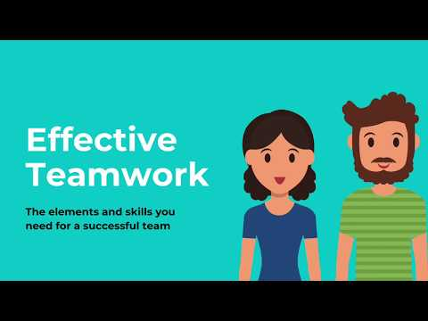
Mae’r clip fideo canlynol gan Childcare Experts sy’n esbonio egwyddorion gwaith tîm a sut mae’n hanfodol bwysig i lwyddiant sefydliad a’r unigolion sy’n perthyn iddo.
The following video clip from Childcare Experts explains the principles of teamwork and how it is vitally important to the success of an organisation and the individuals who belong to it.

Slide 14
Tasg ar gyfer meini prawf 3.2
Esboniwch beth ydy’r egwyddorion craidd sy’n sail i waith tîm effeithiol.
Ymchwiliwch ac ystyriwch eich arsylwadau o’ch profiadau lleoliad gwaith.
Task for assessment criteria 3.2
Explain what the core principles that underpin effective teamwork.
Research and explore your observations from your work placement experiences.

Slide 15
ADRAN 3
SECTION 3
Meini Prawf 3.3
ffyrdd mae gwaith tîm effeithiol yn cyfrannu at les plant, eu teuluoedd/gofalwyr.
Assessment Criteria 3.3
ways in which effective teamwork contributes to the well-being of children, their families/carers.

Slide 16
Mae angen i weithwyr gofal plant allu gweithio gydag eraill fel aelod o dîm er mwyn i’r lleoliad weithredu'n effeithiol. Mae gweithio mewn tîm yn cefnogi gwaith sydd angen gwahanol fathau o sgiliau ac arbenigedd, e.e. tîm o bobl broffesiynol megis arweinydd cylch meithrin, ymwelydd iechyd, therapydd iaith a lleferydd a gweithwyr gofal plant yn cydweithio er mwyn cefnogi plentyn ag anabledd.
Ewch i Adnodd Dysgu gan CBAC ar wefan Dysgu Iechyd Cymru i ddysgu mwy: Egwyddorion gweithio mewn partneriaeth ag eraill a phwysigrwydd gwaith amlasiantaethol
Childcare workers need to be able to work with others as a team member for the setting to operate effectively. Working as a team supports work which requires different types of skills and expertise, e.g. a team of professionals such as a playgroup leader, health visitor, speech and language therapist and childcare workers working together to support a disabled child.
Go to a Learning Resource by WJEC on the Health and Care Learning Wales website to learn more: The principles of working in partnership with others and importance of multi-agency working

Slide 17
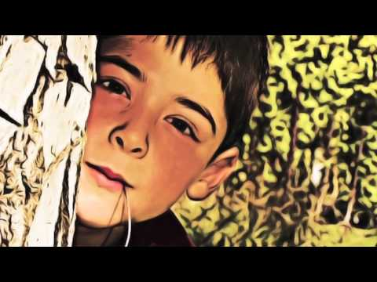
Dyma ffilm fer a grëwyd gan gyngor sir Caerffili sy'n adrodd hanes Justin a'i deulu a sut y gwnaethon nhw, drwy weithio gyda'r tîm o amgylch y teulu, wneud newidiadau cadarnhaol i'w bywydau.
Here is a short film created by Caerphilly county council which tells the story of Justin and his family and how, through working with the team around the family, they made positive changes to their lives.
Think about the impact effective teamwork can have on an individual child and the family.
If there is an opportunity, discuss with your fellow learners. Record your findings.
Meddyliwch am yr effaith gall gwaith tîm effeithiol ei gael ar blentyn unigol a’r teulu.
Os oes cyfle trafodwch gyda'ch cyd-ddysgwyr. Cofnodwch eich canfyddiadau.​

Slide 18
Tasg ar gyfer meini prawf 3.3
Esboniwch ffyrdd mae gwaith tîm effeithiol yn cyfrannu (contributes) at les (well-being) plant, eu teuluoedd/gofalwyr.
Task for assessment criteria 3.3
Explain ways in which effective teamwork contributes to the well-being of children, their families/carers.

Slide 19
Wrth ddilyn yr adnodd hwn roedd cyfle i chi ddysgu am:
In following this resource there was an opportunity for you to learn about:
3.1 Mathau o weithio mewn tîm a strwythur.
3.2 Yr egwyddorion craidd sy'n sail i waith tîm effeithiol
3.3 Y ffordd mae gwaith tîm effeithiol yn cyfrannu at les plant a’u teuluoedd/gofalwyr.
3.1 Types of team working and structure.
3.2 Core principles that underpin effective team working
3.3 The way effective team working contribute to the well-being of children and their families/carers.

