Slide 1
UNED 002
Iechyd, Llesiant, Dysgu a Datblygu
UNIT 002
Health, Well-Being, Learning and Development

Slide 2
Deilliant Dysgu 5
Cefnogi Plant ag Anghenion Dysgu Ychwanegol
Uned 002 Iechyd, Llesiant, Dysgu a Datblygu
Deilliant dysgu 5
Gwybod sut i gefnogi iechyd, llesiant, dysgu a datblygiad plant ag anghenion cefnogi ychwanegol.
Supporting Children with Additional Learning Needs
Unit 002 Health, Well-Being, Learning and Development
Learning outcome 5
Know how to support the health, well-being, learning and development of children with additional support need.

Slide 3
Yn yr adnodd hwn byddwch chi’n dysgu am:
In this resource you will learn about:
MEINI PRAWF ASESU
5.1 fframweithiau cyfreithiol sy'n gymwys i ddarparu gwasanaethau i blant ag anghenion ychwanegol
5.2 y mathau o anghenion cefnogi ychwanegol a allai blant eu cael
5.3 blant mwy abl a thalentog a sut y byddai angen cefnogaeth ychwanegol ar y plant hyn o bosibl
5.4 sut i ddysgu am anghenion cefnogaeth ychwanegol plant
ASSESSMENT CRITERIA
5.1 legal frameworks that apply to the provision of services to children with additional needs
5.2 the types of additional support needs that children may have
5.3 more able and talented children and how these children may require additional support
5.4 how to find out about the additional support needs of children

Slide 4
Byddwch hefyd yn dysgu am:
5.5 egwyddorion cynhwysiant i blant ag anghenion cymorth ychwanegol
5.6 sut i addasu gweithgareddau fel bod pob plentyn yn gallu cymryd rhan
5.5 the principles of inclusion for children with additional support needs
5.6 how to adapt activities to enable all children to take part

Slide 5
Taith Rhiant wrth ddod yn gyfarwydd â gofal am blentyn ag anghenion ychwanegol
Cliciwch y ddolen hon i wylio clip fideo sy’n dangos taith rhiant wrth ddod yn gyfarwydd â gofalu am blentyn ag anghenion ychwanegol: Croeso i’r Iseldiroedd on Vimeo
Ffynhonnell y clip
Mathau o Anghenion Dysgu Ychwanegol – Gwasanaeth Cynhwysiant Sir Benfro (pembsinclusionservice.wales)
https://parentpartnership.pembsinclusionservice.wales/types-additional-learning-needs/
Mae’r Gwasanaethau Partneriaeth Rhieni yn rhoi cymorth a chyngor i rieni â phlant sydd ag Anghenion Dysgu Ychwanegol. Mae gwybodaeth a chyngor ar gael gan dîm penodol sy’n darparu gwybodaeth gywir a niwtral.
Click this link to see a video clip showing a parent's journey in becoming familiar and caring for a child with additional needs:
Welcome to Holland on Vimeo
Source of the clip
Types of Additional Learning Needs - Pembrokeshire Inclusion Service
(pembsinclusionservice.wales)
https://parentpartnership.pembsinclusionservice.wales/types-additional-learning-needs/
Parent Partnership Services provide support and advice to parents whose children have Additional Learning Needs. Information and advice is provided by a dedicated team who provide accurate and neutral information.

Slide 6
ADRAN 1
SECTION 1
Meini Prawf 5.1
fframweithiau cyfreithiol sy'n gymwys i ddarparu gwasanaethau i blant ag anghenion ychwanegol ​
Assessment Criteria 5.1
legal frameworks that apply to the provision of services to children with additional needs​

Slide 7
Deddfwriaeth i ystyried wrth weithio gyda phlant a phobl ifanc ac anghenion ychwanegol.
Legislation to consider when working with children and young people and additional needs.
United Nations Convention on the Rights of the Child (UNCRC)
The Disability Discrimination Act 1995
Education Act 1996
Race Equality (Amendment) Act 2000
Special Learning Needs and Disability Act 2001
Special Educational Needs Code of Practice for Wales 2002
Children Act 2004
Additional Learning Needs and Education Tribunal (Wales) Act 2018
Confensiwn y Cenhedloedd Unedig ar Hawliau’r Plentyn (CCUHP)
Deddf Gwahaniaethu ar Sail Anabledd 1995
Deddf Addysg 1996
Deddf Cydraddoldeb Hiliol (Gwelliant) 2000
Deddf Anghenion Dysgu Arbennig ac Anabledd 2001
Cod Ymarfer Anghenion Addysgol Arbennig Cymru 2002
Deddf Plant 2004
Deddf Anghenion Dysgu Ychwanegol a’r Tribiwnlys Addysg (Cymru) 2018
​

Slide 8
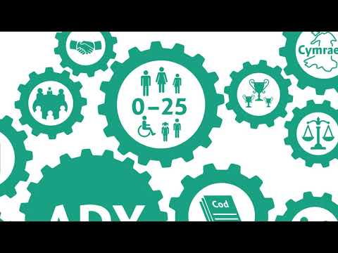
Newidiadau i anghenion ychwanegol
Changes to additional needs
Cliciwch yma i ddysgu mwy:​
Click here to learn more:
Trawsysgrif ar gael​
Transcript available

Slide 9
Newidiadau i anghenion ychwanegol
Changes to additional needs
Cliciwch yma ar gyfer cysylltiad perthnasol i wefan Dysgu Iechyd Cymru -Fframweithiau cyfreithiol | Iechyd, Llesiant, Dysgu a Datblygu (uk.s3-eu-west-1.amazonaws.com)
Click here for a relevant website connection to Health Learning Wales – Legal Frameworks | Health, Wellbeing, Learning and Development (uk.s3-eu-west-1.amazonaws.com)

Slide 10
Tasg Asesu Meini Prawf 5.1
Tasg ar gyfer meini prawf 5.1​
​
5.1 Rhestrwch gan nodi prif bwyntiau fframweithiau cyfreithiol (legal frameworks) sy’n gymwys i ddarparu gwasanaethau i blant ag anghenion ychwanegol (additional needs)
Task for assessment criteria 5.1
5.1 List with the main points of legal frameworks (fframweithiau cyfreithiol) that apply to the provision of services to children with additional needs (anghenion ychwanegol)

Slide 11
ADRAN 2
SECTION 2
Meini Prawf 5.2
y mathau o anghenion cefnogi ychwanegol a allai plant eu cael
Assessment Criteria 5.2
the types of additional support needs that children may have

Slide 12
Anghenion cefnogi ychwanegol
Additional support needs
Cliciwch yma ar gyfer cysylltiad perthnasol i wefan Dysgu Iechyd Cymru- Anghenion cefnogi ychwanegol | Iechyd, Llesiant, Dysgu a Datblygu (uk.s3-eu-west-1.amazonaws.com)
Click here for a relevant website connection to Health Learning Wales - Additional support needs | Health, Wellbeing, Learning and Development (uk.s3-eu-west-1.amazonaws.com)

Slide 13
Gweithgaredd llusgo a gollwng
Drag-and-drop activity
Agorwch y ddolen i gael cynnig ar y gweithgaredd:
Anghenion cefnogi ychwanegol
Llusgwch yr anabledd at y disgrifiad cywir.
Open the link to try the activity.
Additional support needs
Drag the disability to the correct description.

Slide 14
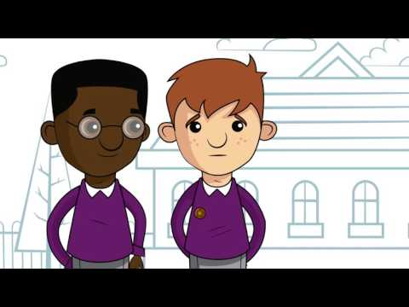
Epilepsy (physical disability)
Epilepsi (anabledd corfforol)
Mae’r clip isod yn trafod epilepsi a’i adwaith ar y plentyn.
Cliciwch yma:
The clip below discusses epilepsy and its reaction on the child.
Click here:

Slide 15
Ewch i wefan Epilepsy Action Cymru am wybodaeth bellach
Visit the Epilepsy Action Cymru website for further information
Beth ydy epilepsi a sut allai effeithio ar blant?
Cliciwch yma:
Plant ag epilepsi | Epilepsy Action
What is epilepsy and how can it affect children?
Click here:
Children with Epilepsy | Epilepsy Action

Slide 16
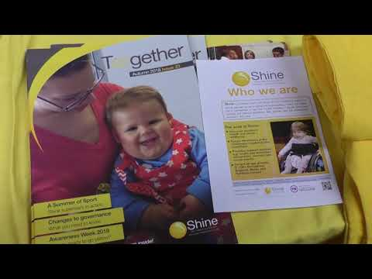
Spina Bifida a hydroceffalws (anabledd corfforol)
Spina Bifida and hydrocephalus (physical disability)
Gwyliwch y clip fideo hwn sydd yn cyflwyno gwaith Shine yn y gymuned. Mae’r fideo yn trafod achosion Spina Bifida a hydroceffalws.
Cliciwch yma:
Watch this video clip which presents Shine's work in the community. The video discusses the cases of Spina Bifida and hydrocephalus.
Click here:

Slide 17
Darllen pellach
Further reading
Cliciwch yma-
https://www.shinecharity.org.uk/downloads/information-in-welsh/walesshine-new-parents-brochure(online).pdf
Click here-
https://www.shinecharity.org.uk/downloads/information-in-welsh/walesshine-new-parents-brochure(online).pdf

Slide 18
Parlys yr ymennydd 'Cerebral Palsy' (anabledd corfforol)
Cerebral Palsy (physical disability)
Gwyliwch y clip fideo i ddarganfod mwy am barlys yr ymennydd (Cerebral palsy)
Cliciwch yma:
Watch the video clip to find out more about cerebral palsy (Parlys yr ymennydd)
Click here:

Slide 19
Tasg
Task
Ewch i wefan Cerebral Palsy Cymru a chasglwch wybodaeth am barlys yr ymennydd
Beth ydy parlys yr ymennydd a sut y gallai effeithio ar blant?
Cliciwch yma-
What is spina bifida? - Shine (shinecharity.org.uk)
Darllen pellach:
Cliciwch yma-
Layout 1 (snapcymru.org)
Visit the Cerebral Palsy Cymru website and collect information on cerebral palsy
What is cerebral palsy and how might it affect children?
Click here-
What is spina bifida? - Shine (shinecharity.org.uk)
Further reading:
Click here-
Layout 1 (snapcymru.org)

Slide 20
Tasg Asesu Meini Prawf 5.2 (rhan 1)
Tasg ar gyfer meini prawf 5.2 (rhan 1)
5.2 Disgrifiwch y mathau o anghenion cefnogi ychwanegol (additional support needs) a fyddai'n gallu bod gan blant.
Ystyriwch anabledd corfforol gan gynnwys gwybodaeth am:
-Parlys yr ymennydd (cerebral palsy)
-Epilepsi (Epilepsy )
-Spina Bifida ac Hydroceffalws
Task for assessment criteria 5.2 (part 1)
5.2 Describe the types of additional support needs that children may have.
Consider a physical disability including information on:
-Cerebral Palsy (parlys yr ymennydd)
-Epilepsy (epilepsi)
-Spina Bifida and Hydrocephalus

Slide 21
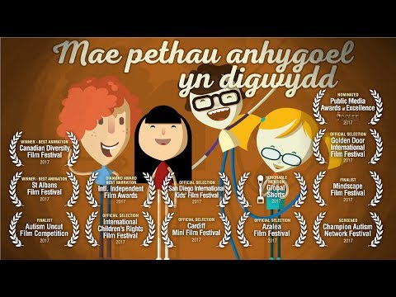
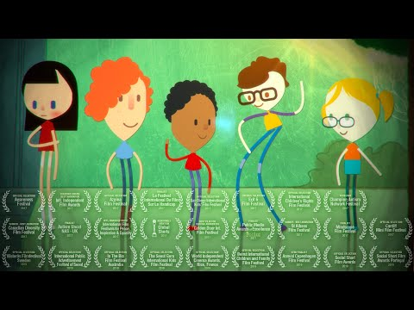
Awtistiaeth 'autism' (anabledd dysgu)
Autism 'awtistiaeth' (learning disability)
Gwyliwch y fideo yma am awtistiaeth
Cliciwch isod:
Watch the following video about autism.
Click below:
Visit the NAS Cymru website and collect information about autism
What is autism and how can you affect the children?
Click here-
What is autism
Ewch i wefan NAS Cymru a chasglwch wybodaeth am awtistiaeth
Beth ydy awtistiaeth a sut y gallai effeithio ar blant?
Cliciwch yma-
What is autism

Slide 22
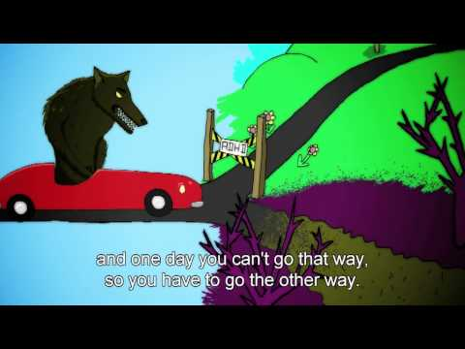
Anhwylder diffyg canolbwyntio a gorfywiogrwydd (ADHD) (anabledd dysgu)
Attention deficit hyperactivity disorder (ADHD) (learning disability)
The video shows the different reaction attention deficit hyperactivity disorder (ADHD) can have on the individual. Click here to view:
Mae’r fideo yn dangos y gwahanol adwaith gall anhwylder diffyg canolbwyntio a gorfywiogrwydd (ADHD) ei gael ar yr unigolyn. Cliciwch yma i weld:

Slide 23
Anhwylder Diffyg Canolbwyntio a Gorfywiogrwydd (ADHD)
Ewch i wefan GIG Cymru i ddarganfod mwy am anhwylder diffyg canolbwyntio a gorfywiogrwydd (ADHD). Beth ydy anhwylder diffyg canolbwyntio a gorfywiogrwydd (ADHD) a sut y gall effeithio ar blentyn.
Cliciwch yma:
NHS 111 Wales - Encyclopaedia : ADHD
Visit the NHS Wales website to find out more about attention deficit hyperactivity disorder (ADHD). What is attention deficit hyperactivity disorder (ADHD) and how it can affect a child.
Click here:
NHS 111 Wales - Encyclopaedia : ADHD

Slide 24
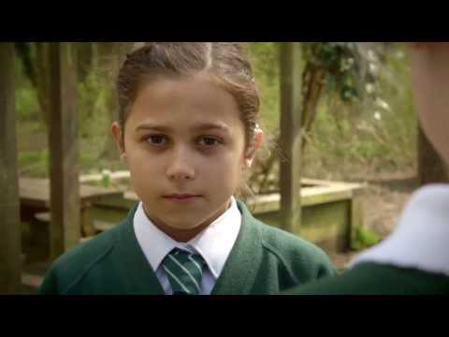
Colli synhwyrau (anabledd dysgu)
Sensory loss (learning disability)
Gwyliwch y fideo hwn i ddarganfod mwy am golli synhwyrau. Ystyriwch beth ydy colli synhwyrau a sut gall effeithio ar blentyn. Cliciwch yma:
Watch this video to find out more about sensory loss.
Consider what sensory loss is and how it can affect a child. Click here:

Slide 25
Cyfathrebu gydag unigolion sydd wedi colli synnwyr
Mae’r adnodd pdf hwn yn egluro sut i gyfathrebu gydag unigolion sydd wedi colli synnwyr.
Cliciwch yma: AOHL Toolkit (Welsh)_0.pdf (rnib.org.uk)
Darllen pellach:
https://www.agored.cymru/Qualification-Guide/163
This pdf resource explains how to communicate with individuals who have lost a sensor.
Click here: AOHL Toolkit (Welsh)_0.pdf (rnib.org.uk)
Further reading:
https://www.agored.cymru/Qualification-Guide/163

Slide 26
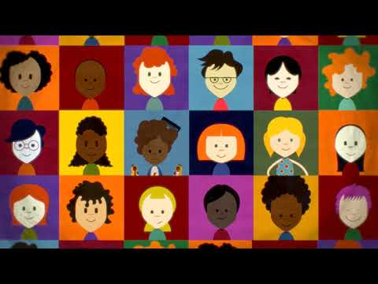
Dyslecsia 'dyslexia' (anabledd dysgu)
Dyslexia 'dyslecsia' (learning disability)
Mae’r wefan yma yn trafod dyslecsia. Cliciwch yma:
This website discusses dyslexia. Click here:

Slide 27
Dyslecsia a’i effaith ar unigolion
Ewch i wefan dyslecsia Cymru i ddarganfod mwy am ddyslecsia. Beth ydy dyslecsia a sut gall effeithio ar unigolyn? Cliciwch yma:
Beth yw Dyslecsia? - Dyslecsia Cymru / Wales Dyslexia
Visit the Welsh dyslexia website to find out more about dyslexia. What is dyslexia and how can it affect an individual? Click here: What is Dyslexia? - Dyslexia Cymru / Wales Dyslexia

Slide 28
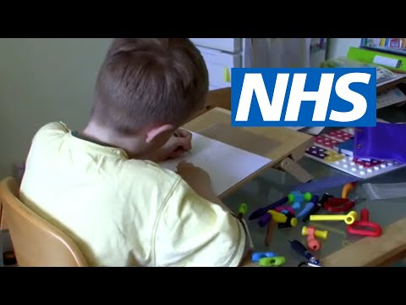
Anhwylder yn natblygiad y cydsymud 'developmental coordination disorder' / Dyspracsia mewn plant (anabledd dysgu)
Developmental coordination disorder 'anhwylder cydsymudiad datblygol' / Dyspraxia in children (learning disability)
Gwyliwch y fideo yma sydd yn trafod Anhwylder yn natblygiad y cydsymud (dyspracsia) mewn plant.
Cliciwch yma:
Watch this video which discusses Developmental coordination disorder (dyspraxia) in children.
Click here:

Slide 29
Dyspracsia: Gwefan GIG Cymru
Ewch i wefan GIG Cymru i ddarganfod mwy am Anhwylder yn natblygiad y cydsymud (dyspracsia) mewn plant. Beth ydy Anhwylder yn natblygiad y cydsymud (dyspracsia) mewn plant, a sut y gall effeithio ar blentyn. Cliciwch yma: NHS 111 Wales - Encyclopaedia : Developmental co-ordination disorder (dyspraxia) in children
Visit the NHS Wales website to find out more about Developmental coordination disorder (dyspraxia) in children.
What is Developmental coordination disorder (dyspraxia) in children, and how it can affect a child. Click here: NHS 111 Wales - Encyclopaedia : Developmental co-ordination disorder (dyspraxia) in children

Slide 30
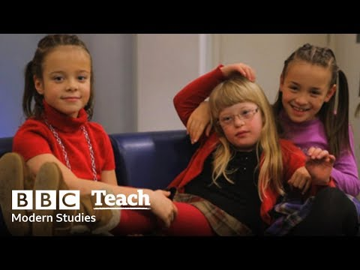
Syndrom Down (newid cromosom)
Down's Syndrome (chromosome change)
Gwyliwch y fideo am stori Alexandra. Cliciwch yma:
Watch the video about Alexandra's story. Click here:

Slide 31
Hands up for Downs
Ewch i wefan 'Hands up for Downs' i ddarganfod mwy am Syndrom Down.
Beth ydy Syndrom Down a sut gall effeithio ar yr unigolyn?
Cliciwch yma:
What is Down's Syndrome? (handsupfordowns.co.uk)
Visit the Hands up for Downs website to find out more about Down's Syndrome.
What is Down's Syndrome and how can it affect the individual?
Click here:
What is Down's Syndrome? (handsupfordowns.co.uk)

Slide 32
Tasg asesu meini prawf 5.2 (rhan 2)
Tasg ar gyfer meini prawf 5.2 (rhan 2)
a)Disgrifiwch y mathau o anghenion cefnogi ychwanegol (types of additional support needs) a fyddai'n gallu bod gan blant.
b) Ystyriwch anghenion dysgu plentyn a’r effaith y gallent ei gael ar yr unigolyn.
Task for assessment criteria 5.2 (part 2)
a)Describe the types of additional support needs (mathau o anghenion cefnogi ychwanegol) that children may have.
b) Consider a child's learning needs and the impact they can have on the individual.

Slide 33
ADRAN 3
SECTION 3
Meini Prawf 5.3
plant mwy abl a thalentog a sut y gallai’r plant hyn fod angen cefnogaeth
Assessment Criteria 5.3
more able and talented children and how these children may require additional support

Slide 34
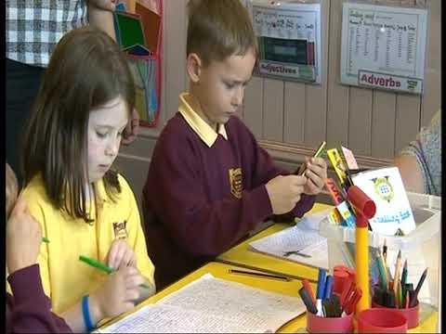
Plant mwy abl a thalentog
More able and talented children
Gwyliwch y clip fideo yma:
Watch the video clip here:

Slide 35
Plant abl a thalentog
Cliciwch yma ar gyfer dolen berthnasol i wefan Dysgu Iechyd Cymru:
Plant abl a thalentog | Iechyd, Llesiant, Dysgu a Datblygu (uk.s3-eu-west-1.amazonaws.com)
Click here for a relevant link to
Health Learning Wales website:
Able and talented children | Health, Well-being, Learning and Development (uk.s3-eu-west-1.amazonaws.com)

Slide 36
Tasg asesu meini prawf 5.3
Tasg ar gyfer meini prawf 5.3 Wrth ystyried plant mwy abl a thalentog sut y byddai angen cefnogaeth ychwanegol ar y plant hyn? Ystyriwch anghenion dysgu plentyn a’r effaith y gallent ei gael ar yr unigolyn.
Task for assessment criteria 5.3
When considering more able and talented children how would these children need additional support?
Consider a child's learning needs and the impact it can have on the individual.

Slide 37
ADRAN 4
SECTION 4
Meini Prawf 5.4
sut i ddysgu am anghenion cefnogaeth ychwanegol plant
Assessment Criteria 5.4
how to find out about the additional support needs of children

Slide 38
Anghenion cymorth ychwanegol plant
Children's additional support needs
Cliciwch yma ar gyfer cysylltiad perthnasol i wefan Dysgu Iechyd Cymru:
Anghenion cymorth ychwanegol plant | Iechyd, Llesiant, Dysgu a Datblygu (uk.s3-eu-west-1.amazonaws.com)
Wrth i chi ddysgu am anghenion cefnogaeth ychwanegol plant, rhaid ystyried Meysydd dysgu a Phrofiadau (AOLE’s) y cwricwlwm Newydd.
Darllenwch y ddogfen yma i ddeall nodau ac amcanion:
Caerphilly well-being plan 2018-2023 (gov.wales)
Click here for a relevant link to Health Learning Wales' website:
Children's additional support | Health, Well-being, Learning and Development (uk.s3-eu-west-1.amazonaws.com)
As you learn about children's additional support needs, the new curriculum Areas of Learning and Experiences (AOLE's) must be considered.
Read this document to understand the aim and objectives of:
Caerphilly well-being plan 2018-2023 (gov.wales)

Slide 39
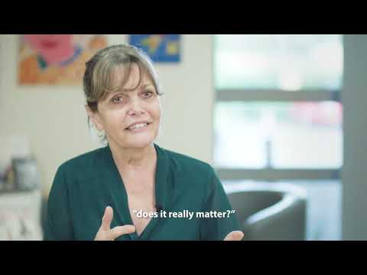
Ysgol Arbennig Crownbridge
Mae ysgol Arbennig Crownbridge yn disgrifio sut mae’r ysgol yn cynllunio i gefnogi anghenion ychwanegol.​
Cliciwch yma i ddysgu mwy:​
Crownbridge Special school describes how the school plans to support additional needs.
Click here to learn more:

Slide 40
Tasg Asesu Meini Prawf 5.4
Tasg ar gyfer meini prawf 5.4
Esboniwch sut i ddysgu am anghenion cefnogaeth ychwanegol plant.
Ystyriwch anghenion dysgu plentyn a’r effaith y gallai ei gael ar yr unigolyn.
Task for assessment criteria 5.4
Explain how to learn about children's additional support needs. Consider a child's learning needs and the effect it can have on the individual.

Slide 41
ADRAN 5
SECTION 5
Meini Prawf 5.5
egwyddorion cynhwysiant i blant ag anghenion cymorth ychwanegol
Assessment Criteria 5.5
the principles of inclusion for children with additional support needs

Slide 42
Cynhwysiant
Disgrifiwch egwyddorion cynhwysiant i blant ag anghenion cymorth ychwanegol.
Cliciwch yma ar gyfer cysylltiad perthnasol i wefan Dysgu Iechyd Cymru:
Egwyddorion cynhwysiant | Iechyd, Llesiant, Dysgu a Datblygu (uk.s3-eu-west-1.amazonaws.com)
Describe the principles of inclusion for children with additional support needs.
Click here for a relevant website connection to Health Learning Wales:
Principles of inclusion | Health, Well-being, Learning and Development (uk.s3-eu-west-1.amazonaws.com)

Slide 43
Cynhwysiant- darganfod mwy
Cliciwch y ddolen yma i ddarganfod mwy am gynhwysiant i blant ag anghenion cymorth ychwanegol:
Cynhwysiant - Mudiad Meithrin
Darllen pellach:
Amdanom ni - Anabledd Dysgu Cymru (ldw.org.uk)
Click this link to find out more about inclusion for children with additional support needs:
Inclusion - Mudiad Meithrin
Further reading:
About us - Learning Disability Wales (ldw.org.uk)

Slide 44
Tasg Asesu Meini Prawf 5.5
Tasg ar gyfer meini prawf 5.5
Disgrifiwch egwyddorion cynhwysiant (principles of inclusion) i blant ag anghenion cymorth ychwanegol.
Task for assessment criteria 5.5
Describe the principles of inclusion (egwyddorion cynhwysiant) for children with additional support needs.

Slide 45
ADRAN 6
SECTION 6
Meini Prawf 5.6
sut i addasu gweithgareddau fel bod pob plentyn yn gallu cymryd rhan.
Assessment Criteria 5.6
how to adapt activities to enable all children to take part.

Slide 46
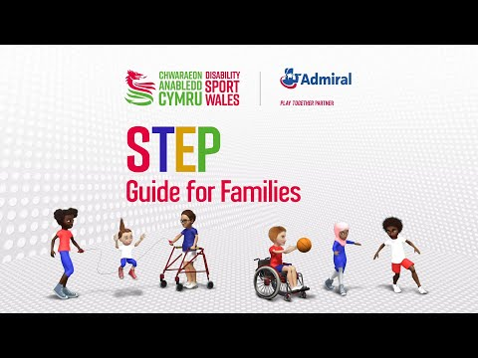
Sut y gall lleoliad addasu gweithgareddau fel bod pob plentyn yn gallu cymryd rhan?
How can a setting adapt activities so that all children can participate?
Cliciwch yma: ​
Click here:

Slide 47
Addasu Gweithgareddau
Cliciwch yma ar gyfer cysylltiad perthnasol i wefan Dysgu Iechyd Cymru:
Addasu gweithgareddau | Iechyd, Llesiant, Dysgu a Datblygu (uk.s3.amazonaws.com)
Darllen pellach: Parties and Playdates (rnib.org.uk)
Click here for a relevant connection to Health Learning Wales' website:
Adapting activities | Health, Well-being, Learning and Development (uk.s3.amazonaws.com)
Further reading: Parties and Playdates (rnib.org.uk)

Slide 48
Tasg Asesu Meini Prawf 5.6
Tasg ar gyfer meini prawf 5. 6
Esboniwch sut y gall lleoliad addasu gweithgareddau (adapt activities) fel bod pob plentyn yn gallu cymryd rhan.
Task for assessment criteria 5.6
Explain how a setting can adapt activities (addasu gweithgareddau) so that all children can participate.

Slide 49
Wrth ddilyn yr adnodd yma roedd cyfle i chi ddysgu am:
In this resource there was opportunity to learn about:
MEINI PRAWF ASESU
5.1 fframweithiau cyfreithiol sy'n gymwys i ddarparu gwasanaethau i blant ag anghenion ychwanegol
5.2 y mathau o anghenion cefnogi ychwanegol a allai blant eu cael
5.3 blant mwy abl a thalentog a sut y byddai angen cefnogaeth ychwanegol ar y plant hyn o bosibl
5.4 sut i ddysgu am anghenion cefnogaeth ychwanegol plant
ASSESSMENT CRITERIA
5.1 legal frameworks that apply to the provision of services to children with additional needs
5.2 the types of additional support needs that children may have
5.3 more able and talented children and how these children may require additional support
5.4 how to find out about the additional support needs of children

Slide 50
Wrth ddilyn yr adnodd yma roedd cyfle i chi ddysgu am:
In this resource there was opportunity to learn about:
5.1 fframweithiau cyfreithiol sy'n gymwys i ddarparu gwasanaethau i blant ag anghenion ychwanegol
5.2 y mathau o anghenion cefnogi ychwanegol a allai blant eu cael
5.3 blant mwy abl a thalentog a sut y byddai angen cefnogaeth ychwanegol ar y plant hyn o bosibl
5.4 sut i ddysgu am anghenion cefnogaeth ychwanegol plant
5.1 legal frameworks that apply to the provision of services to children with additional needs
5.2 the types of additional support needs that children may have
5.3 more able and talented children and how these children may require additional support
5.4 how to find out about the additional support needs of children

Slide 51
Yn ogystal â:
5.5 egwyddorion cynhwysiant i blant ag anghenion cymorth ychwanegol
5.6 sut i addasu gweithgareddau fel bod pob plentyn yn gallu cymryd rhan
5.5 the principles of inclusion for children with additional support needs
5.6 how to adapt activities to enable all children to take part

