Slide 1
Sleid teitl
UNED 001
Egwyddorion a Gwerthoedd Gofal, Chwarae, Dysgu a Datblygiad Plant (0-19 oed)
UNIT 001
Principles and Values of Children's Care, Play, Learning and Development (0-19 years)

Slide 2
Diffiniad Uned 1, deilliant dysgu 10
Dulliau cadarnhaol i gefnogi ymddygiad plant.
Uned 001 Egwyddorion a Gwerthoedd Gofal, Chwarae, Dysgu a Datblygiad Plant (0-19 oed)
Deilliant dysgu 10
Gwybod sut mae'n bosibl defnyddio dulliau cadarnhaol i gefnogi ymddygiad cadarnhaol plant.
Positive approaches to support children's behaviour.
Unit 001 Principles and Values of Children's Care, Play, Learning and Development (0-19 years)
Learning outcome 10
Know how it is possible to use positive methods to support children's positive behaviour.

Slide 3
Yn yr adnodd yma byddwch chi’n dysgu am:
In this resource you will learn about:
MEINI PRAWF
10.1 ystyr y termau 'dulliau cadarnhaol' a 'chefnogi ymddygiad cadarnhaol’
10.2 yr achosion sylfaenol sy'n effeithio ar
ymddygiad plant
10.3 pwysigrwydd gweithio gyda phlant, eu
teuluoedd, gofalwyr ac eraill er mwyn nodi a chytuno ar nodau cyflawnadwy a ffiniau a fydd yn cefnogi ymddygiad cadarnhaol
10.4 pwysigrwydd defnyddio dulliau ac
ymatebion cyson gyda phlant er mwyn cefnogi
ymddygiad cadarnhaol
10.5 y sgiliau a'r technegau sy'n gallu cael eu defnyddio i gefnogi ac annog ymddygiad cadarnhaol plant.
LEARNING OUTCOMES:
10.1 what is meant by the terms ‘positive approaches’ and ‘positive behaviour support’
10.2 underlying causes that have an effect on the behaviour of children
10.3 the importance of working with children, their families/carers and others to identify and agree achievable goals and boundaries that will support positive behaviour
10.4 the importance of using consistent approaches and responses with children to support positive behaviour
10.5 the skills and techniques that can be used to support and encourage childrens’ positive behaviour

Slide 4
ADRAN 1
SECTION 1
Meini Prawf 10.1
ystyr y termau' dulliau cadarnhaol' a 'chefnogi ymddygiad cadarnhaol’
Assessment Criteria 10.1
the meaning of the terms 'positive approaches’ and 'supporting positive behaviour'

Slide 5
Dulliau cadarnhaol o gefnogi ymddysgiad
Dulliau Cadarnhaol o Gefnogi Ymddygiad
Positive Approaches to Supporting Behaviour
Wrth i’r ymarferwr ddatblygu perthynas bositif gyda’r plant yn eu gofal bydd yn sicrhau bod y plentyn yn ganolog i unrhyw benderfyniadau a wneir. Bydd perthynas dda rhwng dulliau cadarnhaol a rhagweithiol ac ymarfer plentyn canolog yn sicrhau bod ymddygiad yn cael ei reoli yn effeithiol a bod y plentyn yn gwybod yr hyn a ddisgwylir ohono.
Ewch i Adnodd Dysgu gan CBAC ar wefan Dysgu Iechyd Cymru i ddysgu mwy: Dulliau cadarnhaol o gefnogi ymddygiad yn y blynyddoedd cynnar: Egwyddorion cefnogi plant i ddatblygu ymddygiad cadarnhaol
As the practitioner develops a positive relationship with the children in their care, they will place the child at the centre of any decisions made. A good relationship between positive and proactive approaches and child-centred practice will ensure that behaviour is managed effectively and that the child knows what is expected of them.
Go to a Learning Resource by WJEC on the Health and Care Learning Wales website to learn more:
Positive approaches to supporting behaviour in the early years: Principles of supporting children to develop positive behaviour

Slide 6
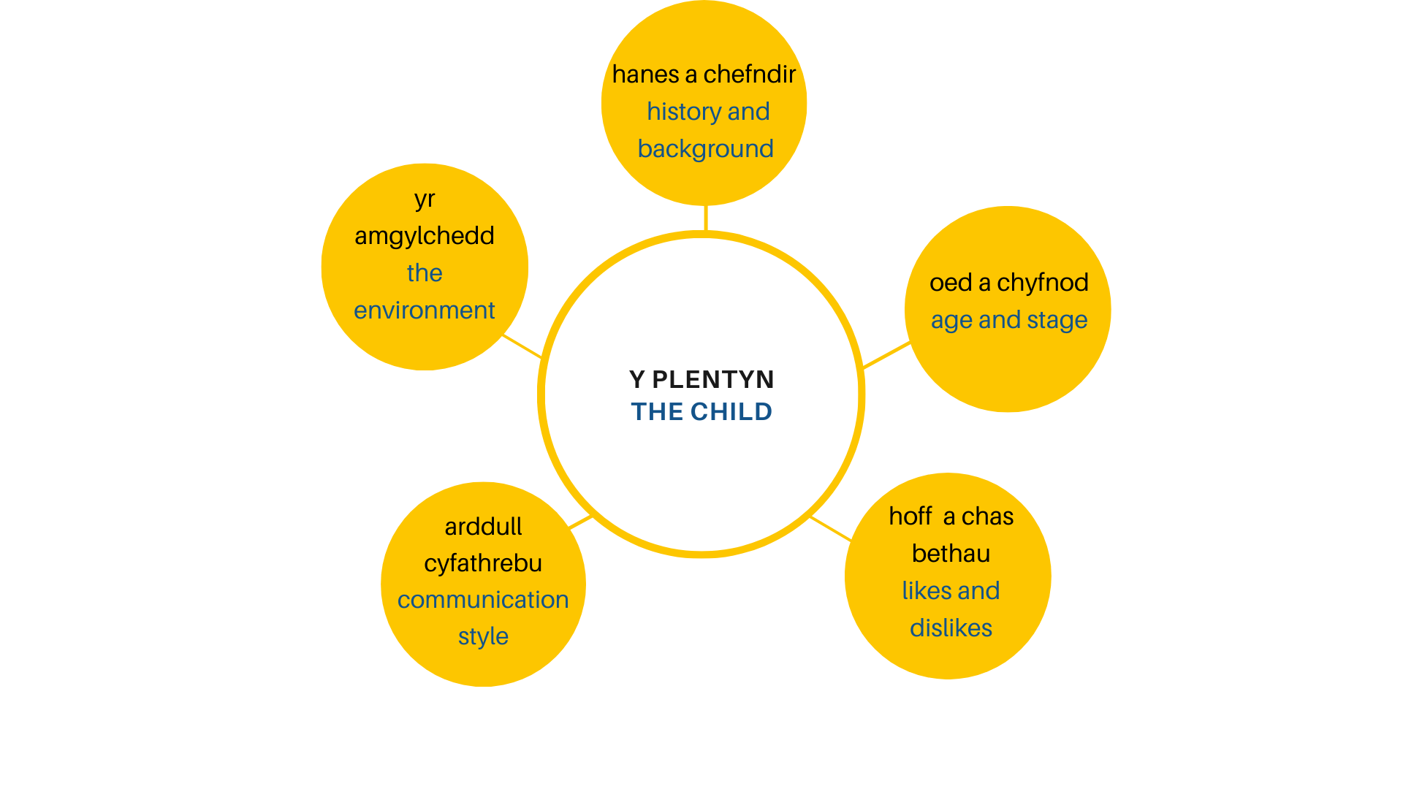
Er mwyn cefnogi ymddygiad cadarnhaol plentyn rhaid adnabod y plentyn yn dda.
To support a child's positive behaviour you must get to know the child well

Slide 7
Cynnwys sy’n cyflwyno deiliant 10.1
Mae plant yn dangos eu teimladau trwy eu hymddygiad ac fe fyddant yn dangos ymddygiad heriol os na fydd eu hanghenion yn cael eu cwrdd. Wrth ddatblygu perthynas dda gyda’r plant mae’r gweithwyr yn gallu dod i’w hadnabod.
Mae’r wybodaeth ganlynol yn bwysig i'w gwybod:
Hanes a Chefndir
Hoff a chas bethau
Oed a chyfnod y plentyn
Arddull Cyfathrebu
Yr amgylchedd
Children express their feelings through their behaviour and exhibit behaviours which challenge if their needs are not met. By developing good relationships with children the workers can get to know them as individuals.
The following information is important to know:
History and background
Likes and dislikes
Age and stage of the child
Communication Style
The environment

Slide 8
Cefnogi ymddygiad cadarnhaol plant
Supporting children’s positive behavior
Gwyliwch y fideo gan Y Seicolegydd Addysg Dr Nicola Canale ar sut i ymateb i ymddygiad plant.
Watch the video by Educational Psychologist Dr Nicola Canale on responding to children’s behaviours.

Slide 9
Tasg 10.1
Tasg ar gyfer meini prawf 10.1​
Esboniwch ystyr y termau :
'dulliau cadarnhaol (‘positive approaches’)
a 'chefnogi ymddygiad cadarnhaol (positive behaviour support) ’
Ymchwiliwch ac ystyriwch eich arsylwadau o’ch profiadau lleoliad gwaith.
Task for assessment criteria 10.1
Explain the meaning of the terms :
a. 'positive approaches’
b. and 'supporting positive behaviour'
Research and explore your observations of your work placement experiences.

Slide 10
ADRAN 2
SECTION 2
Meini Prawf 10.2
yr achosion sylfaenol sy'n effeithio ar ymddygiad plant
Assessment Criteria 10.2
the underlying causes affecting children’s behaviour

Slide 11
Cynnwys ar gyfer 10.2
Mae llawer o ffactorau sy'n helpu i esbonio pam mae plant a phobl ifanc yn ymddwyn yn wahanol, hyd yn oed os yw'n ymddangos eu bod yn yr un sefyllfa ac yn cael yr un profiadau, er enghraifft ffactorau personol neu amgylcheddol.
Ewch i Adnodd Dysgu gan CBAC ar wefan Dysgu Iechyd Cymru i ddysgu mwy:
Egwyddorion a gwerthoedd iechyd a gofal cymdeithasol (plant a phobl ifanc): Achosion sylfaenol a all effeithio ar ymddygiad plant a phobl ifanc
There are many factors which help to explain why children and young people behave differently even when apparently in the same situation and seem to be having the same experiences, for example personal or environmental factors.
Go to a Learning Resource by WJEC on the Health and Care Learning Wales website to learn more:
Principles and values of health and social care (children and young people): Underlying causes that may affect the behaviour of children and young people

Slide 12
Tasg 10.2
Tasg ar gyfer meini prawf 10.2
Rhestrwch gydag esboniad yr achosion sylfaenol sy'n effeithio ar ymddygiad plant
Egwyddorion a gwerthoedd iechyd a gofal cymdeithasol (plant a phobl ifanc): Achosion sylfaenol a all effeithio ar ymddygiad plant a phobl ifanc
Task for assessment criteria 10.2
List with an explanation the underlying causes that have an effect on the behaviour of children
Principles and values of health and social care (children and young people): Underlying causes that may impact upon behaviour of children and young people

Slide 13
ADRAN 3
SECTION 3
Meini Prawf 10.3
pwysigrwydd gweithio gyda phlant, eu teuluoedd, gofalwyr ac eraill er mwyn nodi a chytuno ar nodau cyflawnadwy a ffiniau a fydd yn cefnogi ymddygiad cadarnhaol
Assessment Criteria 10.3
the importance of working with children, their families, carers and others to identify and agree achievable goals and boundaries that will support positive behaviour

Slide 14
Gweithio gyda theuluoedd
Working with families
Wrth gefnogi ymddygiad plant bydd angen mabwysiadu dull o weithio lle mae’n ofynnol i gydweithio â theuluoedd/gofalwyr, cydweithwyr a gweithwyr proffesiynol eraill. Er mwyn sicrhau bod ymddygiad yn cael ei gefnogi yn effeithiol, bydd angen i bawb ddeall eu rolau a'u cyfrifoldebau.
Ewch i Adnodd Dysgu gan CBAC ar wefan Dysgu Iechyd Cymru i ddysgu mwy:
Dulliau cadarnhaol o gefnogi ymddygiad yn y blynyddoedd cynnar: Cydweithio ag eraill i gefnogi ymddygiad
Supporting children's behaviour will require adopting an approach that requires working with families/carers, colleagues and other professionals. To ensure that behaviour is supported effectively, everyone will need to understand their roles and responsibilities.
Go to a Learning Resource by WJEC on the Health and Care Learning Wales website to learn more:
Positive approaches to behaviour support in the early years: Working with others to support behaviour

Slide 15
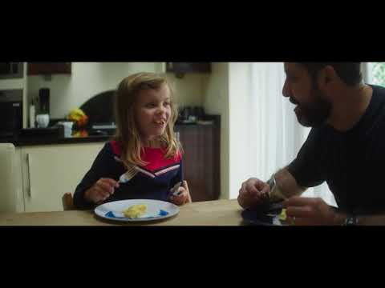
Magu Plant. Rhowch amser iddo.
Parenting. Give it time.
Mae magu plant yn gallu bod yn anodd. Gwyliwch y fideo Magu Plant. Rhowch amser iddo gan Lywodraeth Cymru.
Mae gwybodaeth sy’n cyd-fynd ag ymgyrch y llywodraeth ar eu gwefan:
http://llyw.cymru/rhowchamseriddo.
Os oes cyfle trafodwch gyda'ch cyd-ddysgwyr. Cofnodwch eich canfyddiadau.​
Parenting can be difficult. Watch the video. Parenting. Give it time from the Welsh Government.
Information that coincides with the government's campaign can be on their website:
http://llyw.cymru/rhowchamseriddo.
If there is an opportunity to discuss with your fellow learners. Record your findings.

Slide 16
Tasg 10.3
Tasg ar gyfer meini prawf 10.3
Esboniwch bwysigrwydd gweithio gyda phlant, eu teuluoedd, gofalwyr ac eraill er mwyn nodi a chytuno ar nodau cyflawnadwy a ffiniau a fydd yn cefnogi ymddygiad cadarnhaol.
Task for assessment criteria 10.3
Explain the importance of working with children, their families, carers and others to identify and agree achievable goals and boundaries that will support positive behaviour

Slide 17
ADRAN 4
SECTION 4
Meini Prawf 10.4
pwysigrwydd defnyddio dulliau ac ymatebion cyson gyda phlant er mwyn cefnogi ymddygiad cadarnhaol
Assessment Criteria 10.4
the importance of using consistent methods and responses with children to support positive behaviour

Slide 18
Cynnwys ar gyfer 10.4
Mae angen i’r lleoliad a’r cartref weithio mewn partneriaeth er mwyn hyrwyddo ymddygiad positif, gan gymryd camau i atal ymddygiad negyddol, i atgyfnerthu rheolau’r lleoliad ac i gefnogi’r ysgol pan fydd angen cosbi plentyn neu berson ifanc.
Oherwydd hyn bydd plant yn derbyn negeseuon cyson am sut i ymddwyn yn gadarnhaol yn y lleoliad ac yn y cartref.
Ewch i Adnodd Dysgu gan CBAC ar wefan Dysgu Iechyd Cymru i ddysgu mwy:
Dulliau cadarnhaol o gefnogi ymddygiad yn y blynyddoedd cynnar: Cefnogi plant i ddatblygu ymddygiad cadarnhaol mewn ffordd sy’n briodol i’w hoedran a’i cyfnod datblygiad
Both the setting and the home need to work in partnership to promote positive behaviour, taking steps to prevent negative behaviour, to reinforce the setting's rules and to support the school when a child or young person has to be punished.
Due to this, children will receive consistent messages about how to behave positively in the setting and at home.
Go to a Learning Resource by WJEC on the Health and Care Learning Wales website to learn more:
Positive approaches to behaviour support in the early years: Supporting children to develop positive behaviour in a way that is appropriate to their age and stage of development

Slide 19
Canmoliaeth
Praise
Mae canmol yn help i feithrin perthynas dda rhwng oedolion a phlant.
Mae ymchwil wedi dangos bod gan blant sy’n agos at riant, ac sydd â pherthynas gefnogol dda gyda theulu fwy o hunanhyder ac maen nhw’n fwy llwyddiannus yn yr ysgol a thu hwnt.
Darllenwch y wybodaeth ganlynol ar wefan Magu Plant. Rhowch Amser iddo gan Lywodraeth Cymru. Maen nhw'n sôn am bwysigrwydd canmoliaeth ac yn cynnig awgrymiadau ar gyfer arwain ymddygiad plant.
Gwnewch amser i ganmol
Magu Plant:Rhowch amser iddo
Praise helps to build good relationships between adults and children.
Research has shown that children who are close to a parent, and who have a good supportive relationship with a family have more self-confidence and are more successful in school and beyond.
Read the following information on the Nurturing Children website. Give it amer by the Welsh Government. They talk about the importance of praise and offer suggestions for leading children's behaviour.
Make time to praise
Parenting:Give it time

Slide 20
Tasg 10.4
Tasg ar gyfer meini prawf 10.4
Esboniwch bwysigrwydd defnyddio dulliau ac ymatebion cyson gyda phlant er mwyn cefnogi ymddygiad cadarnhaol.
Rhowch enghreifftiau o’ch profiadau a’r lleoliad gwaith (cofiwch i beidio â datgelu gwybodaeth gyfrinachol am blentyn neu oedolyn).
Task for assessment criteria 10.4
Explain the importance of using consistent methods and responses with children to support positive behaviour.
Please provide examples of your experiences and work placement. (remember to not reveal any confidential information about a child or adult).

Slide 21
ADRAN 5
SECTION 5
Meini Prawf 10.5
y sgiliau a'r technegau sy'n gallu cael eu defnyddio i gefnogi ac annog ymddygiad cadarnhaol plant.
Assessment Criteria 10.5
the skills and techniques that can be used to support and encourage children's positive behaviour.

Slide 22
Cynnwys ar gyfer 10.5
Bydd perthynas dda rhwng dulliau cadarnhaol a rhagweithiol ac ymarfer plentyn-ganolog yn sicrhau bod ymddygiad yn cael ei reoli’n effeithiol a bod y plentyn yn gwybod yr hyn a ddisgwylir ohono.
Os yw’r plentyn yn ganolog wrth greu cynllun i reoli ei ymddygiad bydd yn teimlo’n rhan o’r broses ac yn gallu sicrhau nad yw’r disgwyliadau ohono yn rhy uchelgeisiol.
Ewch i Adnodd Dysgu gan CBAC ar wefan Dysgu Iechyd Cymru i ddysgu mwy:
Dulliau cadarnhaol o gefnogi ymddygiad yn y blynyddoedd cynnar: Cefnogi plant i ddatblygu ymddygiad cadarnhaol mewn ffordd sy’n briodol i’w hoedran a’i cyfnod datblygiad
A good relationship between positive and proactive approaches and child-centred practice will ensure that behaviour is managed effectively and that the child knows what is expected of them.
If the child is at the centre of creating a plan to manage their behaviour, they will feel part of the process and they will be able to ensure that the expectations placed on them are not too ambitious.
Go to a Learning Resource by WJEC on the Health and Care Learning Wales website to learn more:
Positive approaches to behaviour support in the early years: Supporting children to develop positive behaviour in a way that is appropriate to their age and stage of development

Slide 23
Darllenwch y wybodaeth sydd yn y dolenni canlynol a fydd o help wrth i chi wneud y dasg nesaf
Read the information in the following links that will help as you do the next task
Cymerwch eich amser i fodelu’r ymddygiad rydych chi am ei weld
Gwnewch amser ar gyfer cariad ac anwyldeb
Gwnewch amser i wrando, siarad a chwarae
Take your time to model the behaviour you want to see
Make time for love and affection
Make time to listen, talk and play

Slide 24
Tasg 10.5
Tasg asesu ar gyfer meini prawf 10.5
Disgrifiwch y sgiliau a’r technegau sy'n gallu cael eu defnyddio i gefnogi ac annog ymddygiad cadarnhaol plant.
Wrth ateb y dasg mae angen i chi ystyried y canlynol:
Ymagwedd plentyn-ganolog
Eich dulliau o gyfathrebu
Eich profiadau yn ystod cyfnod profiad gwaith
Y fideos yr ydych wedi eu gwylio
Task for assessment criteria 10.5
Describe the skills and techniques that can be used to support and encourage children's positive behaviour.
In answering the task you need to consider the following:
• A child-centred approach
• Your methods of communication
• Your experiences during the work experience period
• The videos you have watched

Slide 25
Wrth ddilyn yr adnodd hwn roedd cyfle i chi ddysgu am:
In following this resource there was an opportunity for you to learn about:
10.1 ystyr y termau 'dulliau cadarnhaol' a 'chefnogi ymddygiad cadarnhaol’
10.2 yr achosion sylfaenol sy'n effeithio ar ymddygiad plant
10.3 pwysigrwydd gweithio gyda phlant, eu teuluoedd, gofalwyr ac eraill er mwyn nodi a chytuno ar nodau cyflawnadwy a ffiniau a fydd yn cefnogi ymddygiad cadarnhaol
10.4 pwysigrwydd defnyddio dulliau ac
ymatebion cyson gyda phlant er mwyn cefnogi
ymddygiad cadarnhaol
10.5 y sgiliau a'r technegau sy'n gallu cael eu defnyddio i gefnogi ac annog ymddygiad cadarnhaol plant.
10.1 what is meant by the terms ‘positive approaches’ and ‘positive behaviour support’
10.2 underlying causes that have an effect on the behaviour of children
10.3 the importance of working with children, their families/carers and others to identify and agree achievable goals and boundaries that will support positive behaviour
10.4 the importance of using consistent approaches and responses with children to support positive behaviour
10.5 the skills and techniques that can be used to support and encourage childrens’ positive behaviour

