Slide 1
Diffiniad Uned 1
UNED 001
Egwyddorion a Gwerthoedd Gofal, Chwarae, Dysgu a Datblygiad Plant (0-19 mlwydd oed)
Unit 001
Playwork Principles and Values of Children’s Care, Play, Learning and Development (0-19 years of age)

Slide 2
Diffiniad Uned 1 Deilliant dysgu 6
Llesiant
Uned 001 Egwyddorion a Gwerthoedd Gofal, Chwarae, Dysgu a Datblygiad Plant (0-19 mlwydd oed)
Deilliant dysgu 6
Deall llesiant yng nghyd-destun gofal, chwarae, dysgu a datblygiad plant.
Well-being
Unit 001 Principles and Values of Children’s Care, Play, Learning and Development (0-19 years of age)
Learning outcome 6
Understand well-being in the context of children’s care, play, learning and development.

Slide 3
Yn yr adnodd yma byddwch chi’n dysgu am:
In this resource you will learn about:
MEINI PRAWF
6.1 y term ‘llesiant’
6.2 pam mae llesiant yn bwysig
6.3 ffactorau sy'n effeithio ar lesiant plant a'u teuluoedd/gofalwyr
6.4 pwysigrwydd teuluoedd a ‘phobl bwysig eraill’ o ran llesiant plant
6.5 ffyrdd o weithio sy'n cefnogi llesiant a chyn- hwysiant.
LEARNING OUTCOMES:
6.1 the term ‘well-being’
6.2 why well-being is important
6.3 factors that affect the well-being of children and their families/carers
6.4 the importance of families and ‘significant others’ in the well-being of children
6.5 ways of working that support well-being and inclusion.

Slide 4
ADRAN 1
SECTION 1
Meini Prawf 6.1
y term ‘llesiant’
Assessment Criteria 6.1
the term ‘well-being’

Slide 5
Cynnwys ar gyfer 6.1
Mae llesiant plant a phobl ifanc yn golygu eu bod yn ddiogel, yn gyfforddus, yn hapus, yn teimlo’n dda amdanyn nhw eu hunain ac yn barod i ddysgu a datblygu. Mae’n hanfodol bod plant yn byw ac yn cael eu dysgu mewn amgylchedd diogel a sefydlog er mwyn sicrhau datblygiad lles cadarn.
Agorwch y ddolen i wefan CBAC i gael rhagor o wybodaeth
CBAC: Llesiant a'i bwysigrwydd
The well-being of children and young people means that they are safe, comfortable, happy, feeling good about themselves and ready to learn and develop. It's essential that children live and are taught in a safe and stable environment in order to ensure sound well-being development.
Open the link to the WJEC website for more information
WJEC :Well-being and its’ importance

Slide 6
Beth yw Llesiant?
What is Well-being?
Er mwyn i blentyn fod yn hapus, ffynnu a datblygu mae angen amgylchedd diogel a chyfforddus.
Maen nhw angen oedolion sy’n ofalgar ac sy’n gallu bodloni eu hanghenion unigol.
Llesiant | Llesiant yng nghyd-destun gofal, chwarae, dysgu a datblygiad plant (uk.s3.amazonaws.com)
For children to be happy, thrive and develop they need to be in a safe and comfortable environment.
They need adults that are caring and meet their individual needs.
Well-being | Well-being in the context of children’s care, play, learning and development (uk.s3.amazonaws.com)

Slide 7
Termau Llesiant:
Well-being Terms:
Teulu a ffrindiau - Friends and family
Iechyd a Diogelwch - Health and Safety
Hawliau - Rights
Tlodi - Poverty
Gofal a chariad - Care and love
Cyfleoedd ac addysg - Opportunity and education

Slide 8
Deddfwriaeth a Pholisi cysylltiedig a llesiant plentyn
Legislation and Policy related to children’s well-being
Confensiwn y Cenhedloedd Unedig ar Hawliau'r Plentyn a'r saith nod craidd a ddatblygwyd gan Lywodraeth Cymru
Y Confensiwn Ewropeaidd ar Hawliau Dynol
Deddf Hawliau Dynol (1998)
Deddf Cydraddoldeb (2010)
Cynllun datblygu 10 mlynedd ar gyfer y gweithlu blynyddoedd cynnar, gofal plant a chwarae
Cymru – Gwlad Lle mae Cyfle i Chwarae (Llywodraeth Cymru 2014)
Deddf Plant 1989 a 2004
Deddf Llesiant Cenedlaethau'r Dyfodol (Cymru) 2015
United Nations (UN) Convention on the Rights of the Child and the seven core aims developed by Welsh Government
European Convention on Human Rights
Human Rights Act (1998)
Equality Act (2010)
10-year workforce development plan for early years childcare and play
Wales – A Play Friendly Country (Welsh Government 2014)
The Children`s Act 1989 and 2004
The Well-Being of Future Generations (Wales) Act 2015

Slide 9
Cynnwys dau ar gyfer 6.1
Cliciwch yma i ddysgu am Deddf Llesiant Cenedlaethau’r Dyfodol (Cymru) 2015:
Deddf Llesiant Cenedlaethau'r Dyfodol (Cymru) 2015
Gwnewch waith ymchwil a chofnodwch bwyntiau pwysig y deddfwriaethau hynny sy’n gysylltiedig â llesiant plentyn
Click here to learn about The Well-Being of Future Generations (Wales) Act:
Well being of Future Generations (Wales) Act 2015
Do some research and record the important points of legislation relating to a child's well-being

Slide 10
Confensiwn y Cenhedloedd Unedig ar Hawliau'r Plentyn a'r saith nod craidd a ddatblygwyd gan Lywodraeth Cymru (CCUHP)
United Nations (UN) Convention on the Rights of the Child and the seven core aims developed by Welsh Government (UNCRC)
Gwelir crynodeb o 54 erthygl y CCUHP isod:
CCUHP - Hawliau Plant - Children’s Commissioner for Wales (complantcymru.org.uk)
A summary of the 54 articles of the UNCRC can be found below:
UNCRC - Children’s Commissioner for Wales (childcomwales.org.uk)

Slide 11
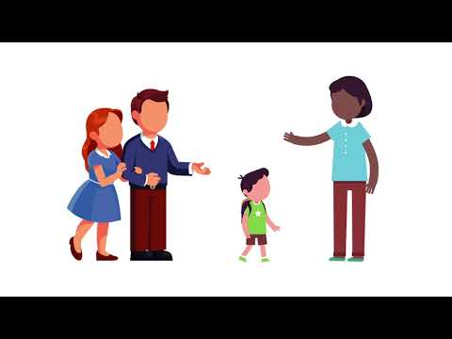
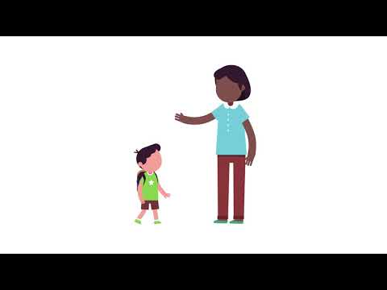
Eich rôl chi wrth ystyried CCUHP
Your role when considering UNCRC
Gwyliwch y clip fideo:
Watch the video clip:
Gwiriwch eich dealltwriaeth drwy gwblhau’r gweithgaredd llusgo a gollwng ar dudalen 2 gwefan CBAC: http://resource.download.wjec.co.uk.s3.amazonaws.com/vtc/2018-19/HSC18-19_3-1/_multi-lang/unit06/01-well-being.html?lang=Cy
Check your understanding by completing the drag and drop activity on the WJEC website page 2: http://resource.download.wjec.co.uk.s3.amazonaws.com/vtc/2018-19/HSC18-19_3-1/_multi-lang/unit06/01-well-being.html

Slide 12
Tasg 6.1
Tasg ar gyfer meini prawf 6.1
Esboniwch y term 'llesiant’
Task for assessment criteria 6.1
Explain the term ‘well-being’

Slide 13
ADRAN 2
SECTION 2
Meini Prawf 6.1
pam mae llesiant yn bwysig?
Assessment Criteria 6.1
Why is well-being important?

Slide 14
Pam mae llesiant yn bwysig?
Why is well-being important?
Mae llesiant plant a phobl ifanc yn golygu eu bod yn ddiogel, yn gyfforddus, yn hapus, yn teimlo’n dda am eu hunain ac yn barod i ddysgu a datblygu. Mae’n hanfodol bod plant yn byw ac yn cael eu dysgu mewn amgylchedd diogel a sefydlog er mwyn sicrhau datblygiad lles cadarn. Mae angen gwerthfawrogi plant fel eu bod yn datblygu i’w llawn botensial.
Darganfyddwch y ffactorau hynny sy’n cyfrannu tuag at lesiant plant a phobl ifanc ar wefan CBAC:
CBAC: ffactorau sy'n cyfrannu at lesiant plant ac oedolion ifanc
The well-being of children and young people means that they are safe, comfortable, happy, feeling good about themselves and ready to learn and develop. It's essential that children live and are taught in a safe and stable environment in order to ensure sound well-being development. Children need to be valued in order for them to develop to fulfil their potential.
Find out the factors that contribute towards children and young adults’ well-being on the WJEC website:
WJEC: Factors that contribute to the well-being of children and young adults

Slide 15
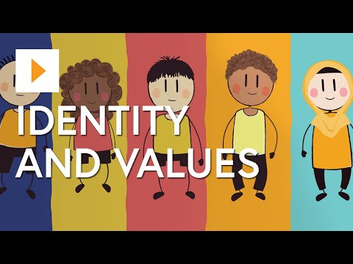
Pwy ydych chi? Beth ydych chi'n hoffi ei wneud?
Beth sy'n eich gwneud chi yn chi?
Eich hunaniaeth, neu bwy ydych chi fel person, yn cynnwys ystod eang o wahanol bethau.
Gall gynnwys o ble rydych chi'n dod, eich ethnigrwydd, eich crefydd, eich iaith, beth rydych chi'n ei hoffi, eich hobïau, eich personoliaeth unigryw, a llawer mwy.
Who are you? What do you like to do?
What makes you, you?
Your identity, or who you are as a person, is made up of a whole range of different things.
It can be made up of where you come from, your ethnicity, your religion, your language, what you like, your hobbies, your unique personality, and much more.

Slide 16
Tasg 6.2
Tasg ar gyfer meini prawf 6.2
Pam mae llesiant yn bwysig?
Gan ystyried y pwyntiau isod yn ogystal â’ch profiadau ar leoliad, ewch ati i greu restr o resymau pam mae llesiant plant bach yn bwysig.
-Empathi at eraill
-Hunan ymwybyddiaeth
-Hunan-hyder
-Hunanddelwedd
-Hunan-werth
-Ymateb i her
-Newidiadau bywyd
Task for assessment criteria 6.2
Why is well-being important?
Considering the following points and your practical workplace experiences, list with details why well-being in young children is important.
-Empathy for others
-Self awareness
-Self-esteem
-Self-image
-Self-worth
-Responding to a challenge
-Life changes

Slide 17
ADRAN 3
SECTION 3
Meini Prawf 6.3
Ffactorau sy'n effeithio ar lesiant
Assessment Criteria 6.3
Factors that affect well-being

Slide 18
Cynnwys ar gyfer 6.3
Mae Deddf Llesiant Cenedlaethau'r Dyfodol (Cymru) 2015 yn amlygu'r ffactorau a all effeithio ar les plentyn neu oedolyn ifanc.
Gall amrywiaeth o ffactorau effeithio ar les plant a'u teuluoedd/gofalwyr, gan arwain at ganlyniadau difrifol.
Gallant gynnwys:
Iechyd a Diogelwch
Gofal
Cam-drin
Symbyliad ac Addysg
Tlodi
Teulu/gofalwyr a ffrindiau
The video Well being of Future Generations (Wales) Act 2015 highlights the factors which can affect the well being of a child or young adult.
A variety of factors can affect the well-being of children and their families/carers, leading to serious consequences.
They can include:
Health and Safety
Care
Abuse
Stimulation and Education
Poverty
Family/carers and friends

Slide 19
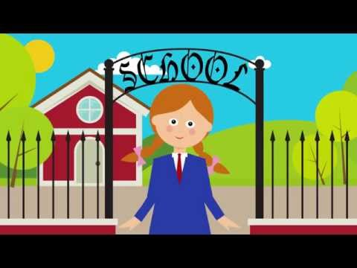
Gwyliwch y clip fideo a chwblhewch yr asesiad ar y sleid nesaf
Watch the video clip and complete the assessment on the next slide

Slide 20
Tasg 6.3
Tasg ar gyfer meini prawf 6.3
Pa ffactorau sy'n effeithio ar lesiant plant a'u teuluoedd/gofalwyr)?
Task for assessment criteria 6.3
What are the factors that affect the well-being of children and their families/carers?

Slide 21
ADRAN 4
SECTION 4
Meini Prawf 6.4
Teuluoedd a phobl bwysig eraill o ran llesiant plant
Assessment Criteria 6.4
Families and other important people in the context of a child’s well-being

Slide 22
Cynnwys ar gyfer 6.4
Mae rhieni/gofalwyr a theuluoedd/gofalwyr yn annatod wrth ystyried llesiant plant a phobl ifanc. Maen nhw’n ganolog i’w bywyd ac mae llesiant y teulu/gofalwyr yn cael dylanwad ar lesiant y plant.
Beth yw rôl gweithwyr gofal plant?
Mae’n bwysig bod yr gweithwyr gofal plant yn cefnogi’r berthynas hon drwy rannu gwybodaeth berthnasol a chydweithio er mwyn sicrhau y canlyniadau gorau posib i’r plant.
Parents/carers and families/carers are integral to the well-being of children and young people. They are central to their lives and the well-being of the family/carers influences the well-being of the children.
What is the role of the childcare worker?
It's important that childcare workers support this relationship by sharing relevant information and cooperating in order to ensure the best possible results for the children.

Slide 23
Cynnwys 2 ar gyfer 6.4
Darllenwch yr adran ar wefan CBAC (tudalen 5) a gwnewch nodiadau i’ch galluogi i wneud yr asesiad
Gwefan CBAC:Pwysigrwydd teuluoedd/gofalwyr ac eraill o ran llesiant plant
Read the section on the WJEC website (Page 5) and make notes ready for the assessment
WJEC website:The importance of families/carers and significant others in the well-being of children

Slide 24
Tasg 6.4
Tasg ar gyfer meini prawf 6.4
Esboniwch bwysigrwydd teuluoedd (families) a ‘phobl bwysig eraill’ (‘significant others’) o ran llesiant (well-being) plant.
Task for assessment criteria 6.4
Explain the importance of families and ‘significant others’ ‘(pobl bwysig eraill)’ in the well-being (llesiant) of children.

Slide 25
ADRAN 5
SECTION 5
Meini Prawf 6.5
Ffyrdd o weithio sy’n cefnogi llesiant a chynhwysiant.
Assessment criteria 6.5
Ways of working that support well-being and inclusion

Slide 26
Cynnwys ar gyfer 6.5
Mae dyletswydd gan yr ymarferwr i sicrhau eu bod yn cefnogi llesiant a chynhwysiant wrth weithio gyda phlant a phobl ifanc.
Rhaid i’r ymarferwr :
hyrwyddo iechyd da
darparu amgylchedd diogel
cefnogi ac ehangu datblygiad ac addysg y plant
rheoli ymddygiad plant a phobl ifanc yn effeithiol
The childcare worker has a duty to ensure that they support well-being and inclusion when working with children and young people.
The childcare worker must :
promote the good health
provide a safe environment
support and expand the children's development and education
effectively manage the behaviour of children and young people

Slide 27
Beth yw gwytnwch?
What is resilience?
Mae seicolegwyr yn diffinio gwytnwch fel y broses o addasu'n dda yn wyneb adfyd, trawma, trasiedi, bygythiadau, neu ffynonellau straen sylweddol - megis problemau teulu a pherthynas, problemau iechyd difrifol, neu straen yn y gweithle a straen ariannol.
Psychologists define resilience as the process of adapting well in the face of adversity, trauma, tragedy, threats, or significant sources of stress—such as family and relationship problems, serious health problems, or workplace and financial stressors.

Slide 28
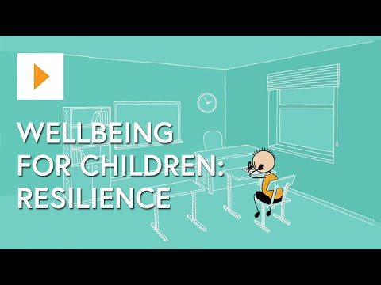
Fideo lles

Slide 29
Tasg 6.5
Tasg asesu ar gyfer meini prawf 6.5
Gan ystyried popeth rydych chi wedi’i ddysgu am lesiant a’ch profiadau ymarferol o’ch lleoliad gwaith:
Rhestrwch ffyrdd o weithio sy’n
cefnogi llesiant a chynhwysiant
*Cofnodwch eich casgliadau a’u cyflwyno i’ch tiwtor/asesydd.
Task for assessment criteria 6.5
Considering all you have learned about children’s well-being and your practical workplace experiences):
List ways of working that support well-being and inclusion
*Record your findings and present them to your tutor/assessor.

Slide 30
Wrth ddilyn yr adnodd hwn roedd cyfle i chi ddysgu am:
In following this resource there was an opportunity for you to learn about:
6.1 y term ‘llesiant’
6.2 pam mae llesiant yn bwysig
6.3 ffactorau sy'n effeithio ar
lesiant plant a'u teuluoedd/gofalwyr
6.4 pwysigrwydd teuluoedd a ‘phobl bwysig eraill’ o ran llesiant plant
6.5 ffyrdd o weithio sy'n cefnogi
llesiant a chynhwysiant.
6.1 the term ‘well-being’
6.2 why well-being is important
6.3 factors that affect the well-being of children and their families/carers
6.4 the importance of families and ‘significant others’ in the well-being of children
6.5 ways of working that support well-being and inclusion.

