Slide 1
Productivity Applications

Slide 2
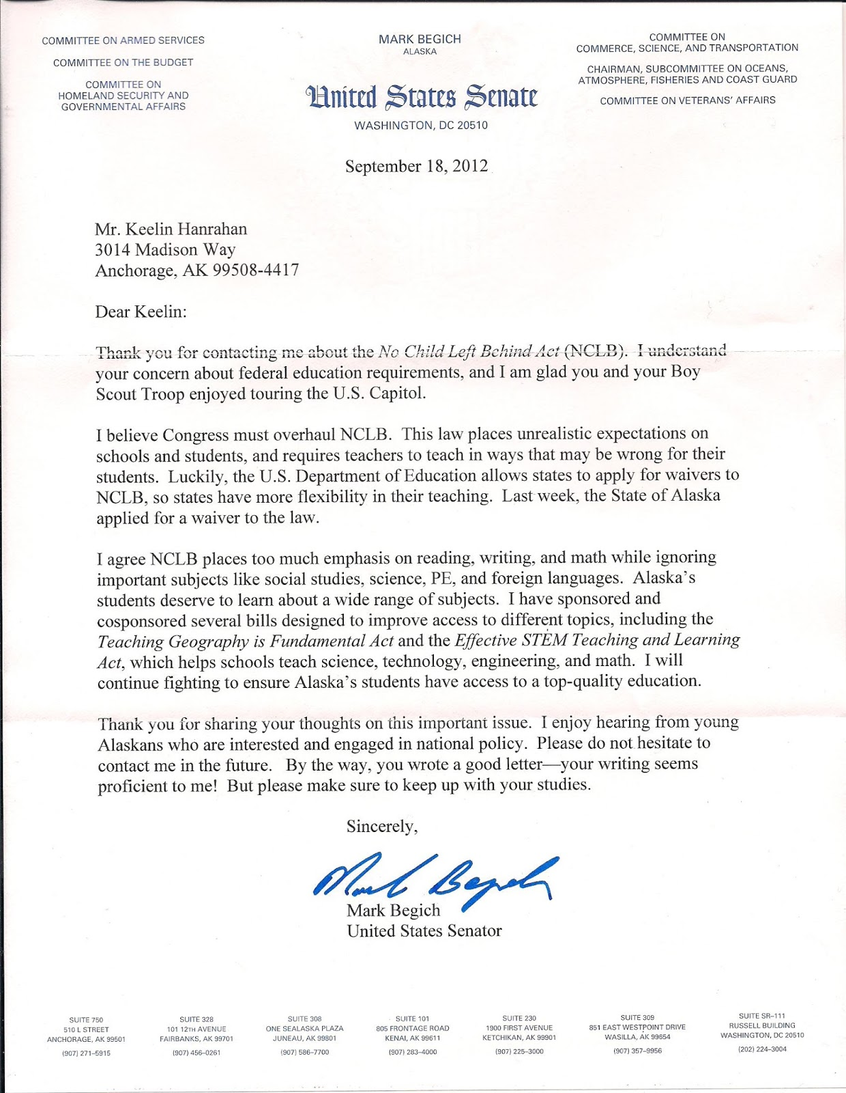
Which software is used for writing letters?
A Publisher
B Excel
C Word
D Access

Slide 3
Which software is used for keeping a budget?
A Publisher
B Excel
C Word
D Access

Slide 4
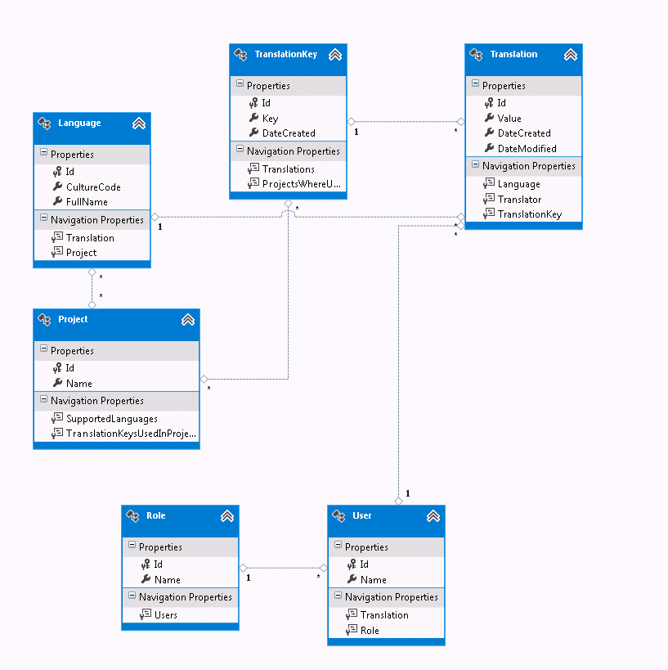
Which software is used for databases?
A Publisher
B Excel
C Word
D Access

Slide 5
What benefits are there of using suites of productivity applications?

