Slide 1
DERMATITIS
WHAT’S THE BIG DEAL!!!!!

Slide 2
DERMATITIS
WHAT DO YOU KNOW?
CAN YOU LIST 3 THINGS THAT YOU KNOW ABOUT DERMATITS

Slide 3
Dermatitis is a skin condition caused by contact with something that irritates the skin or causes an allergic reaction. It usually occurs where the irritant touches the skin, but not always.
There are two types:
allergic contact dermatitis; and,
irritant contact dermatitis

Slide 4
What Causes Dermatitis in a Hair or Beauty Salon?
Dermatitis can affect all parts of the body but most commonly it just affects the hands. People that work with irritants in their job, or those whose work involves a lot of water, are more at risk of suffering from dermatitis than others – which is why hairdressers and Beauty Therapists need to be extra careful.

Slide 5
In a Hair or Beauty salon, dermatitis is likely to be caused by:
Frequent contact with water.
Contact with the chemicals in hairdressing and beauty products, e.g. shampoo, bleach or hair colour, oils, creams or waxes.
Contact with cleaning chemicals or detergents.

Slide 6
ALLERGIC CONTACT DERMATITIS
ACD
Some hair dyes
UV cured printing inks
Adhesives
Some plants (eg chrysanthemums

Slide 7
IRRITANT CONTACT DERMATITIS
ICD
Wet work
Soaps, shampoos and detergents
Solvents
Oils and greases
Dusts
Acids and alkalis

Slide 8
BAD HAND DAY!

Slide 9
Areas of Contact
How is the skin exposed to substances:
Direct Handling
Touching contaminated surfaces
Splashing
Depositing
Soiled gloves
Incorrect removal of gloves

Slide 10
Controlling Dermatitis
Dermatitis is a type of eczema that occurs when your skin comes into direct contact with an irritant. The irritant damages the outer layer of the skin, causing redness, itching, burning or stinging and can lead to your skin becoming blistered, dry and cracked.
It is reported that up to 70% of hairdressers suffer from work-related skin damage, such as dermatitis, at some point throughout their career. Skin damage like this is unsightly, unpleasant and unprofessional looking but it can be prevented.

Slide 11
Health and Safety
COSHH in Hairdressing and Beauty Therapy: What does the law require? The law requires employers to prevent or, where that is not reasonably practicable, adequately control exposure to materials in the workplace that cause ill health like dermatitis. The Control of Substances Hazardous to Health Regulations 2002 (COSHH) require employers to: ■ assess risks; ■ provide adequate control measures – and ensure the use and maintenance of these; ■ provide information, instruction and training; and ■ in appropriate cases, provide health surveillance

Slide 12
Health & Safety Legislation
HASWA
COSHH
RIDDOR
PPE

Slide 13
Employee/Employers Responsibility
Employee Responsibilities
Employer Responsibilities
Safe working with equipment
Maintain a safe working environment
Wear/use personal protective equipment
Provide information, instruction and training on risks and precautions.
Personal protective equipment for staff
Regular hand checks
Appropriate hand wash/lotions.

Slide 14
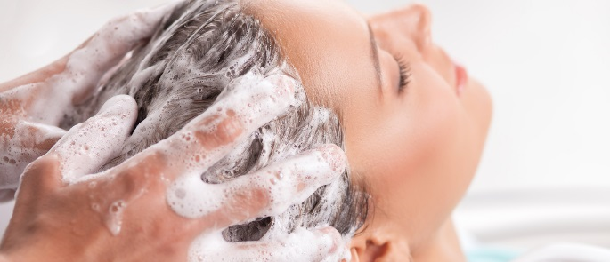

Slide 15
What … does it feel like?
Someone who has dermatitis may experience symptoms of itching and pain.
The signs and symptoms of this condition can be so bad that the sufferer is unable to carry on at work.

Slide 16
How to Prevent Dermatitis in a Hair Salon
Although dermatitis is an unpleasant condition to have, the good news is that it’s easily preventable. There are a few simple things you can do to help prevent dermatitis:
Wear disposable, non-latex gloves for shampooing, colouring and bleaching etc.
Dry your hands thoroughly with a disposable paper towel.
Moisturize your hands as often as possible with fragrance-free moisturiser. Make sure that you moisturise all of your hands, wrists and fingers.
Wear a new pair of gloves for every customer.
Check your skin regularly for early signs of skin problems.

Slide 17
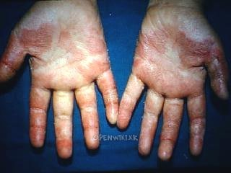
SEVERE REACTION

Slide 18
PREVENTION Here's how to wave goodbye to bad hand days. Five small steps to prevent dermatitis becoming a big problem
:

Slide 19
How to prevent dermatitis
Step 1
Wear disposable non-latex gloves when rinsing, shampooing, colouring, bleaching, etc.
Step 2
Dry your hands thoroughly with a soft cotton or paper towel.
Step 3
Moisturise after washing your hands, as well as at the start and end of each day. It's easy to miss fingertips, finger webs and wrists.
Step 4
Change gloves between clients. Make sure you don't contaminate your hands when you take them off.
Step 5
Check skin regularly for early signs of dermatitis.

