Slide 1
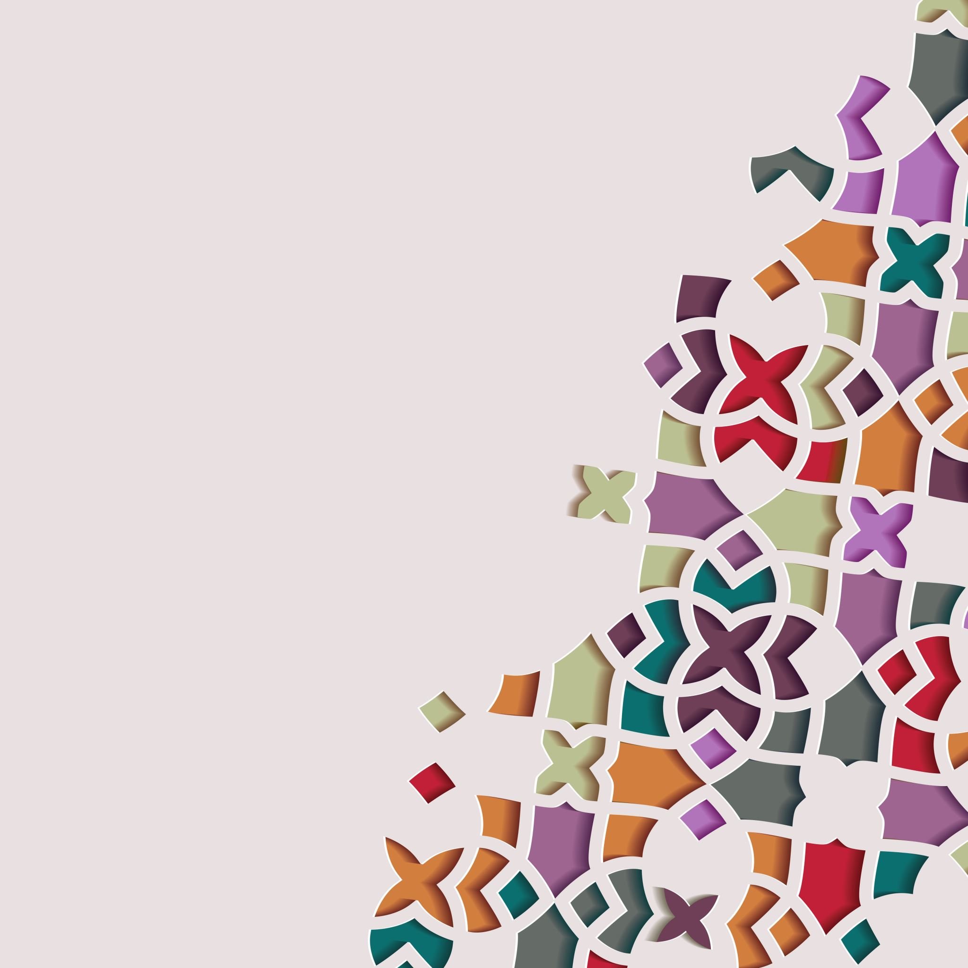
Create a Hair & Beauty Image
UV10479

Slide 2
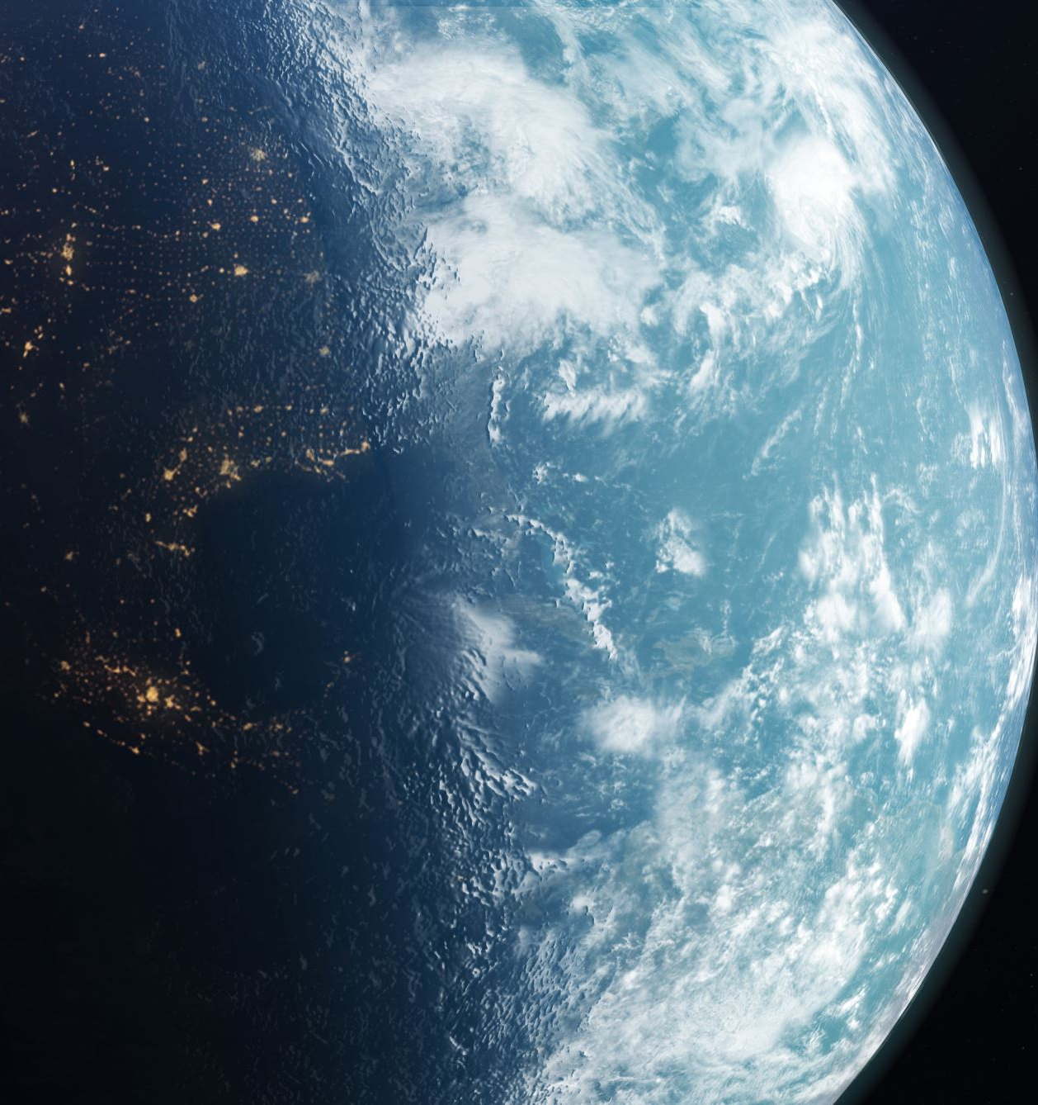
Chosen theme is........
SPACE

Slide 3
Create a Mind Map of ideas for the chosen theme

Slide 4
Evening Make-up
Face Painting
Plaits
Make- up
Hair
Glitter spray
Smokey eyes
curls
SPACE
Dress
Nail Art
Outfit
Nails
Homemade costume
French polish

Slide 5
Collection of pictures for........
Hair
Make-up
Nails
Outfit ideas
…....to create the mood board

