Slide 1
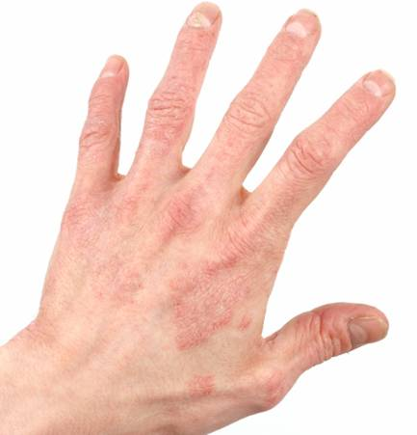
Occupational Dermatitis
What you and your students need to know

Slide 2
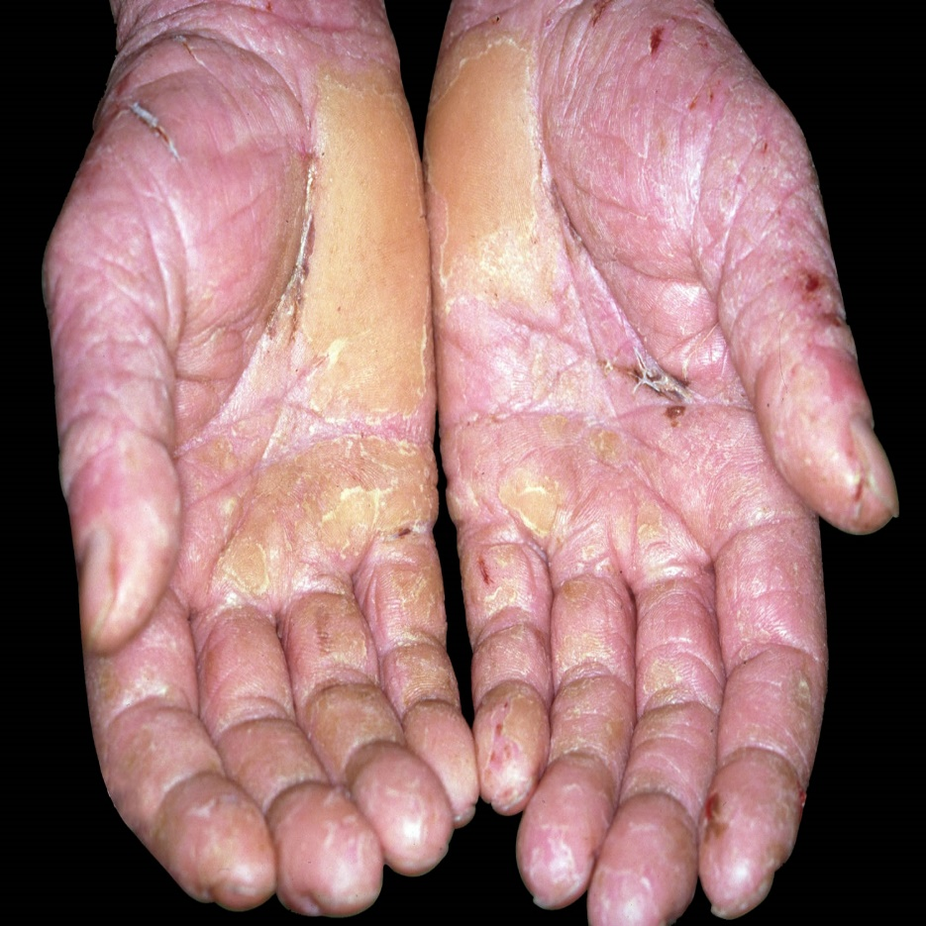

What is dermatitis?
Inflammatory reaction in skin
Due to contact with outside agents
2 main types
  irritant contact
  allergic contact
Notes:
Lets start with the basics – what is dermatitis? It is often referred to as eczema. It can become a long lasting and serious condition if not managed properly.
There are several types of dermatitis – but the work-related types tend to fall into two categories – irritant contact dermatitis and allergic contact dermatitis.
Irritant contact dermatitis accounts for around 80% of all dermatitis cases and is caused by working with materials that physically damage the skin at the point of contact – e.g. cleaning products that dissolve the skin’s protective layer of oils, leaving it dry, damaged and often inflamed.
Some strong irritants, such as cleaning chemicals, can cause damage straight away. However, Irritant dermatitis can also be caused by prolonged wet-working – wet work refers to work where the hands are either submerged in water for a significant part of the day for example - a hairdresser, or for hygiene reasons repeated hand washing is required – for professions such as Nursing, Food preparation etc.
Allergic dermatitis involves the body’s immune system and results in an allergic reaction to something which has been put on the skin. We call substances which may illicit an allergic reaction ‘skin sensitisers’.
Symptoms of dermatitis are dryness, tightness, cracking of the skin, and with untreated or prolonged cases weeping and ultimately scarring may occur.
Dermatitis is not, however contagious. Although it is a reportable ‘disease’ you cannot catch dermatitis from someone else.
Dermatitis is entirely preventable! No contact, no dermatitis.
******************************************************************************************************
Quite literally dermatitis means inflammation of the skin. It is sometimes called eczema. (see note 1 for extra information)
Dermatitis is a non-infectious inflammation and when work related it occurs as a result of contact between the skin and some material or substance in the workplace capable of causing it. Hence it is commonly referred to as work related contact dermatitis. (see note 2 for extra information).
Whilst dermatitis can affect all parts of the body, it is most common to see the hands affected
Contact dermatitis can be divided into 2 main types, irritant contact dermatitis and allergic contact dermatitis. Outwardly they are very similar in appearance. However, their aetiology is very different (one involves an immune response, the other does not) and this has implications for how prevention is managed.
Note 1. Although dermatitis and eczema are subtly different, the difference is so fine that we can consider dermatitis and eczema as interchangeable.
Note 2. Dermatitis can be divided into 3 main classes, unclassified, endogenous and exogenous. The commonest form (amongst the general population) is endogenous, caused by malfunctions or disorders within the body. Contact dermatitis is classed as exogenous, occurring as a result of contact with a material outside of the body.

Slide 3
What is irritant contact dermatitis?
Irritants penetrate skin & typically remove natural skin oils
Caused by single contact with strong irritants or prolonged contact with weak irritants
Can heal up given time
Notes:
Irritant contact dermatitis arises from working with materials that physically damage the skin at the site of contact, e.g. organic solvents can dissolve the skin’s protective layer of oils leaving the skin dry and damaged.
Some strong irritants can cause immediate damage, many weaker substances may require prolonged contact before there is any visible effect.
If contact is stopped, the skin will heal in time. But, it will remain vulnerable for some time after the skin has apparently healed. If contact is resumed too soon, it is likely that dermatitis will quickly reappear.

Slide 4
What is allergic contact dermatitis?
Allergen penetrates skin provoking sensitisation
Once sensitised further contact with even small amounts can trigger allergic reaction
Once sensitised likely to remain so for life
Notes:
Some substances penetrate the outer layer of the skin and cause a reaction called sensitisation, so that even very low levels of exposure to a substance will trigger an allergic reaction in the future. (see note 1 for further information)
Examples, onions, garlic, some hair dyes, adhesives…..
Sensitisation may occur within days of exposure, but usually takes a lot longer. This is why workers may suddenly develop an allergy to a substance that they have been working with for years without any problems. Why and when this can happen is not clear.
Once sensitisation occurs it can be life long and any exposure to the sensitising substance needs to be avoided.
*********************************************************************************************
Note1. Allergic contact dermatitis is where the body’s immune system recognises the presence of a foreign body and responds in defence. The foreign body or substance does not need to cause any direct cell damage.

Slide 5
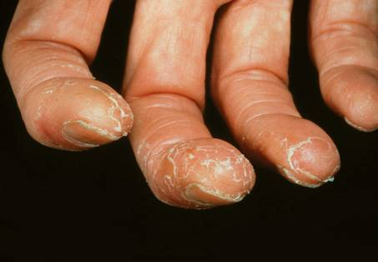
What are the signs and symptoms of dermatitis?
Redness
Itching
Swelling
Flaking
Blistering
Cracking
Pain
Notes:
As mentioned earlier, the signs and symptoms of irritant contact dermatitis and allergic contact dermatitis are similar.
Dry red itchy skin is usually the first sign.
Swelling, flaking, blistering, cracking and pain can follow.
Sufferers can develop any or all of the signs and symptoms.
The photograph shows flaking of the skin on a chef’s hands due to allergic contact dermatitis from garlic.

Slide 6
Who is at risk?
High risk occupations include:
Hairdressing
Construction
Health Services
Motor Vehicle Repair
Catering
This list is not exhaustive!
Notes:
HAIRDRESSING
Up to 70% of hairdressers suffer from skin damage.
One of the main causes of dermatitis is wet working - having your hands in contact with water for long periods of time in a day, over 2 hours for example. Or if your hands are wet several times a day,
The other main cause of dermatitis is contact with the chemicals in hairdressing products, when shampooing, colouring or bleaching, or in the products you use for cleaning up.
CONSTRUCTION
All construction workers, but in particular bricklayers, roofers, road builders and painters, who have frequent contact with harmful substances
In the construction industry, the substances that cause most skin health problems are:
wet cement;
epoxy resins and hardeners;
acrylic sealants;
bitumen or asphalt;
solvents used in paints, glues or other surface coatings;
petrol, diesel, oils and greases; and
degreasers, descalers and detergents.
HEALTH SERVICES
It is estimated that each year, 1000 nurses develop work-related contact dermatitis. Nurses are reported to have an incidence of diagnosable work-related contact dermatitis which is nearly seven times higher than the average for all professions.
Contact dermatitis is the most common form of work-related skin disease in nurses and other healthcare professionals.
Those who are most affected are nurses, midwives, medical radiographers, nursing auxiliaries and assistants, medical practitioners (doctors, SHOs etc) and physiotherapists.
Other professionals in this sector that can suffer from work-related contact dermatitis are those who need to wash their hands regularly, or those whose skin is frequently exposed to chemicals or rubber materials used in personal protective equipment.
MVR
Spray painters are seven times more likely to develop dermatitis than the average working population; body preparation workers are twice as likely.
Frequent or prolonged contact with used engine oil may cause dermatitis and other skin disorders including (more rarely) skin cancer.
Many cleaning and degreasing substances used in valeting can cause dermatitis.
Exposure to fine dust during hand sanding can cause dermatitis.
Some substances in two-part adhesives, body fillers and foam fillers can cause skin allergies.
If the hands are frequently wet, or wet for prolonged periods during the workday (for example during wet sanding), this can lead to dermatitis.
CATERING
Dermatitis is one of the main causes of ill-health for catering staff (chefs, cooks and catering assistants).
The number of new cases per year is twice the average of all other industries.
- washing hands a lot during the day to meet food safety laws;
- cleaning kitchen surfaces, ovens, pots, pans and kitchen utensils.

Slide 7
Part 2
Miriam’s Story - Real life example

Slide 8

Miriam’s story

Slide 9
Dermatitis Prevention
Think A, P, C
A – avoid contact
P – protect the skin
C – check for early signs
Notes:
So, what can be done to prevent occupational dermatitis? This can be summarised by three letters A, P and C.
Firstly – occupational contact dermatitis is caused by contact with an agent – therefore if you have no contact – you have no dermatitis.
Secondly, you need to protect the skin. If frequent washing is removing moisture from the skin, this moisture will need to be replaced by a suitable moisturiser.
Finally, by checking for early signs of dermatitis, you can ensure that it is treated as quickly as possible. Checks can also help indicate a possible lapse in your preventative control measures, and the need to reassess the situation.

Slide 10
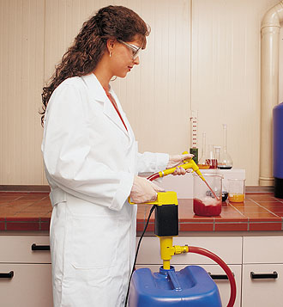
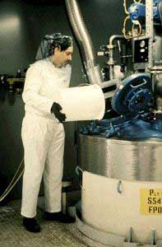
Avoiding contact
Notes:
Here are some examples of methods of avoiding contact
Using a tool – rather than using the hand as a tool
Pumping out a substance rather than pouring
Using LEV to extract dust away from the operative
There are illustrated examples of other ways of ensuring a safe working distance on this HSE poster – available on our website

Slide 11
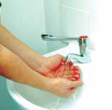
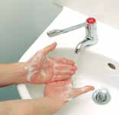
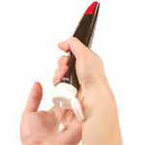
Protecting the Skin
Remove any contamination from the skin
Dry hands thoroughly after washing
Pre and post work creams
Use the correct type of PPE
Notes:
Personal skin protection is important, and all students should be encouraged to take good care of their skin.
Key steps that should be taken are:
Contamination should be removed from the hands by adequate washing – taking care not to neglect the areas of the hands that are frequently missed such as round the wrists and between the fingers.
The hands should be dried thoroughly after washing, for this soft towels or adequate soft paper towels should be provided by the employer.
Pre and post work creams should be offered – the post work creams are important as they replace any moisture removed though hand washing. Pre-work creams help put up an additional barrier against water, detergents etc, however caution should be exercised with barrier creams which claim to put an impenetrable barrier between the skin and chemicals, as a lot of these claims are unfounded they should not be seen as a replacement for gloves.
When applying the creams care should again be taken not to miss the commonly neglected areas of the hands mentioned earlier.
Finally the skin can be protected by using the correct type of Personal Protective Equipment – will discuss this further on the next slide

Slide 12
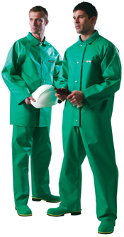
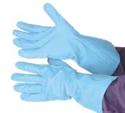
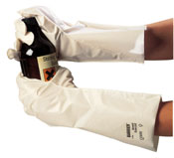
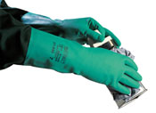
Personal Protective Equipment
When to provide
Gloves – which are appropriate?
Overalls, aprons, coveralls
Storage, cleaning and availability
Notes:
Personal protective equipment, or PPE for short is always intended as a final defence measure after other controls have been implemented. This is because it only protects the wearer. This is not to say PPE should not be provided however, as it is often very effective at preventing accidental exposure to irritating or sensitising agents. As dermatitis mainly affects the hands, gloves are the most common type of PPE used to prevent occupational dermatitis.
However, the correct glove for the job must be provided. Only certain gloves protect against certain chemicals. For example: PVC gloves will only protect the wearer against water miscible substances and weak alkalis and acids, whereas Nitrile rubber gloves will protect the wearer against weak acids/alkalis, but also oils.
Each type of glove also has a breakthrough time. This is the length of time of exposure to a substance before the glove will allow the substance to permeate through. Interestingly, for a nail technician using nail varnish remover, the thin disposable gloves worn allow the acetone to breakthrough immediately. In fact the best glove for preventing exposure to acetone is the thick black Viton glove - you don’t see too many beauticians wearing them do you! Once the breakthrough time has been exceeded, the gloves are no longer effective, therefore they should be replaced before this time.
There have been well-publicised issues with natural rubber or Latex gloves, particularly in the healthcare industries. Prolonged wearing of latex gloves has been known to cause a nettle-sting-like rash which is a form of dermatitis known as contact urticaria (ur-ti-kair-ee-uh) – the urticaria occurs within minutes of exposure, and can be very uncomfortable.
As a result many employers have moved away from using latex gloves, particularly the powdered ones. However, any decision to use a glove should be based on your COSHH risk assessment.
Another key factor to take into account when choosing the most appropriate job is the ergonomic requirements of the user – for example if the job requires a lot of manual dexterity, it is not really appropriate to wear big thick gloves – hence why beauticians don’t.
Overalls, aprons or coveralls can also be provided if significant splashing may occur, again they should be appropriate to the substance worked with, for example fabric coveralls would not be appropriate if a lot of wet work is being carried out.
For all PPE, appropriate cleaning and storage facilities should be provided. If a glove is removed, but then sits on a contaminated surface for the rest of the shift, the breakthrough time may be exceeded, rendering the glove useless. Similarly if contaminants are not quickly washed off the glove, they may then remain on the glove for a significant period of time, again causing breakthrough
There should be a readily available supply of gloves (and other PPE) so that employees are encouraged to replace gloves when they need to be replaced, and not wait until the gloves are falling apart.
Finally, students should be trained in the correct donning and removal, cleaning and storage of PPE, for it to be effective.

Slide 13
Checking - Health Surveillance
Can be done in-house
Periodic skin check
Referral to Occupational Health Professional
Results must be maintained
Results should be fed back into overall dermatitis management
Report cases to HSE!
Notes:
Checking for dermatitis is best done by formalised health surveillance. It is mandatory under the COSHH Regulations where employees come into contact with skin sensitising substances - labelled R43 (or R42/43).
Where irritants are used – and that includes soap and water (although only if there are a significant number of hand washes per day), health surveillance is strongly recommended as it is a useful tool for the early detection and prevention of dermatitis.
It is a common myth that health surveillance is very expensive – here are some facts:
Basic health surveillance can be carried out in-house by a responsible person. To start with a skin condition assessment should be carried out on any new starters (or as soon as possible after they have started work).
Then periodic skin checks should be carried out at intervals determined by your COSHH assessment (this may be more frequently for those who carry out a lot of wet-work or are exposed sensitisers). This will need only take a couple of minutes. If this check identifies a potential problem – for example the person is displaying any of the symptoms, then they should be referred to an occupational health professional for further advice. Any suspected cases must be confirmed by a doctor, one who is familiar with occupational health. This can be the employee’s GP, but it is better to retain the services of a independent doctor who has experience of dealing with work-related illnesses. The doctor should be provided with as much information as possible as to nature of the affected persons work activity, and the substances they are likely to have been exposed to.
Any results of health surveillance must be maintained for a period of 40 years, even if the employee leaves the company.
The results of health surveillance should be fed back into the dermatitis management system. It may be that existing controls are not fully effective, are faulty or are not being used appropriately. Whatever the case, any problems should be remedied to prevent further cases.
Finally – any written diagnosis of a case of dermatitis which has been attributed to the affected persons work activity must to be reported to the HSE under the Reporting of Injuries Diseases and Dangerous Occurrences (RIDDOR) regulations.
It helps to have a formalised procedure in place which states how health surveillance is carried out, what to do if a case is suspected, and what to do if a case is confirmed. Managers or others involved in health surveillance should be trained in this procedure.

Slide 14
Student Awareness
What substances may be a problem?
How do I protect my skin?
What are the symptoms of dermatitis?
What do I do if I suspect I have dermatitis?
Notes:
Ok – so you have put all your controls in place – dermatitis problem sorted, right? – wrong!
The effectiveness of any control system depends on your students following all the measures which have been put in place. Students need to be made aware of the results of COSHH assessments, so they know which substances could cause dermatitis. They need to be made aware of the importance of skin protection at work, and how this is done, including what provisions have been made, such as provision of creams and PPE.
Students also need to be made aware of the symptoms and what to do if they suspect they may have dermatitis, so that it can be diagnosed and treated promptly, and additional control measures implemented where necessary.
Students should be made aware of the reporting system for reporting suspected cases within the organisation, for example to their line manager, or occupational health adviser. They should also be made aware of what will happen following their report, so that they don’t have any apprehension and conceal their problem.
Many of you may be thinking that you already provide a lot of this information in induction and additional training, and that is good – it should be part of any course induction training, however students should be reminded from time to time, and this can be done by various methods – you could do a ‘tool-box talk’ – a 5-10 minute discussion at the beginning of the shift, or display posters.

Slide 15
Summary
Occupational dermatitis can be prevented!
Avoid contact with agent
Protect the skin
Use the ‘right’ glove
Carry out checks – health surveillance
Increase awareness and provide training
Notes:
So, to summarise:
You have heard about the often simple measures for preventing occupational dermatitis.
The key thing to remember and feedback to your students is to avoid contact with the agent, and to protect the skin – this can be by using a glove appropriate to the task in hand.
Also remember that where sensitising agents are used, health surveillance must be provided, and it is good practice to carry out skin checks on all employees likely to be exposed to substances which may cause irritant dermatitis. These can easily be done ‘in-house’, but remember any suspected cases must be referred to an appropriate doctor.
Finally, ensure your students are aware of dermatitis, and provide training on the control measures, how to don/remove gloves properly and where to store PPE when it is not in use.

Slide 16
Reference material
  HSE’s ‘Skin at Work’ website: www.hse.gov/skin
  Leaflets/Posters
  Tools – COSHH Essentials -www.hse.gov.uk/coshh
  B.A.D. - www.bad.org.uk
  NHS Direct - 0845 4647
  Workplace Health Connect
  HSE Infoline - 0845 345 0055
Notes:
You can get further information on HSE’s skin at work web page.
There is a lot of useful information on the HSE’s website – including free downloadable leaflets and information sheets, and posters. The posters are very useful in increasing employee awareness.
HSE is about to publish a booklet, called ‘Managing skin exposure risks at work’, (show) which covers all of the areas highlighted in this presentation, and more, in greater detail. For example – guidelines on how to measure hands for the correct glove size.
The COSHH essentials website can help with COSHH assessments and also has useful information sheets on the appropriate controls necessary. The health surveillance for occupational dermatitis provides useful information on in-house health surveillance.
The British Association of Dermatologists have more information on the clinical aspects of dermatitis and how it is diagnosed, including the symptoms to look for.
NHS direct provides useful information on the symptoms, diagnosis and treatment of dermatitis, it also has information in other languages, which maybe useful if not all your students have English as their first language.
Workplace Health Connect is an independent organisation (working in partnership with HSE) which offer free advice on health matters for small and medium sized business. In certain areas of the country they will come to you workplace to make recommendations
You can also contact HSE’s infoline for basic advice, or contact your local HSE office for more specific advice. We have occupational health inspectors who can provide comprehensive information on all occupational health matters.

