Slide 1
Gears
Mechanical Principles
HNC Unit 8

Slide 2
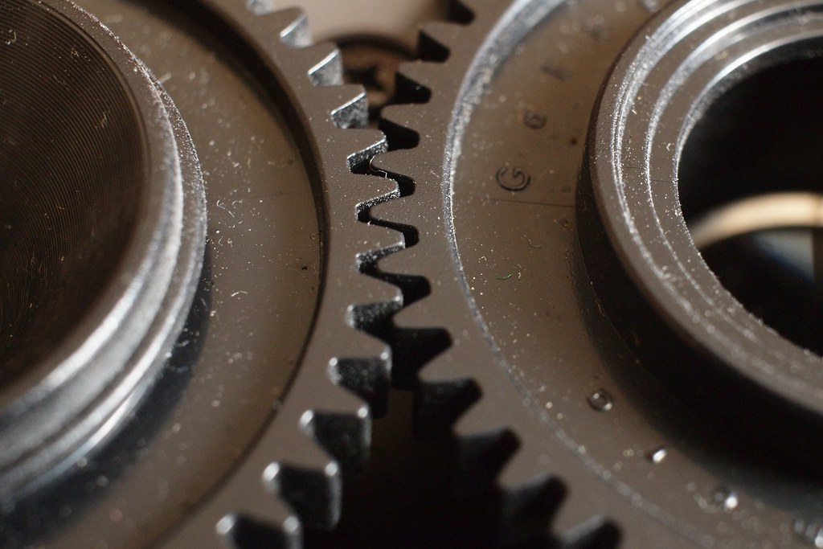
Pair work – 15 minutes
What are gears used for?
How do gears work?
Give 3 examples of applications that use gears
What materials are used for gears?

Slide 3
What are gears used for?
Gears are wheels with teeth on the outer edge
The teeth on 2 gears interlock, meaning when one rotates, it forces the second one to spin
They are used to increase or decrease the speed or power of rotary motion

Slide 4
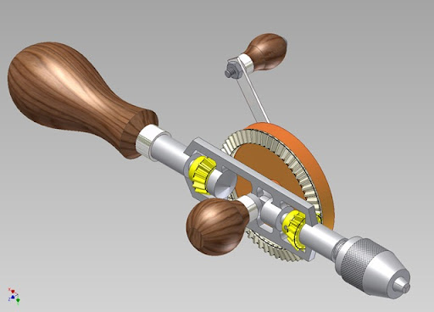
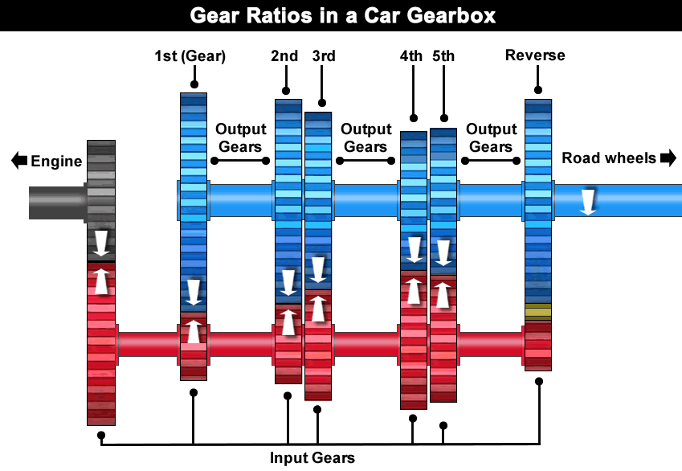
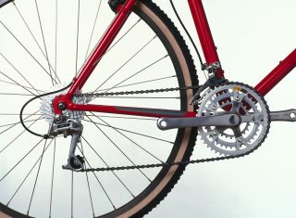
What examples can you think of that use gears?

Slide 5
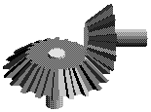
SPUR GEAR
BEVEL GEAR
Teeth are parallel to the axis of the gear
Advantages
Cost
Ease of manufacture
Availability
Disadvantages
Only works with mating gear
Axis of gear is parallel
Gear axis at 90°, based on rolling cones
Advantages
Right angle drives
Disadvantages
Get axial loading which complicates bearings and housings

Slide 6
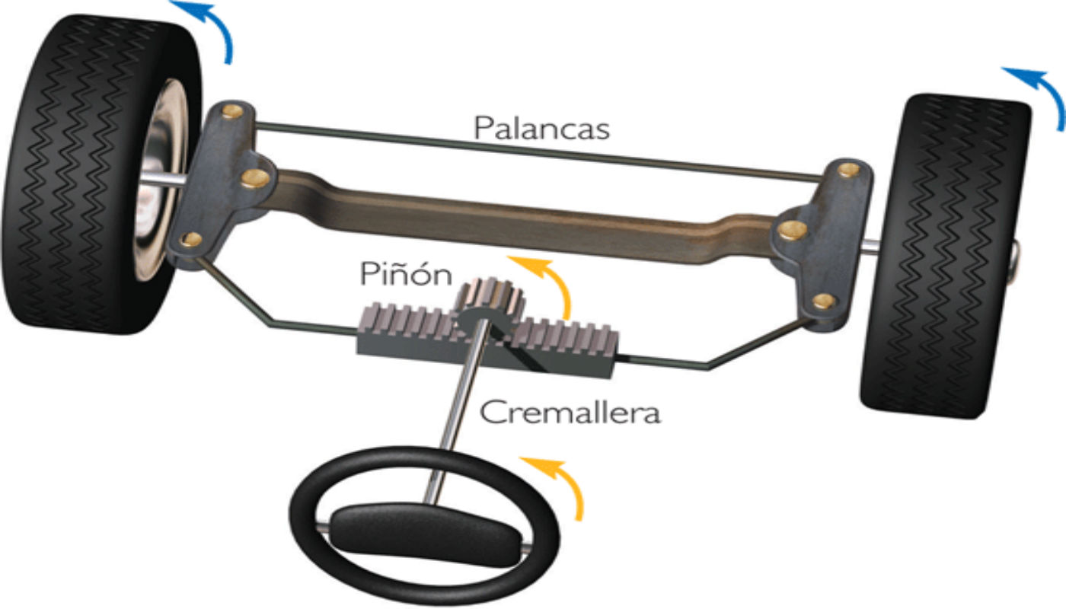
WORM GEAR
Rack and Pinion
Gears that are 90° to each other
Advantages
Quiet / smooth drive
Can transmit torque at right angles
No back driving
Disadvantage
Most inefficient due to excessive friction
Needs maintenance
The rack and pinion gear is used to convert between rotary and linear motion.
Could have straight or bevel teeth
Provides less backlash
Greater feedback

Slide 7
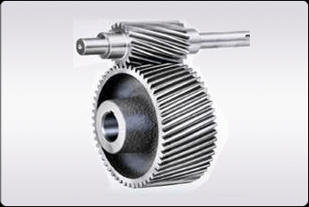
Helical GEARS
Teeth are at an angle to the gear axis (usually 10° to 45°) Advantages
Smooth and quiet, due to gradual tooth engagements
More tooth engagement allows for greater power transmission for given gear size.
Disadvantage
More expensive

Slide 8
Spur Gears
Most common type of gear
Made up of a driver gear and a driven gear
Driver is connected to the motor
Meshing gears always rotate in opposite directions
If gear A turns
Clockwise,
What direction
Will gear G turn

Slide 9
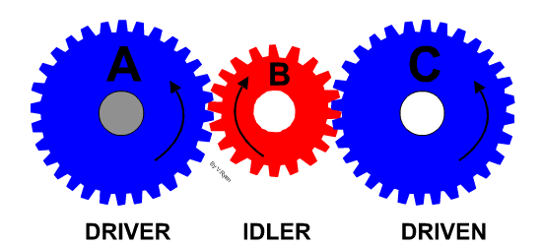
Idle Gears
In some applications you would require the direction of rotation of input shaft to be the same as the output shaft
To achieve this, an idler gear is introduced
An idler gear is a gear wheel that is inserted between two or more other gear wheels

Slide 10
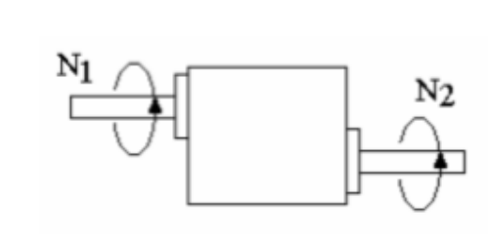
Gear ratio
A gear ratio is the ratio of the number of rotations of a driver gear to the number of rotations of a driven gear.

Slide 11
Gear ratio - example
A 100 tooth gear drives a 20 tooth gear. Calculate the gear ratio for the meshing teeth
Gear ratio = Number of teeth on driven gear
Number of teeth on driver gear
Gear ratio = driven 20 = 1
driver 100 5
This is written as 1:5

Slide 12
Torque
As we have previously seen…
Power = Torque x Angular Velocity ($P=T ω)$
Therefore in a gearbox,
$$Shaft Power \left(SP\right)=\frac{2πNT}{60}$$

Slide 13
Torque
If we consider an ‘ideal’ gearbox which is totally efficient then the input and output will be the same
$\frac{2πN_{1}T_{1}}{60}$= $\frac{2πN_{1}T_{1}}{60}$
Or
$$N_{1}T_{1}=N_{2}T_{2}$$
Hence gearbox ratio
GR= $\frac{N_{1}}{N_{2}}=\frac{T_{1}}{T_{2}}$
When the speed of a rotating shaft is reduced by a gearbox then the torque of the output shaft will be increased and vice versa.

Slide 14
Torque efficiency
In reality, we can not achieve an ideal situation, due to friction
Power from input shaft lost
Output power will be smaller than input power

Slide 15
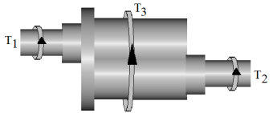
Holding Torque
We can see that input and output torques will be different
However, in a system – total torque must be zero
We must consider the holding toque that is applied or required to clamp the gearbox
Anticlockwise torque is positive

Slide 16
Example 1
a) 5:1 b) 127 Nm (clockwise) c) 14kW d) 445 Nm (anticlockwise) e) -318 Nm

Slide 17
Example 2
a) -238 Nm b) 30kW c) 573 Nm d) -334 Nm e) anticlockwise

Slide 18
Example 3
A gear box must produce an output power and torque of 40 kW and 60 Nm when the input shaft rotates at 1000 rev/ min. Determine the following:
The gear ratio
The input power assuming an efficiency of 70 %
a) 0.1571 b) 57.14 kW

Slide 19
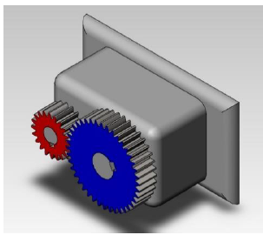
Gear Trains

Slide 20
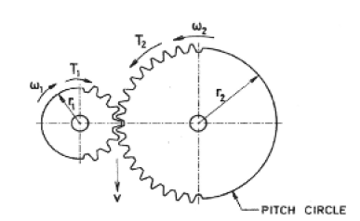
Gear Trains
The ratio of gears in any gear train is given by $\frac{Driven}{Driving}$.
This can simply be applied to the number of teeth on a gear shown as
$\frac{Number of teeth on B}{Number of teeth on A}=\frac{NB}{NA}$

Slide 21
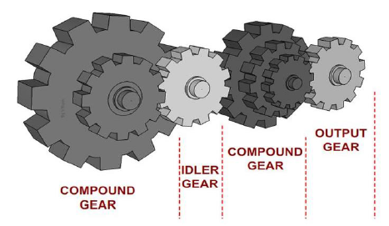
Compound gears
Calculating gear ratios for compound gear trains can again be considered in pairs in same principle of $\frac{Driven}{Driving}$.
$Gear ratio \left(GR\right)=\frac{NB}{NA}x\frac{ND}{NC}x\frac{NF}{NE}$

Slide 22
Compound gears
$Gear ratio \left(GR\right)=\frac{NB}{NA}x\frac{ND}{NC}x\frac{NF}{NE}$

Slide 23
Example 4
A simple train has 2 gears. Gear A is the input and has 50 teeth. Gear B is the output and has 150 teeth. Gear A rotates at 1500 rev/min anticlockwise. The input torques on A is 12 Nm and the efficiency is 75%.
Calculate:
GR and output speed
Output Power
Output torque and the holding torque
1) 3:1 500rpm clockwise 2) 1.41 kW 3) 27 Nm(clockwise) T3= 15Nm

Slide 24
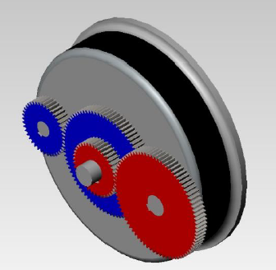
Example 5
Calculate the GR for the compound chain shown, if Gear A has 20 teeth, Gear B 100 teeth, Gear C 40 teeth & Gear D 100 teeth. If the input gear rotates clockwise, in which direction does the output rotate?
1) 12.5:1 clockwise

Slide 25
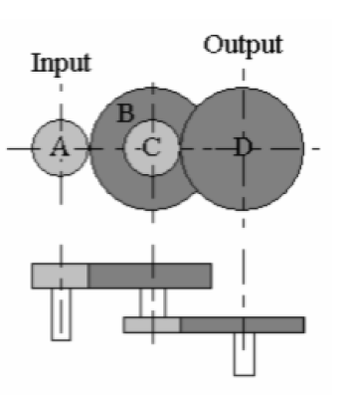
Example 6
Compound gear box shown here has an input gear A that revolves at 1200 rev/min clockwise viewed from the left end. The input torque is 30Nm and the efficiency is 70%.
If :
Gear A has 50 teeth
Gear B has 150 teeth
Gear C has 30 teeth
Gear D has 60 teeth
Calculate:
Gear ratio
Output speed and its direction
Input and output power
Output and holding torque

Slide 26
Example 6
Compound gear box shown here has an input gear A that revolves at 1200 rev/min clockwise viewed from the left end. The input torque is 30Nm and the efficiency is 70%.
If :
Gear A has 50 teeth
Gear B has 150 teeth
Gear C has 30 teeth
Gear D has 60 teeth
Calculate:
Gear ratio -6:1
Output speed and its direction – 200 rpm clock
Input and output power – 3.77 kW 2.64kW
Output and holding torque – -126 Nm, 156 Nm

