Slide 1
Major Project and Research Methods Final Report Briefing
BSc Applied Computing

Slide 2
In this session…
The purpose of the Final Project
The structure of the Final Project
Grading
Abstract
Design and implementation
Evaluation
Conclusions and recommendations
Reflection
References and Appendices

Slide 3
Purpose of the Final Project
To communicate clearly and concisely the motivation for your project, the area in which it is based, how it progressed, what it produced and what you discovered.
Each project is unique and consequently the sections covered may vary somewhat from project to project. Also some sections may be larger than others and be split into two chapters, especially if the project deals with the convergence of more than one technology.
The following is meant to be a guide to help you, not a straight-jacket. Each major section should be present in some way, although not necessarily in a chapter of its own. The chapter layout must be appropriate to each particular project.
Your supervisor should be consulted about the best layout for your particular project documentation.

Slide 4
Purpose of the Final Project
Word count: 8000 words (10% tolerance).
The word limit is set for the following reasons:
The discipline to write at this length is considerable. It is a substantial piece of academic work yet it requires good editorial skills to avoid excessive length.
It encourages incisiveness and a good grasp of technical and theoretical issues to bring them into sharp focus.
It necessitates a tight definition of the topic.
It necessitates a meaningful analysis of the relevant literature not a mere listing of sources with brief comments.
It necessitates communication of complex ideas in clear and precise fashion.

Slide 5
Structure of the Final Project
Title page (use the template in the handbook).
Declaration form (the form is in the handbook).
Abstract (short summary of the entire project. It should summarise the important points).
Introduction (set the context for your project).
Research and review of literature (a comprehensive element of review and scholarly research. Your work is done in the context of an academic discipline, Computing. Show how your project fits into the framework of that discipline by reviewing books and papers describing the problem you are trying to solve and potential solutions to the problem).
Methodology (explain in detail the what, why and how of the procedures you used in order to generate the solution to the idea).
Design and implementation (a major section which describes your deliverable. It may be a software artifact, a new framework, a systems design).
Evaluation (either you compare what you did with your objectives, or you can compare what you did with what someone else did)
Conclusions and recommendations (Does your project suggest any further avenues for research?)
Reflection (What did you learn while doing the project? How did it change you as a person?)
References, bibliography, demonstration files, appendices.

Slide 6
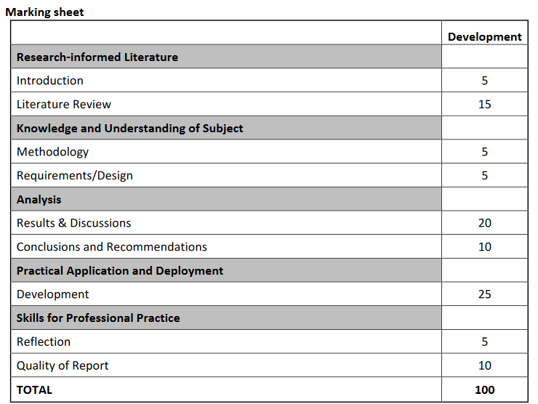
Grading
Mark distribution for the Final Report.

Slide 7
Pertinent sections
Major Project and Research Methods

Slide 8
Abstract
The abstract is the first section of the report but should be the last section written
It is a brief synopsis of the report including:
The overall aims and objectives.
A summary of the methods used.
A summary of the major findings and/or deliverables.
A statement of conclusions and recommendations.
There is a session on how you write an abstract to follow in a few weeks.

Slide 9
Design and implementation
You had to make some design decisions along the way:
Why did you choose to do something one way rather than another?
Why did you choose to include one thing but leave out something else?
Which factors did you think were most important and which did you choose to ignore?
Do not just list your decisions, place them in a context. It should be possible for the reader to understand how your design decisions contributed to meeting your objectives.
Also important is that you show the method by which you accomplished your design - “process” is as important as “product” to an engineer.

Slide 10
Evaluation
What conclusions can be drawn from your data?
Did your data back up the research in your literature review or disagree with it?
Did you meet your objectives? If not, why not?
Did you meet your aim? If not, why not?
Overall, are the answers what you would expect? If not then why not?
If you were to do it again, what would you do differently?

Slide 11
Conclusions and Recommendations
This chapter is where you tie up all the loose ends in the previous chapters.
It is most important that it relates to what you have described previously, and that it does so in a relevant and concise fashion.
You need to show how what you did contributed to meeting the objectives you set in the introduction. In doing so, it is appropriate to repeat (in summary form) key points from your review, design, implementation and evaluation as necessary.
The benefits gained from your work should be identified (these are not to include personal benefits). Also, any recommendations should be included here.
It is perfectly okay to have some loose ends left at the end of a project.
Aspects you simply did not have time to address.
Things that you were unable to do because of force of circumstances.
Pointers raised during the course of the project that you did not anticipate and were not within your scope to tackle.
All these things can be discussed in this chapter and, where further work can be identified, a distinct sub-section, “Suggestions for further work”, should be included.

Slide 12
Evaluation
Critically analyse these aspects of your project.
What conclusions can be drawn from your data?
Did your data back up the research in your literature review or disagree with it?
Did you meet your objectives? If not, why not?
Did you meet your aim? If not, why not?
Overall, are the answers what you would expect? If not then why not?
If you were to do it again, what would you do differently?

Slide 13
Reflection
Reflection is the process of looking back at something which has happened in order to show what you have learned from it. The purpose of reflective writing is to help you learn from a particular practical experience. Put simply, could you have done it better and, if so, how?
Use an established framework… but do not write your reflection as if you are filling in a form.
Gibbs reflective cycle is a good place to start.

Slide 14
References and Appendices
References (numeric system of referencing).
Vancouver system.
Guides are available on Moodle.
You could use a citation management tool like citethisforme. [4]
Include references either in the notes pane (as in these example slides) or on slide(s) at the end of the slideshow.
Appendices, information that, while not important or interesting enough to be included in the body of the report, is nevertheless relevant.
Common examples include:
Program source code.
Program documentation.
Intermediate documents.
Your report stands alone without these, but the reader may occasionally wish to refer to them.
Notes:
4. Citethisforme. Citing Vancouver. Available at: https://www.citethisforme.com/vancouver/source-type. Last Accessed: 7/8/2022.

Slide 15
Final notes
Other areas of the final project will build upon similar areas in the Project Proposal and Interim Viva.
This does not mean that you should copy them over verbatim.
All aspects of your project should grow and develop as it progresses:
Aims and objectives can (and should) change.
Literature reviews grow more weighty as you continue to read.
Approaches differ as they appear more or less viable.
These sections have not been covered in much detail here, do not think that this means that they should not be considered fully and again here.

Slide 16
Summary
Major Project and Research Methods

Slide 17
In this session…
The purpose of the Final Project
The structure of the Final Project
Grading
Abstract
Design and implementation
Evaluation
Conclusions and recommendations
Reflection
References and Appendices

Slide 18
Any questions?
No?
Then you can make a start!!

