Slide 1
Major Project and Research Methods Final Viva and Exhibition Briefing
BSc Applied Computing

Slide 2
In this session…
Final Viva
The purpose of the Final viva
The structure of the Final viva
Grading
Exhibition
Purpose and remit of the exhibition
Structure
Examples
Grading
References and Appendices

Slide 3
Final Viva
Major Project and Research Methods

Slide 4
Purpose of the Final Viva
The major project is your opportunity to impress the assessors with how much you have learnt.
You will be expected to demonstrate a cohesive, suitably technical and complete project which is consistent with study at this academic level.
You will demonstrate a detailed and academic body of knowledge acquired across the breadth of the project including aspects of planning, analysis, design, development, SQA and reflection.
The Viva allow use PowerPoint slides to assist your presentation.
It also allows time for you to demonstrate your developed outcome.
Both of these allow your assessors to gain a detailed understanding of the remit of what you have achieved.

Slide 5
Structure of the Final Viva
A 30-40 minute total oral examination of your project before your project supervisor and a second marker.
During the viva voce the student should give a presentation on his/her project for 15-20 minutes. You need to summarise the project, presenting:
The aims and objectives.
Main findings of the literature review.
Main results/conclusions.
Any recommendations for future work.
You will then answer questions about the work for a further 10-15 minutes.
Remember that the second marker only has knowledge of your project from the information presented in the Interim Viva, so you should pitch to accommodate them.
Warning: if the student is unable to answer questions about their project report, this may be an indication of unfair practice.
There is a mark for a demonstration of the work produced as part of your viva mark. This demonstration should preferably be at the end of the viva.

Slide 6
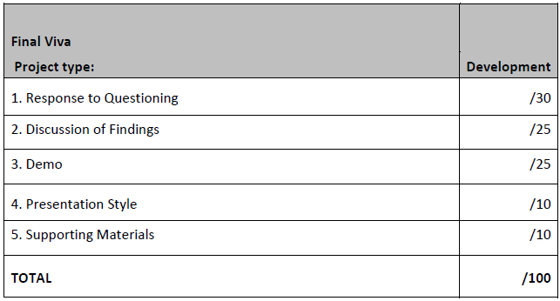
Grading
Mark distribution for the Final Viva.

Slide 7
Exhibition
Major Project and Research Methods

Slide 8
Purpose and remit of the exhibition
The exhibition section provides a summary of your work in a concise and visually attractive manner.
The ideal poster:
Will be visually attractive
Provides a brief overview of your work
Can initiate discussion and questions

Slide 9
Structure
The poster should be at A1 size.
It should cover the key points of your work.
It should include illustrations as well as text.
It should “flow”:
Try to follow our reading direction from top left to bottom right.
Make the contents a story from start to finish or the project.
Pay attention to information hierarchy:
The title of your project should appear most prominently.
Your name and degree programme should appear next most important.
Split the project into sections, give each a heading, make this less prominent.
Finally, the content text should appear smallest.
The University logo should also appear (reasonably prominently).

Slide 10
Examples

Slide 11
Examples

Slide 12
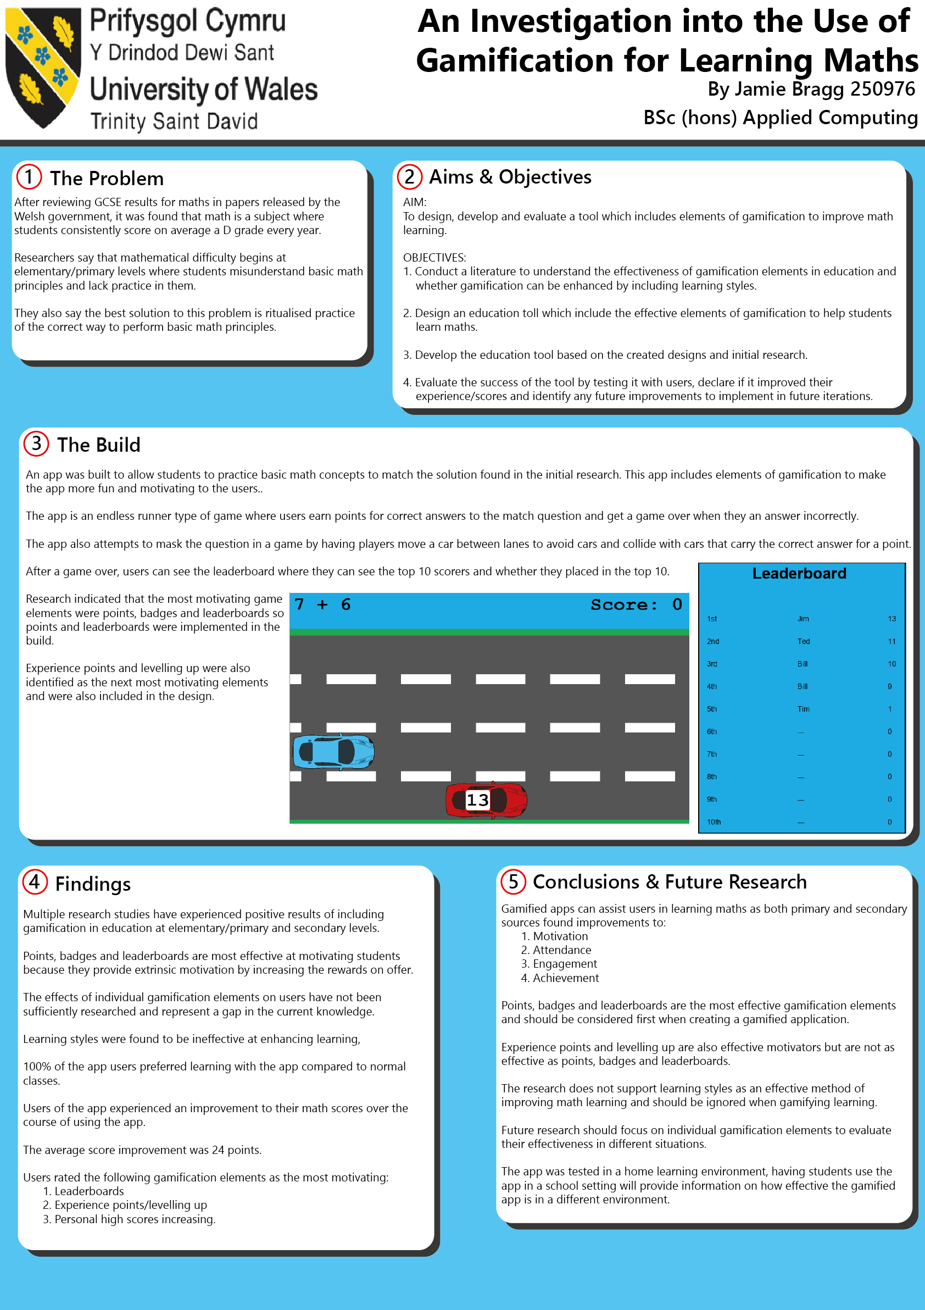

Slide 15
Grading
Mark distribution for the Exhibition poster.

Slide 16
References and Appendices
Major Project and Research Methods

Slide 17
References and Appendices
The Final Viva should be fully referenced:
You could use the notes pane of the slides.
Or you could include standalone slides at the end as a compiled bibliography.
The poster should not need references:
Make sure that you write findings using your own words.
Try to avoid reliance on prior texts here.
Space is limited so describe broad trends rather than specific aspects of researched materials.

Slide 18
Summary
Major Project and Research Methods

Slide 19
In this session…
Final Viva
The purpose of the Final viva
The structure of the Final viva
Grading
Exhibition
Purpose and remit of the exhibition
Structure
Examples
Grading
References and Appendices

Slide 20
Any questions?
No?
Good luck!

