Slide 1
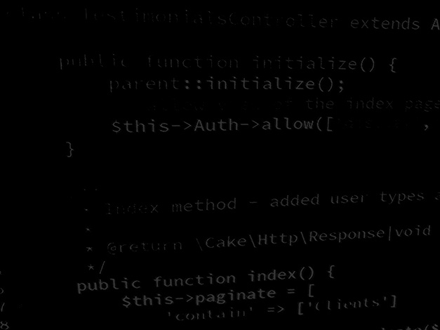
Major Project and Research Methods Reflective Writing
BSc Applied Computing

Slide 2
In this session…
What is reflection, and why is it important?
Research diary.
Reflective structure:
Tabular model.
Gibbs Reflective Cycle.

Slide 3
Reflective Writing
Major Project and Research Methods

Slide 4
What is reflection, and why is it important?
Reflection is the detailed and structured study of an experience or your own performance with a view to learning and improving.
Simply put, reflection allows us to grow.
In the context of the Major Project:
We are looking for you to demonstrate that you have learnt something, that you have developed skills and knowledge that you did not have when you started.
We are looking for you to have a complete grasp of how much you have learned and the importance of that learning.

Slide 5
Research Diary
Reflection usually takes place as the last action in the project cycle.
It can be difficult to remember the specifics:
What happened.
When it happened.
What you did about it.
What you learnt.
How you felt about it.
What you resolved to do next time.
Keeping a research diary will help with this.
It will also help you organise the massive amount of data you will read and generate while conducting your project.

Slide 6
Research Diary
A research diary is as simple or complex as you need it to be.
Could be notebooks and post-it notes to mark pages.
Blog.
OneNote.
Electronic document repository / resource (GitHub?).
Audio notes recorded on a phone or laptop.
Other?
If you keep your diary electronically, back up frequently or be prepared to deal with losing your research notes.

Slide 7
Reflective structure
When you finally come to write your reflection, you need a structure.
A reflection should take in at least three things:
A description of what has happened.
Your interpretation of this.
What you learnt from this.
A number of frameworks exist to help you structure your reflection… or you could come up with your own.
We will look at a couple of the more common approaches:
Tabular approach.
Gibbs’ Reflective Cycle.

Slide 8
Tabular approach
Before an experience | During an experience | After an experience
What do you expect to happen? | What is happening? How do you feel about it? | What are your insights following the experience? Was it successful or not? How do you feel about it when some time has passed and you have some distance?
I read “Real World Research” hoping to get an insight into research project management techniques regarding time management. | The book is weighty and intimidating. The detailed indexing and many sections allowed me to locate information on project planning using Gantt charts that I needed quickly. | I will feel more confident in approaching this reference when researching further project management techniques.

Slide 9
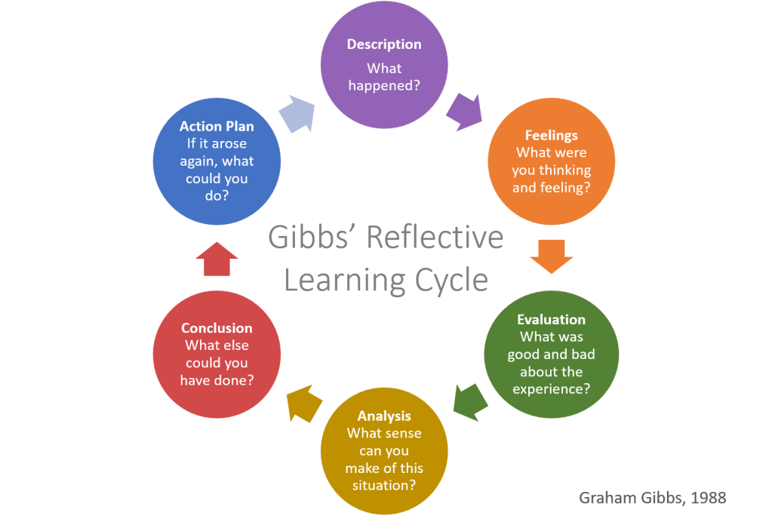
Gibbs’ Reflective Cycle
[1]
Notes:
1. Gibbs’ Reflective Learning Cycle [image on the Internet, c.2021]. [cited 3/10/2022]. Available from: https://helendenheld.com/tag/gibbs-reflective-learning-cycle.

Slide 10
Gibbs’ Reflective Cycle
This model provides a little more detail.
This is the accepted model for reflective writing at many universities.
It provides a detailed structure for good quality note-making.
Lends itself well to iterative experiences such as software development.
Helpful questions for Gibbs [2]:
What happened?
When and where did it happen?
Who was present?
What did you and the other people do?
What was the outcome of the situation?
Why were you there?
What did you want to happen?
Notes:
2. University of Edinburgh. Gibbs' Reflective Cycle. Available at: https://www.ed.ac.uk/reflection/reflectors-toolkit/reflecting-on-experience/gibbs-reflective-cycle. Last Accessed: 3/10/22.

Slide 11
A Final Word…
When writing notes for your reflection use these templates.
Do not structure your reflection using headings and sections like this in your final report.
Instead, take your notes from each stage of the model used and blend them together as a narrative passage.
Using Gibbs’ is advised as:
This is a model that will provide ample detail.
It is a model that will definitely meet your needs.
Using this model is standard reflective practice for higher education and especially post-graduate research projects.

Slide 12
In this session…
What is reflection, and why is it important?
Research diary.
Reflective structure:
Tabular model.
Gibbs Reflective Cycle.

Slide 13
Any questions?
No?
Work on the Project!

