Slide 1
Types of Joint Motion and Anatomical Directions

Slide 2
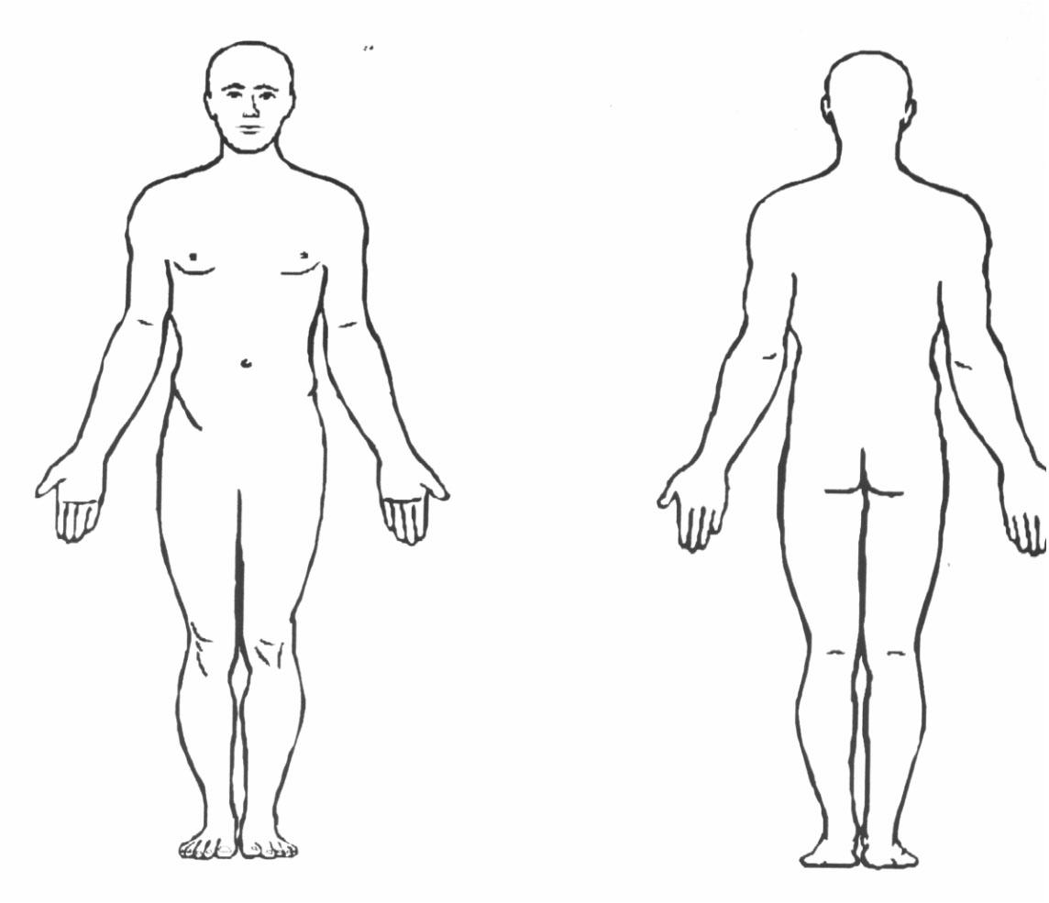
The body must be in the anatomical position for the above definitions to be true.
Notes:
Recruitment: during enrolment it is essential that key staff are in place to provide correct information. Initial screening must be used to signpost study support mechanisms possible transfers. Induction must focus on the student experience and give as much support as possible. 8 week VTCT rule to register. Crucial that staff are not trigger happy with equal prior to this. Retention .TRO ,All staff /DHoS Sl’s to check parent level retention on ARC and communicate instantly effectively across all staff learners at risk. Retention is currently 12% higher than last year at
Attainment must improve from 78% to targeted 92% . All HAT staff are driving measures forward under my direction to achieve this. Task and Finish groups address the QDP issues from the SAR . Mature learners are 49% across provision, exciting calendar of events , inspire, employer engagement, competitions and educational visits / European wplacements. Formalis d exam schedule involving penalty fees of £20 no show £10 each resist. This is showing a huge improvement from previously, missed opportunity assessments and flexible approach to support all students . Main aim to prevent end loading of assessments and assessment fatigue.

Slide 3
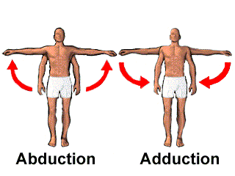
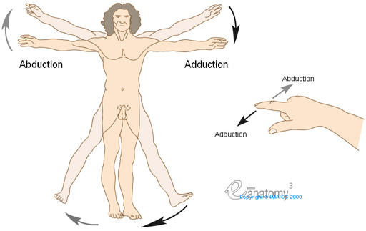
Abduction – To draw away from the mid-line
from the body.
Adduction – To draw towards the mid-line of the
body.
Notes:
Recruitment: during enrolment it is essential that key staff are in place to provide correct information. Initial screening must be used to signpost study support mechanisms possible transfers. Induction must focus on the student experience and give as much support as possible. 8 week VTCT rule to register. Crucial that staff are not trigger happy with equal prior to this. Retention .TRO ,All staff /DHoS Sl’s to check parent level retention on ARC and communicate instantly effectively across all staff learners at risk. Retention is currently 12% higher than last year at
Attainment must improve from 78% to targeted 92% . All HAT staff are driving measures forward under my direction to achieve this. Task and Finish groups address the QDP issues from the SAR . Mature learners are 49% across provision, exciting calendar of events , inspire, employer engagement, competitions and educational visits / European wplacements. Formalis d exam schedule involving penalty fees of £20 no show £10 each resist. This is showing a huge improvement from previously, missed opportunity assessments and flexible approach to support all students . Main aim to prevent end loading of assessments and assessment fatigue.

Slide 4
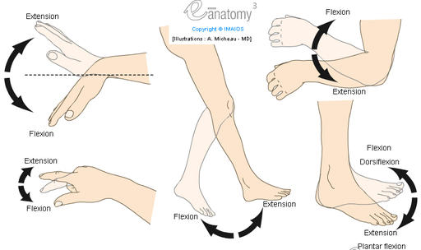
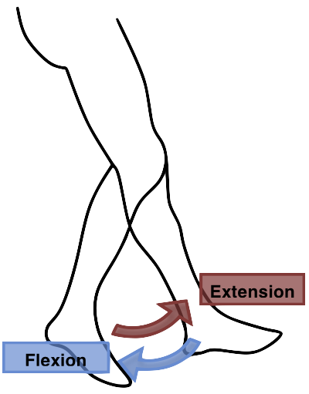
Flexion – To Bend into the body.
Extension – To draw towards the mid-line of the
body.
Notes:
Recruitment: during enrolment it is essential that key staff are in place to provide correct information. Initial screening must be used to signpost study support mechanisms possible transfers. Induction must focus on the student experience and give as much support as possible. 8 week VTCT rule to register. Crucial that staff are not trigger happy with equal prior to this. Retention .TRO ,All staff /DHoS Sl’s to check parent level retention on ARC and communicate instantly effectively across all staff learners at risk. Retention is currently 12% higher than last year at
Attainment must improve from 78% to targeted 92% . All HAT staff are driving measures forward under my direction to achieve this. Task and Finish groups address the QDP issues from the SAR . Mature learners are 49% across provision, exciting calendar of events , inspire, employer engagement, competitions and educational visits / European wplacements. Formalis d exam schedule involving penalty fees of £20 no show £10 each resist. This is showing a huge improvement from previously, missed opportunity assessments and flexible approach to support all students . Main aim to prevent end loading of assessments and assessment fatigue.

Slide 5
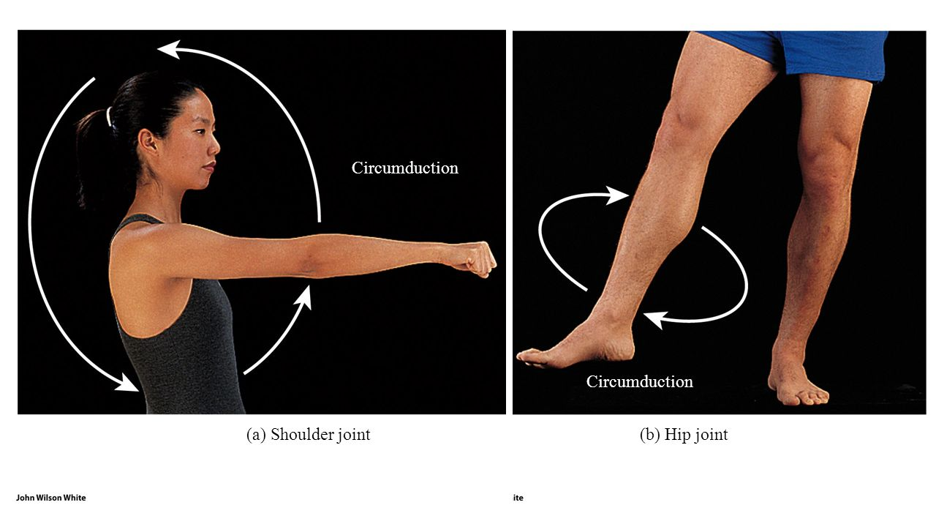
Circumduction – To move a limb in a circular manner.
Notes:
Recruitment: during enrolment it is essential that key staff are in place to provide correct information. Initial screening must be used to signpost study support mechanisms possible transfers. Induction must focus on the student experience and give as much support as possible. 8 week VTCT rule to register. Crucial that staff are not trigger happy with equal prior to this. Retention .TRO ,All staff /DHoS Sl’s to check parent level retention on ARC and communicate instantly effectively across all staff learners at risk. Retention is currently 12% higher than last year at
Attainment must improve from 78% to targeted 92% . All HAT staff are driving measures forward under my direction to achieve this. Task and Finish groups address the QDP issues from the SAR . Mature learners are 49% across provision, exciting calendar of events , inspire, employer engagement, competitions and educational visits / European wplacements. Formalis d exam schedule involving penalty fees of £20 no show £10 each resist. This is showing a huge improvement from previously, missed opportunity assessments and flexible approach to support all students . Main aim to prevent end loading of assessments and assessment fatigue.

Slide 6
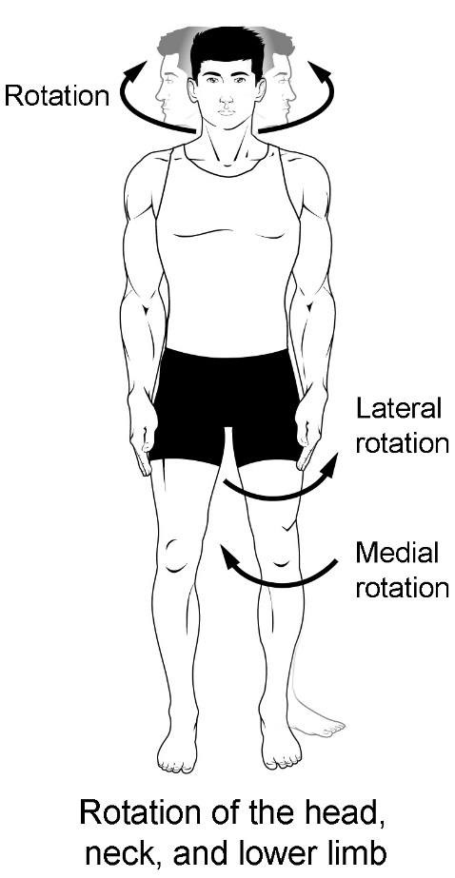
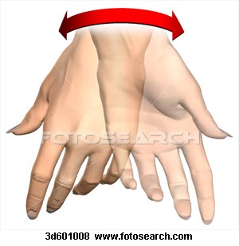
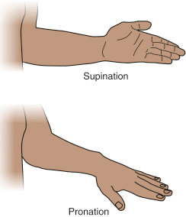
Rotation – To turn around.
Supination – Turn face or palm upwards.
Pronate – Turn face down or palm down
Notes:
Recruitment: during enrolment it is essential that key staff are in place to provide correct information. Initial screening must be used to signpost study support mechanisms possible transfers. Induction must focus on the student experience and give as much support as possible. 8 week VTCT rule to register. Crucial that staff are not trigger happy with equal prior to this. Retention .TRO ,All staff /DHoS Sl’s to check parent level retention on ARC and communicate instantly effectively across all staff learners at risk. Retention is currently 12% higher than last year at
Attainment must improve from 78% to targeted 92% . All HAT staff are driving measures forward under my direction to achieve this. Task and Finish groups address the QDP issues from the SAR . Mature learners are 49% across provision, exciting calendar of events , inspire, employer engagement, competitions and educational visits / European wplacements. Formalis d exam schedule involving penalty fees of £20 no show £10 each resist. This is showing a huge improvement from previously, missed opportunity assessments and flexible approach to support all students . Main aim to prevent end loading of assessments and assessment fatigue.

Slide 7
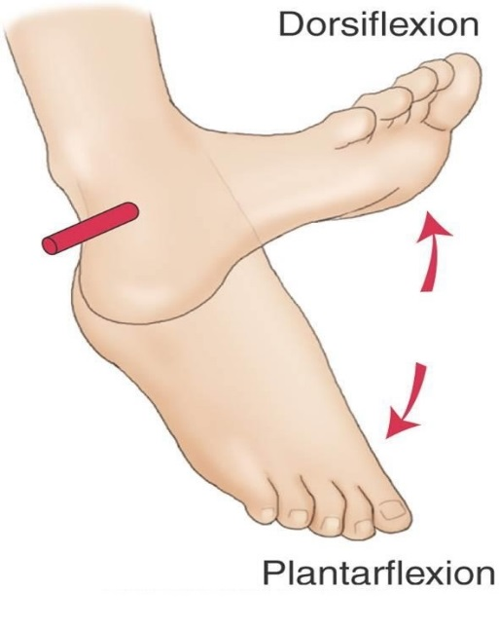
Plantar flexion – Downward movement of the big toe.
Dorsi-flexion – Upward Movement of the big toe
Notes:
Recruitment: during enrolment it is essential that key staff are in place to provide correct information. Initial screening must be used to signpost study support mechanisms possible transfers. Induction must focus on the student experience and give as much support as possible. 8 week VTCT rule to register. Crucial that staff are not trigger happy with equal prior to this. Retention .TRO ,All staff /DHoS Sl’s to check parent level retention on ARC and communicate instantly effectively across all staff learners at risk. Retention is currently 12% higher than last year at
Attainment must improve from 78% to targeted 92% . All HAT staff are driving measures forward under my direction to achieve this. Task and Finish groups address the QDP issues from the SAR . Mature learners are 49% across provision, exciting calendar of events , inspire, employer engagement, competitions and educational visits / European wplacements. Formalis d exam schedule involving penalty fees of £20 no show £10 each resist. This is showing a huge improvement from previously, missed opportunity assessments and flexible approach to support all students . Main aim to prevent end loading of assessments and assessment fatigue.

Slide 8
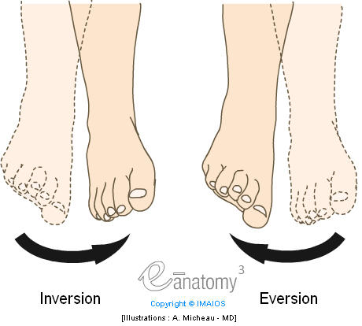
Inversion – Turn inwards
Eversion – Turn outwards
Notes:
Recruitment: during enrolment it is essential that key staff are in place to provide correct information. Initial screening must be used to signpost study support mechanisms possible transfers. Induction must focus on the student experience and give as much support as possible. 8 week VTCT rule to register. Crucial that staff are not trigger happy with equal prior to this. Retention .TRO ,All staff /DHoS Sl’s to check parent level retention on ARC and communicate instantly effectively across all staff learners at risk. Retention is currently 12% higher than last year at
Attainment must improve from 78% to targeted 92% . All HAT staff are driving measures forward under my direction to achieve this. Task and Finish groups address the QDP issues from the SAR . Mature learners are 49% across provision, exciting calendar of events , inspire, employer engagement, competitions and educational visits / European wplacements. Formalis d exam schedule involving penalty fees of £20 no show £10 each resist. This is showing a huge improvement from previously, missed opportunity assessments and flexible approach to support all students . Main aim to prevent end loading of assessments and assessment fatigue.

Slide 9
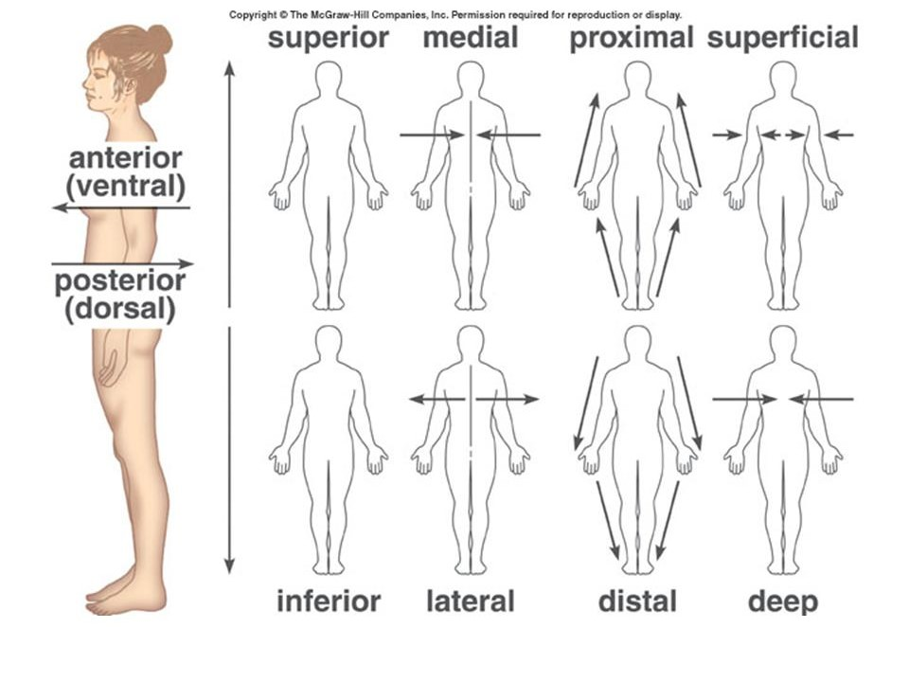
Notes:
Recruitment: during enrolment it is essential that key staff are in place to provide correct information. Initial screening must be used to signpost study support mechanisms possible transfers. Induction must focus on the student experience and give as much support as possible. 8 week VTCT rule to register. Crucial that staff are not trigger happy with equal prior to this. Retention .TRO ,All staff /DHoS Sl’s to check parent level retention on ARC and communicate instantly effectively across all staff learners at risk. Retention is currently 12% higher than last year at
Attainment must improve from 78% to targeted 92% . All HAT staff are driving measures forward under my direction to achieve this. Task and Finish groups address the QDP issues from the SAR . Mature learners are 49% across provision, exciting calendar of events , inspire, employer engagement, competitions and educational visits / European wplacements. Formalis d exam schedule involving penalty fees of £20 no show £10 each resist. This is showing a huge improvement from previously, missed opportunity assessments and flexible approach to support all students . Main aim to prevent end loading of assessments and assessment fatigue.

Slide 10
Anatomical Direction | Meaning
Anterior | Front
Posterior | Back
Superior | Towards the head/upper part
Inferior | Away from the head/lower part.
Medial | Towards the midline
Lateral | Away from the midline
Proximal | Near to structure
Distal | Furthest away from a structure
Superficial | Close to the surface of the body
Deep | Away from the surface of the body
Dorsum | Back of hand
Palmar | Palm of hand
Plantar | Downward movement of the big toe
Notes:
CLIF removed , more focus on practical work , timetable inclusion of competition workshops that allow high challenges and professionalism , in house campus competitions that lead to School competition that then filter students to Skill Wales regionals . Involvement of employers to deliver master classes in these sessions
Removal of courses of Level 2 extended dip in Hair/ Beauty piloted this year due to high level of a/ p for students entry req and screening results. sports massage removed from Applied therapy replaced by Thai stamp . Introducing of Level 1 Beauty at Afan piloting , level 2 technicals and h/ b provision at Brecon to act as platform to progression either discipline route
QR reader directory in each salon from level1 to 5 YouTube , tutorial blogs ,, interactive websites , allow support for less abled and more abled to develop discussions and high order thinking and critique of challenging scenarios

