Slide 1
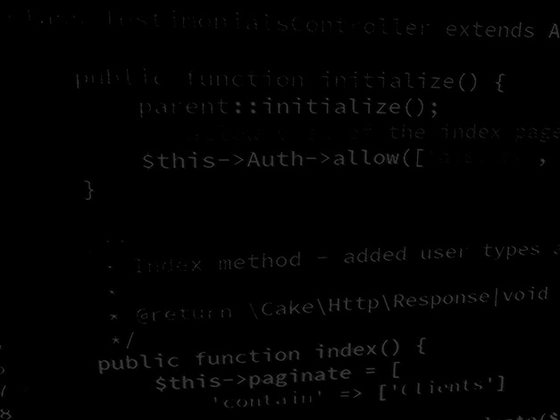
Data handling in Application development Semi-structured data Coding a MongoDB NoSQL load / save data class
BSc Applied Computing

Slide 2
In this session…
Last Session
Semi-structured data
JSON
Session Rationale
NoSQL and MongoDB
Caveats
Result Calculator project
Setting up a MongoDB Atlas Cloud account
Adding a MongoDB load / save class

Slide 3
Previous sessions
BSc Applied Computing

Slide 4
Semi-structured data
“Semi-structured data refers to data that is not captured or formatted in conventional ways. Semi-structured data does not follow the format of a tabular data model or relational databases because it does not have a fixed schema. However, the data is not completely raw or unstructured, and does contain some structural elements such as tags and organizational metadata that make it easier to analyse. The advantages of semi-structured data is that it is more flexible and simpler to scale compared to structured data.”[1]
In order for an application to be able to use data, rather than just edit it, the data needs to conform to some kind of schema so that the application can recognise one bit of data from another.
Notes:
1: Teradata. What is Semi-Structured Data? Available at: https://www.teradata.com/Glossary/What-is-Semi-Structured-Data. Last Accessed: 29/6/22

Slide 5
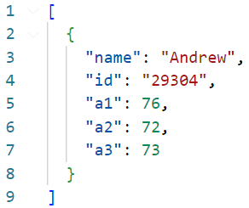
What is JSON
JavaScript Object Notation.
Saves data in a more computational format with square brackets representing lists and curly brackets representing objects.
Similar (but not identical) to the CSS data format.
Somewhat overcomes the file size issues of XML by reducing formatting information.
In the case of our Result Calculator application *:
Notes:
* The example saves each record as a list of keys and values separated by colons. JSON is able to save numerical information and String information, it can indicate its datatype by adding or omitting quotation marks.

Slide 6
When and where to use JSON
JSON creates formatted data blobs which are simple to parse from a data collection for saving to disk, and equally simple to load and parse to memory.
JSON is far more efficient than XML but is equally less human-readable.
As a result JSON is a better choice for large blobs of data or for data which have to be saved frequently but it will still hit a performance bump with reasonably large data stores... Unless these are all save to individual files… but then that will increase load time and resources.
JSON is a good is an excellent choice when data is saved and read by applications, especially when those applications do not share a platform.
For example: JSON can be served from an API running PHP on a Linux server and have that read by a Windows-based C# application.
As with XML, this is a perfectly acceptable data format for the results calculator application due to the small amount of data saved.

Slide 7
Session rationale
BSc Applied Computing

Slide 8
What is NoSQL
Not Only SQL.
Non-tabular databases.
Late 2000s.
Deployed by Facebook 2005 .
Decrease in price of storage.
Increase for need to data warehouse.
“Over the last two years alone 90 percent of the data in the world was generated” Bernard Marr (2018).
Many uses of data increasingly reliant on relationships.
Notes:
https://www.mongodb.com/nosql-explained
https://www.forbes.com/sites/bernardmarr/2018/05/21/how-much-data-do-we-create-every-day-the-mind-blowing-stats-everyone-should-read/#6372b5960ba9

Slide 9
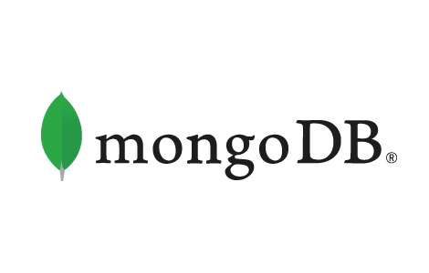
Document databases
Document store :
books, articles, magazines, etc.
JSON-like data structure:
Field / value pairs.
Values can be text, Boolean, object, etc.
Allows for irregular collections to exist without wastage (no null fields).
Can horizontally scale-out to accommodate large data volumes.
Notes:
https://www.mongodb.com/document-databases

Slide 10
Result calculator project
BSc Applied Computing

Slide 11
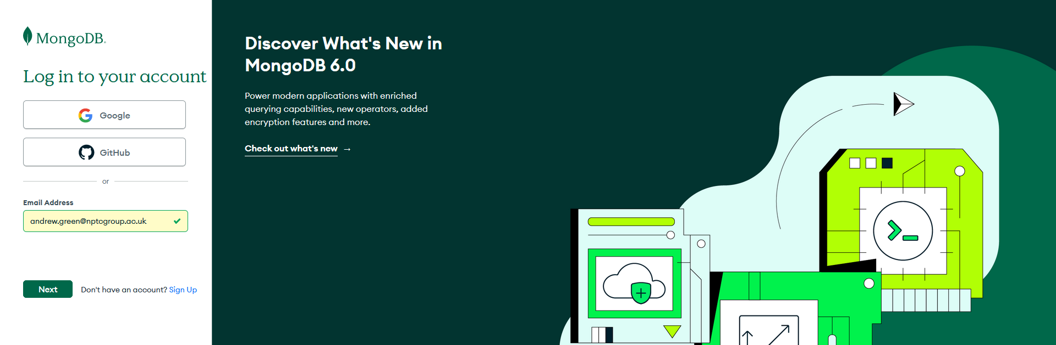
MongoDB Atlas
Atlas is a cloud-based instance of MongoDB which can be access from any location.
It prevents the need to download, install and configure a local instance of the MongoDB server.
Start by browsing to www.mongodb.com and open a free account.

Slide 12
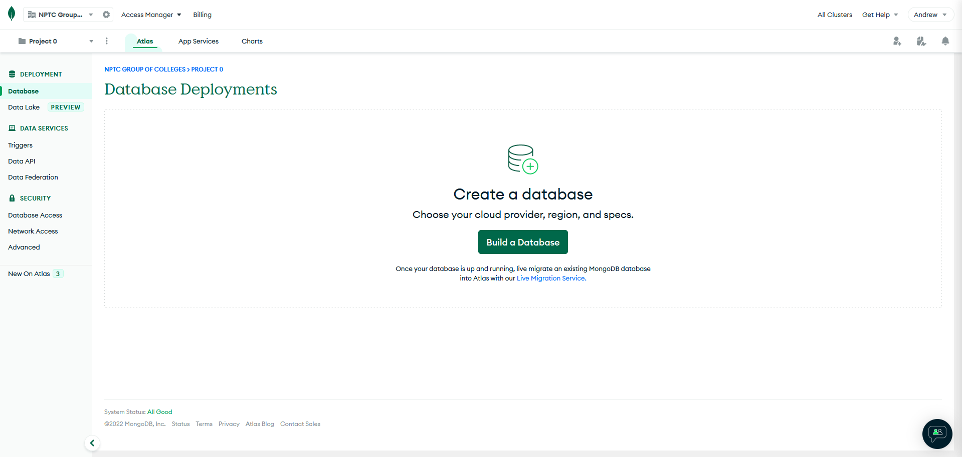
Create a database instance
Log into your account.
Locate Database Deployments and use the Build a Database control.

Slide 13
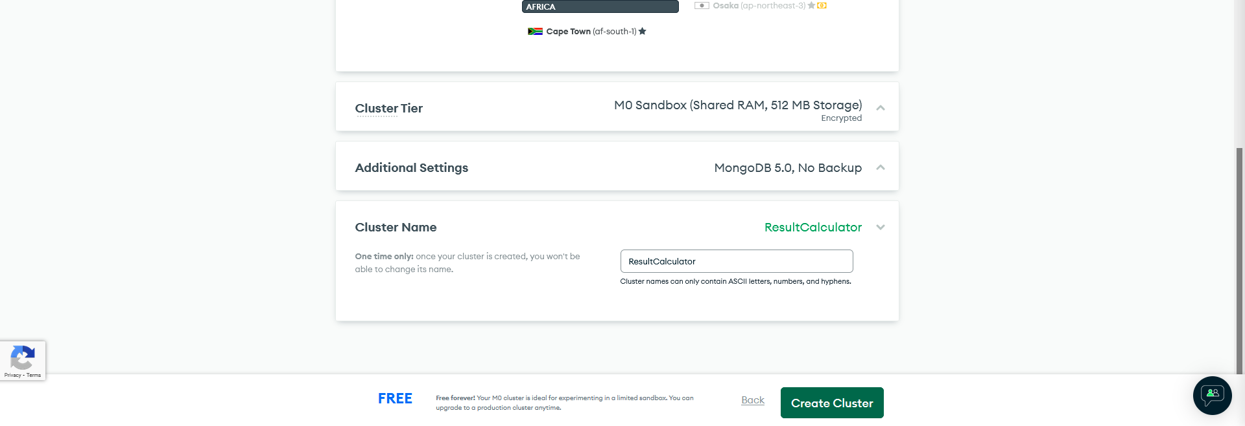
Set up the database instance
Choose the free shared database and then leave most of the other settings at their default values.
Scroll to the bottom of this screen and change the cluster name from Cluster0 to ResultCalculator.
Use the Create Cluster button to build the database.

Slide 14
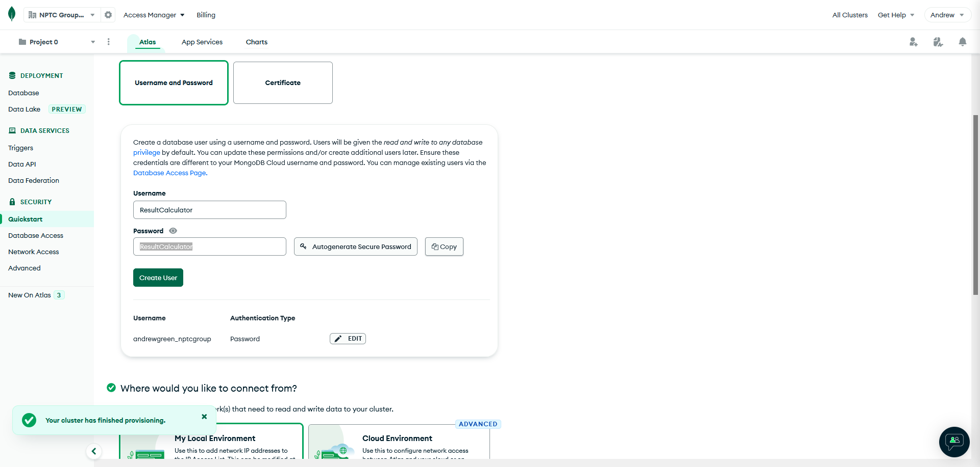
Set up a user account
Set both username and password to ResultCalculator. *
Use the Create User control.
Notes:
* This is VERY insecure… but as we are only trying this out and not storing any important data, it is the best and easiest way of remembering the UN/PW combination while developing.
If you feel that this is iffy, please substitute these details with your own.

Slide 15
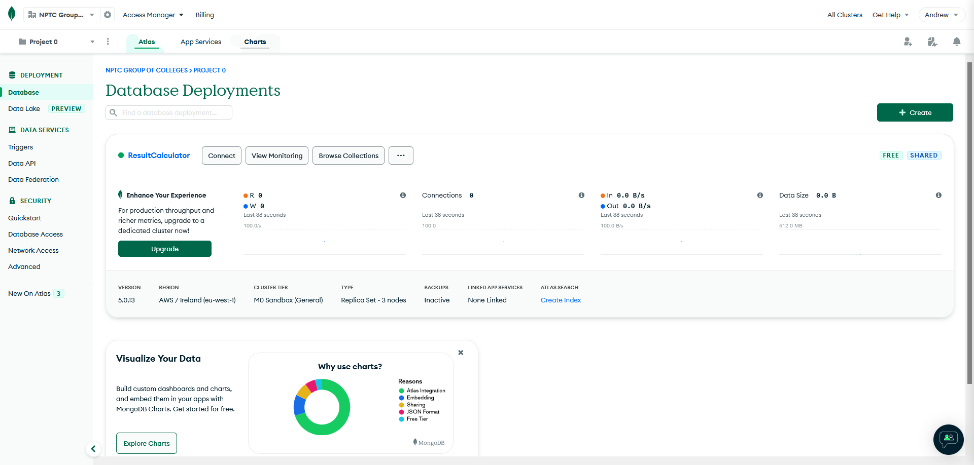
Success!
You have created your database!

Slide 16
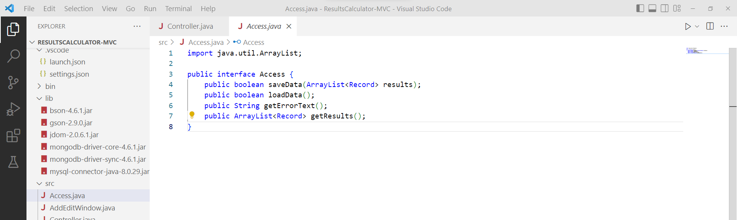
Project start
We will continue to build into the last project.
Project start up:
Open the project name ResultCalculator-MVC.
Download the bson-4.6.1.jar, the mongodb-driver-core-4.6.1.jar and the mongodb-driver-sync-4.6.1.jar from Moodle and add it to the project lib directory. *
Notes:
* If you would like to use a the most up-to-date version of MongoDB drivers, you can go here: https://www.mongodb.com/docs/drivers/java/sync/current/
At the time of writing, 4.7 is the most recent release.

Slide 17
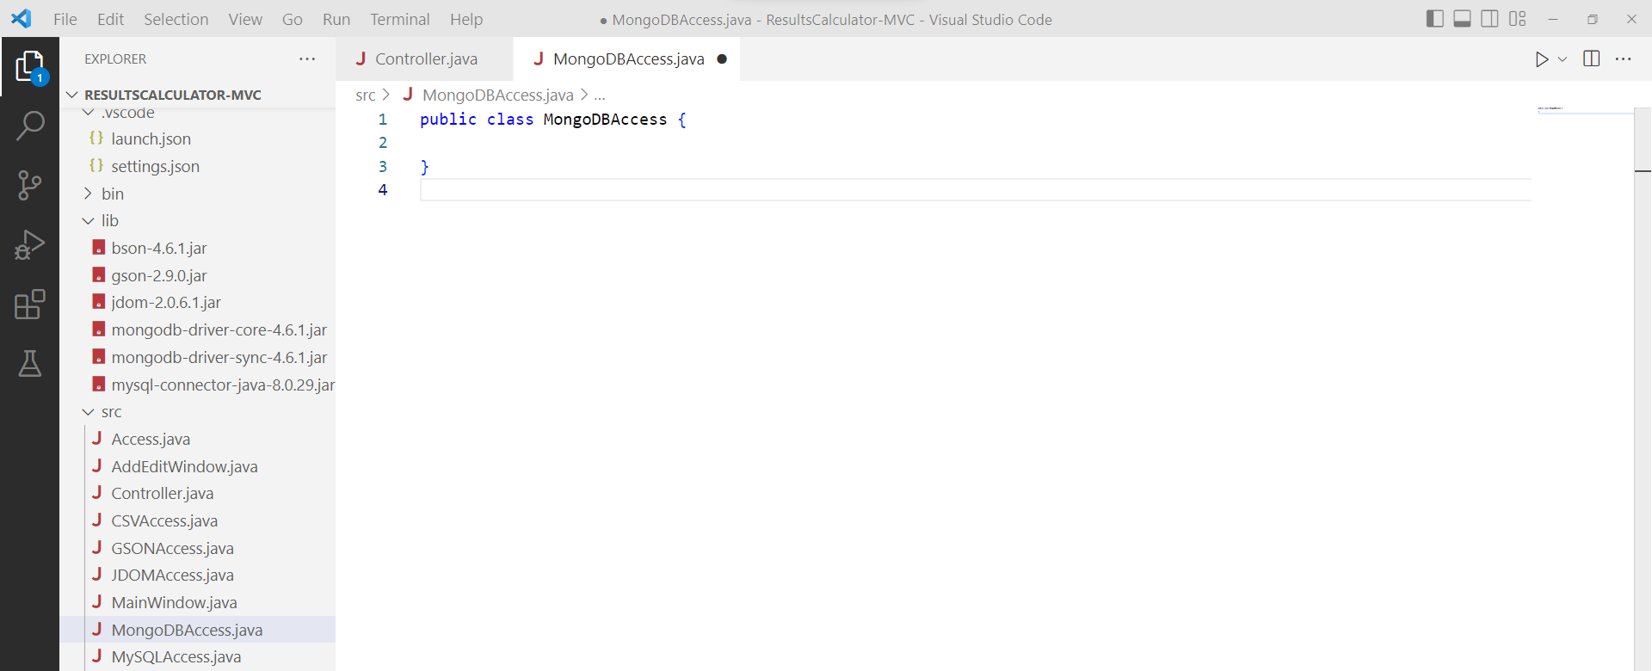
Create a data load / save class
Add a new class to the src directory by opening the Command Palette* and selecting Java: New Java Class.
Give the new class the name MongoDBAccess.
Notes:
* The command palette can be opened with either CTRL+SHIFT+P or View > Command Palette…

Slide 18
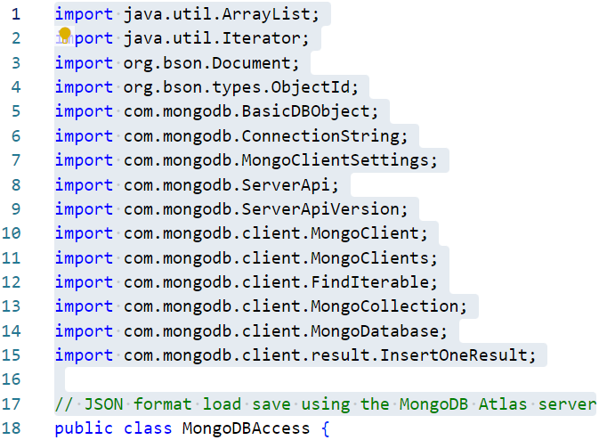
Add import statements
Add import statements required by this class.
Most of these are MongoDB driver and BSON libraries.*
Add the highlighted statements.
Notes:
* BSON is the library MongoDB uses to structure JSON-like document formats.

Slide 19
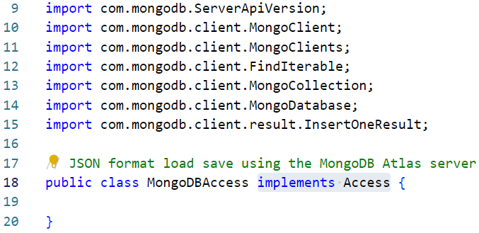
Add an implements statement
This class will implement the Access interface.
Ignore the error, this is caused by the fact that we have implemented the interface, that in doing so we have promised to include a number of methods and that we have not included these yet.
Add the highlighted statement.

Slide 20
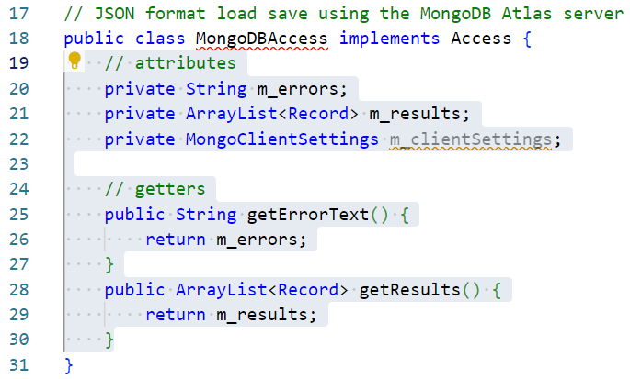
Add attributes and getter methods
Add attribute and getter methods to access them.
Add the highlighted statements and methods. *
Notes:
* Clarification:
Line 20 declares a reference to a String which will contain any error text generated by either a load or save action which cannot complete.
Line 21 declares an ArrayList of Record objects which will be used to load data from file into. The data will be stored here until it is requested by the Controller.
Line 22 declares an instance of the MongoClientSettings class which will contain the connection string required to access the Atlas cloud server.
Lines 25 to 30 contain getter methods for the error text string and the collection of Record objects.

Slide 21
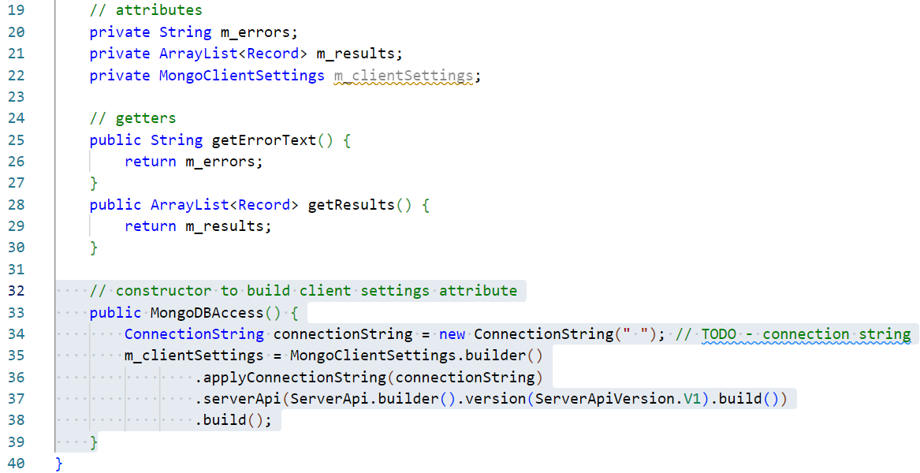
Add a constructor method
Add getter methods for two attributes just added.
Add the highlighted methods. *
Notes:
* Clarification:
Lines 33 to 39 declares a the constructor method which will be called whenever this class is instantiated. In this instance the method will instantiate and configure the global m_clientSettings reference. As this is an object, this has to be instantiated in a constructor or after.
Line 34 initialises a ConnectionString class. This requires a connection string with which to connect to the Atlas server. This will be added in the next step so we add a TODO comment for now.
Lines 35 to 38 initialise the m_clientSettings reference, applies the connection string and sets a few other default values.

Slide 22
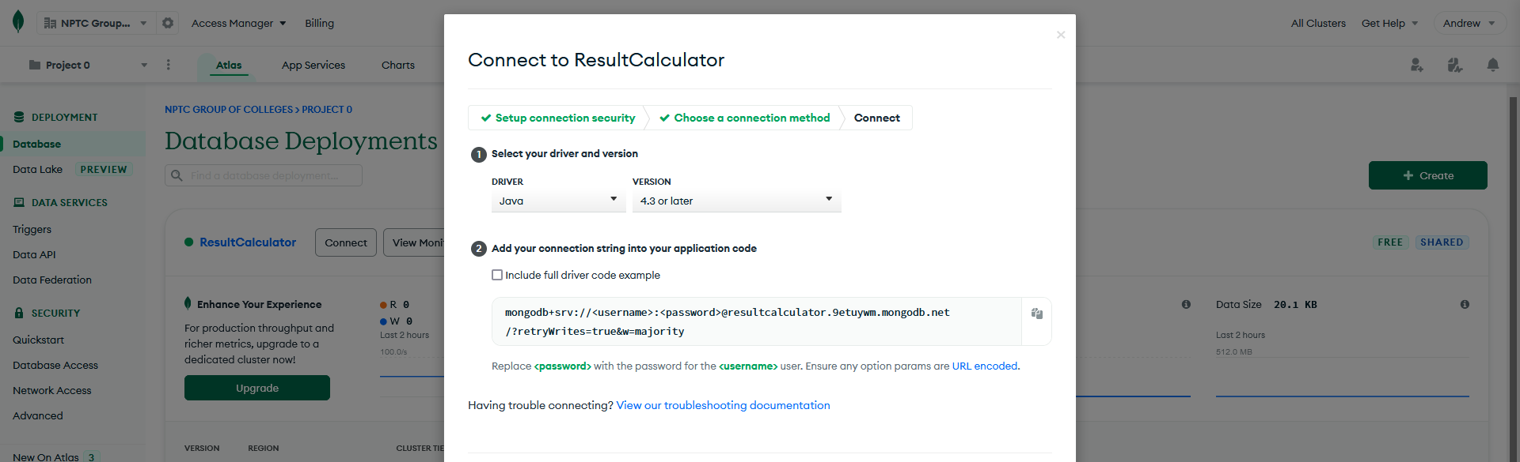
Get the connection string
Return to the Altas server instance in the web browser.
Use the Database entry in the menu on the left.
Use the Connect control.
Use the Connect My Application control.
Set the controls to the latest version of Java.
Copy the connection string presented.

Slide 23
Add the connection string
Paste the connection string into he constructor and remove the TODO.
The string has been split across 5 lines in the example below.
If you want to mimic this to make the string more readable, do so but it is also fine to keep this all on the one line.
Add your version of the following highlighted string. *
Notes:
* Clarification:
If you use the exact code shown, you will connect to MY instance of the Atlas server and not yours. This is fine but won’t help you understand how to create your own ap.

Slide 24
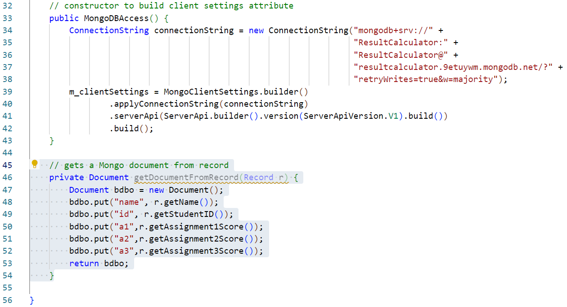
Add a Record convert method
Add a method which converts a Record to a BSON document.
Add the following highlighted method. *
Notes:
* Clarification:
Line 46 declares the method which returns a Document instance (a BSON document in this case) accepts a single Record as an argument.
Line 47 declares a new BSON Document instance.
Lines 48 to 52 systematically adds each attribute from the Record to the BSON Document object.
Line 53 returns the Document.

Slide 25
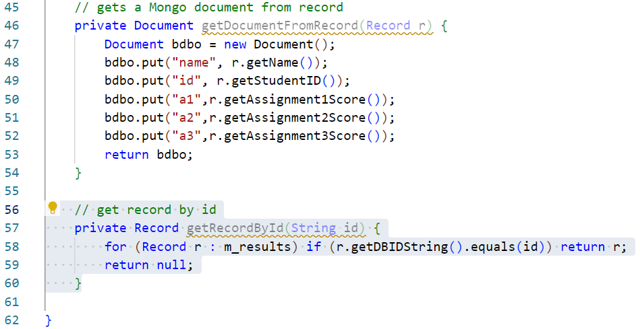
Add a Record search method
Add a method which returns a Record by ID.
Add the following highlighted method. *
Notes:
* Clarification:
Line 57 declares the method which returns a Record and accepts a single argument of a String id.
Line 58 declares a foreach loop which iterates over the Record collection returning the first Record which has an ID matching the argument value.
Line 59 returns a value of null if no matching Record is found.

Slide 26
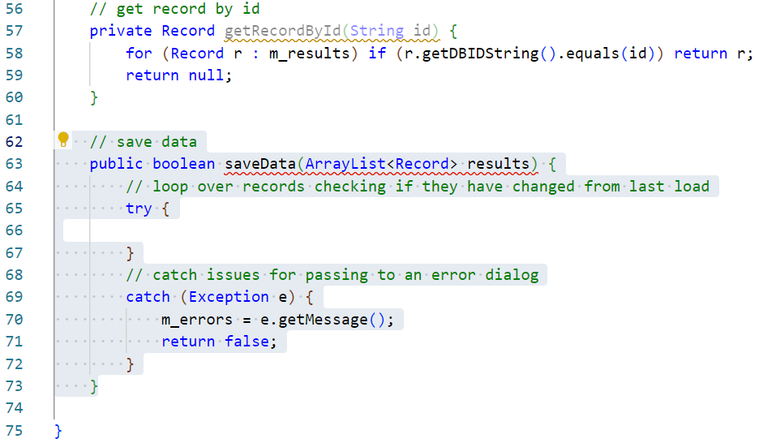
Add a save data method
Add a the framework for a save data method.
Add the highlighted methods. *
Notes:
* Clarification:
Line 63 declares the method specified in the interface which returns a boolean to indicate success or failure and accepts a single argument of an ArrayList collection of Records to save.
Lines 65 to 72 implements a try/catch block. As a file write is an operation which can generate exceptions, this block will prevent the application crashing if the write fails.
Line 70 sets the error message attribute to the message generated by the exception thrown.
Line 71 returns false to indicate that the file write has failed.

Slide 27
Add a save data method
As with the MySQL class, this method will be a little more involved.
In this build we will iterate over the collection of Records to save then:
Check to see if the DBID field is empty, if so this is a new record:
Save the new record to the database.
Select the newly entered record from the database to find the ID it has been given.
Set the DBID property on the Record object.
If the DBID field is not empty this is an existing record:
Select the previously saved record from the database.
Check the saved data against the Record object to see if anything has changed.
If anything has changed, update the record in the database.
Get a list of all records from the database:
Iterate over these looking for Records that have been deleted from the collection in memory, build a list of records to delete.
Iterate over the list of records to delete, delete these records from the database.
This is a little unorthodox and stems from an application flow designed to deal with single save data-files. *
Notes:
* Good analysis of the brief would have identified the need for a database. This should have led to an application workflow more in sympathy with the idea of loading, deleting and saving individual records at a time rather than the whole datastore at once.
It is important to recognise this limitation in the following code and to recognise that a far more performant approach is possible.

Slide 28
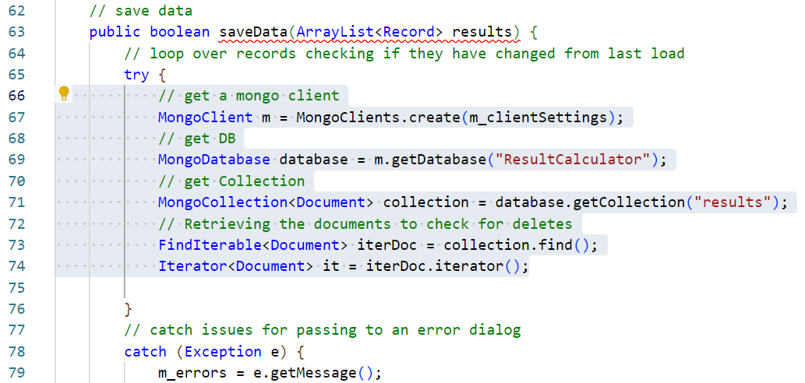
Add a save data method
Create a MongoDB connection and get a reference to the data collection.
Add the highlighted statements. *
Notes:
* Clarification:
Line 67 creates an instance of a MongoClient class using the connection settings defined earlier.
Line 69 gets a reference to the named database on the MongoDB server.
Line 71 gets a reference to the data collection of the named database.
Line 73 converts the collection to a type which can be iterated over with a while loop.
Line 74 creates an iterator which can be used to examine the data in the collection individually.

Slide 29
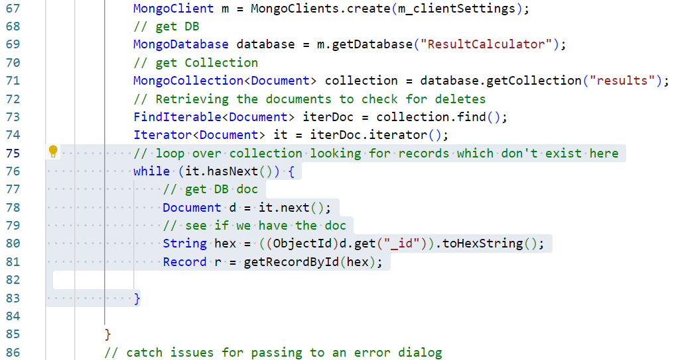
Add a save data method
Iterate over the data collection, look for records to delete.
Add the highlighted statements. *
Notes:
* Clarification:
Line 76 declares a while loop which will iterate as long as the it reference has more entries (data records).
Line 78 gets a reference to the current BSON Document in the data collection.
Line 80 gets a string refence of the this Document hex id (which is what Mongo uses for the datatype of its ids).
Line 81 uses the utility method coded earlier to return the corresponding Record from the application data collection (if the Record does not exist a value of null will be returned meaning that the Record has been deleted from the application and should now also be deleted from the database.

Slide 30
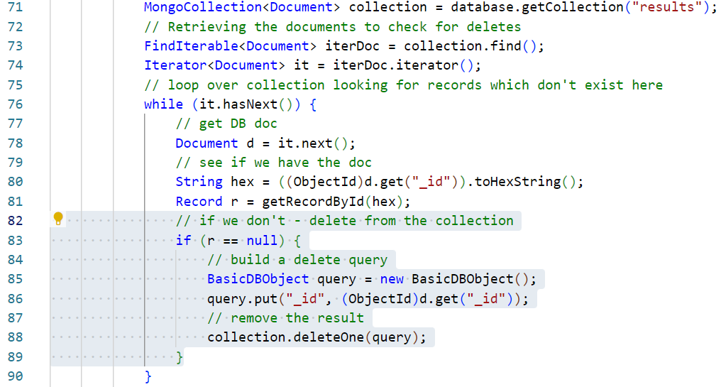
Add a save data method
Remove old documents from the database.
Add the highlighted statements. *
Notes:
* Clarification:
Line 83 tests the Record to see if has been deleted (is equal to null).
Line 85 begins building a query object.
Line 86 specifies that the record to be deleted should be identified via its ID.
Line 88 executes the delete process on the database collection removing this record.

Slide 31
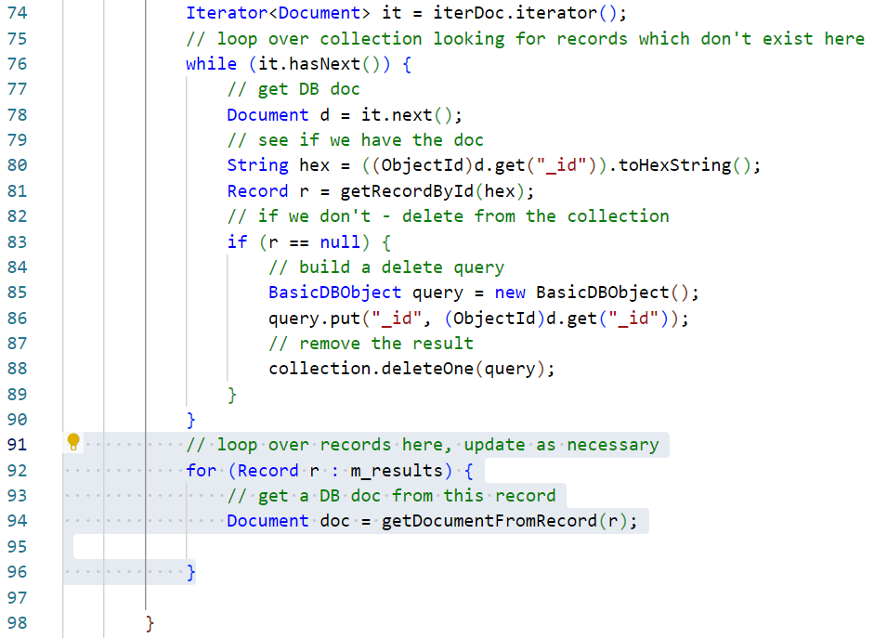
Add a save data method
Loop through the Records in the collection, action adding and amending.
Add the highlighted statements. *
Notes:
* Clarification:
Line 92 declares a foreach loop which will iterate over the Record collection.
Line 94 uses the method coded earlier to get a BSON Document which corresponds to this Record.

Slide 32
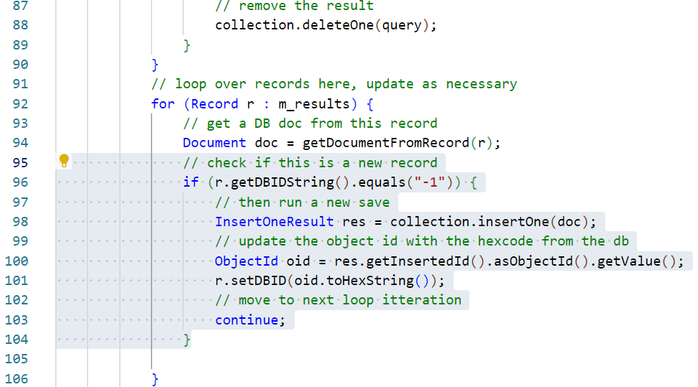
Add a save data method
Add in any new Records.
Add the highlighted statements. *
Notes:
* Clarification:
Line 96 tests the Record id, if it is -1 then this is a new Record and needs to be added to the database.
Line 98 declares and actions an insert query passing the Document object created earlier.
Line 100 gets the new database id that Mongo assigns to this Document.
Line 101 sets the new database id attribute of the corresponding Record object.
Line 103 declares continue which skips the rest of the statements in this loop iteration as there is no need to amend this Record further if it is new data.

Slide 33
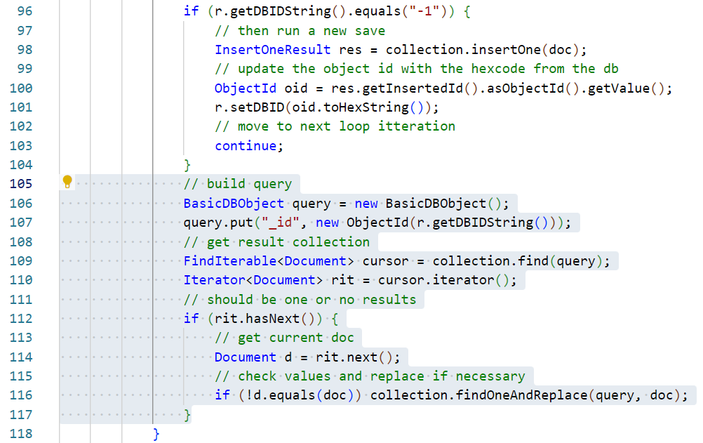
Add a save data method
Check for amended Records replace older data in the database.
Add the highlighted statements. *
Notes:
* Clarification:
Lines 106 to 110 build and execute a query to return a collection of objects which have the object ID of the corresponding Record. This should only ever be a collection of 1 Document.
Line 112 tests that the collection has a Document.
Line 114 retrieves the first and only Document form the collection
Line 116 executes a replacement on the stored Document with the Document created at the top of the save method. This systematically replaces all existing data in the database with that in memory. This is not especially efficient application workflow and can certainly be improved as ideally minimising database interaction is desirable. Ideally the application would act to load and save data a record at a time as would also benefit the MySQL application workflow. For now, this demonstrate how to action a find and replace using this kind of database and it is a workflow which works in the context of this application and its interface. Ideally, the application logic and interface would have been initially defined with database interaction in mind.

Slide 34
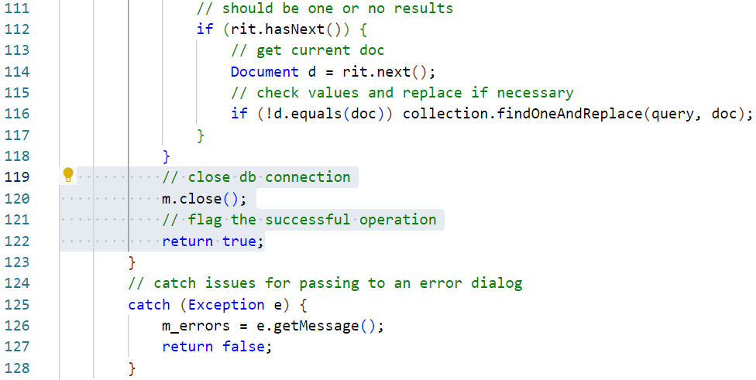
Add a save data method
Complete the method by closing the connection.
Add the highlighted statements. *
Notes:
* Clarification:
Line 120 closes the MongoClient connection object.
Line 122 returns a value of true to indicate a successful save operation.

Slide 35
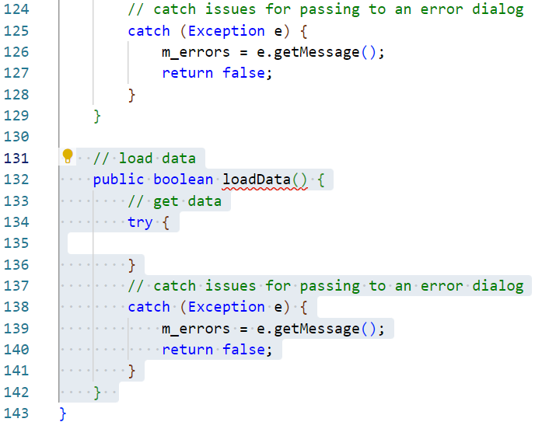
Add a load data method
Finally, we add a method to load and parse data from the XML file.
Add the highlighted method. *
Notes:
* Clarification:
Line 132 declares the method specified in the interface which returns a boolean to indicate success or failure and does not require any arguments.
Lines 138 to 1141 implements a try/catch block. As a data read is an operation which can generate exceptions, this block will prevent the application crashing if the write fails.
Line 139 sets the error message attribute to the message generated by the exception thrown.
Line 140 returns a value of false to indicate that the file read has failed.

Slide 36
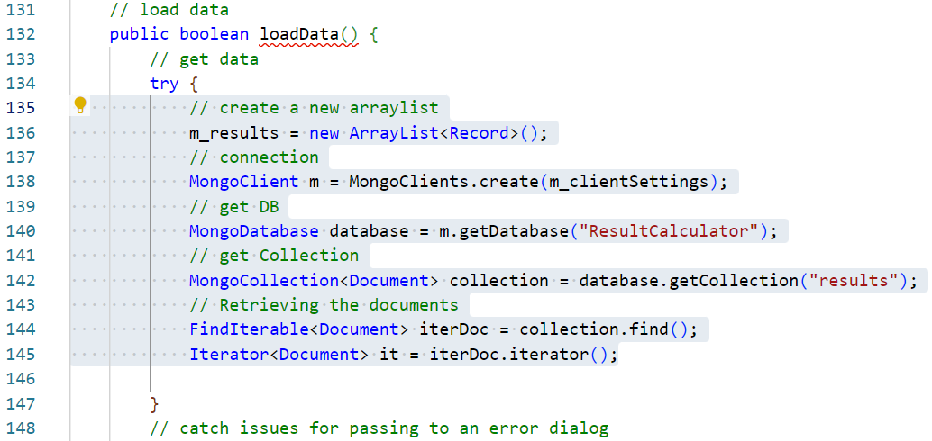
Add a load data method
Start to add the ability for this new method to connect to the database.
Add the highlighted statements. *
Notes:
* Clarification:
Line 136 resets the ArrayList collection of Record objects to a new, empty collection.
Line 138 creates a new MongoClient object from the connection settings object created in the constructor method.
Line 140 creates a new reference to the MongoDatabase that the app is connected to.
Line 142 retrieves a collection of all documents linked to the Results database.
Line 144 creates a “load all” query and returns this as an iterable collection of Mongo Document objects.
Line 145 creates an Iterator collection of Mongo Document objects from the results of the query.

Slide 37
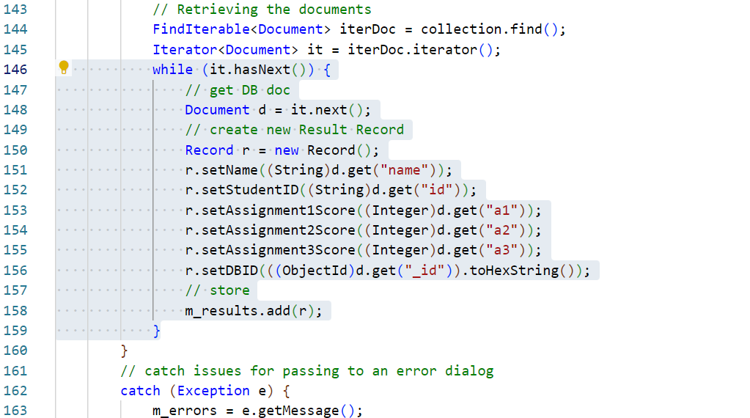
Add a load data method
Add an ETL loop to load the data to Record objects.
Add the highlighted statements. *
Notes:
* Clarification:
Lines 146 to 159 implements a while loop which iterates while the Iterator collection has another member. Each Document object is converted to a Record object by setting the appropriate attributes. The loop continues converting all Mongo data to the Record classes used by the application. Finally, each Record is added to the global ArrayList collection for the Controller class to collect later.

Slide 38
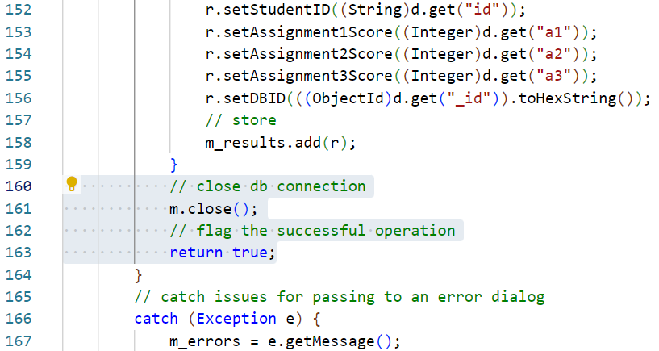
Add a load data method
Finally, close the database connection.
Add the highlighted statements. *
Notes:
* Clarification:
Line 161 closes the ResultSet closing the database connection.
Line 163 returns true indicating a successful load operation.

Slide 39
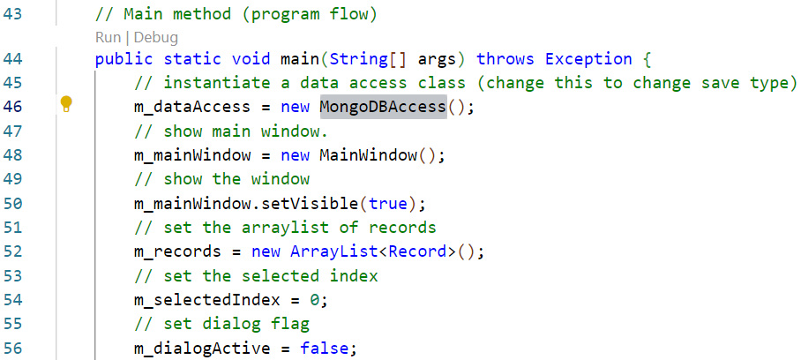
Set the Controller to use MySQL
The application needs to be set to use the new MySQL load/save class.
Amend the highlighted statement. *
Notes:
* Clarification:
Line 46 is altered from using the old MySQLAccess class to using the new MongoDBAccess class. As both of these classes implement the Access interface, the rest of the application can be left unaltered as it already knows how to interact with any class using the Access interface. The application should now load and save data to the Mongo Atlas cloud database created earlier.

Slide 40
Test the application
BSc Applied Computing

Slide 41
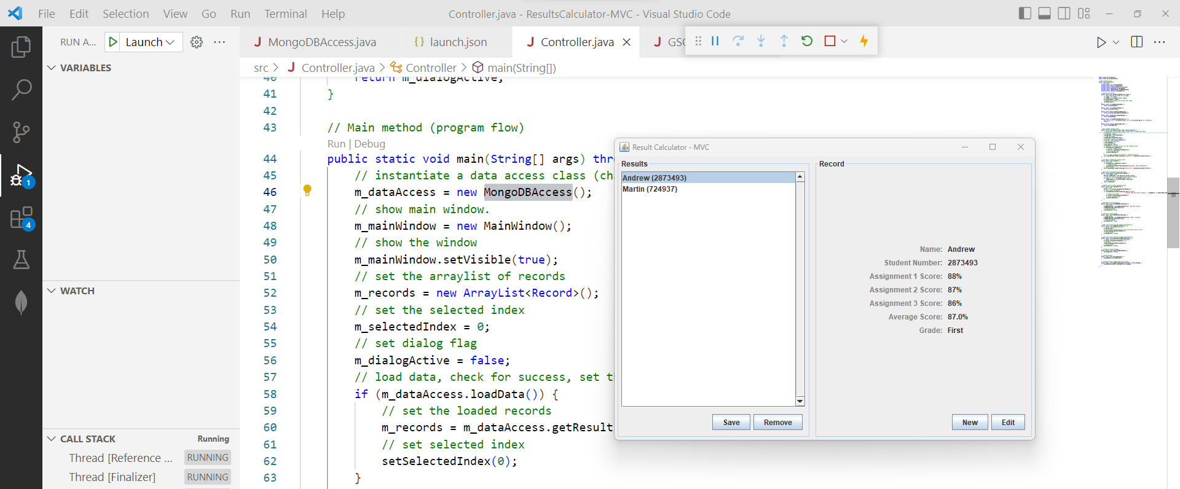
Test the application
Open the Run and Debug panel.
Use the green Start Debugging arrow to run the program.
You should be able to fully use the application. *
Notes:
* If you get an authentication error here, it is possible that the connection string has not been entered correctly, or you are in a location which blocks access to MongoDB because of a restricted port number. The error message should explain which it is. If access to MongoDB is blocked, try running the program again from a different location.

Slide 42
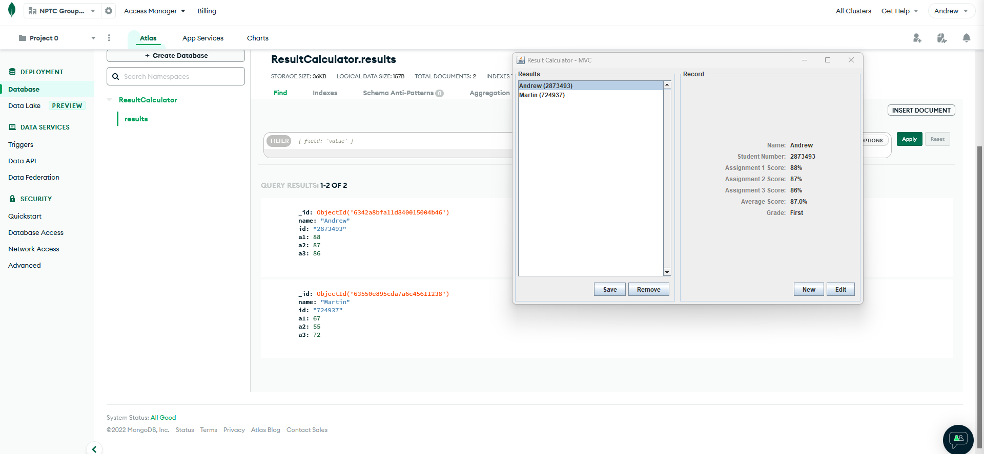
Test the application
Log into your MongoDB Atlas account.
Start the application again to load in the data saved in the previous run.

Slide 43
Project Summary
BSc Applied Computing

Slide 44
This project has covered…
Taking advantage of the of the functional divisions created by the MVC architecture and of OOP interfaces.
Using a cloud-based NoSQL database server. The application does not have an ideal workflow for this kind of connection but, as with the MySQL connection class, this is simply intended to demonstrate how these connections work.
Applying 3rd party libraries (JAR files) manually to a Java project.

Slide 45
To reiterate…
It should be acknowledged that the best way to interact with any form of database is to save records one at a time.
To make our application do this cleanly would require a structural rethink of the Controller class and possibly the Record class. It would certainly require amending the Access interface.
Ordinarily, the task would be analysed and if a database server is required, this approach would be built in.
For the purposes of time, speed and sanity, the Result Calculator’s MongoDB save method will loop through its list of Records. Any new records will be added to the database. Any existing records will be compared against a copy retrieved from the database, if changes are found, a new version of the record will be saved.
This is NOT ideal and not performant. It will demonstrate how to load and save data to a Mongo database, which is the overriding point.

Slide 46
Session recap…
Last Session
Semi-structured data
JSON
Session Rationale
NoSQL and MongoDB
Caveats
Result Calculator project
Setting up a MongoDB Atlas Cloud account
Adding a MongoDB load / save class

Slide 47
Any questions?
Next…
Saving the data to the NoSQL MongoDB Atlas cloud service.

