Slide 1

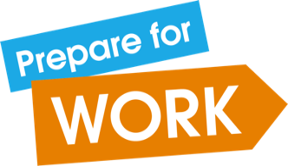
^{Could you be an} ^{entrepreneur?}

Slide 2
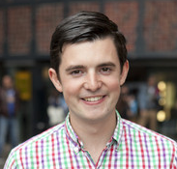
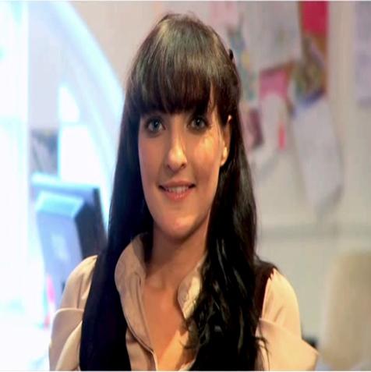
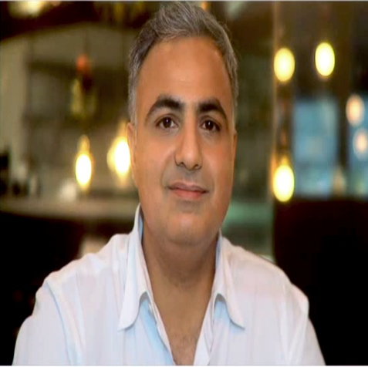
Successful entrepreneurs
Can you match Fraser, Katy and Shamil to their business?
Fraser Doherty
Katy Sale
Shamil Thakrar
Founder of Princess Parties, plans events and parties for girls aged 4 – 18 years old.
Opened Dishoom,
an Indian restaurant putting a modern twist on Indian cooking.
Established SuperJam at age of 14 using a family recipe. The jam now sells in over 2,000 supermarkets worldwide.

Slide 3
Is there a difference?
Self-employed people work for themselves. They will generally offer a product or service that already exists, but may try to do this in a different
or better way. A self-employed person could be an entrepreneur, but not
all entrepreneurs are self-employed.
An entrepreneur is someone who aspires to come up with an idea for
an innovative business, product or service. They could be self-employed, but not all entrepreneurs are self employed.
3 | Could you be an entrepreneur?

Slide 4
Quiz: Are you a born entrepreneur?

Slide 5
Which would you find more enjoyable?
(a) Dealing with real-life situations, closing a deal, winning a new client.
(b) Day dreaming about products that don't yet exist.

Slide 6
Which description best fits you?
(a) I relate more to people, things and information.
(b) I respond powerfully to beauty and often find it in things others don't.

Slide 7
When you hit a block in reaching a goal, which are you more likely to say to yourself?
(a) If I can just stick to my game plan and persevere, I'll get there,
I've done it before.
(b) Maybe there's another way to reach my goal, besides, I'd rather try
something new anyway.

Slide 8
If you're forced to break a promise to your best friend, which would you be more likely to say to yourself?
(a) Well, we're good friends; they will understand.
(b) I'll either find a way to keep my promise or make it up to them somehow.

Slide 9
Which statement best describes what you do when faced with a task you dislike?
The sooner I get this out of the way, the sooner I won't have to think about it anymore.
(b) I know I've got to do it sometime – just not now.

Slide 10
After you've been to a party with a lot of other people, which are you more likely to feel?
(a) Energised, maybe even sorry to leave the party.
(b) Tired and ready for some quiet time alone.

Slide 11
On holiday, how would you prefer to spend most of your time?
(a) Going, doing, and seeing as much as possible.
(b) Relaxing, reading, and kicking back.

Slide 12
When you've been successful at something, you feel it's been mostly because:
(a) You've worked harder and are smarter than a lot of other people.
(b) You've had a lot of help from others, great opportunities, and a little luck.

Slide 13
The Results
Count up how many A’s and B’s you have:
  Very few A’s: Is the life of an entrepreneur really for you?
  Mainly A’s: Don't hang around. You were born for business.

Slide 14
Skills and qualities of an entrepreneur
  Creative
  Determined
  Confident
  Passionate
  Able to make decisions
  Open minded – every situation
  is a business opportunity
  Self starter – entrepreneurs know that if something needs to be done, they should start it themselves
  Competitive
  Communication and persuasion skills – good at selling things
  Ability to plan and restrain impulses
  Spontaneous
  Free-spirited
  Extrovert
  Ability to cooperate with others

Slide 15
Myth busters
Discuss whether the comments below are really true. Click on each one to reveal the answer. Once they’ve all been explored click on the ‘Next’ button
to move to the next slide.
Entrepreneurs must be experts
Entrepreneurs must have original ideas
Entrepreneurs are larger-than-life personalities
Entrepreneurs are egomaniacs
Entrepreneurs are huge risk takers
Next

Slide 16
Myth busters
Entrepreneurs must be experts
Whilst it is important for entrepreneurs to know about the market place (industry) in which they wish to sell their product or service, they don’t need to know everything from the start. You can learn over time. The key to success is having the drive to learn!
Back

Slide 17
Myth busters
Entrepreneurs must have original ideas
Whilst a lot of entrepreneurs are incredibly creative, a lot of successful businesses are just copies or adaptations of other businesses. The key is to make sure that you are doing it better than anyone else.
Back

Slide 18
Myth busters
Entrepreneurs are larger-than-life personalities
It’s true that people with big and bold personalities get noticed. But being the life and soul of the party is not important when you're starting a business. It’s more important to ensure that what you are offering is something people will want to buy and that you can convince others to work with you and buy from you.
Back

Slide 19
Myth busters
Entrepreneurs are egomaniacs
Although some entrepreneurs may come across overly confident about themselves, the best will have what is known as a healthy ego. These are entrepreneurs who listen to the opinion of others, are able to take criticism and build relationships with others.
Back

Slide 20
Myth busters
Entrepreneurs are huge risk takers
Starting a new business or launching a new idea can be risky, especially when you’ve put money into your idea. But the best entrepreneurs work out (calculate) the risks involved and plan for these.
Back

Slide 21
Being employed versus working for yourself
 | Job security | Other benefits | Flexibility | Control | Responsibility
Being employed by an organisation | Regular income and job security | Will typically be paid for holiday and sick leave, and have access to benefits such as an employer pension or private health care | Generally less opportunity to vary your working hours and will have a set number of holiday days to take each year | You have less freedom to make your own decisions | You are not responsible for the overall performance of the organisation
Working for yourself or starting a business | Income and work available may vary | You need to make your own pension arrangement, you don’t get paid for sick leave/ holiday | More freedom to work varied hours and take holiday | You are your own boss and so have ultimate control | You are responsible for the performance of the organisation and whether it succeeds

