Slide 1


^{Assessments and interviews}
1 | Assessment and interviews – Prepare to pass

Slide 2

Possible stages in the recruitment process
  Telephone interviews
  Face-to-face interviews
  Individual assessments
  Group interviews and assessments
  Assessment centres
Notes:
Explain that by being involved in the delivery of the Barclays Money Skills ‘weeks’ activities, ‘college champions’ will develop some of the key skills that employers look for in new recruits.
Many employers feel that despite having the relevant qualifications, young people often lack other key skills and competencies that their employees need to succeed in the workplace.
As a ‘college champion’ they will have lots of opportunities to practice and improve some of the key skills that employers look for. These include:
Planning and organising
Communication
Inter-personal skills
Team working
Taking initiative
They will also be able to use their experiences as a ‘college champion’ to their advantage on their CV, to support job applications etc.
For learners doing BTEC (Business and Technology) qualifications, they could use the skills employed in delivering activities as evidence towards their course units on running an event or team working.

Slide 3
Telephone interviews
Used to decide who to invite to a face-to-face interview
Key features
  Normally last no more than 30 minutes
  Timings agreed in advance
  There may be more than one person on the phone
Tips
  Make sure you are in a quiet place where you won’t be disturbed
  Know the name and position of who you will be speaking to
  Prepare in the same way that you would for a full interview (see face-to-face interview)
  Have your CV or application form to hand
  First impressions count, practice answering the phone professionally
  Try to build rapport, don’t just answer yes or no
Notes:
Explain that by being involved in the delivery of the Barclays Money Skills ‘weeks’ activities, ‘college champions’ will develop some of the key skills that employers look for in new recruits.
Many employers feel that despite having the relevant qualifications, young people often lack other key skills and competencies that their employees need to succeed in the workplace.
As a ‘college champion’ they will have lots of opportunities to practice and improve some of the key skills that employers look for. These include:
Planning and organising
Communication
Inter-personal skills
Team working
Taking initiative
They will also be able to use their experiences as a ‘college champion’ to their advantage on their CV, to support job applications etc.
For learners doing BTEC (Business and Technology) qualifications, they could use the skills employed in delivering activities as evidence towards their course units on running an event or team working.

Slide 4
Face-to-face interviews
Used to meet you in person and decide if you are right for the job
Key features
  You will be asked questions by one person or a panel of people
  Usually the person who will manage you will be in the interview
  You may have to attend more than one face-to-face interview
  Tips
  Research the company in advance. Know:
    What they do and where they do it
    Their vision and values
    Any recent news about the company
  Prepare examples of how your skills and competencies match the role requirements in advance
  Think of some questions to ask at the end of the interview
Notes:
Explain that by being involved in the delivery of the Barclays Money Skills ‘weeks’ activities, ‘college champions’ will develop some of the key skills that employers look for in new recruits.
Many employers feel that despite having the relevant qualifications, young people often lack other key skills and competencies that their employees need to succeed in the workplace.
As a ‘college champion’ they will have lots of opportunities to practice and improve some of the key skills that employers look for. These include:
Planning and organising
Communication
Inter-personal skills
Team working
Taking initiative
They will also be able to use their experiences as a ‘college champion’ to their advantage on their CV, to support job applications etc.
For learners doing BTEC (Business and Technology) qualifications, they could use the skills employed in delivering activities as evidence towards their course units on running an event or team working.

Slide 5
Individual assessments
Used to test whether candidates have the required skills and competencies
Key features
  You can be asked to do these before or after an interview
  May be completed online
  Often multiple choice
  May be timed
  You may have to pass to move on to the next stage of the recruitment process
  Types of assessments include:
  Numeracy, literacy and logical reasoning tests
  Personality questionnaire – to identify your key character traits and see if you ‘fit’ the organisation and role.
  In-tray exercise – to check how you would approach a task that you might do in the role
Notes:
Explain that by being involved in the delivery of the Barclays Money Skills ‘weeks’ activities, ‘college champions’ will develop some of the key skills that employers look for in new recruits.
Many employers feel that despite having the relevant qualifications, young people often lack other key skills and competencies that their employees need to succeed in the workplace.
As a ‘college champion’ they will have lots of opportunities to practice and improve some of the key skills that employers look for. These include:
Planning and organising
Communication
Inter-personal skills
Team working
Taking initiative
They will also be able to use their experiences as a ‘college champion’ to their advantage on their CV, to support job applications etc.
For learners doing BTEC (Business and Technology) qualifications, they could use the skills employed in delivering activities as evidence towards their course units on running an event or team working.

Slide 6
Individual assessments – continued
Tips
  Have a look online to see if there are any example tests that you can practice
  in advance.
  Stay calm
  Listen/read the instructions and questions carefully
  Don’t rush but be aware of the time
  For personality questionnaires, answer honestly – there is no right
  or wrong answer
  If possible, check your answers at the end
Notes:
Explain that by being involved in the delivery of the Barclays Money Skills ‘weeks’ activities, ‘college champions’ will develop some of the key skills that employers look for in new recruits.
Many employers feel that despite having the relevant qualifications, young people often lack other key skills and competencies that their employees need to succeed in the workplace.
As a ‘college champion’ they will have lots of opportunities to practice and improve some of the key skills that employers look for. These include:
Planning and organising
Communication
Inter-personal skills
Team working
Taking initiative
They will also be able to use their experiences as a ‘college champion’ to their advantage on their CV, to support job applications etc.
For learners doing BTEC (Business and Technology) qualifications, they could use the skills employed in delivering activities as evidence towards their course units on running an event or team working.

Slide 7
Group assessments
Used to find out how candidates work and communicate in a team
Key features
  Involve several candidates who may be competing for the same job
  Usually last up to half a day
  Tend to involve more than one activity such as:
    Group interview – candidates are asked questions in turn
    Group task – candidates work together to complete a task
    Role plays – candidates are asked to act out a given situation
  Tips
  Listen carefully to what you are expected to do
  Be polite and listen to the contributions of others
  Make sure that you contribute – you can only be assessed on what you say and do
Notes:
Explain that by being involved in the delivery of the Barclays Money Skills ‘weeks’ activities, ‘college champions’ will develop some of the key skills that employers look for in new recruits.
Many employers feel that despite having the relevant qualifications, young people often lack other key skills and competencies that their employees need to succeed in the workplace.
As a ‘college champion’ they will have lots of opportunities to practice and improve some of the key skills that employers look for. These include:
Planning and organising
Communication
Inter-personal skills
Team working
Taking initiative
They will also be able to use their experiences as a ‘college champion’ to their advantage on their CV, to support job applications etc.
For learners doing BTEC (Business and Technology) qualifications, they could use the skills employed in delivering activities as evidence towards their course units on running an event or team working.

Slide 8
Assessment centres
Used to decide whether a number of candidates are suitable for the job at the same time.
Key features
  May last a full day
  Attended by a number of candidates
  Tend to include both individual and group assessments
Tips
  Make sure that you’re clear about what activities you will be undertaking
  Follow the relevant tips provided in the previous slides
Notes:
Explain that by being involved in the delivery of the Barclays Money Skills ‘weeks’ activities, ‘college champions’ will develop some of the key skills that employers look for in new recruits.
Many employers feel that despite having the relevant qualifications, young people often lack other key skills and competencies that their employees need to succeed in the workplace.
As a ‘college champion’ they will have lots of opportunities to practice and improve some of the key skills that employers look for. These include:
Planning and organising
Communication
Inter-personal skills
Team working
Taking initiative
They will also be able to use their experiences as a ‘college champion’ to their advantage on their CV, to support job applications etc.
For learners doing BTEC (Business and Technology) qualifications, they could use the skills employed in delivering activities as evidence towards their course units on running an event or team working.

Slide 9

Jade’s story – questions
  What positive actions did Jade take to prepare for her
  telephone interview?
  What could Jade have done differently?
  What can Jade do to prepare for the face-to-face interview?
Notes:
Explain that by being involved in the delivery of the Barclays Money Skills ‘weeks’ activities, ‘college champions’ will develop some of the key skills that employers look for in new recruits.
Many employers feel that despite having the relevant qualifications, young people often lack other key skills and competencies that their employees need to succeed in the workplace.
As a ‘college champion’ they will have lots of opportunities to practice and improve some of the key skills that employers look for. These include:
Planning and organising
Communication
Inter-personal skills
Team working
Taking initiative
They will also be able to use their experiences as a ‘college champion’ to their advantage on their CV, to support job applications etc.
For learners doing BTEC (Business and Technology) qualifications, they could use the skills employed in delivering activities as evidence towards their course units on running an event or team working.

Slide 10
Jade’s story – Suggested answers
  What positive actions did Jade take to prepare for her
  telephone interview?
    Practiced greeting the interviewer with her mum
    Thought about the questions that she might be asked
  What could Jade have done differently?
    Found a place to sit that would be quiet for the duration of the interview
    Had a copy of her CV in front of her to look at
  What can Jade do to prepare for the face-to-face interview?
    Research the nursery – size, services, age of children attending
    Select an appropriate outfit
    Think about the body language she wants to have during the interview
    Think about the skills needed for the job
    Come up with examples to show that she has the required skills and competencies
Notes:
Explain that by being involved in the delivery of the Barclays Money Skills ‘weeks’ activities, ‘college champions’ will develop some of the key skills that employers look for in new recruits.
Many employers feel that despite having the relevant qualifications, young people often lack other key skills and competencies that their employees need to succeed in the workplace.
As a ‘college champion’ they will have lots of opportunities to practice and improve some of the key skills that employers look for. These include:
Planning and organising
Communication
Inter-personal skills
Team working
Taking initiative
They will also be able to use their experiences as a ‘college champion’ to their advantage on their CV, to support job applications etc.
For learners doing BTEC (Business and Technology) qualifications, they could use the skills employed in delivering activities as evidence towards their course units on running an event or team working.

Slide 11

Positive body language for interviews
  Stand up straight and walk tall
  Make eye contact
  Smile
  Shake hands
  Sit up straight
  Lean in slightly
  Appear interested
Notes:
Explain that by being involved in the delivery of the Barclays Money Skills ‘weeks’ activities, ‘college champions’ will develop some of the key skills that employers look for in new recruits.
Many employers feel that despite having the relevant qualifications, young people often lack other key skills and competencies that their employees need to succeed in the workplace.
As a ‘college champion’ they will have lots of opportunities to practice and improve some of the key skills that employers look for. These include:
Planning and organising
Communication
Inter-personal skills
Team working
Taking initiative
They will also be able to use their experiences as a ‘college champion’ to their advantage on their CV, to support job applications etc.
For learners doing BTEC (Business and Technology) qualifications, they could use the skills employed in delivering activities as evidence towards their course units on running an event or team working.

Slide 12
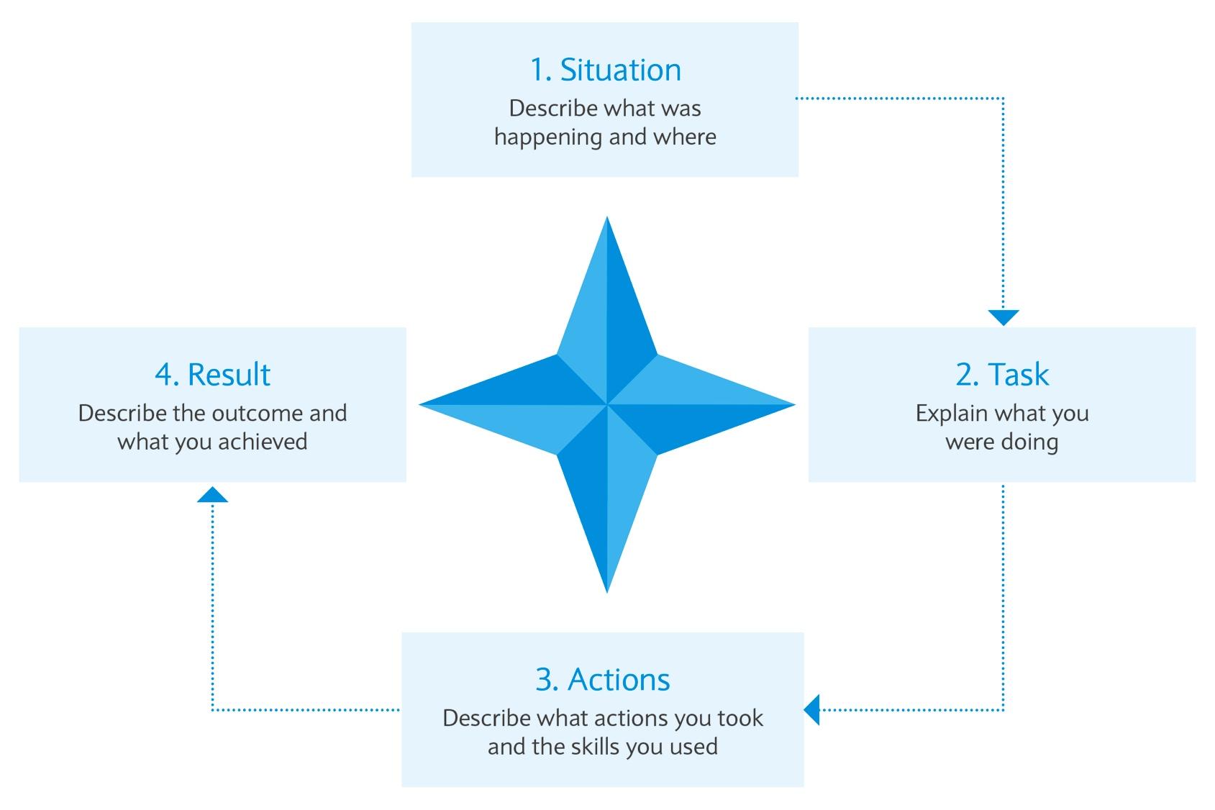
STAR technique
  Situation
  Task
  Action
  Result
Notes:
Explain that by being involved in the delivery of the Barclays Money Skills ‘weeks’ activities, ‘college champions’ will develop some of the key skills that employers look for in new recruits.
Many employers feel that despite having the relevant qualifications, young people often lack other key skills and competencies that their employees need to succeed in the workplace.
As a ‘college champion’ they will have lots of opportunities to practice and improve some of the key skills that employers look for. These include:
Planning and organising
Communication
Inter-personal skills
Team working
Taking initiative
They will also be able to use their experiences as a ‘college champion’ to their advantage on their CV, to support job applications etc.
For learners doing BTEC (Business and Technology) qualifications, they could use the skills employed in delivering activities as evidence towards their course units on running an event or team working.

