Slide 1
Knowledge build for teachers
Long history in brief bullet points: https://threadreaderapp.com/thread/1497215854546665489.html
Long history in one hour podcast: https://twitter.com/TheRestHistory/status/1496877376541708297?s=20&t=BqVoasY6kF74Hz8Ew5GPXA
Teaching about refugees, some guidance: https://www.unhcr.org/publications/brochures/618bc1d64/unhcr-teaching-refugees-2021-guide-teachers.html
Teaching about misinformation: https://www.euronews.com/next/2022/02/25/the-disinformation-war-the-falsehoods-about-the-ukraine-invasion-and-how-to-stop-them-spre

Slide 2
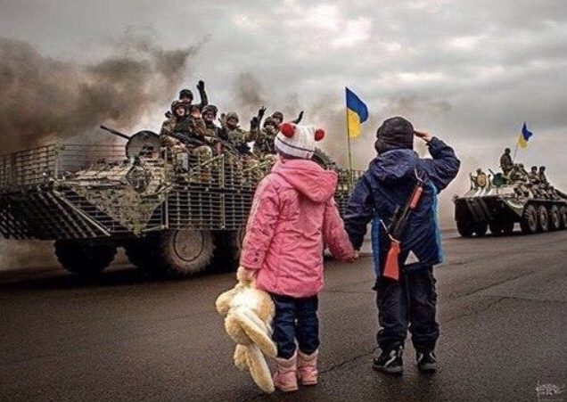
The Russian invasion
of Ukraine, February 2022
Historical context & current events

Slide 3
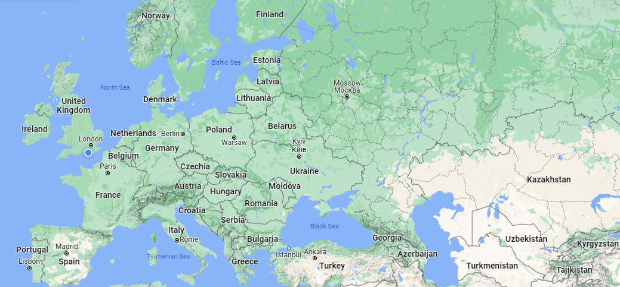
Background: Ukraine
#

Slide 4
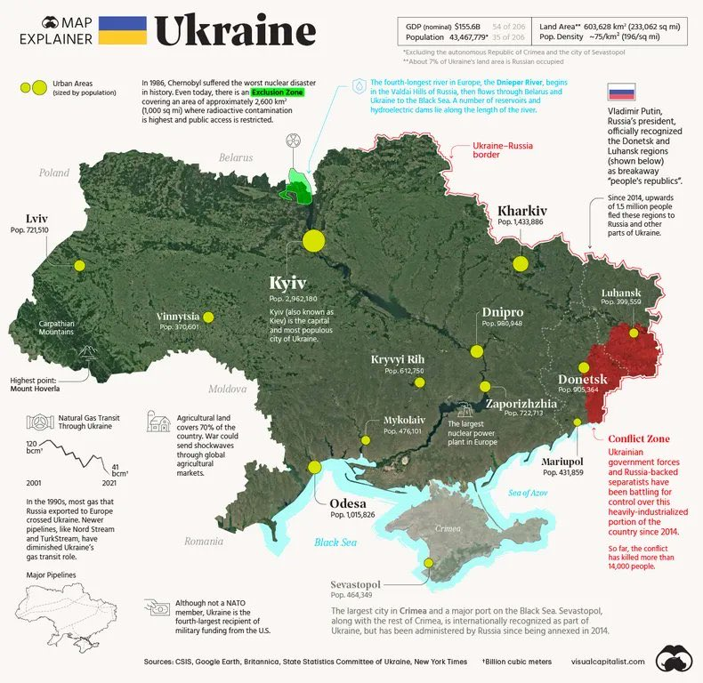

Slide 5
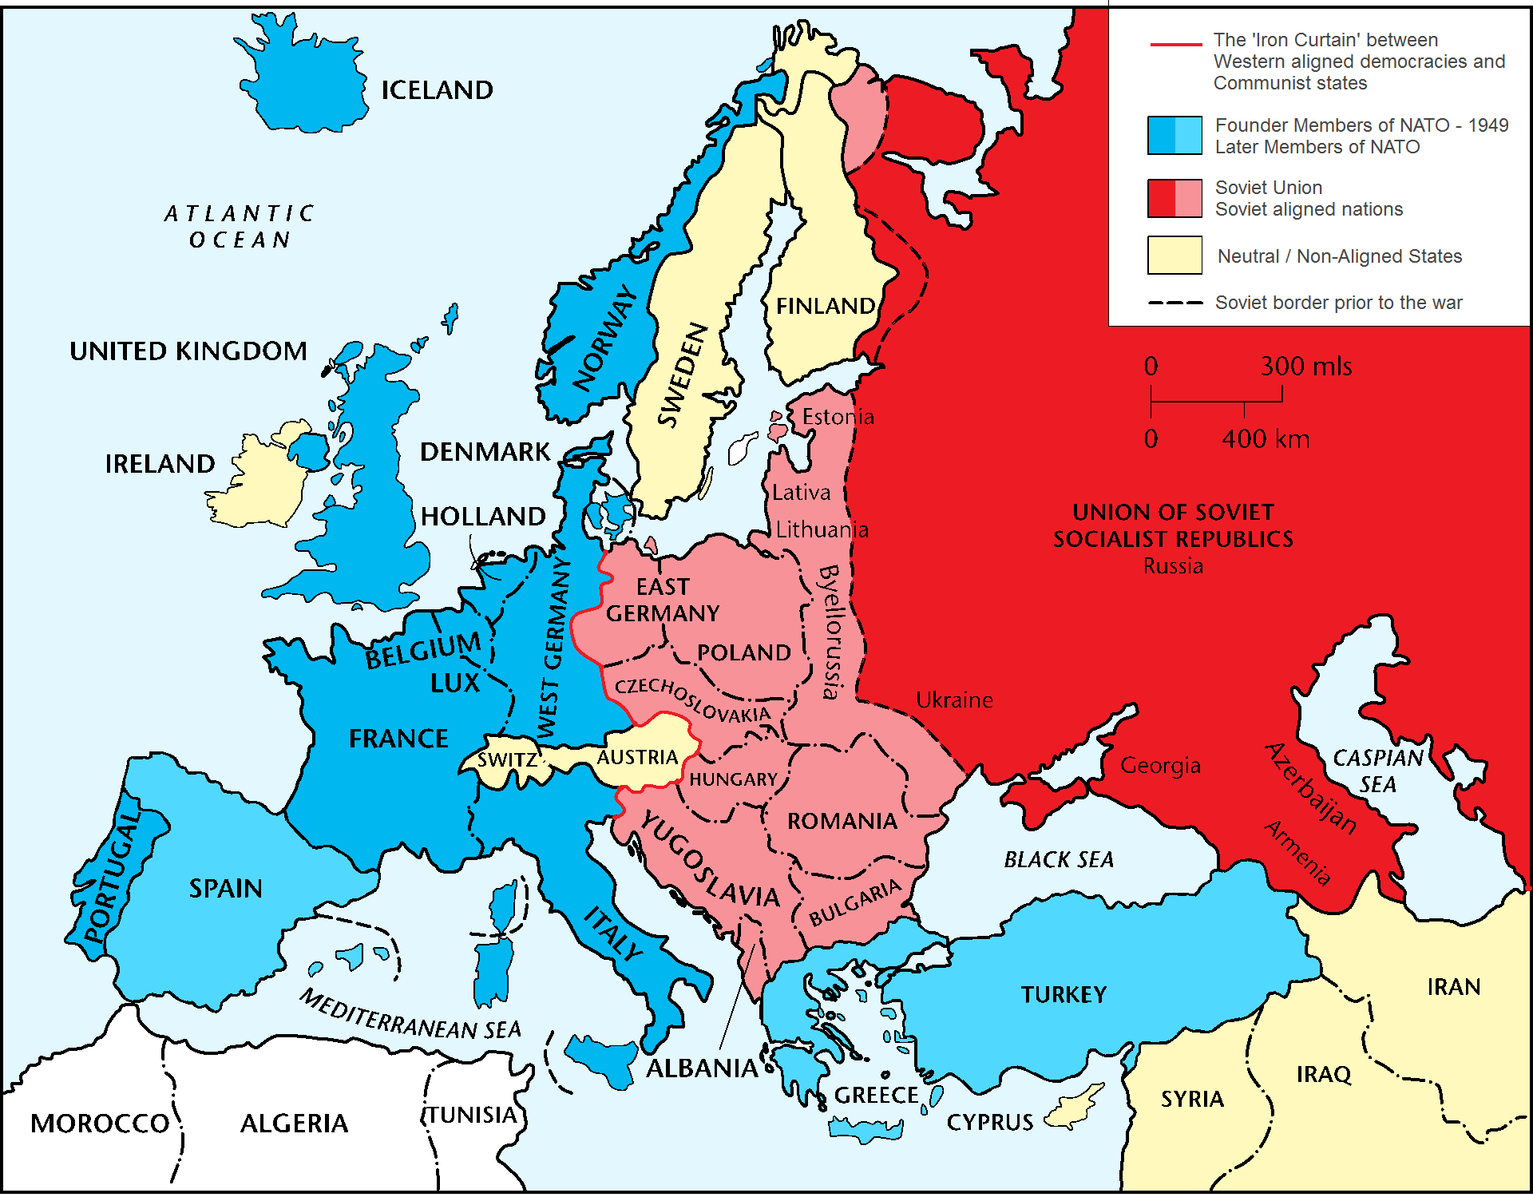
Context: The Cold War
Notes:
A huge amount of this current crisis is rooted in the legacy of the Cold War (1945-1991) which was a period of mistrust and competition between the USA (the West) and the Soviet Union (the East).
The world split between the two sides in fear of nuclear war.
Russia at that time was known as the USSR. A communist superpower.
Western Europe was on the USA’s side in an organisation called NATO. (North Atlantic Treaty Organisation)
Both sides feared invasion. Russia controlled several countries on its border to act as a buffer against the threat of NATO forces.

Slide 6
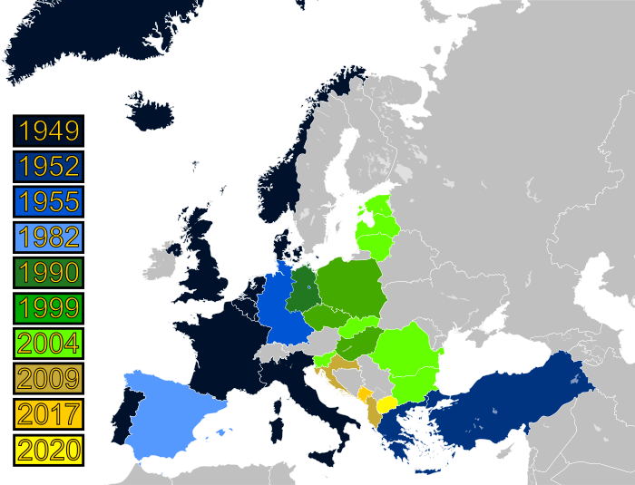
Context: NATO
Notes:
After the USSR collapsed, Russia lost what it saw as a ‘buffer zone’. NATO remained. NATO expanded as you can see on the map.
Ukraine, which was part of the Soviet Union won independence as the USSR broke up in 1991.
Russia has always considered Ukraine to be within its ‘sphere of influence’ and is extremely hostile to allow the Ukraine to have closer ties with the EU/NATO.

Slide 7
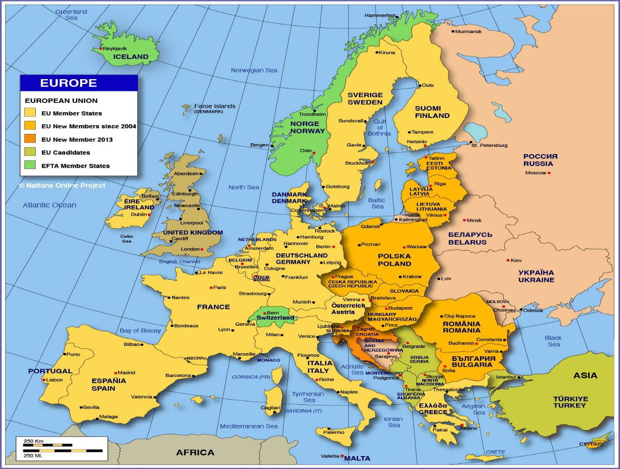
Context: the EU
Notes:
And it’s not just NATO.
Look at this map of the European Union.
The light yellow countries are original countries. The darker yellow countries are ones that joined in 2004.
Ukraine wanted to join the EU.
Ukraine used to be part of the USSR. It has close cultural ties with Russia.
Why do you think Putin so interested in Ukraine?

Slide 8
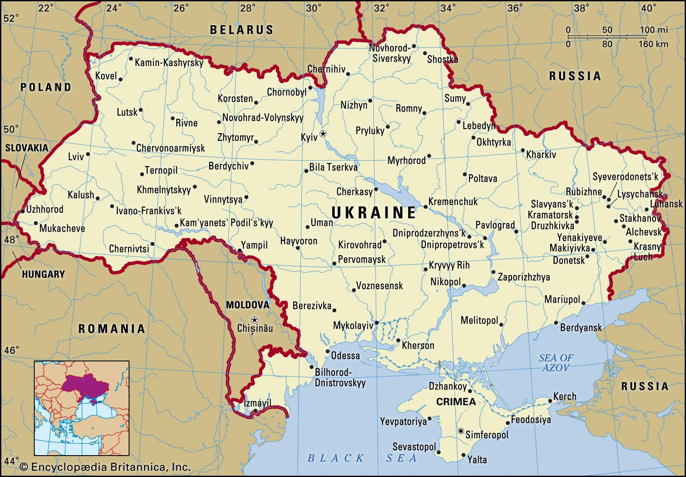
Context: Crimea, 2014
Notes:
The country shares borders with Russia both to the east and northeast.
In 2014 Russia annexed (took over) the Crimea. The region was of particular interest to Russia since it depends on the Black Sea for access to the Mediterranean. The Port of Sevastopol, is one of the few ice-free deepwater ports available to Russia. This conflict, which began in 2014, is ongoing. There are many Russian speakers in eastern Ukraine who prefer to be close to Russia, not the West. But western leaders say that is no excuse for Russia to wade in and support a war..
The Ukraine is an important route for Russian gas. The continent gets nearly 40% of its natural gas and 25% of its oil from Russia.

Slide 9
Why is there a war?
https://www.bbc.co.uk/programmes/p0br5fxh
“Many of President Putin's arguments were false or irrational. He claimed his goal was to protect people subjected to bullying and genocide and aim for the "demilitarisation and de-Nazification" of Ukraine. There has been no genocide in Ukraine: it is a vibrant democracy, led by a president who is Jewish.” – more her, updated regualrly: https://www.bbc.co.uk/news/world-europe-56720589
Whist Putin is not solely responsible, is appears that this war is not supported by many Russian people.
It is important to distinguish the many from the ruling elite – a group of ultra-rich Russians often described as ‘oligarchs’ and their immediate supporters.
Notes:
Major reasons include:
Ukraine trying to join NATO and EU which would permanently remove them from Russian influence
Huge mineral deposits, to help prop up Russian economy
Agricultural wealth – creates food for 600m people- so climate change and food security an issue.
Putin’s own desire to see the expansion of Russia to include more of the old USSR
Some pro-Russian rebels in the far east of Ukraine, although not enough to have any democratic influence nationally.

Slide 10
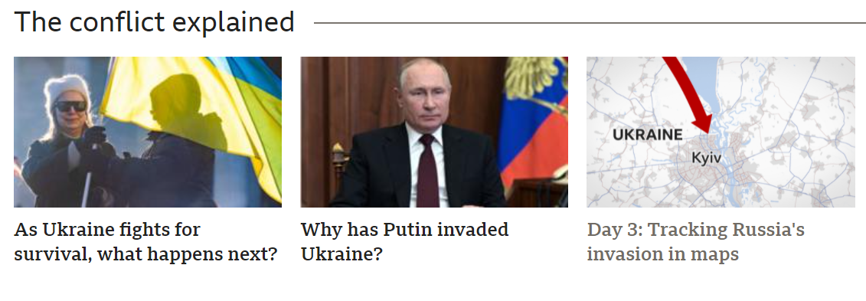
What has happened so far?
https://www.bbc.co.uk/news/world-europe-60506682
For the latest, use https://www.bbc.co.uk/news/world-60525350
Scroll to this section and use the ‘in maps’ page.
Notes:
Don’t get too bogged down in this – it is a rapidly changing situation, so show the students where they can find more if they want the detail.

Slide 11
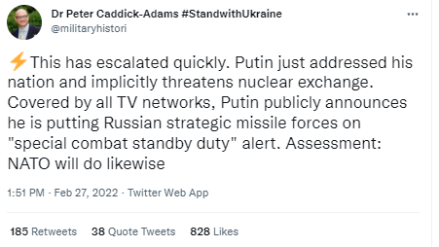
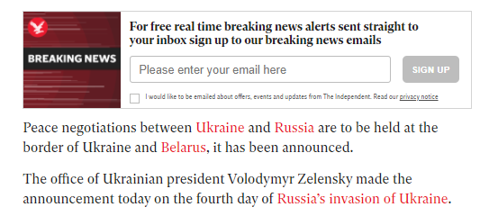
What has happened so far: Sunday

Slide 12
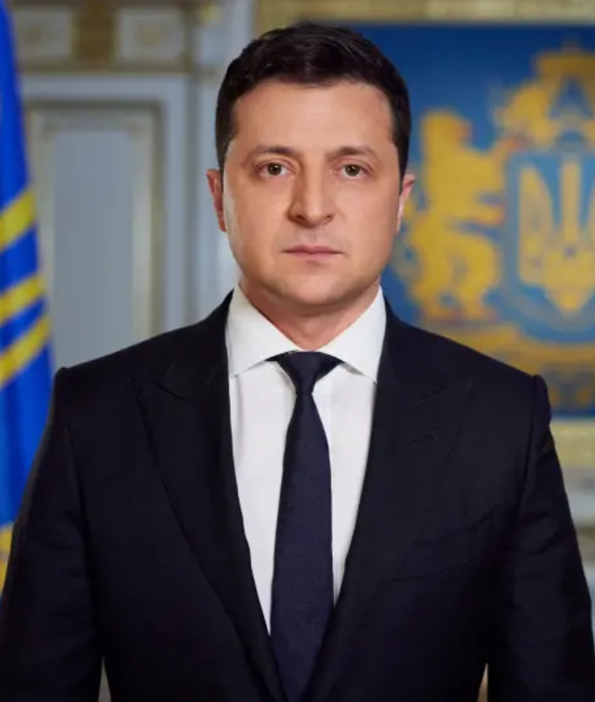
How is Ukraine responding?
Key Figure
Ukrainian President Volodymyr Zelensky
Armed Forces:
Fighting back, with some success
Turning Kyiv into a difficult city to capture
Conscripting fighting age men
Civilians
Training with weapons
Creating own weapons
Fleeing conflict zones
Trying to survive in shelters and subways underground
https://www.bbc.co.uk/news/av/world-europe-60539193

Slide 13
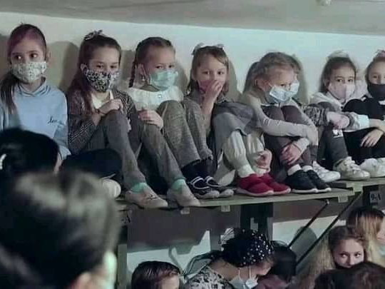
Notes:
Ukrainian children hiding in the Kyiv metro from #ussian missile and bomb strikes

Slide 14
.
Notes:
Julia, a teacher and Ukrainian volunteer, weeps as she waits to be deployed to fight Russian troops around Kyiv on Saturday

Slide 15
How are other countries responding?
Imposing sanctions
Stopping trade with Russian banks
Preventing Russia from accessing SWIFT, the main international payment system
Limiting trade (imports and exports) of certain goods.
Banning planes flying to Russia from using their airspace.
Providing weapons:
For example, Germany is providing ground-to-air missiles and anti-tank weapons to the Ukrainian Army
‘Sanctions?’
Using non-military (usually economic) methods to cause problems for a country who has broken international law.
Can be effective, but usually slow to start to take effect.
Can be highly targeted at individuals.
https://www.bbc.co.uk/iplayer/episode/p0br5dhc/ros-atkins-on-what-do-sanctions-mean-for-russia

Slide 16
How else is the UK likely to be affected?
Personal trauma, stress, fear and tragedy for Ukrainians and others living in Britain who have family and friends in Ukraine.
Companies that trade with Russia seeing problems caused by trade bans and other sanctions
Rises in energy prices and bills as international supplies are disrupted.

Slide 17
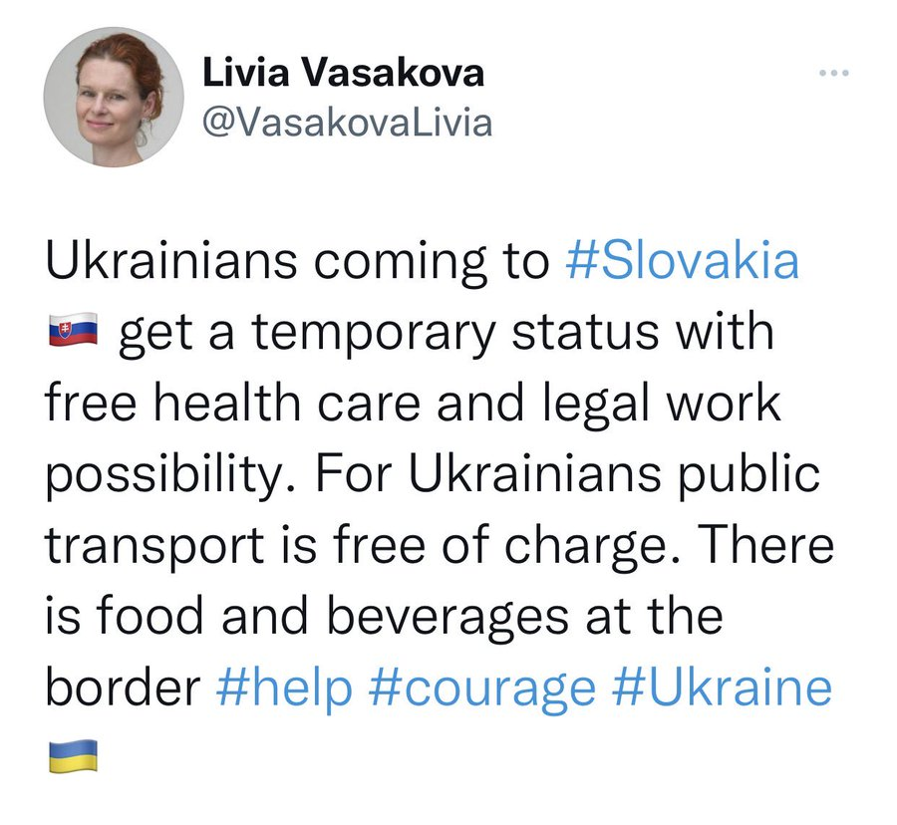
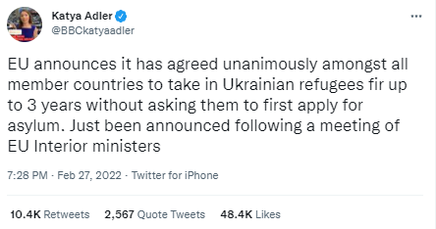
Refugees
Questions about Britain should respond to Ukrainians seeking temporary shelter.
Currently (Monday) just the families of those already in the UK can come from Ukraine.

Slide 18
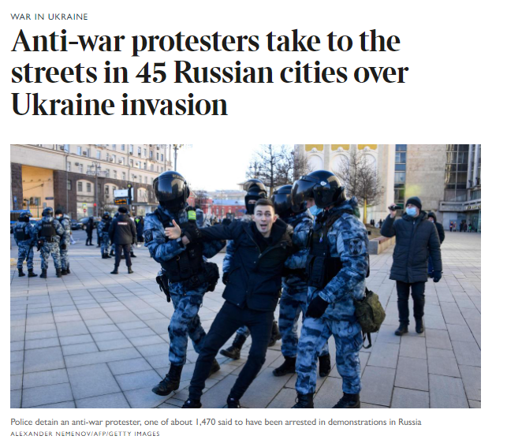
Protests
Protests are happening against the war across Europe and the wider world
Most importantly, many Russian people are against the war and (although likely to be arrested and face severe punishment) many are protesting in Russia itself.

Slide 19
What about non-governmental responses?
Anonymous (hacker group) hacked Russian state TV to broadcast what was happening, counter to Russian reporting.
Elon Musk is providing Starlink internet connections via satellite over Ukraine
The Champions League Final has been moved from St Petersburg to Paris – and the F1 Russian GP cancelled - don’t underestimate the importance of sport!

Slide 20
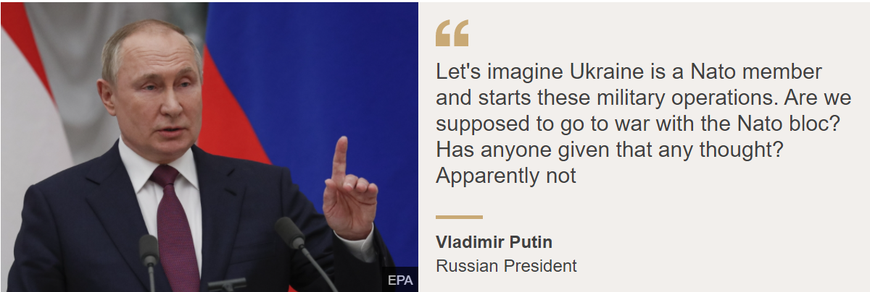
Are we likely to go to war?
As things stand, it seems unlikely.
‘Mutually-assured destruction’
So Putin might continue to move Russian soldiers up to the NATO border but is very, very unlikely to cross it. The below quote suggests he wants to avoid war with NATO.
However, major European wars have been sparked by small events in the past. Crucially however, never in the nuclear age.
Notes:
On mutually assured destruction:
Theoretically helps avoid war and is likely to prevent the major powers going to war with each other directly.
However, it does mean they struggle to stop another nuclear power using military force on a third party.

Slide 21
Important to remember
People in our school community have connections with Ukraine.
This war not a subject for jokes, either in person that people may overhear or on social media that people may see.
In either case you could be doing something that would hugely upset someone listening or reading it.

Slide 22
How do I find out more?
Take real care: look at these examples of misinformation (AKA ‘Fake News’ https://www.bbc.co.uk/news/60513452
Let other people do the fact-checking: use reliable news sources: BBC, Sky, Channel 4 are some of your best bets. Don’t believe things that don’t match up with what trustworthy media is reporting.
If you are finding this troubling or upsetting, as many people are: https://www.bbc.co.uk/newsround/13865002

