Slide 1
Notes from the Author
Please do not remove the photo credits from any of the photos you use and we would be very grateful if you could leave YPTE’s logo and web address on the relevant pages.
We want to encourage more and more young people to learn about taking care of our world and our website is a great starting point for this. You can find lots more supporting information by visiting the ‘Explore’ section of https://ypte.org.uk

Slide 2
CLIMATE CHANGE
Registered charity number 1153740

Slide 3
1. WHAT ARE WE DOING TO OUR WORLD?

Slide 4
Weather describes the day-to-day conditions in a place

Slide 5
Climate describes the average weather conditions in a region over a long period of time
World Climate Zones Map

Slide 6
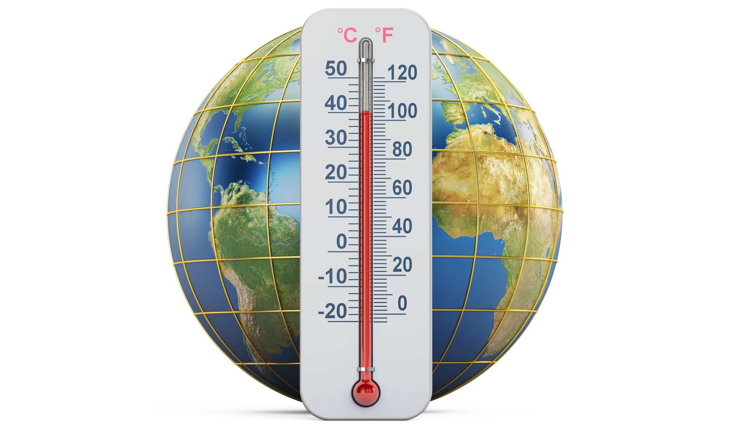
Our world is getting hotter
This is called climate change

Slide 7
Climate change is already having disastrous impacts on millions of people around the world

Slide 8
1. More Frequent and More Powerful Storms and Floods

Slide 9
Hurricane Michael - one of the most powerful storms in US history - battered north-west Florida in 2018
Photo: Tabitha Kaylee Hawk

Slide 10
Storm Desmond in 2015 broke the UK’s 24 hour rainfall record and caused severe flooding
Photo: Steve

Slide 11
The flooding of the Somerset Levels in 2014 is the largest flood event ever known in the area
Photo: Nick

Slide 12
2. More Drought

Slide 13
Horn of Africa drought, 2011
A woman scoops water from a dry riverbed
Photo: DFID

Slide 14
3. More Hunger
Photo: IHH Humanitarian Relief Foundation

Slide 15
900 million people are short of food and climate change means this number is increasing
Photo: Feed My Starving Children

Slide 16
4. Melting Glaciers, Sea Ice and Ice Sheets
Photo: NASA Goddard Space Flight Centre

Slide 17
Melt water ends up in the oceans causing sea levels to rise

Slide 18
5. Rising Sea Levels Lead to Flooding

Slide 19
In Louisiana land is being lost at a rate of a football field every 45 minutes
Photo: Tobin

Slide 20
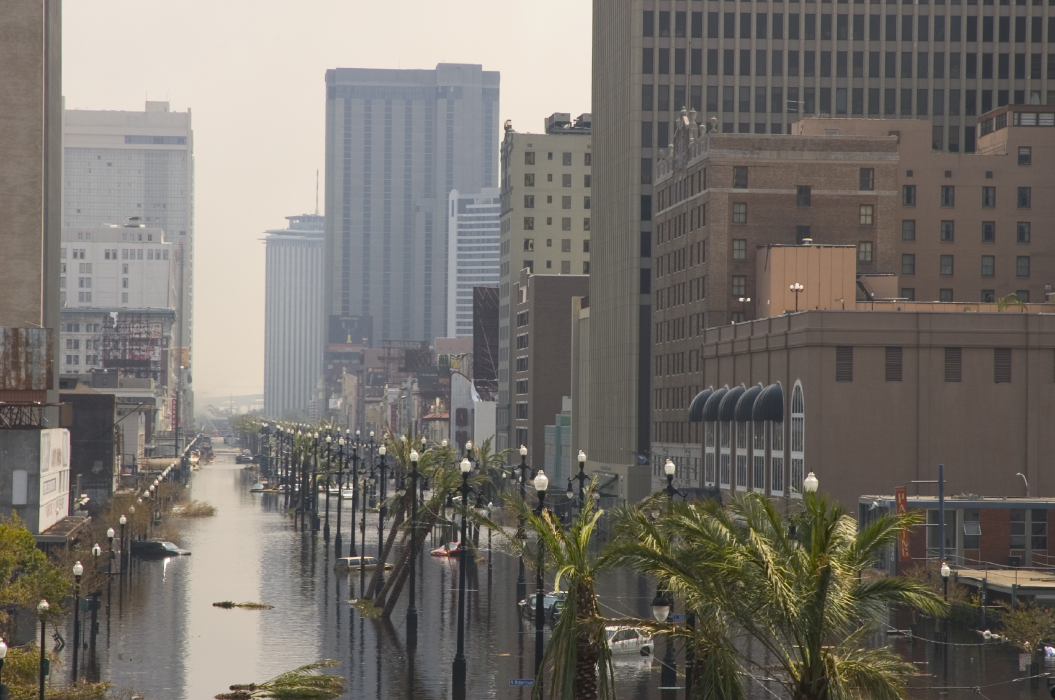
Could this be our future?

Slide 21
6. Animals Lose Their Habitats and Cannot Adapt to Climate Change
Polar bears need sea ice to hunt, raise their young and rest

Slide 22
Some species – like these bats in Cairns - are unable to adapt to rapidly changing conditions
Photo: denisbin

Slide 23
2. HOW ARE WE DOING THIS?

Slide 24
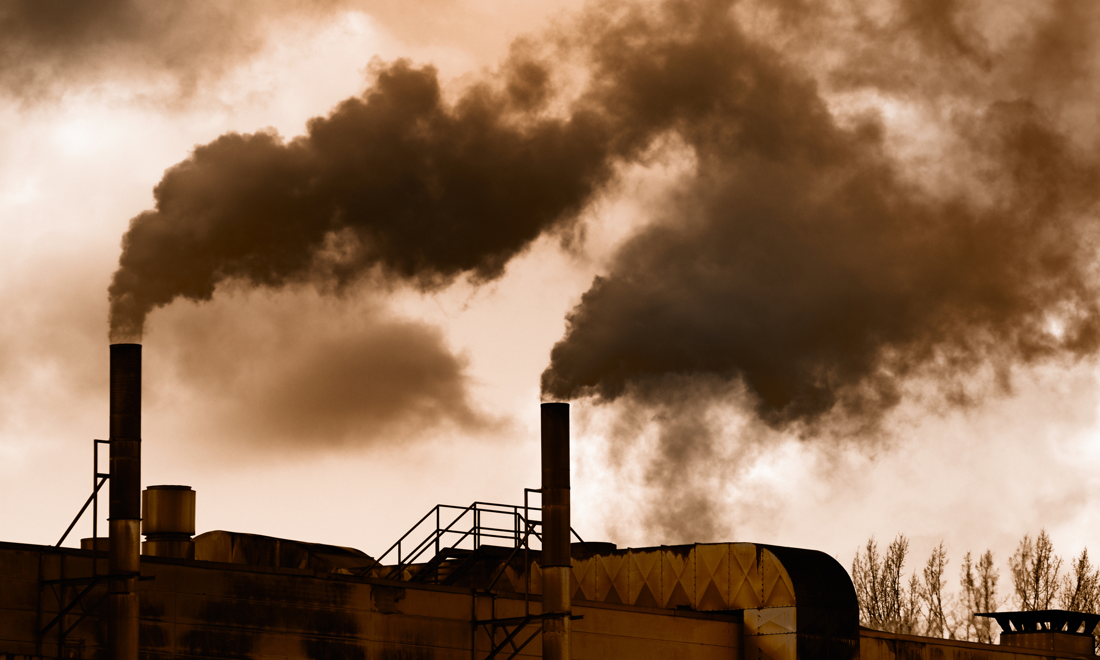
It started over 200 years ago when scientists learned how to use steam to create power

Slide 25
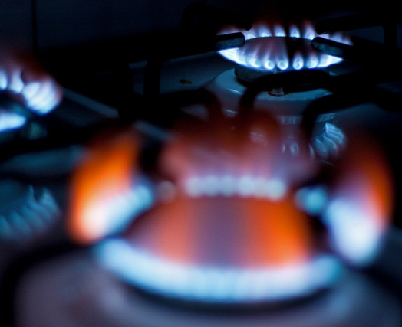
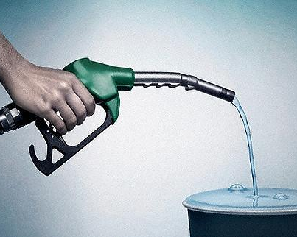
It all depended on fossil fuels being burned to produce heat and turn water into steam
Coal
Gas
Oil
Photo: Jeffrey Beall
Photo: Jose Luis Agapito
Photo: Stephen Shrubsole

Slide 26
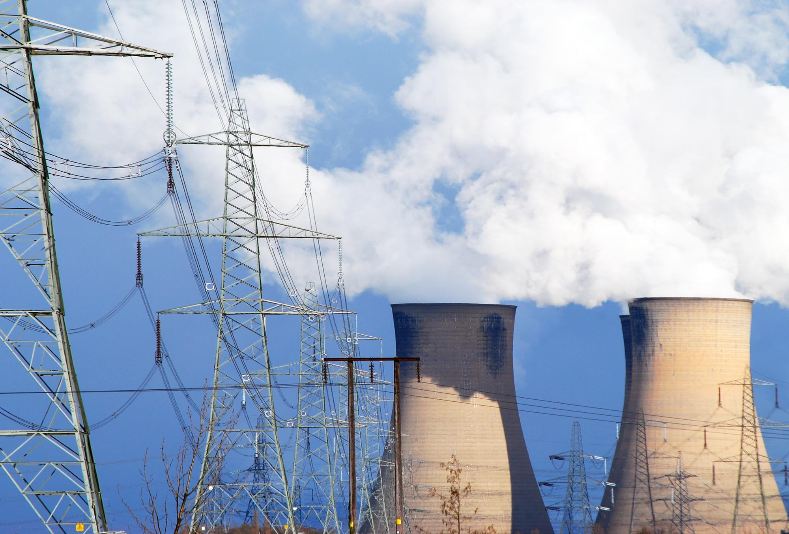
Soon steam power was being used to generate electricity

Slide 27
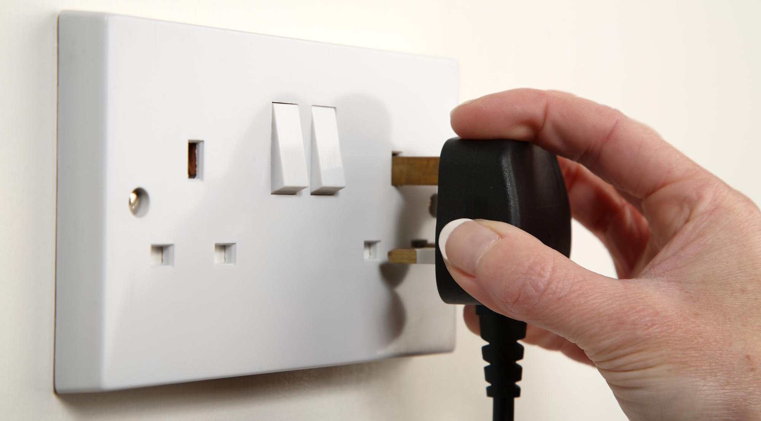
Around three-quarters of the electricity generated in the UK comes from power stations fuelled by fossil fuels

Slide 28
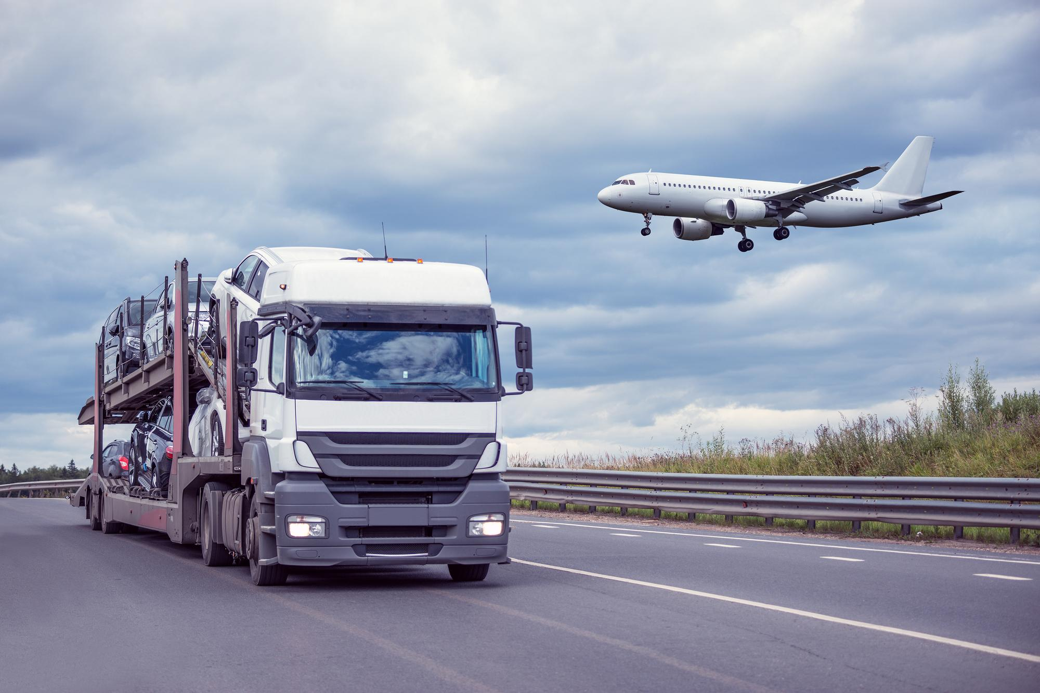
We rely on fossil fuels to make electricity, provide our heating and power our vehicles

Slide 29
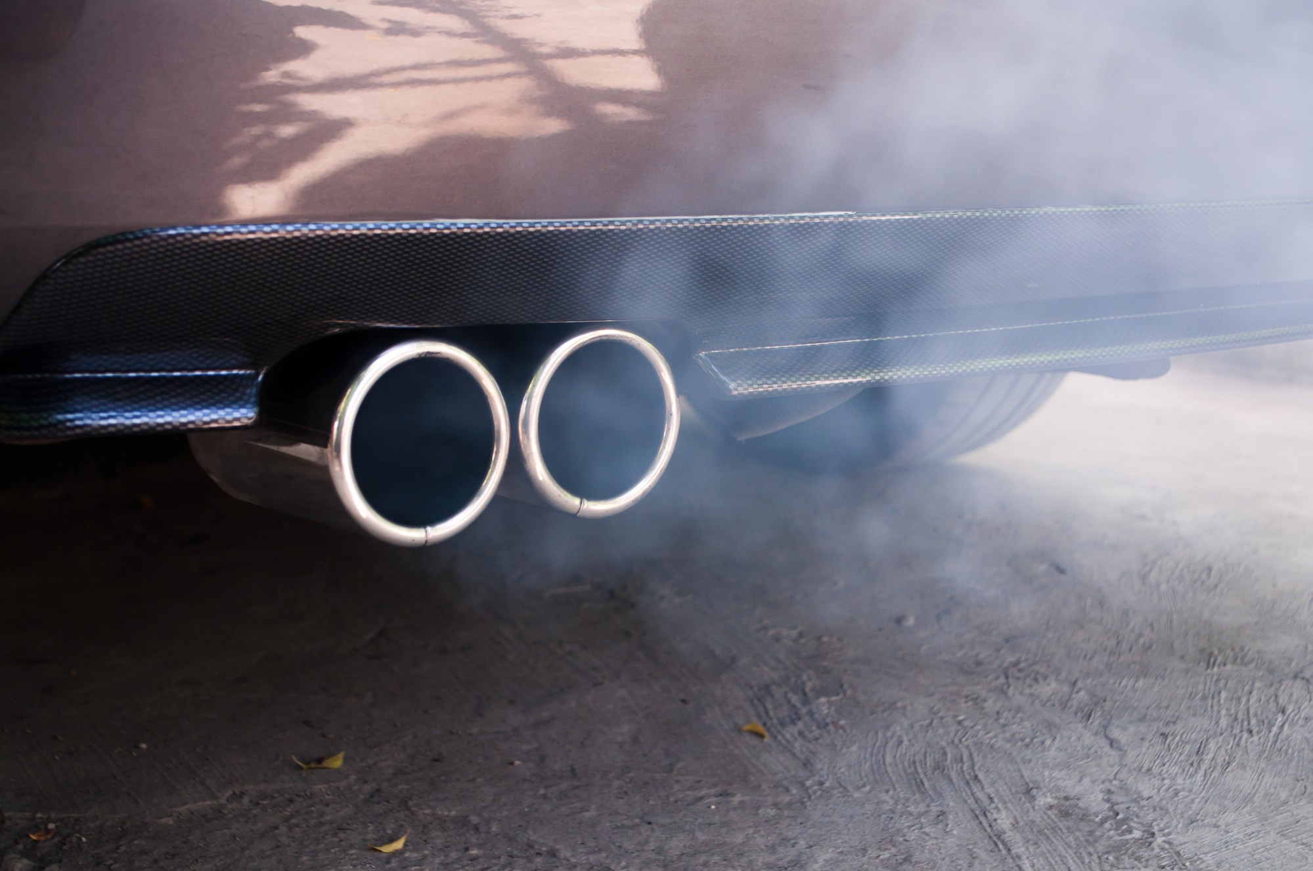
BUT the big problem is that fossil fuels release carbon dioxide when they burn

Slide 30
Carbon dioxide is a greenhouse gas It forms a layer in the atmosphere that reflects heat back to earth

Slide 31
…..this causes the Earth to warm up – a bit like tomatoes in a greenhouse

Slide 32
There is a clear relationship between carbon dioxide in the atmosphere and temperature increase
Photo: Matt Lemmon

Slide 33
We all have a carbon footprint – how big is yours?

Slide 34
Dairy farming is also a big contributor to climate change as cows and sheep release methane
Photo: Rockin’Rita

Slide 35
Deforestation is a huge contributor to climate change as trees absorb carbon dioxide and burning trees releases carbon dioxide into the atmosphere

Slide 36
3. WHAT CAN WE DO TO STOP CLIMATE CHANGE?

Slide 37
If we don’t take action now we could face devastating consequences

Slide 38
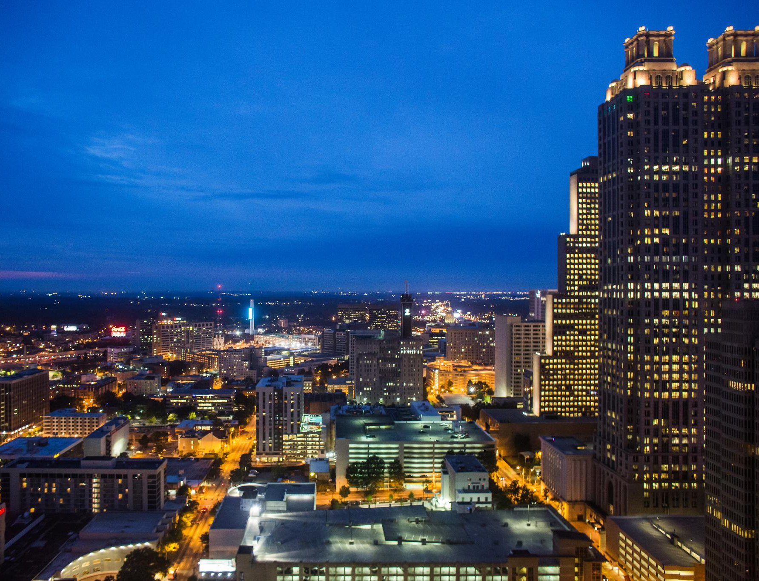
We are all contributing to climate change
It is everyone’s problem and we can all do something about it
Photo: Thomas Hawk

Slide 39
1. Raise Awareness

Slide 40
Greta Thunberg is a young girl who campaigns for something to be done about climate change
Photo: European Parliament

Slide 41
2. Reduce Your Energy Use

Slide 42
Think of all the things you use that need electricity
ONLY USE THEM WHEN YOU REALLY NEED TO

Slide 43
Switch off lights when you leave a room

Slide 44
Turn the smartboard off when not in use
Photo: F Delventhal

Slide 45
Turn computers off when not in use
Photo: ttarasiuk

Slide 46
Keep doors shut to keep heat in

Slide 47
Change how you travel

Slide 48
The most effective way for people to reduce their carbon footprint is not to fly

Slide 49
3. Reduce Reuse & Recycle

Slide 50
Most things you throw away can be recycled

Slide 51
Sort recycling correctly to reduce waste

Slide 52
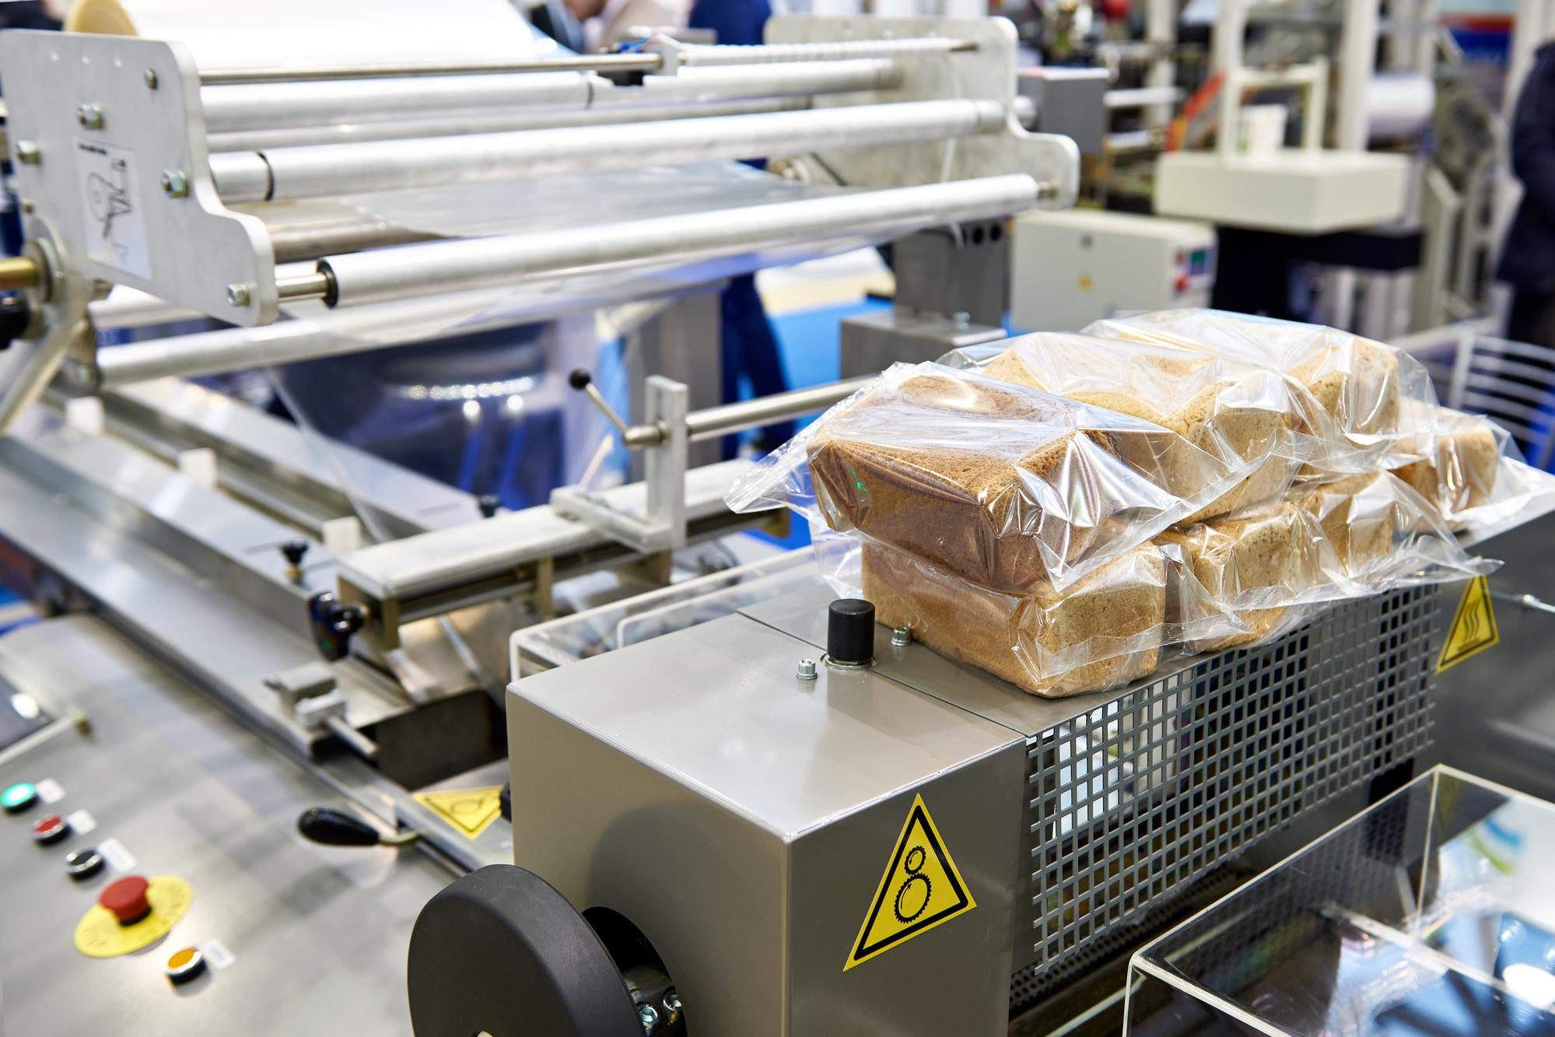
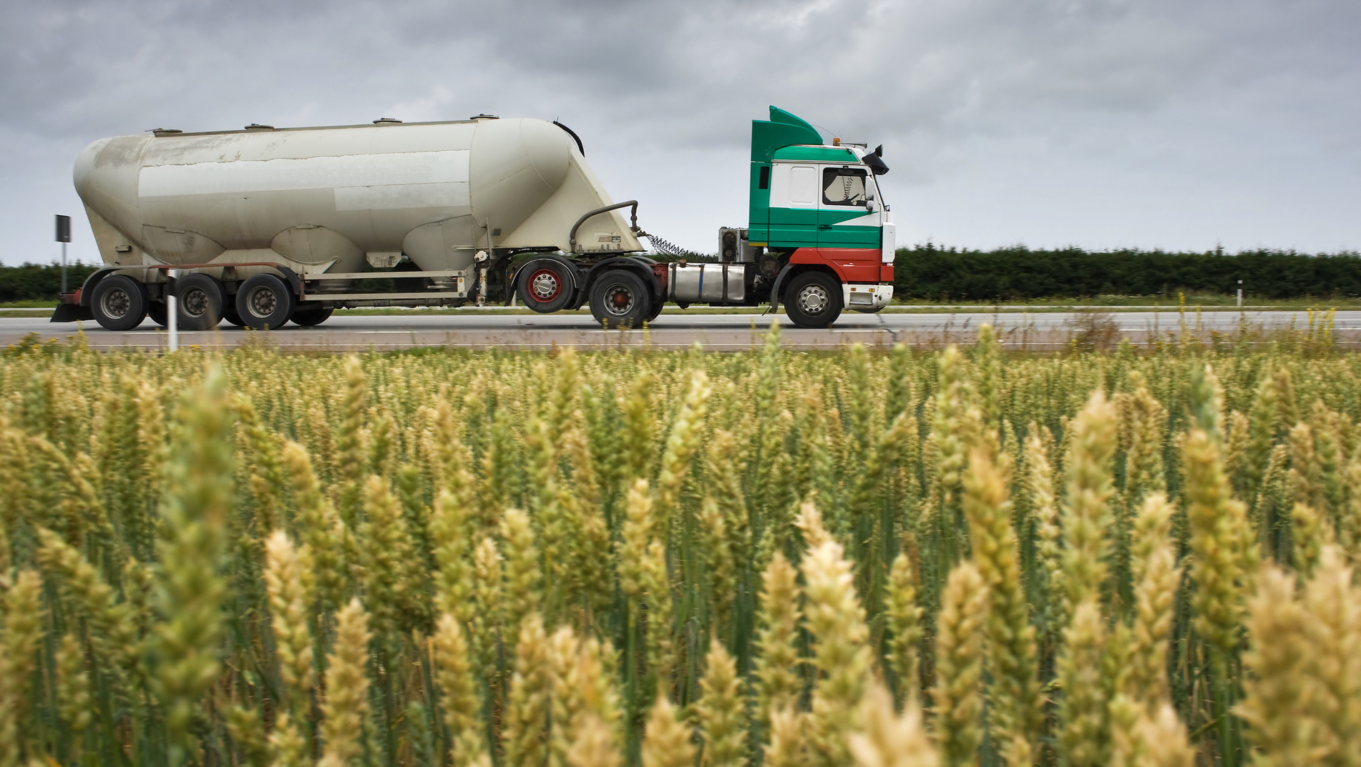
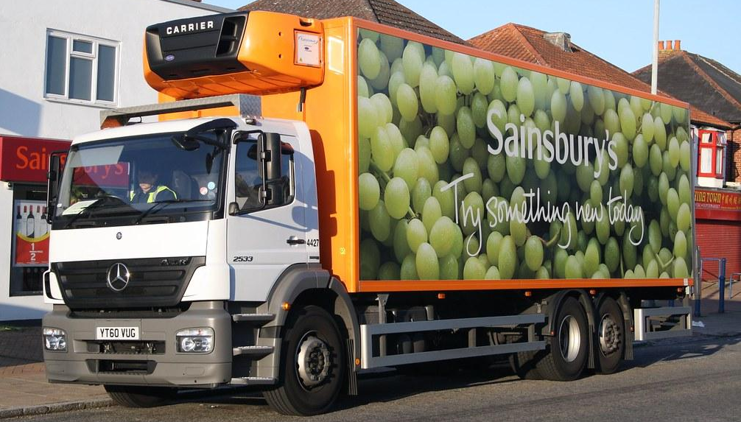
Think about all the energy needed to produce and transport your food
Photo: EDDIE

Slide 53
The food we buy accounts for a quarter of the carbon footprint in the UK

Slide 54
Only buy what you will eat to reduce waste

Slide 55
Be clever when using up leftovers

Slide 56
Buy local produce to reduce food miles

Slide 57
Reduce meat consumption – remember the methane!

Slide 58
4. Support Renewable Energies

Slide 59
Renewable energies use natural resources such as the sun, wind and water
They are clean energies and do not release any greenhouse gases

Slide 60
Wind power generates electricity by using the wind to turn big arms on a wind turbine
Photo: steve p2008

Slide 61
Solar power generates electricity by absorbing heat and light from the sun in special panels
Photo: Solar Trade Association

Slide 62
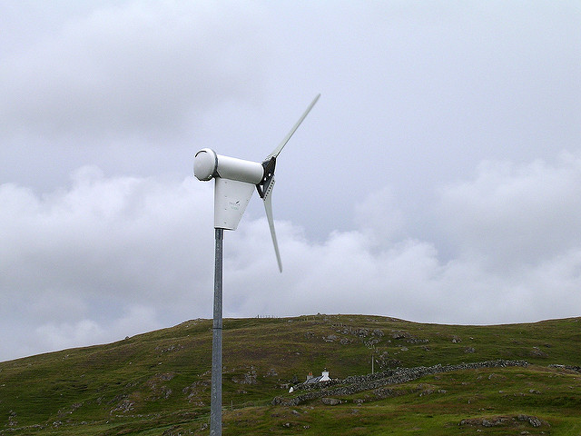
With small solar panels and wind turbines it’s possible to generate electricity at your own home or school
Photo: cowrin
Photo: Elliott Brown

Slide 63
Only after the last tree has been cut down, Only after the last river has been poisoned, Only after the last fish has been caught, Only then will you find that money cannot be eaten
Cree Indian Proverb

Slide 64
It’s not too late if we all do our bit to save our world
Photo: woodleywonderworks

Slide 65
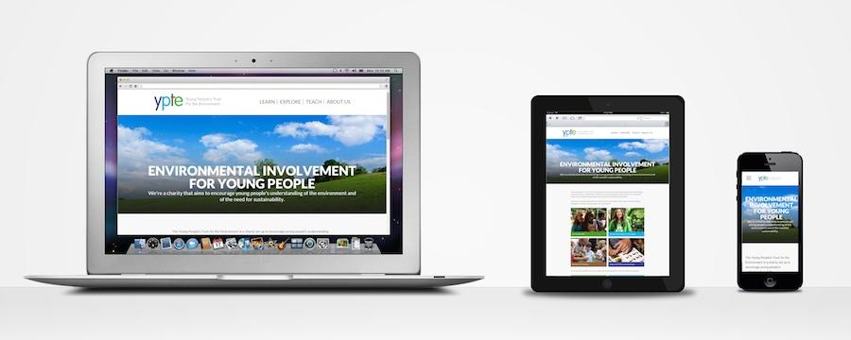
To find out more, please visit
ypte.org.uk
Registered charity number 1153740
Creating a better future by inspiring young people to look after our world

Slide 66
Credits
YPTE would like to thank all the amazing photographers on Flickr who allow the use of their photos for non-commercial purposes.
Your photos are helping young people to learn more about environmental issues. We couldn’t have created this presentation without you!

