Slide 1
Who’s Really Paying for COVID?

Slide 2
Who’s Really Paying for COVID?
Lesson Objectives
Understand the difference between money and debt;
Learn about personal debt and sovereign debt;
Explore the connection between personal and sovereign debt and why the future of young people is affected by what a country borrows;
Explore the impact of increased UK sovereign debt as a result of the government response to COVID-19;
To reflect on the following points:
How young people will be affected by increased UK government borrowing?
Why should citizens hold governments to account for their borrowing decisions?
2
© Young Citizens

Slide 3
Who’s Really Paying for COVID?
Meet the Speaker
Dania studied law at University
Her areas of expertise are: business law, sovereign debt, financial regulation, contract law, company law
She teaches at the University of Glasgow
She is a lecturer in Business Law
Video 1: https://vimeo.com/476237431
1
© Young Citizens

Slide 4
Who’s Really Paying for COVID?
Activity 1:
Learn the Lingo
Video 2: https://vimeo.com/476237604
3
© Young Citizens

Slide 5
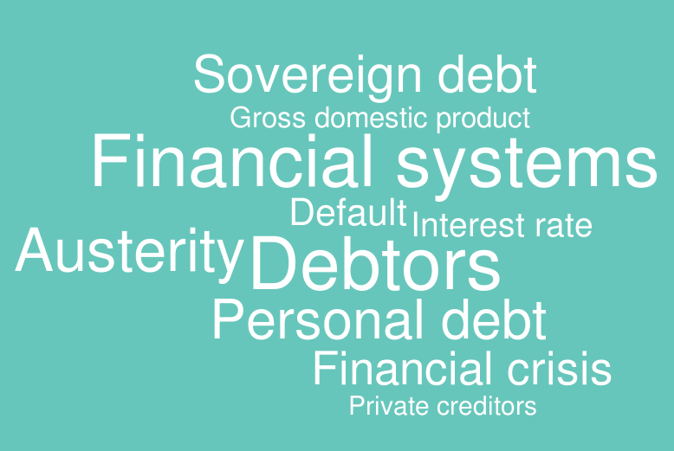
Who’s Really Paying for COVID?
4
© Young Citizens

Slide 6
Who’s Really Paying for COVID?
Activity 2:
Borrowing to meet your goals
5
© Young Citizens

Slide 7
Who’s Really Paying for COVID?
Imagine you on your way to university, your first job or to start an apprenticeship. Make a list of things that you will need to help you...
6
© Young Citizens

Slide 8
Who’s Really Paying for COVID?
Where will you go to borrow money to buy these things?
7
© Young Citizens

Slide 9
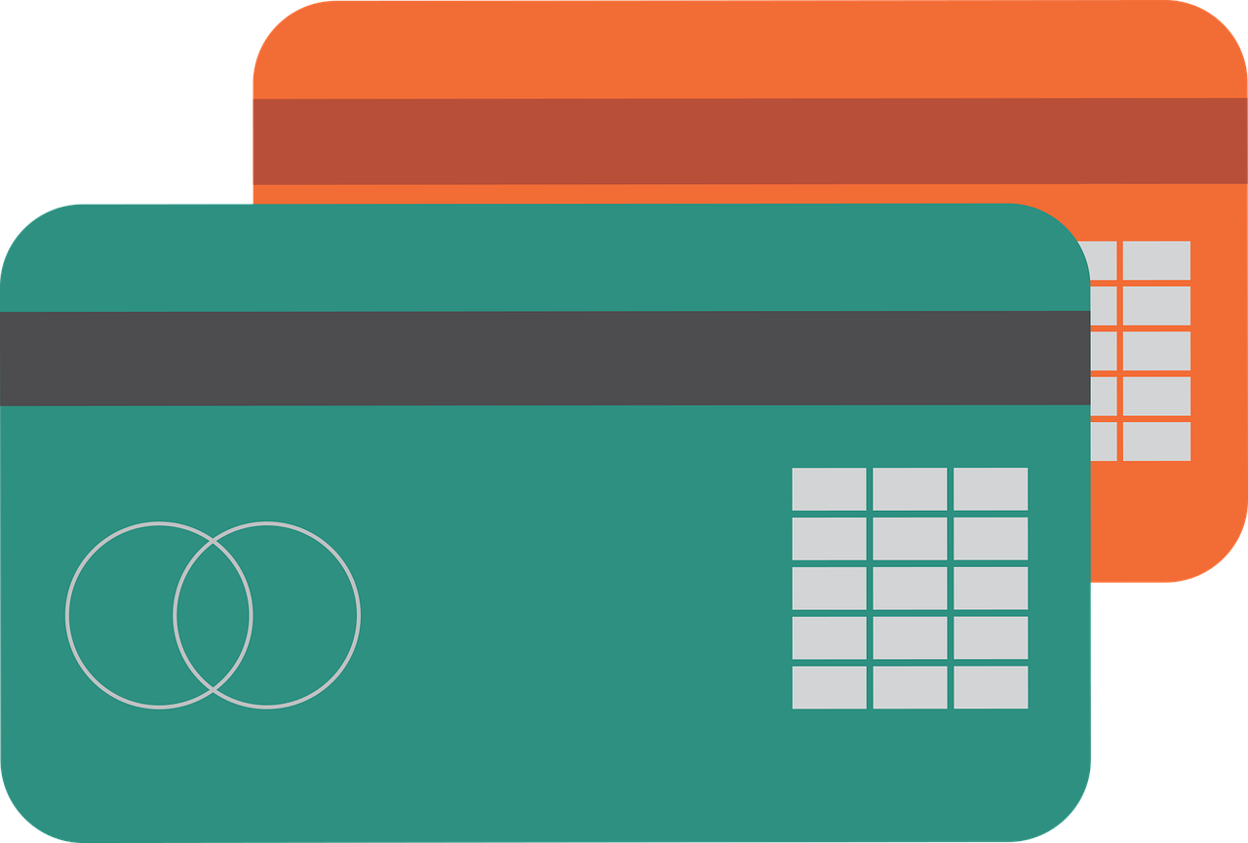
Who’s Really Paying for COVID?
What are the advantages and disadvantages of each money source?
Friends
Family
Loan from the bank
8
© Young Citizens

Slide 10
Who’s Really Paying for COVID?
What are the advantages and disadvantages of each money source?
You trust each other
Friends may not have enough cash to support you.
Might cause tension in friendship.
Friends
9
© Young Citizens

Slide 11
Who’s Really Paying for COVID?
What are the advantages and disadvantages of each money source?
You trust each other.
They may have the money.
Can pay back in instalments interest free.
Will ask you to pay them back with a lifetime of chores.
May not have the money.
You might have to pay the full amount back.
Family
10
© Young Citizens

Slide 12
Who’s Really Paying for COVID?
What are the advantages and disadvantages of each money source?
You will get as much as you need.
The terms on which you get the money will be set out clearly.
You can pay back in instalments.
You will have to pay back the amount with interest.
You will have to pay a very high interest rate as you are a young person who may not have borrowed before.
Loan from the bank
11
© Young Citizens

Slide 13
Who’s Really Paying for COVID?
Activity 3:
Faustian Bargain
Video 3: https://vimeo.com/476237845
12
© Young Citizens

Slide 14
Who’s Really Paying for COVID?
What does the phrase ‘Faustian Bargain’ mean?
A deal with the devil where you always lose out.
13
© Young Citizens

Slide 15
Who’s Really Paying for COVID?
Activity 4:
Sovereign debt
14
© Young Citizens

Slide 16
Who’s Really Paying for COVID?
Financial system
Lloyds Banking Group
Bank of Scotland
Halifax
Video 4: https://vimeo.com/476238830
15
© Young Citizens

Slide 17
Who’s Really Paying for COVID?
Economic cycles
What kind of things does the government spend money on?
Local council
Defence
Education
Transport
Work and pensions
Health and social care
Environment
Justice
16
© Young Citizens

Slide 18
Who’s Really Paying for COVID?
What do you think might be the impact of these cuts on future generations?
Video 5: https://vimeo.com/476239752
17
© Young Citizens

Slide 19
Who’s Really Paying for COVID?
Activity 5:
The costs of COVID-19
18
© Young Citizens

Slide 20
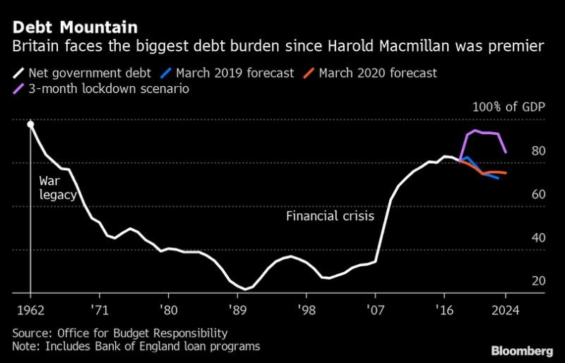
Who’s Really Paying for COVID?
Video 6: https://vimeo.com/476245146
21
© Young Citizens

Slide 21
Who’s Really Paying for COVID?
22
© Young Citizens

Slide 22
Who’s Really Paying for COVID?
Reflections and Discussion
Video 7: https://vimeo.com/476246951
23
© Young Citizens

Slide 23
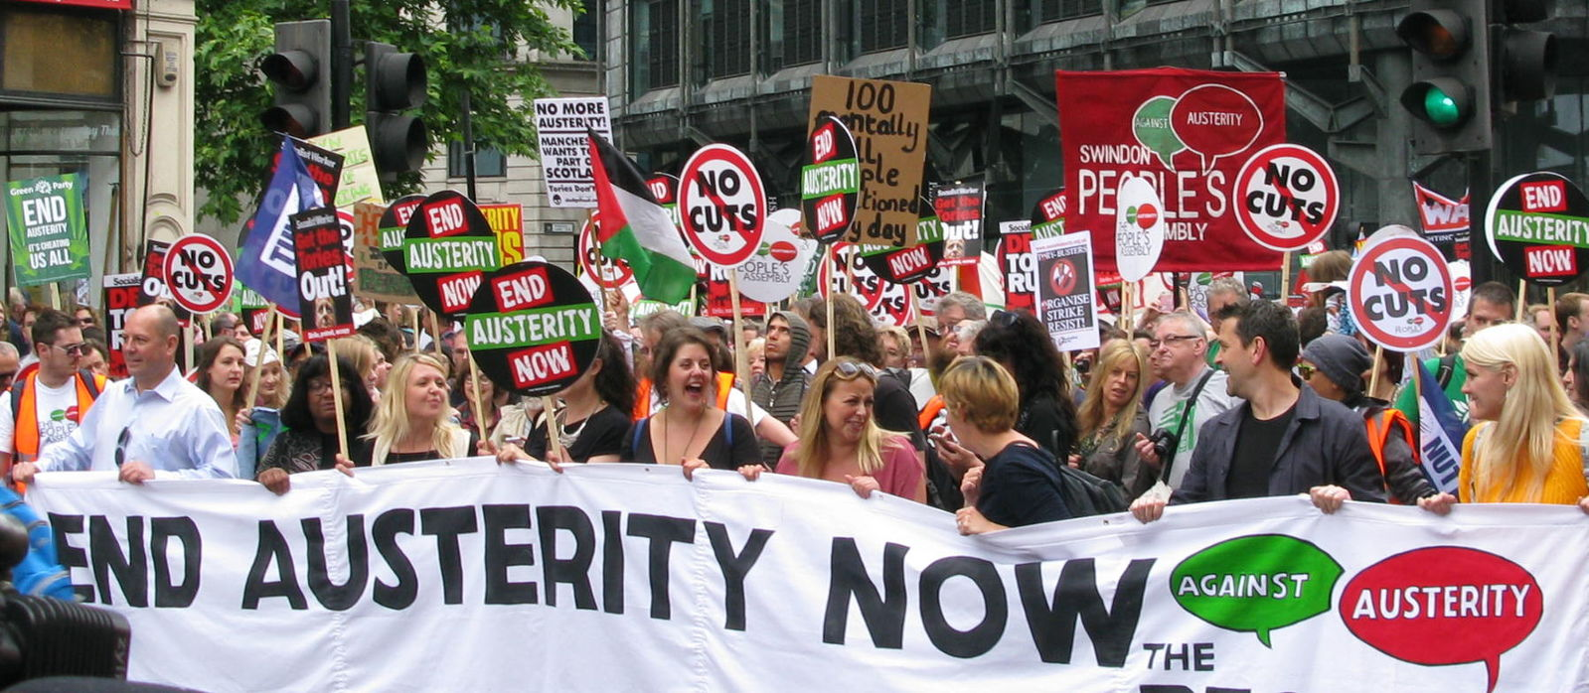
Who’s Really Paying for COVID?
Discuss the following questions…
1. How will you be affected by increased government borrowing due to COVID-19?
2. Is austerity the only option to deal with sovereign debt? What other options are there?
3. Are there any steps you and other young people can take to hold the Government accountable for their borrowing decisions? What might these be?
24
© Young Citizens

