Slide 1
COVID and the Economy

Slide 2
COVID and the economy
During this lesson we will:
Explore some of the key economic decisions made by the UK Government during the pandemic and consider the possible reasons behind these decisions.
Analyse the economic impact that the pandemic has had on specific industry area and assess what support these areas might require in order to recover.
2
© Young Citizens

Slide 3
COVID and the economy
Governments all over the world had to decide how they would manage the pandemic.
Sweden
China
Keep the
economy open
Close down the economy
Q: Where do you think the UK Government’s decision
fell on the scale?
3
© Young Citizens

Slide 4
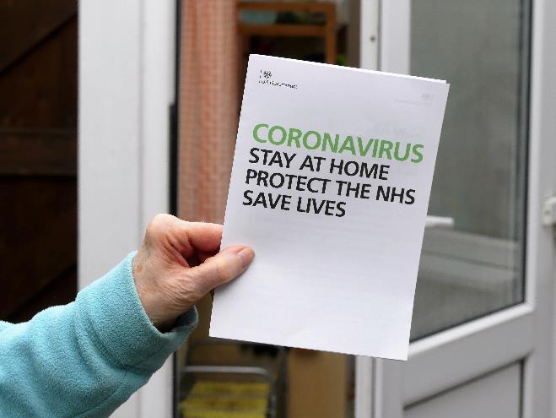
COVID and the economy
On 25th March 2020, the Coronavirus Act came into effect. This act set out a series of measures to respond to the COVID-19 outbreak. It gave the Government a series of powers that it could switch on and off as needed.
The Government initiated three national lockdowns.
The Government lifted nearly all restrictions on 19th July 2021
Q: What kind of restrictions did the
Government put in place during
these lockdowns?
Q: What impact do you think this had
on the economy?
4
© Young Citizens

Slide 5
COVID and the economy
Impact on the economy
The UK economy shrank by 9.8% in 2020 (the largest fall on record).
It is predicted it will take until late 2021 / early 2022 for the economy to return to pre-Covid levels.
730,000 people have lost their jobs since the pandemic began.
There were 5.9 million people on Universal Credit on 8th July 2021. This figure has nearly doubled since March 2020.
5
© Young Citizens
Notes:
9.8% fall: https://www.theguardian.com/business/2021/mar/31/uk-economy-savings-expansion-recovery
Late 2021 recovery: https://www.theguardian.com/business/2021/jun/18/cbi-predicts-uks-economic-recovery-will-accelerate-into-autumn
Early 2022 recovery: https://inews.co.uk/inews-lifestyle/money/investing/the-uk-economy-is-on-a-bumpy-road-to-full-recovery-1153568
730,000 jobs: https://www.ft.com/content/c8ef84bf-0539-4281-b353-d5b840d10b5e
8th July UC: https://www.gov.uk/government/statistics/universal-credit-statistics-29-april-2013-to-8-july-2021/universal-credit-statistics-29-april-2013-to-8-july-2021
March UC: https://www.gov.uk/government/statistics/universal-credit-29-april-2013-to-9-april-2020/universal-credit-29-april-2013-to-9-april-2020

Slide 6
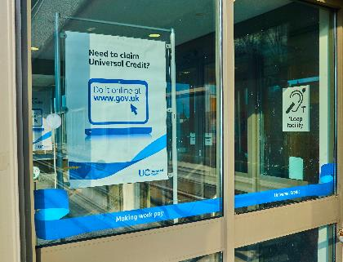
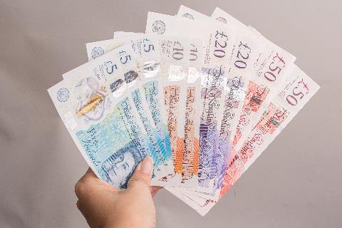
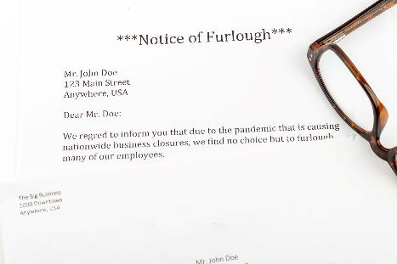
COVID and the economy
Government support
Furlough
Increased benefits
Company loans and grants
Q: Why do you think these packages were put in place?
6
© Young Citizens

Slide 7
COVID and the economy
The multiplier effect…
(1)
Lots of people lose their jobs.
(4)
These areas make less
money and have to
get rid of staff.
(2)
They have less income to spend.
(3)
People start spending less in areas such as retail and travel.
7
© Young Citizens

Slide 8
COVID and the economy
Task
The Government has announced a £10 billion recovery grant which will be split across the following areas:
1) Hotels and
restaurants
2) Retail
3) Transport
4) Construction
5) Manufacturing
Your group will be allocated an industry area by your teacher. In your group:
Read through the information provided.
Decide how you think the grant should be split.
Prepare a two-minute presentation outlining how you think the grant should be split and why.
Allocate one person in your group to present your pitch to the rest of the class.
You will have 25 minutes to prepare.
8
© Young Citizens

Slide 9
COVID and the economy
Feedback
Each group will now be asked to present their two minute pitch to the rest of the class.
During your pitch you should clearly state how your group has decided the grant should be split and the reasons behind your decision.
Options:
All areas to receive an equal share of the grant.
Grant to be split proportionally based on how many people the industry employed in 2019.
Grant to be split proportionally based on how much GDP the industry generated in 2019.
Grant to be split proportionally based on how much tax the industry payed in 2019.
Create your own suggestion about how you believe the grant should be allocated.
9
© Young Citizens

Slide 10
COVID and the economy
Plenary
During this session we have considered some of the key economic decisions made by the Government during the pandemic and explored some of the support packages that have been put in place.
These packages all cost money.
10
© Young Citizens

Slide 11
COVID and the economy
Government spending
In 2019/20 (before the pandemic) borrowing was £60 billion.
In 2020/21, the government borrowed £304 billion, a peacetime high.
Borrowing is forecast to fall back to £234 billion next year.
Q: How will the Government
look to recover this money
in the long term?
11
© Young Citizens
Notes:
Image - https://www.shutterstock.com/image-illustration/united-kingdom-national-debt-budget-deficit-277780205
2019/2020 borrowing: https://www.ons.gov.uk/economy/governmentpublicsectorandtaxes/publicspending/bulletins/ukgovernmentdebtanddeficitforeurostatmaast/march2020
2020/2021 borrowing: https://www.ons.gov.uk/economy/governmentpublicsectorandtaxes/publicspending/bulletins/ukgovernmentdebtanddeficitforeurostatmaast/march2021
Predicted 2021/2022 borrowing: https://www.ons.gov.uk/economy/governmentpublicsectorandtaxes/publicsectorfinance/bulletins/publicsectorfinances/june2021#:~:text=Official%20forecasts%20suggest%20that%20borrowing,in%20the%20FYE%20March%202021.

Slide 12
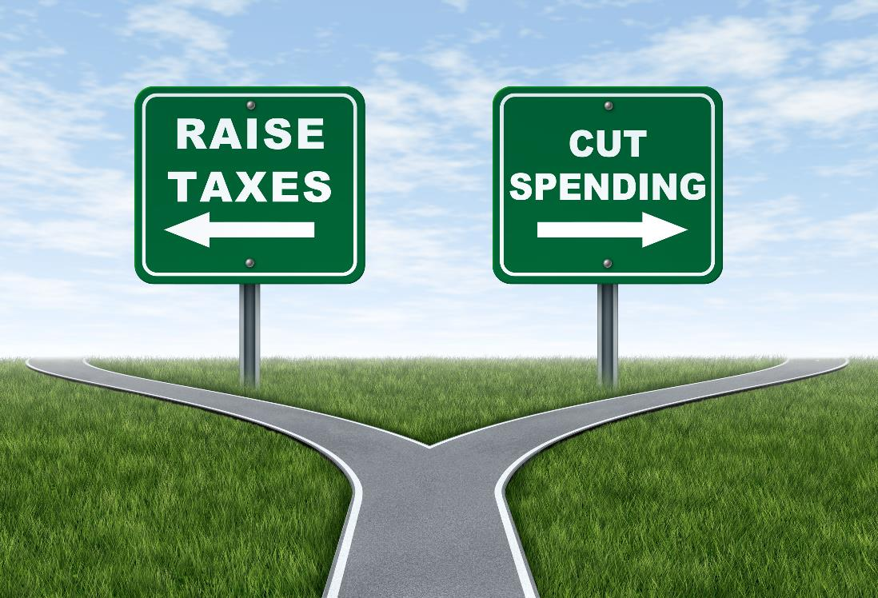
COVID and the economy
12
© Young Citizens

Slide 13
COVID and the economy
Thank you for taking part in this lesson from Young Citizens.
Don’t forget to give us your feedback here:
Teacher: https://www.surveymonkey.co.uk/r/VCRWHMZ
Student: https://www.surveymonkey.co.uk/r/VR3XVRQ
You can also let us know you took part by tagging @YoungCitizensUK on Twitter and Instagram
13
© Young Citizens

