Slide 1
R

Slide 2
RE

Slide 3
RES

Slide 4
RESP

Slide 5
RESPE

Slide 6
RESPEC

Slide 7
RESPECT

Slide 8
RESPECT
What does it mean to you?

Slide 9
I am Phil Williams in my 60’s
I spent 18 years living around the world working in TV and theatre production.
During that time I travelled to remote locations such as the Amazon Rainforest where I spent time with wonderful Indigenous people.
Since 1996 I have been touring schools, colleges, universities and businesses promoting an understanding of the importance of RESPECT

Slide 10
I have put this programme together with no sound and only a few simple images.
I want people to go through this activity with thought, discussion and debate.
It is an opportunity to create and develop your own personal views on the importance of RESPECT in today’s world.

Slide 11
RESPECT
is a feeling of deep admiration for Someone, Something, Somewhere, Some theory.
Some Achievement.

Slide 12
RESPECT
RESPECT FOR ALL PEOPLE
RESPECT FOR THE ENVIRONMENT
(ALL LIVING THINGS)
RESPECT FOR ONESELF

Slide 13
RESPECT
Who or what do you RESPECT?

Slide 14
RESPECT....
Can be closely linked to INSPIRE.
The RESPECT I have for Amazonian Indians is also linked to the way they INSPIRE me with their aim to protect all living things.
My mother is 96 lives on her own and I RESPECT her as my mum but she also INSPIRES me because of the way she has handled the virus situation.

Slide 15
RESPECT
I RESPECT ......
Nelson Mandela for what he did for humanity especially after all he went through.
The Indigenous people of the rainforest who spend their lives protecting the forest for ALL humans
Greta Thunberg and Malala Yousaafzai for showing that one person can make a difference. I RESPECT who they are what they stand for and what they have achieved.
Homeless People of the world as they have as much right to be here as me.

Slide 16
RESPECT
I RESPECT ......
All living things as we are linked. Biodivesity is so important for us all.
I RESPECT the Culture and Lifestyle of people around the world

Slide 17
CORONAVIRUS
In Melbourne, Australia Flinders University and Latrobe University have been carrying out research and
Nikolai Petrovsky Professor of Medicine states:
The finding of the study shows that the Coronavirus is very likely to be man-made.

Slide 18
During this ongoing global situation are we showing RESPECT
Respect for the virus and the continued worldwide problems it has created.........
..........but there is another RESPECT linked to the virus..........

Slide 19
RESPECT
Respect for each other.
Look at the way Essential Services have come together like never before showing RESPECT for each other and working together to find solutions.

Slide 20
Essential Services include:
Health and Social Care
Transport
Utilities
Public and National Security
Food and Necessary goods
Local and National Government
Key Public Services
Education and Childcare.

Slide 21
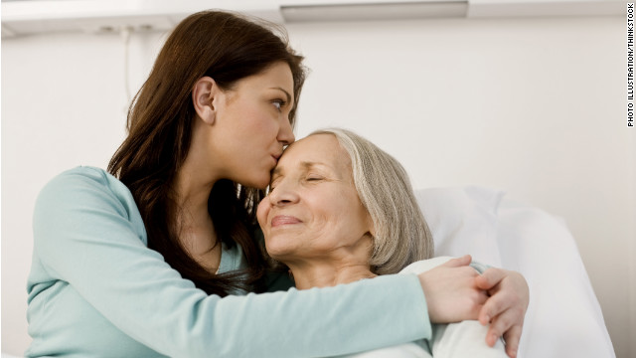
RESPECT
We have RESPECTED the need of the old and lonely......
........by visiting where possible or making a phone call to remind people they are remembered, cared for and not forgotten.

Slide 22
RESPECT for each other by
Carrying out the wishes of the government and scientists.
Wearing Masks
Washing hands often
Keeping a distance.....
That is showing RESPECT for others.

Slide 23
However:
There are those who show no respect...thinking only of themselves.
Those who refuse to wear masks.
Those who think they can congregate with friends in a pub rather than keep their distance.
Those who think they can do what they want?
This lack of respect sadly runs into other areas

Slide 24
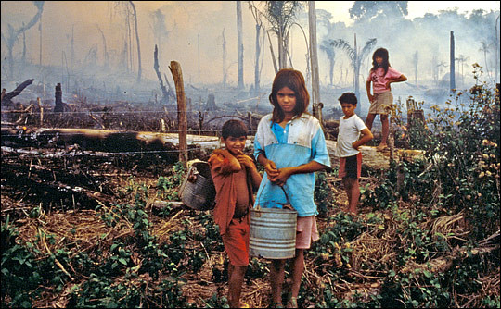
Lack of Respect......
Those who actively support and promote the destruction of the Rainforest for personal short term financial gain ......... Knowing we cannot get it back the negative impact on the local people and the planet especially for future generations.

Slide 25
Black Lives Matter
The movement has been in the spotlight in 2020 but has been around since 2013.
Campaigning against racism and violence aimed at black people.
It aims to intervene in violence inflicted on Black Communities and Black people globally.

Slide 26
Black Lives Matters
Aim to hold RESPECTFUL protests and demonstrations.
The RESPECTFUL SIDE OF
BLACK LIVES MATTER is worthwhile but like all good organisations they are often infultrated by disrespectful people who care only about themselves and have know link or understanding of the organisation in question.

Slide 27
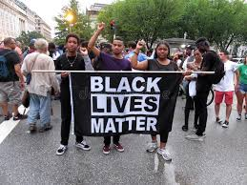
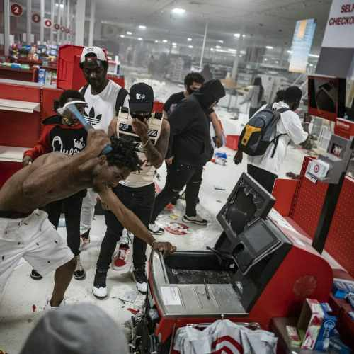
Which of these actions has more impact on the population and public? Both are reported to be BLACK LIVES MATTER protests.
Respectful
Disrespectful

Slide 28
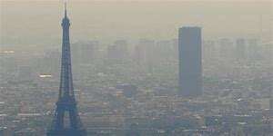
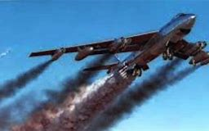
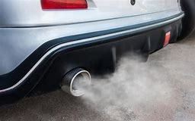
Climate Change.....Is this a RESPECTFUL way for us to treat the planet and your future?

Slide 29
Climate Change is normal.......
.........it’s just that one species US is speeding up the process resulting in:
Ice Caps Melting
Sea Levels Rising
Erratic weather patterns
Increased flooding and Coastal erosion
Increase of Global Forest Fires
Loss of Food.
Loss of Life

Slide 30
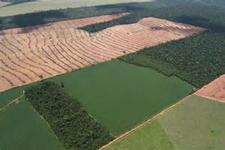
Is this a RESPECTFUL way for us to live?

Slide 31
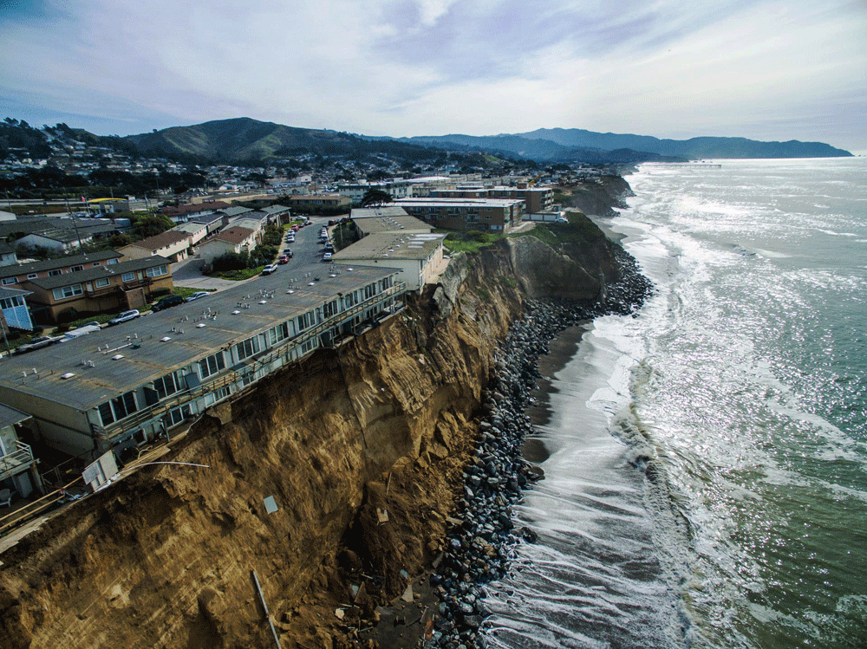
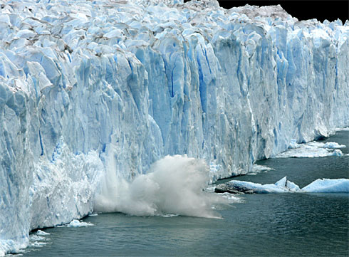
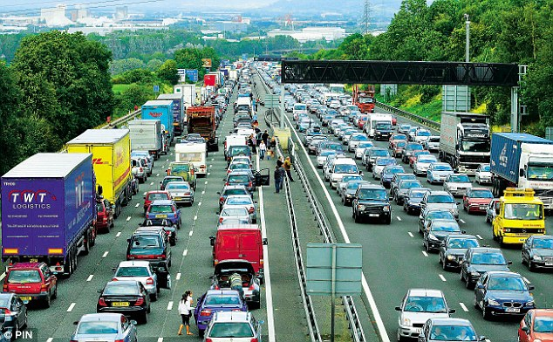
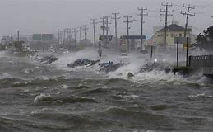

Slide 32
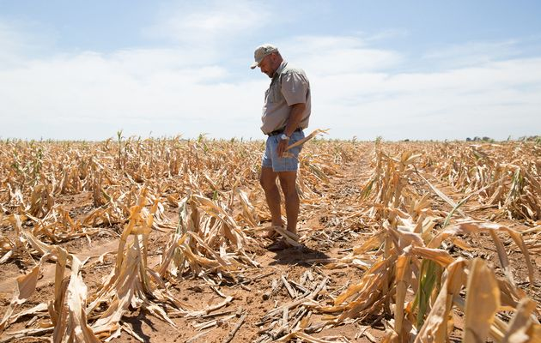
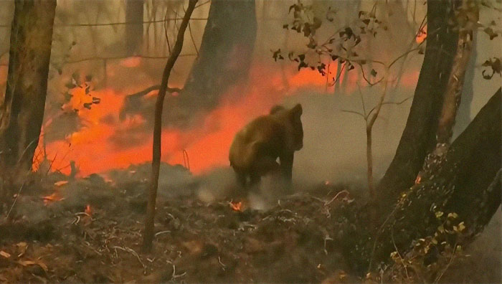
The more pollution the faster the change

Slide 33
Is this a RESPECTFUL way for us to
treat the planet.
OUR home.

Slide 34
Whether you have a religion or not is fine but it should be pointed out
Most religions through their teachings and books tell us to be
RESPECTFUL AND TAKE CARE OF ALL LIVING THINGS.
This includes Humans.

Slide 35
Around the world there are:
2.1 Billion CHRISTIANS
1.3 Billion MUSLIMS/Islam
900,000,000 HINDUS
470,000,000 BUDDHISTS
14,000,000 Jews

Slide 36
Muslims see themselves as having responsibility towards the world and the environment.
Christianity teaches about caring for the environment through the Bible.

Slide 37
Islam states: Humans are on the world as trustees to the world for future generations.
Hinduism: People should use the world unselfishly in order to maintain the natural balance.

Slide 38
Sikhism: Believe that Waheguru created the world as a place where every type of plant and animal could live to prove that they are good enough to be important to the planet.
Judaism: The planet belongs to everyone.
Buddhists and Hindus: Believe in doing no harm

Slide 39
We humans come in different shapes, sizes, ages, colours, religions, faiths and interests.

Slide 40
We need to be RESPECTFUL of ourselves and each other.

Slide 41
We need to learn to be
PROUD OF OUR DIFFERENCES.
PROUD OF WHO WE ARE.
PROUD OF WHO YOU ARE.

Slide 42
WHAT DO YOU SEE?

Slide 43
A fellow human being.
We don’t know their name.
We don’t know where they are from.
We do not know if they have a religion.
We do not know their views and ideas.
BUT WE DO KNOW THEY ARE A FELLOW HUMAN BEING.

Slide 44
We need to RESPECT them for who they are
In the same way you would want others to RESPECT YOU.

Slide 45
RESPECT
Who or what do you RESPECT?
Has it changed?

Slide 46
How can we create.....
A MORE RESPECTFUL WORLD.
A MORE CARING WORLD.
A MORE SUSTAINABLE WORLD.

Slide 47
Your Challenge
For ALL people
How would you make a
more respectful caring world?

Slide 48
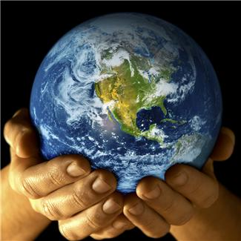
It’s YOUR FUTURE YOU ARE AN IMPORTANT PERSON IT IS IN YOUR INTEREST TO MAKE A DIFFERENCE

