Slide 1
An introduction to Equality and Diversity
Notes:
Created by CE, May 2019

Slide 2
Today we’re looking at:
What is equality and diversity?
Why does equality and diversity matter?
Where does prejudice come from?
Breaking down stereotypes
The power of words
Challenging inappropriate behaviour
= exercise or group discussion topic
= link to further reading

Slide 3
What is equality and diversity?
How would you define “equality” and “diversity”? What are the differences?
Equality – creating a level playing field so that everyone can participate as fully as they can
Diversity – embracing the differences between individuals, celebrating these and learning from these.
Notes:
Exercise: ask class to suggest definitions and write them all down – then read out the actual definitions, and connect the answers given to the correct definition.

Slide 4
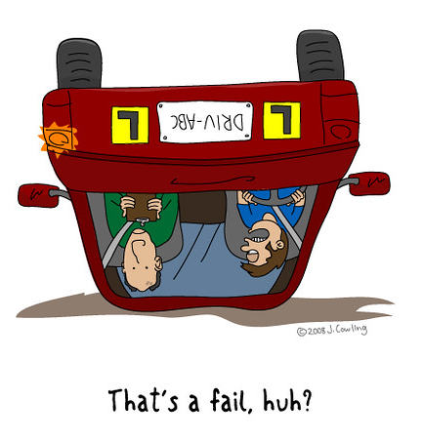
Think of it this way -
If you were taking your driving test, you’d want to be assessed fairly based on how well you can drive.
If you failed because you crashed the car, you might feel disappointed, but you wouldn’t feel that you were treated unfairly.
But if the examiner failed you because you’re Irish, or a woman, you’d be annoyed – and rightly so!
Equality is about making sure people are treated fairly and aren’t judged by unrelated factors like their gender or where they were born.

Slide 5
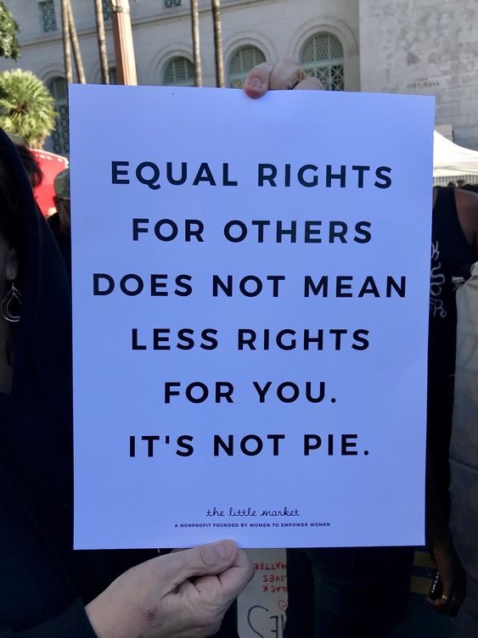
Important: equality DOESN’T mean “treating everyone exactly the same”, or “giving certain people special treatment”.
It means treating people fairly and according to their needs, so they can access the same opportunities as everyone else.
For example, if you were dyslexic then you might get extra time for an exam.
No one is the same – but everyone is equal.

Slide 6
What’s wrong with this picture?
Notes:
Exercise: what’s wrong with this picture? Explain the picture: 3 people of different heights are trying to watch a free baseball game over a tall fence. They ask for 3 boxes to stand on, to help them see over the fence. They are given 1 box each to stand on. Ask the students to identify what’s wrong with this scenario, and suggest how to fix it.
Click to the next slide for the answer.

Slide 7
Treating everyone “equally”
Treating everyone according to what they need
Notes:
Picture on the left – person 1 and person 2 can now see the game, but person 3 can’t.
Picture on the right – by giving out the boxes according to what people need, everyone wins.

Slide 8
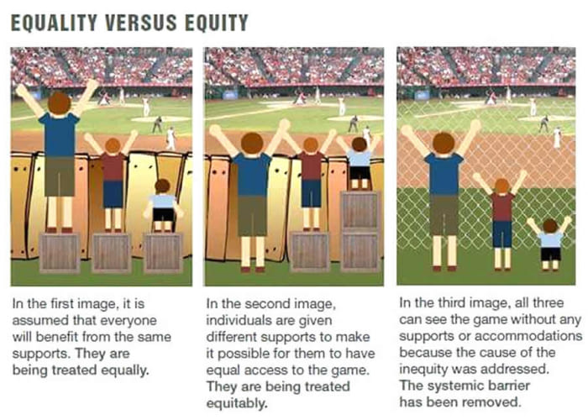
Bad
Better
Best
Notes:
By removing the barrier, everyone can see equally well, and no one has to go ask for a box to stand on.

Slide 9
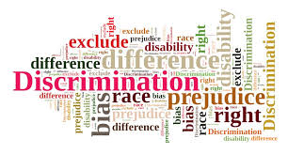
There are 9 “protected characteristics”
A “protected characteristic” is a feature of a person that is legally protected from discrimination – it’s not just immoral to treat someone badly on the basis of a protected characteristic, it’s also illegal.

Slide 10
Which of these are protected by law?
The elderly (over 65)
Wheelchair users
Asian people
Pregnant people
Atheists
Married couples
Someone who has recently given birth
Autistic people
Bisexual people
Men
Dyslexic people
18 year olds
Transgender people
Muslims
Women
Jewish people
Christians
People with depression
Deaf people
Lesbians
Notes:
Exercise: select which ones are protected by law – i.e. is it illegal to discriminate against an elderly person?

Slide 11
Answer: all of them!
The elderly (over 65)
Wheelchair users
Asian people
Pregnant people
Atheists
Married couples
Someone who has recently given birth
Autistic people
Bisexual people
Men
Dyslexic people
18 year olds
Transgender people
Muslims
Women
Jewish people
Christians
People with depression
Deaf people
Lesbians
Notes:
All of these are protected by law – equality is for everyone.
Age = people of all ages, young and old
people who are pregnant and people who have given birth.
Men and women
Disabled people = physical disabilities (e.g. wheelchair users), learning disabilities (e.g. autism), and mental health conditions (e.g. depression).
People of all ethnicities – black, white, Asian, or any other minority ethnic background
Transgender people – people whose gender is different to the sex they were assigned at birth.
People with a religion or belief, including people with no religion or belief such as atheists
Sexual orientation = this covers lesbians, gay people, bisexual people, and straight people.
Marriage and civil partnership = covers people who are married, in CPs, and people who are unmarried.

Slide 12
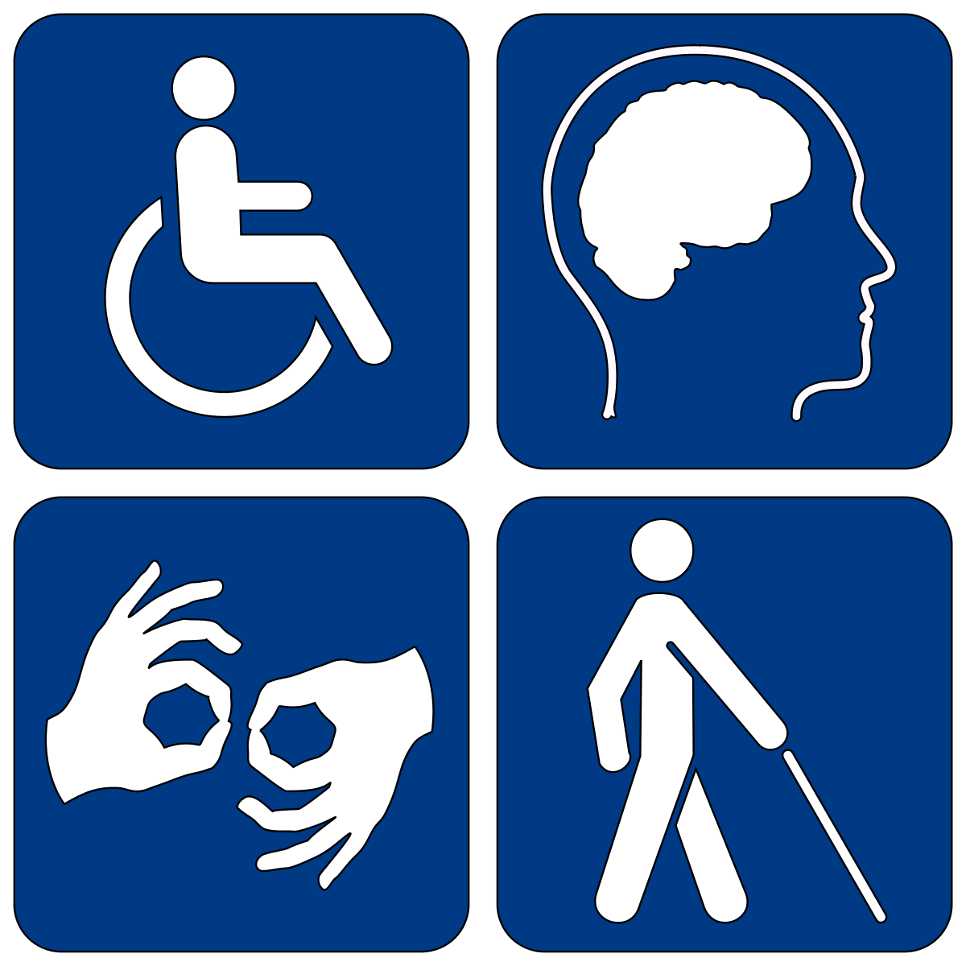
What exactly is a disability?
A disability is a long-term physical or mental impairment that affects a person’s day-to-day life.
This includes physical disabilities (like blindness or being unable to walk), learning disabilities (like autism or ADHD), and mental illness (like depression and OCD).
Click to read our Equality pages to learn more about disability equality.

Slide 13
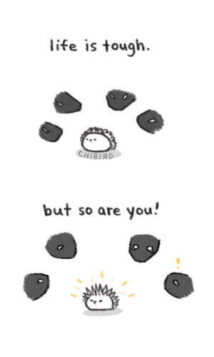
What do we mean by “mental health”?
Good mental health means being generally able to think, feel and react in the ways that you need and want to live your life.
Mental health problems affect around one in four people in any given year. They range from common problems, such as depression and anxiety, to rarer problems such as schizophrenia and bipolar disorder.
Click to read our Equality pages to learn more about mental health.

Slide 14
What does LGBT+ stand for?
Lesbian = a woman who is attracted to other women
Gay = a man who is attracted to other men
Bisexual = someone attracted to people regardless of their gender
Trans = someone whose gender is different to the sex they were assigned at birth.
Plus = other sexual and gender identities, including (but not limited to) :
Asexual (someone who doesn’t experience sexual attraction)
Non-binary (someone whose gender is neither male nor female)
Queer (an umbrella term for “not straight”)
Notes:
Out of interest, raise hands – who knows what LGBT stands for? (ignore the plus)
Someone shout out the answer?

Slide 15
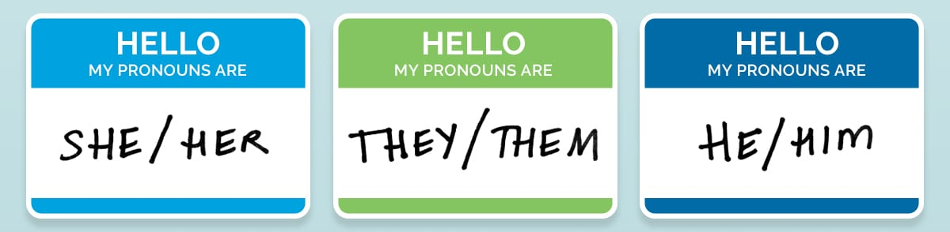
Gender-Neutral Pronouns
A pronoun is a noun used to refer to another person in place of their name, that indicates someone’s gender.
Sarah brought an umbrella with her.
Michael dropped his phone.
Jo was tired so they went to bed.
Notes:
Gender-neutral pronouns have been around since 13th century and are grammatically correct
We use them all the time for individual people whose gender we don’t know, nothing new – e.g. “someone phoned asking for you, they didn’t leave a message” or “I believe every person deserves to be rewarded for their hard work”

Slide 16
How to use gender-neutral pronouns
If someone asks you to call them “they”, call them “they”
Practice!
If you make a mistake, quickly correct yourself and move on
Don’t mention how hard it is for you
Correct others who use the wrong pronoun
Don’t worry if it takes time to adjust.
Click to read our Equality pages to learn more about LGBT+.
Notes:
We have been trained from birth to use gendered pronouns, so it’s of course it’s going to feel unnatural for a while to call people “they”
Think of it as someone who changed their surname after a tough divorce, and you insist on calling them by their married name, because that’s how you were introduced, and god it’s so hard to use a different name, and oh you know what I mean don’t you?! “oh actually I use my maiden name, I’m trying to put the past behind me”
Correct others – if other students or staff use the wrong one, say “just to let you know, Alex uses the pronoun she” , and move on.

Slide 17
Why does all this matter?
Treating everyone fairly and without discrimination is the right thing to do
An equal world supports people to be the best version of themselves - better grades, better jobs, making friends, involved in the community
The world is diverse – so it’s important to learn about the different types of people we may meet in future
We can learn from people with different backgrounds and life experiences.

Slide 18
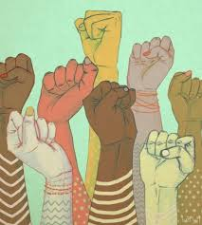
What’s in it for you?
To be treated fairly and get through college based on merit alone
To be valued and respected as an individual
The right to challenge and remove any unfair barriers that stand in the way of your progress
The right to reach your full potential
Support from the college if you ever need to raise any issues or challenge any unacceptable behaviour.

Slide 19
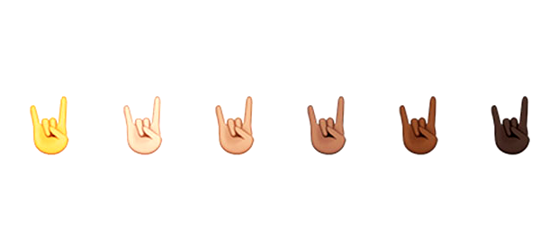
The key point is that equality and diversity isn’t just good news for particular groups of people: it’s good news for everyone.

Slide 20
Why do people treat others unfairly?
At the root of most inequality is prejudice – an unfair negative attitude towards members of a particular group. A well-known example is racism, which targets different racial groups.
Where do our prejudices come from? Most agree on two key triggers: preconceptions and stereotypes.
PRECONCEPTIONS
prejudice
STEREOTYPES

Slide 21
Preconceptions → Stereotypes
As we grow up, we develop deep-rooted ideas about the world, based on the things we see and experience. These are called preconceptions, and they form our understanding of what’s “normal”.
While preconceptions are natural, they can be dangerous – they might prevent us from seeing or accepting things in a certain way.
Preconceptions can lead us to stereotype people, which is an over-generalised belief about a particular category of people.
For example, maybe when you were in school, you only knew one Asian person, and he was always rude to you. This might result in your brain assuming that all Asian people are rude.

Slide 22
In the same way that we place objects around us into categories, we do the same with people. This could be on the basis of gender, race, sexuality, religion, or disability.
The problem is when we make generalisations about these groups, which can form stereotypes, and can lead to prejudice.
Put people into groups e.g. Asian people and White people
Make generalisations about groups e.g. “Asian people tend to be rude”
Becomes the root of prejudice e.g. “I don’t like Asian people because they’re always rude”

Slide 23
Exercise: who are your five closest friends?
Write down a list of your 5 closest friends, or the 5 people you spend the most time with – don’t overthink it!
Thinking about the protected characteristics we discussed earlier, write down each friend’s age, gender, race, disability, and religion, if you know them.
Compare this list of characteristics to your own age, gender, race, disability, and religion. What do you notice?
Most people find that their 5 closest friends are similar to themselves – they are roughly the same age, are often the same gender and race, and often have similar religious or spiritual beliefs.
This shows how our preconceptions can lead us to stick with people who are like us, and (unconsciously) avoid people who are not like us, even if we don’t mean to.
Notes:
Individual exercise – reveal each step 1 at a time

Slide 24
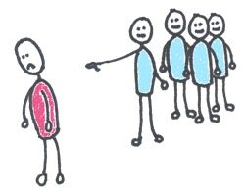
Task: Harvard Implicit Bias test
Try out the Harvard Implicit Association test.
Discuss with the rest of the group:
Did your results surprise you?
Do you think that your biases might affect how you relate to people who are different to you?
What one thing do you think you can do now to try and change your behaviours around your biases?
Notes:
Harvard implicit association test – test people’s unconscious biases and preconceptions.

Slide 25
If this is unconscious … what can we do?
Be honest and try to explore your biases
Understand the impact it can have on your behaviour
Avoid stereotyping or generalisations about other people
Challenge your assumptions (e.g. gut feelings) – think it through
Seek out chances to chat with people who are different to you
Try to be positive about changes in society and don’t dismiss them as pointless or silly – sometimes people dislike change, but history has shown that the most successful people are those that embrace change.

Slide 26
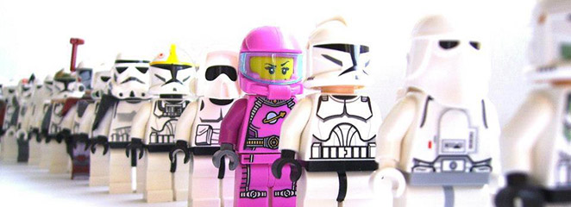
Breaking down stereotypes
Focus on the individual – get to know them and understand them, look for the things that make each person unique
Be aware of the stereotypes you’ve been exposed to and think about how they might interfere with the way you see and speak to others
Recognise that we all belong to many different groups, none of which can fully define who we are. To think that everyone in a particular group is the same, is like thinking that every fiction book in the library is the same!

Slide 27
The power of words
Most of us love jokes and banter – but it’s important not to attack people based on who they are, and not to say offensive words like “tranny” and “retard”, even if it’s “just a joke”.
Jokes and comments like this can upset other people, and can make them feel unwanted and abnormal.
Imagine if a word associated with your identity was considered an insult. It would sting, right? And every time people used it, they would be reinforcing the idea that people like you are bad and unwanted.
Notes:
In this slide, verbally mention the language that is unacceptable, for example:
DISABILITY: Retard / retarded, cripple, spaz, schizo, gimp, special, as in “he’s a bit special”
LGBT+: “that’s so gay” or generally using “gay” as an insult, poof, fairy, tranny, fag, lesbo
RACE: the n-word, chinky, using racial words like “jew” as an insult
Ask them to reflect on a word associated with their identity, e.g. “blonde”, and think about how this would hurt if people used it as an insult.

Slide 28
How do I know if a word is ok to use?
The answer depends on the context and situation.
“She’s autistic” to describe an autistic person is a factual statement – but “ugh she’s so autistic” to describe someone’s unusual behaviour is not ok.
The key thing here is: avoid using a word that refers to a person’s identity in a descriptive sense to suggest that something is bad, weird, or unacceptable.
On the plus side, using inclusive language means you get to expand your vocabulary and communicate better, conveying exactly what you mean!

Slide 29
Exercise: in other words
Come up with a list of other words could you use instead of words like “that’s so gay”, “retarded”, or “spaz”:
When something frustrates you (e.g. “that’s so stupid!”)
When something is bad or unpleasant (e.g. “this sucks”)
When someone or something is being too intense (e.g. “he’s wild”)
When something or someone is embarrassing or dorky (e.g. “they’re ridiculous”)

Slide 30
Weird. Messed up. Annoying. Silly. Awkward. Pathetic. Dumb. Weak. Boring. Ridiculous. Absurd. Surreal. Nuts. Wild. Wack. Stupid.
Interesting. Sick. Naff. Outrageous. Gross. Frustrating. Pointless. Obnoxious. Awful. Cheesy. Dorky. Nonsensical. Bizarre.
Notes:
Here are some suggestions

Slide 31
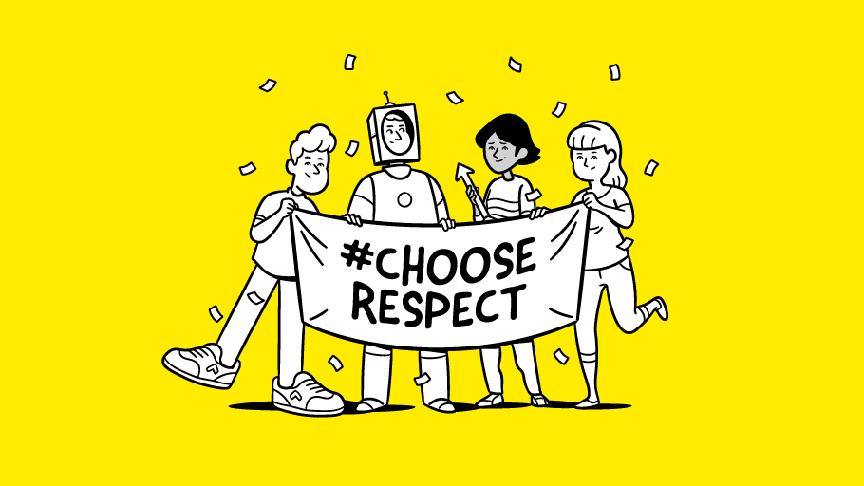
Other people’s behaviour and language
The College is fully committed to equality, diversity, safety, and respect, and we will tackle any unacceptable behaviour and language that occurs on campus.
If you see or hear someone else making inappropriate comments or treating someone unfairly, please speak up and let them know that it’s not ok.

Slide 32
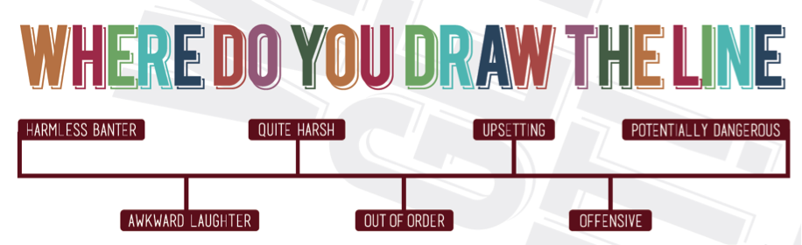

Slide 33
How to challenge unacceptable behaviour
Step 1: speak up right away
Step 2: speak calmly but firmly, and don’t smile or laugh, otherwise they might not take you seriously.
Step 3: Be specific – tell them what you found unacceptable, how it made you feel, and what you want them to do – or stop doing – in the future.
Step 4: if the person tries to laugh it off, tell them you’re being serious and make it clear to them that their behaviour is unacceptable.
Step 5: if the person tries to argue or becomes confrontational, just walk away. This will show how serious you are about their behaviour.

Slide 34
What if the problem continues?
Speak to your tutor, or to Student Services
Don’t suffer in silence – if you feel that you, or anyone else, is being treated unfairly, we will support you to resolve the issue.

Slide 35
Find out more about Equality and Diversity
We have an Equality and Diversity Moodle full of information, links, resources, quizzes, and more!
Contact diversity@nptcgroup.ac.uk if you want to ask any questions, or want any advice.
NPTC Student Union for advice, support, and campaigns:
www.facebook.com/NPTC.SU
NPTC Student Union LGBTQ Society – open to anyone who is LGBTQ or questioning:
www.facebook.com/NPTC.LGBTQ

