Slide 1
LGBT+:
An Overview

Slide 2
Hopes in a Hat
What do you hope to learn in today’s session?
It can be a specific query, or a general hope for the training
Notes:
OPTIONAL EXERCISE: ask everyone to write down one thing that they want to learn today, or one question they have about lgbt issues – try to address all in the session – any that you’re unsure of,

Slide 3
Today we’ll cover:
Definitions: what is LGBT+?
Mythbusting
Why does this matter?
Language
Pronouns

Slide 4
What does LGBT+ stand for?
Lesbian = a woman who is attracted to other women
Gay = a man who is attracted to other men
Bisexual = someone attracted to people regardless of their gender
Trans = someone whose gender is different to the sex they were assigned at birth.
Plus = other sexual and gender identities, including (but not limited to) :
asexual
intersex
genderqueer
Notes:
Out of interest, raise hands – who knows what LGBT stands for? (ignore the plus)
Someone shout out the answer?

Slide 5
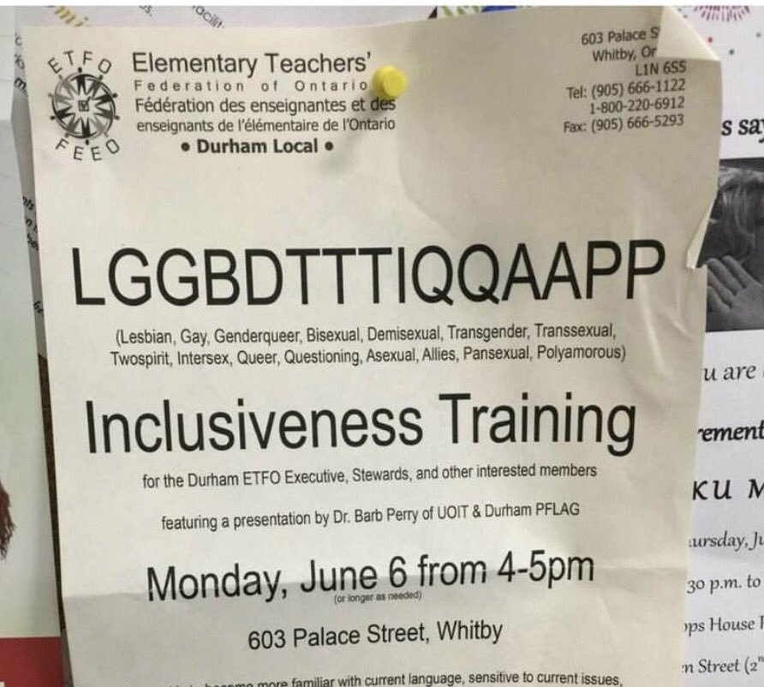
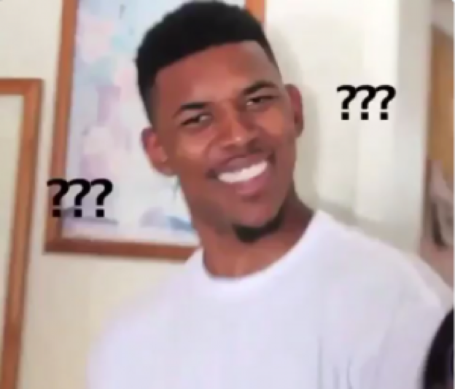
LGBT ü
LGBT+ ü
LGBTQ ü
(LGBTQIA)
(QUILTBAG)

Slide 6
LGBT+ or Queer
Lesbian
Gay
Bisexual
Transgender
Asexual
Pansexual
Intersex
Other ‘plus’ labels
Notes:
LGBT+ or Queer are “umbrella terms” which encompass all the specific gender and sexual identity labels

Slide 7
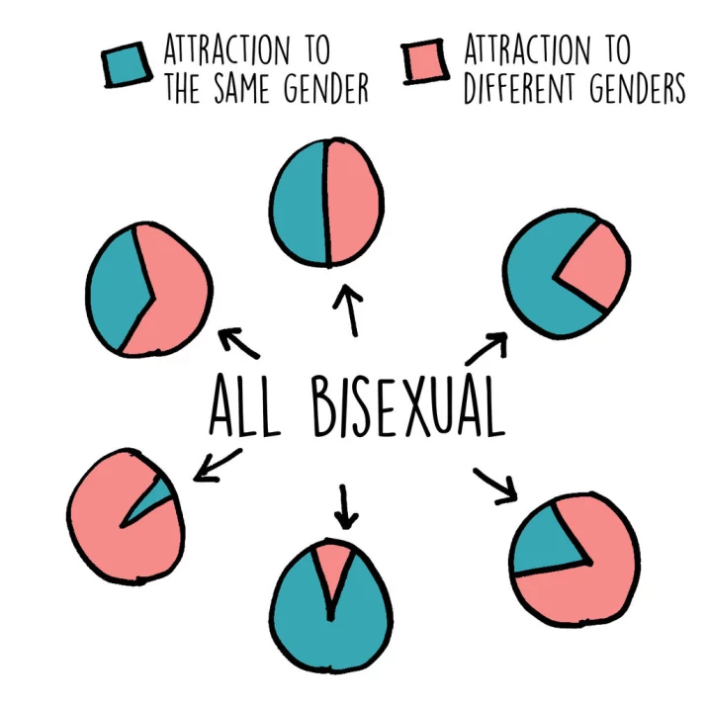
BISEXUALITY
Bisexuality is not just “men and women”
Bisexuality is not 50:50
43% of 18-24 year olds aren’t gay or straight

Slide 8
Notes:
The gender unicorn is a chart designed to outline the differences between these 5 concepts:
Gender identity = the gender you feel yourself to be in your head
Gender expression = how you present your gender via clothes, hair, makeup, body shape
Sex assigned at birth = when you were born, were you categorised by the doctor as male, female, or intersex
Physical attraction = which genders you are physically/sexually attracted to
Emotional attraction = which genders you are emotionally/romantically attracted to
“woman”, “man” and “other” are all separate arrows on this chart instead of a scale with “male” and “female” at opposite ends – this is because not all trans people exist on a scale of womanhood and manhood, that you can be varying degrees of any of these things.
EXERCISE: fill out your own gender unicorn and put a cross on every arrow on the chart according to what feels right to you.

Slide 9
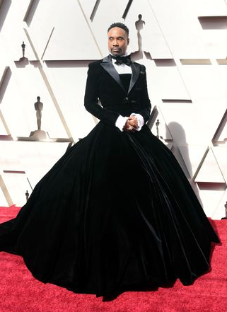
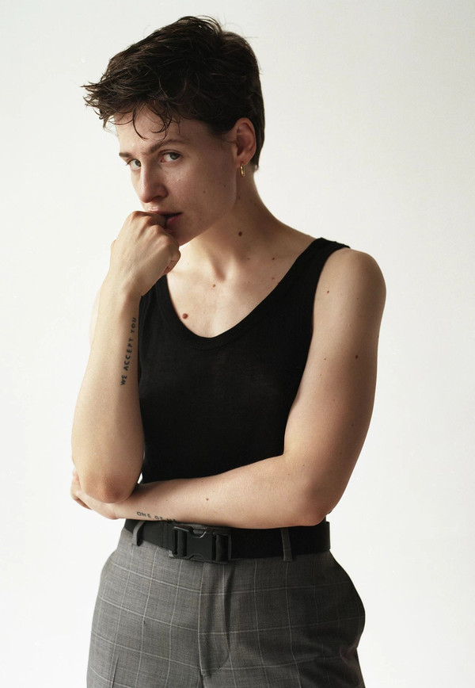
Notes:
Here are some celebrity examples of fluid gender expression. From left: Milla Jovovich - Billy Porter – Eloiz Letissier (Christine and the Queens) – Ezra Miller

Slide 10
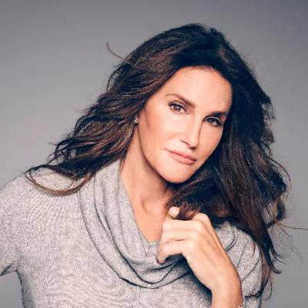
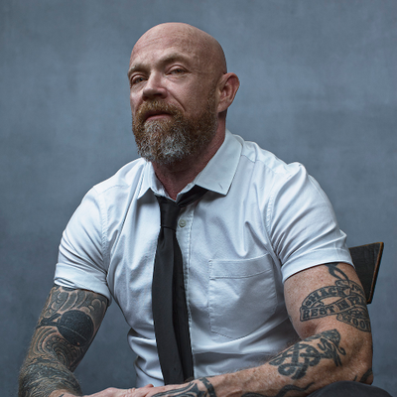
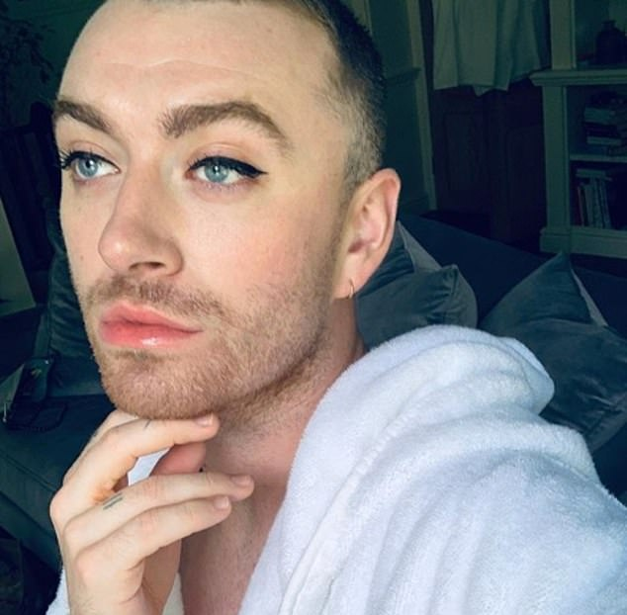
A trans man is a man who was assigned female at birth but is now a man.
A non-binary person is someone who was assigned either male or female at birth, but is now not exclusively male or female.
A trans woman is a woman who was assigned male at birth but is now a woman.
Notes:
From left: Caitlin Jenner, Buck Angel, Sam Smith

Slide 11
Notes:
Direct link: https://youtu.be/TUplfl44svc

Slide 12
Transitioning
Changing one’s gender = “transitioning”
Transition doesn’t always include surgery
Transsexual is an older term – “trans” is the preferred term
Terms such as “sex change” or “pre-op/post-op” unnecessarily fixate on a person’s anatomy and should be avoided
Avoid saying things like “she used to be a man”: we always refer to trans people as the gender they are now.
“trans” is an adjective, not a noun.

Slide 13
How many genders are there?
Female
Male
Non-binary
Encompasses other gender identities including (but not limited to)
bigender, agender, & genderqueer

Slide 14
Isn’t this all a bit complicated?
Identity and knowing who you are
Allows freedom to dress and act as you like
Specificity helps fight prejudice and misconceptions
Validates complex feelings about gender/sexuality
Community and Pride – important for LGBT+ people who grew up excluded from mainstream community
Understanding = able to support LGBT+ people

Slide 15
Why does all this matter?
Treating everyone fairly and without discrimination is the right thing to do
An equal world supports people to be the best version of themselves - better grades, better jobs, making friends, involved in the community
Fighting barriers to accessing healthcare
The world is diverse – so it’s important to learn about the different types of people we may meet in future
We can learn from people with different backgrounds and life experiences.

Slide 16
Quick thought experiment
If someone gave you 10 million pounds to fully change your gender and live it for the rest of your life – full body surgery, hormones, vocal coaching, physical therapy, documentation, clothes, hair, make up, living as your new gender at work, at home, when socialising, when dating – would you?
If not, why not? How does it feel to consider your body and your gender as being “wrong”?

Slide 17
Myth vs Reality
In groups, sort the statements into two sections – “myth” and “reality”
Was there anything you were unsure of?
Did anything surprise you?

Slide 18
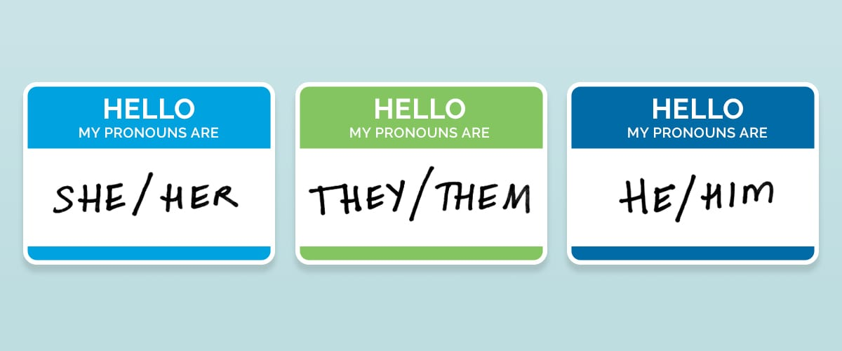
Gender-Neutral Pronouns
Pronoun = noun used to refer to another person in place of their name.
Sarah brought an umbrella with her.
Michael dropped his phone.
Jo was tired so they went to bed.

Slide 19
Gender-Neutral Pronouns
Pronoun = noun used to refer to another person in place of their name.
Sarah brought an umbrella with her.
Michael dropped his phone.
Jo was tired so they went to bed.

Slide 20
How to use gender-neutral pronouns
Use in the same way as “she/her” or “he/him”
Practice!
If you make a mistake, quickly correct yourself and move on
Don’t mention how hard it is for you
Correct others who use the wrong pronoun
Don’t worry if it takes time to adjust.

Slide 21
Quick pronoun exercise!
Hi! My name is …
and I use ....... pronouns
Notes:
EXERCISE: ask everyone to pair up and introduce themselves with this template
How did that feel?

Slide 22
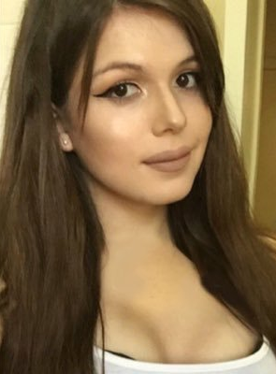
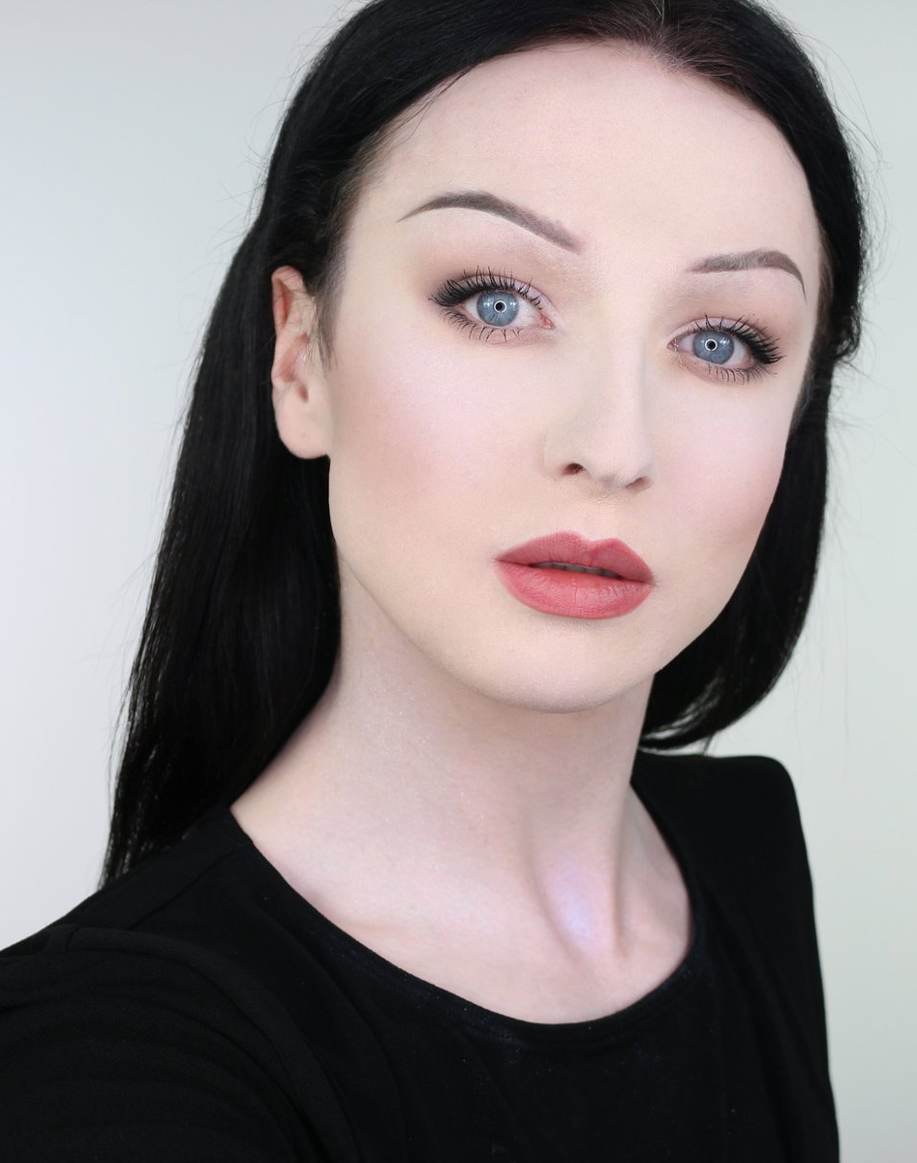
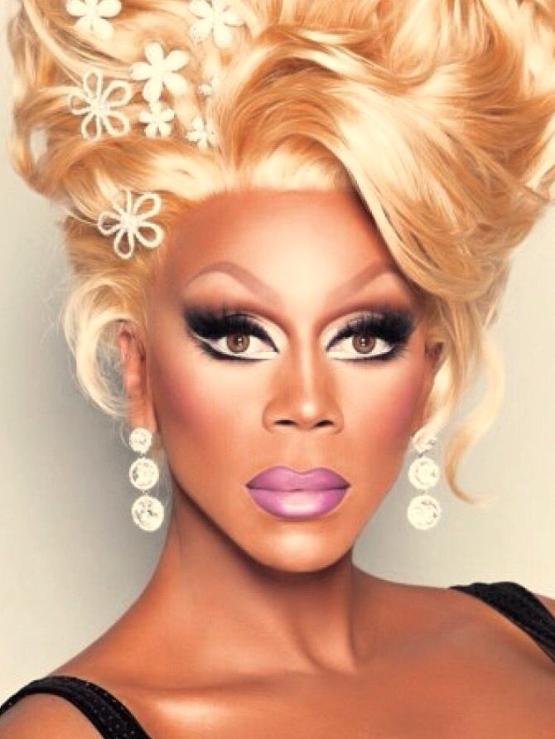
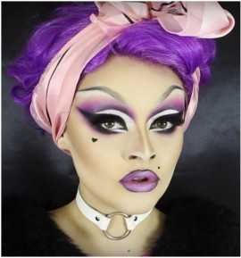
You can’t always tell someone’s gender by their appearance
Notes:
If you had these 5 people in a new class, you might assume that they’re all women – or maybe you’d assume that some are men in drag?
FROM LEFT:
Blaire White – trans woman (binary trans woman)
John Mclean – make-up artist who uses male pronouns (binary cis man)
Courtney Act – a non-binary genderqueer person
RuPaul – a man who performs as a woman (binary cis man)
Lucy Garland – a cis woman who performs as a drag queen
Gender is not binary – there are many different ways to express your gender, many different gender identities

Slide 23
What language should I use?
Never use an LGBT+ term as a pejorative, e.g. “that’s so gay”, “she looks like a tranny”. These imply that it’s bad or shameful to be LGBT+.
Imagine if a word associated with your identity was considered an insult. It would hurt! And every time people used it, they would be reinforcing the idea that people like you are bad and shameful.
Always correct people who use hurtful words like “tranny”, “she-male”, “it”, “poof”, “lesbo”, etc.

Slide 24
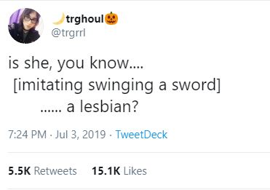
Am I allowed to say “gay” at all?
It’s less about the words, and more about the intent.
“He’s gay” to describe a gay man is a factual statement – but “ugh he’s so gay” to describe someone’s effeminate behaviour is not ok.
Don’t whisper the words as though they’re swear words
Avoid using a word that refers to a person’s identity in a descriptive sense to suggest that something is bad, weird, or unacceptable.

Slide 25
Weird. Messed up. Annoying. Silly. Awkward. Pathetic. Dumb. Weak. Boring. Ridiculous. Absurd. Surreal. Nuts. Wild. Wack. Stupid.
Interesting. Sick. Naff. Outrageous. Gross. Frustrating. Pointless. Obnoxious. Awful. Cheesy. Dorky. Nonsensical. Bizarre.

Slide 26
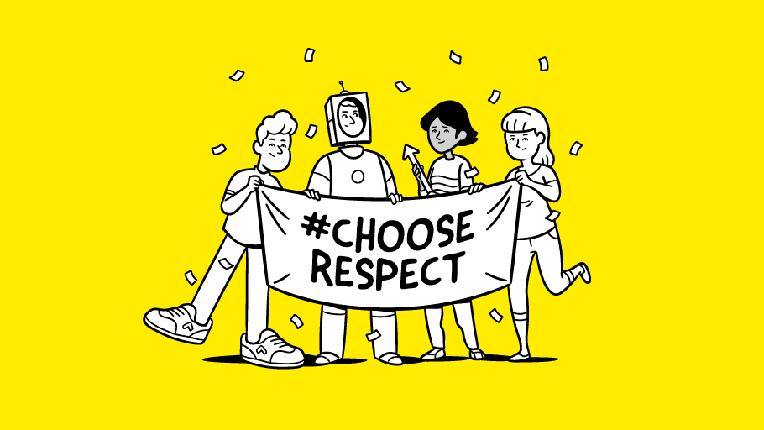
Other people’s behaviour and language
The College is fully committed to equality, diversity, safety, and respect, and we will tackle any unacceptable behaviour and language that occurs on campus.
If you see or hear someone else making inappropriate comments or treating someone unfairly, please speak up and let them know that it’s not ok.

Slide 27
How to challenge unacceptable behaviour
Step 1: speak up right away
Step 2: speak calmly but firmly, and don’t smile or laugh, otherwise they might not take you seriously.
Step 3: Be specific – tell them what you found unacceptable, how it made you feel, and what you want them to do – or stop doing – in the future.
Step 4: if the person tries to laugh it off, tell them you’re being serious and make it clear to them that their behaviour is unacceptable.
Step 5: if the person tries to argue or becomes confrontational, just walk away. This will show how serious you are about their behaviour.

Slide 28
Want to learn more?
E-STEP tutorial programme
Info and resources on Equality and Diversity Moodle page
Student Union LGBTQ Society: facebook.com/nptc.lgbtq
diversity@nptcgroup.ac.uk

