Slide 1
Notes:
The information has been compiled by the Safeguarding team to ensure student safety at college

Slide 2
The Aims of the Session are to:
Understand what is meant by Safeguarding
Types of Safeguarding
Know who to contact if you need support or have concern for others
How to keep yourself safe

Slide 3
What is Safeguarding?.......
Safeguarding is a term used to denote measures to protect the health, well-being and human rights of individuals, which allow people to live free from abuse, harm and neglect
At college all staff have a duty of care to safeguard students
Notes:
Discussion
Consider how you would feel if someone was talking about you
Please feel free to leave if you feel upset
Speak to your tutor or member of safeguarding team if you are concerned or wish to share anything
Part of this tutorial is to understand the correct ways to raise concerns

Slide 4
Ground Rules for our Session
Ground Rules for our Session
Sensitive issue-sensitive themes-sensitive response
We do not talk about individual people or use names
The tutorial space is a ‘safe space’
We want to encourage questions
We want you to express opinions
You need to be mindful of other people views
You need to speak and act in a way which shows respect to others
Notes:
Discussion
Consider how you would feel if someone was talking about you
Please feel free to leave if you feel upset
Speak to your tutor or member of safeguarding team if you are concerned or wish to share anything
Part of this tutorial is to understand the correct ways to raise concerns

Slide 5
All FE providers have a duty to safeguard their students
Notes:
One of the colleges main values is to keep you safe, treat you with respect and offer you support
The College has a legal duty and this is specified in:
Legislation
All Wales procedures and codes of practice that relate to those defined children and vulnerable adults
The College also has its own policies which include Safeguarding, Anti bullying, Equality and Diversity etc
In addition all staff receive safeguarding training at induction and annual refresher courses

Slide 6
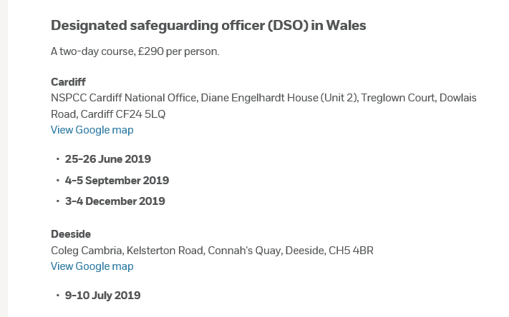
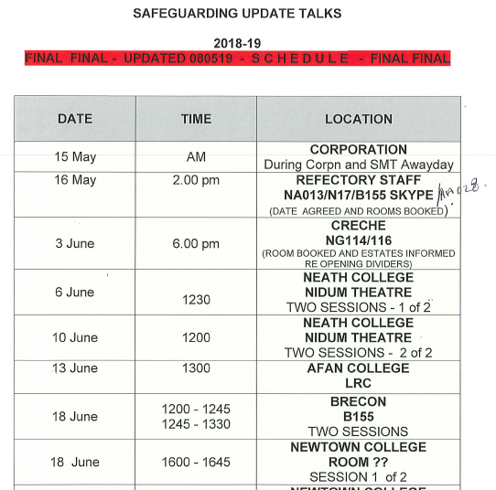
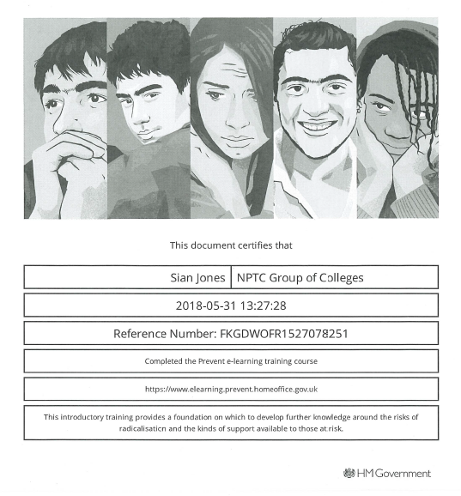
The Duty requires colleges to:
Notes:
In 2015 the Prevent Duty was included as part of Safeguarding and as part of the Counter Terrorism Act. This is covered in more detail in the Prevent tutorial

Slide 7
Safeguarding Policy – Updated Annually
Updated last in June 2021 to include, more detailed reference to and guidance on handling issues around violence against women, domestic abuse and sexual violence
The 2019 update took into account the Wales Safeguarding Procedures that provided more guidance on exploitation in its broadest sense and beyond sexual exploitation
Notes:
The College Safeguarding policy was put in place to ensure vulnerable people are not abused in any way.
It makes it clear what the College will do to keep students safe.
The Policy is updated annually and available on SharePoint and Moodle

Slide 8
Different Types of Safeguarding…
Abuse – Domestic, Physical, Emotional, Sexual, Neglect, Financial
Self-Harm, Suicide Ideation
Bullying Harassment, Cyberbullying
Grooming, Radicalisation
Child Trafficking for Sexual Exploitation, Domestic Slavery, Committing crimes, Benefit Fraud
Female Genital Mutilation, Forced Marriage
Rape, Non-consensual Sex, Inappropriate sexual activity with a child/vulnerable adult
Sexual Exploitation, Sexting
Notes:
How many different types of Safeguarding Concerns can you list?

Slide 9
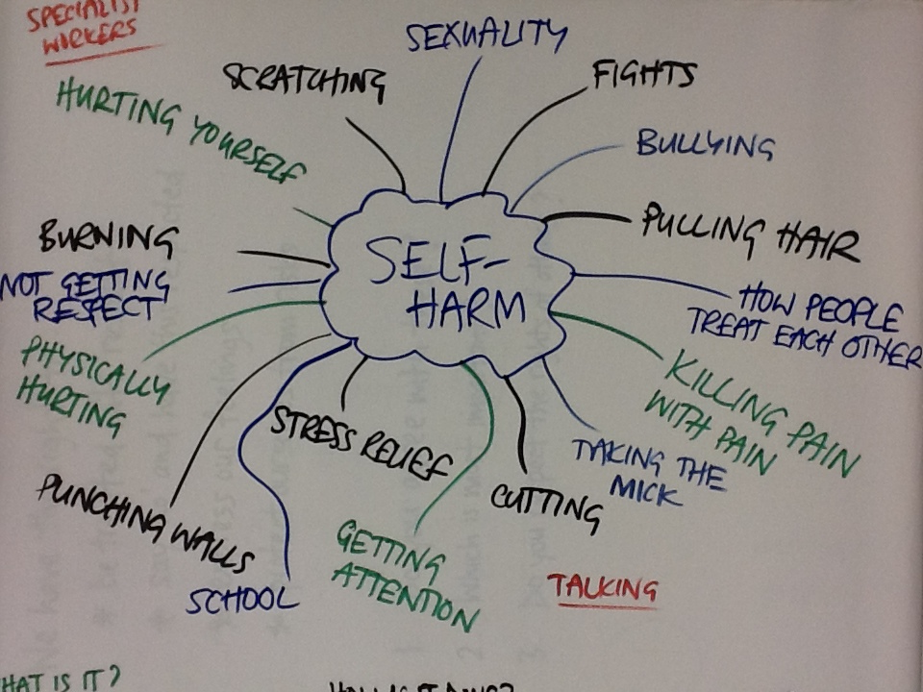
Wellbeing and Mental ill Health
The BIG FOUR:
The College has trained over 100 mental health first aiders
Notes:
Discussion – what would you think would be the main concerns students come to the wellbeing team?
Depression
Anxiety and panic attacks
Suicidal ideation
Self harm

Slide 10
Email: Safeguarding@nptcgroup.ac.uk
Notes:
There are currently 8025 students enrolled across all sites
Specialised team of 20+ trained staff dedicated to look after the welfare of students who present safeguarding concerns
Work with local authorities, GPS’s, police

Slide 11
Limits of Confidentiality
If you are under 18 years of age or a vulnerable adult and you disclose an issue that involves any form of abuse to yourself.
If you disclose an issue that involves abuse of any person under the age of 18 years or any person who is considered a vulnerable adult.
Where the Safeguarding team believes there is a significant risk of harm to you or others.
If you disclose information that involves acts of terrorism.
If a member of the Safeguarding team is summoned to court
If you disclose information that involves acts of drug trafficking.
Notes:
Look for Safeguarding Poster around college and further information on moodle

Slide 12
How to Contact the Safeguarding Team
Speak to your tutor
Speak to a member of staff wearing a yellow lanyard
Email: safeguarding@nptcgroup.ac.uk
Call to Student Support
Notes:
Look for Safeguarding Poster around college and futher information on moodle

Slide 13
Keeping Yourself Safe
Staff
SStaffg
Safe-
guarding
Diogelu
FE
Student
Myfyriwr AB
Student
Rep
Cynrych-iolydd Myfyrwyr
HE
Student
Myfyriwr AU
Junior
Apprentice
Prentis Iau
School
Link
Cyswllt Ysgol
Visitor
Ymwelydd
Notes:
Did you realise there are 8 different lanyards worn by staff/students/visitors – it is for your own safety that you MUST wear your lanyard and ID badge whilst on site
Staff are now proactive in ensuring students wear their lanyard and ID badge – so you will be approached if you are not wearing your lanyard!

Slide 14
Be Careful with Sexual Behaviour, Especially Consent…
Notes:
take steps to protect yourself
consider social networking media and how we interact in the virtual world
consider social networking media and how we interact with students and trainees in the virtual world
polices, procedures and codes of conduct make sure you know where to find the up to date copies -moodle

Slide 15
Be Careful with Personal Information

Slide 16
Any Questions ?
For further information contact
Assistant Manager for Safeguarding and Resilience
email: mandy.mellor@nptcgroup.ac.uk
Notes:
For further information contact Assistant Manager for Safeguarding and Resilience, Mandy Mellor email: mandy.mellor@nptcgroup.ac.uk

