Slide 2
The aims of the session are to:
Understand what is meant by the term “prevent duty”
1
Define “extremism” and “radicalisation”
2
Understand the main threats and risks from extremist groups in the UK today
3
Define British Values
4
Consider online threats to radicalisation
5
Understand the term run, hide, tell
6
Notes:
TUTOR – go through aims

Slide 3
The ground rules for the session:
Important issue
-mature themes
-mature response
The tutorial space is a “safe space”
We want to encourage questions
We want you to express opinions
You need to be mindful of other people’s views
You need to speak and act in a way which shows respect to others
Notes:
TUTOR
Take time at the start of the session to set these rules – the tutorial is a safe space to explore concerns and opinions around these issues

Slide 4
Question - What is prevent?
Prevent is part of the government’s counter-terrorism strategy (Prevent, Pursue, Protect, and Prepare)
01
Prevent is about stopping people becoming “radicalised” and drawn into violent extremism
02
Prevent is NOT about stopping people having opinions, discussions and debates
03
Prevent is NOT about targeting any one group of people e.g muslims
04
Notes:
BACKGROUND
The new Counter Terrorism Legislation received Royal Accent on 12th February 2015.
This Act has introduced the Prevent Duty for a range of bodies which have significant interaction with people who could be vulnerable to radicalisation.
These bodies include:
local authorities
police forces
some NHS bodies
Schools
further and higher education providers
prisons and young offender institutions
providers of probation services
TUTOR
It is very important to stress the last 2 points on this slide – Prevent is NOT about ……

Slide 5
Question - What do we know?
What do you understand about the word extremism?
Can you think of examples of extremists?
Can you think of examples of extremism or terrorism in the UK recently?
Do you think extremism and terrorism are a problem?
What would you do if you were concerned about someone or something you saw online?
Notes:
TUTOR
Arrange the students in discussion groups – ask the questions one at a time, give time for the groups to consider then ask them to feedback
BACKGROUND
The government has defined extremism in the Prevent Duty as:
"vocal or active opposition to fundamental British values, including democracy, the rule of law, individual liberty and mutual respect and tolerance of different faiths and beliefs."
This also includes calls for the death of members of the British armed forces

Slide 6
Question - Why a prevent tutorial?
The College’s basic values are around keeping you safe; treating you with respect; offering support
Prevent is part of our duty to keep you safe
The College is required by law to take the prevent duty into account
Section 26 of the Counter-Terrorism and Security Act 2015 (the Act) places a duty on certain bodies….. to have “due regard to the need to prevent people from being drawn into terrorism”.
Notes:
TUTOR
Go through each point with the students and offer a full explanation
Please emphasise the
Keeping you safe
We are required in law

Slide 7
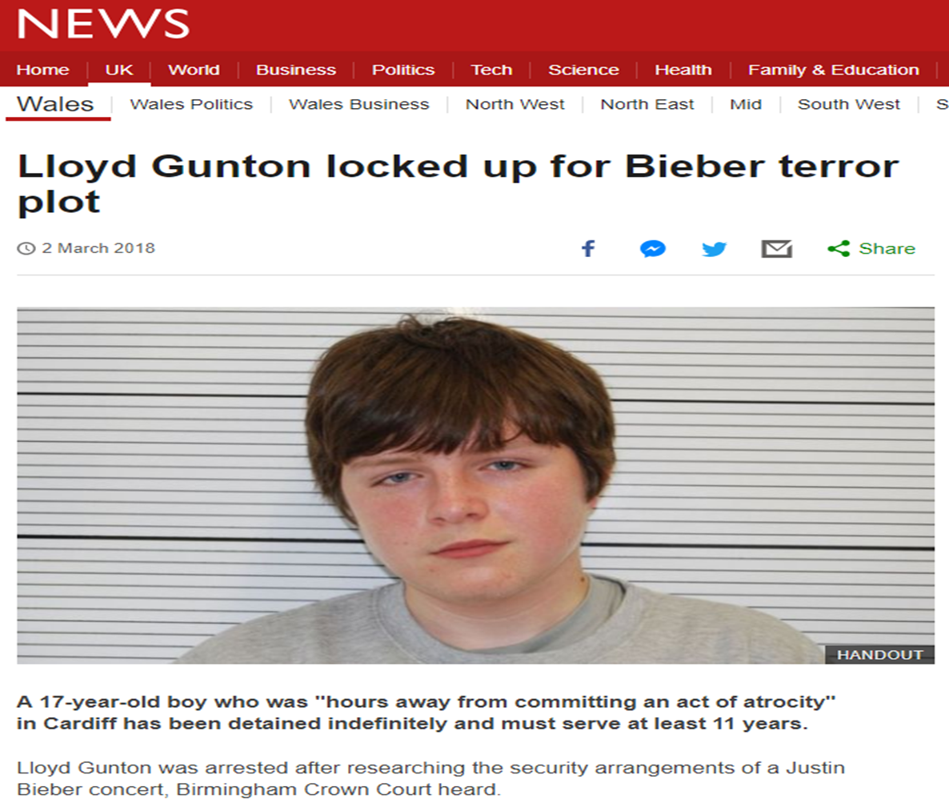
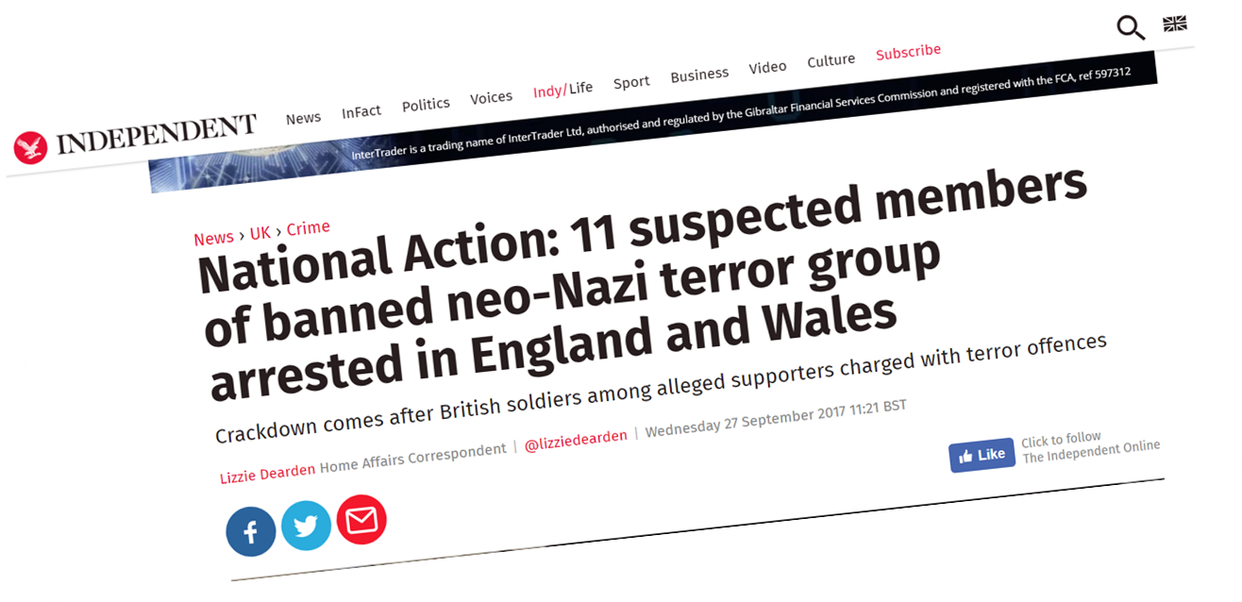
Examples of terrorist acts:
Notes:
BACKGROUND
The examples provided are all local and show that it is happening in and being derived from individuals in Wales
TUTOR
You may know of more and want to highlight these – don't be constrained by the clips included

Slide 8
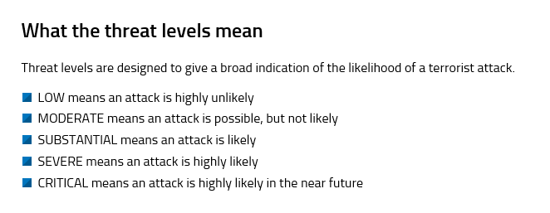
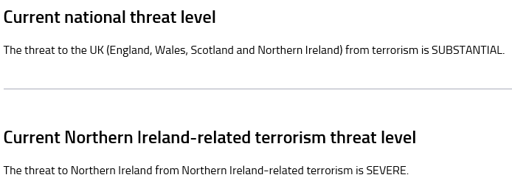
Current threat levels in the UK :
Notes:
BACKGROUND
Anyone can have a look at the MI5 website where the UK threat levels are defined and kept up to date
There are 2 threat levels:
1 is about the national threat level this has been reduced since September 2019
The other is about the threat related to N Ireland – this has been increased recently
TUTOR
Emphasise the current threat level is now substantial – this means an attached is likely – it has been reduced recently having been at SEVERE for a long period of time and generally following incidents it is raises to CRITCAL for a short periods of time

Slide 9
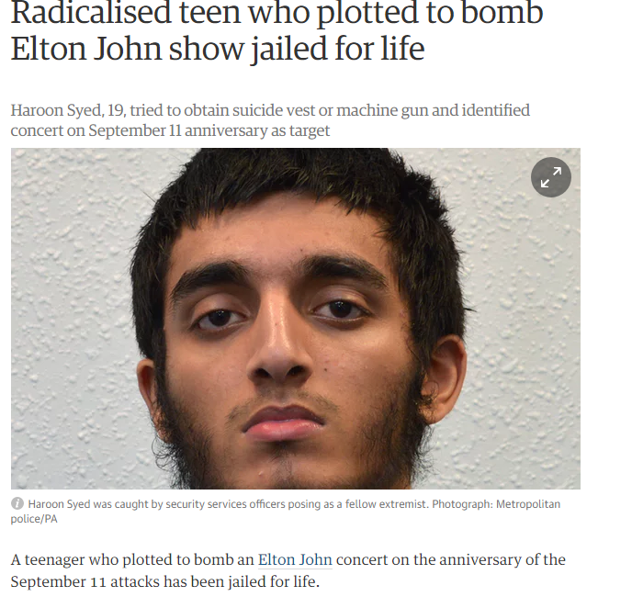
Notes:
TUTOR
Ask the discussion groups to consider the number of plots that have been foiled – what did they think the number would be ?

Slide 10
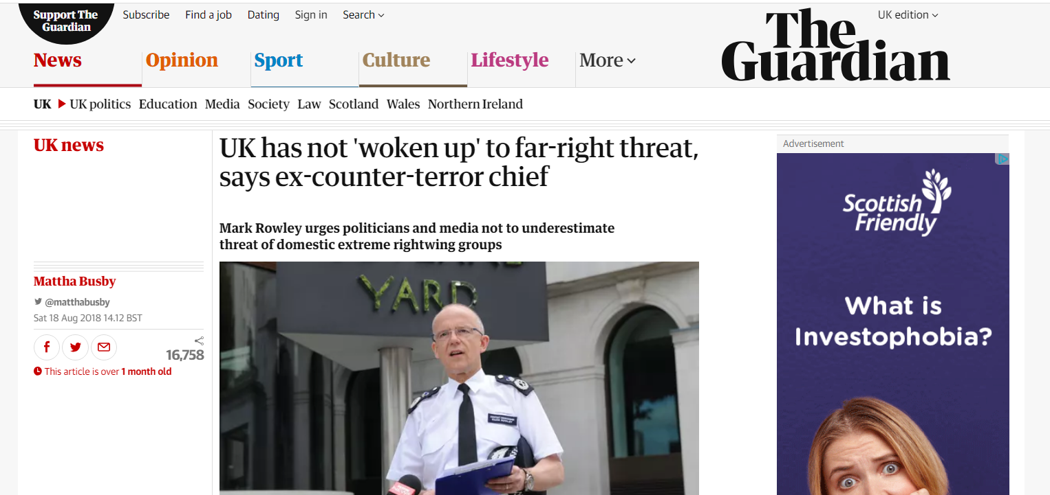
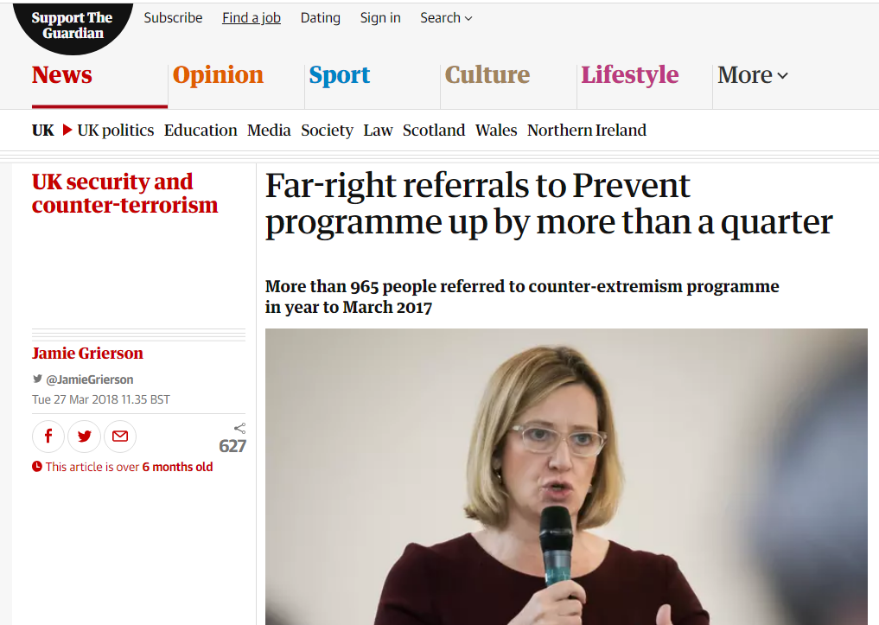
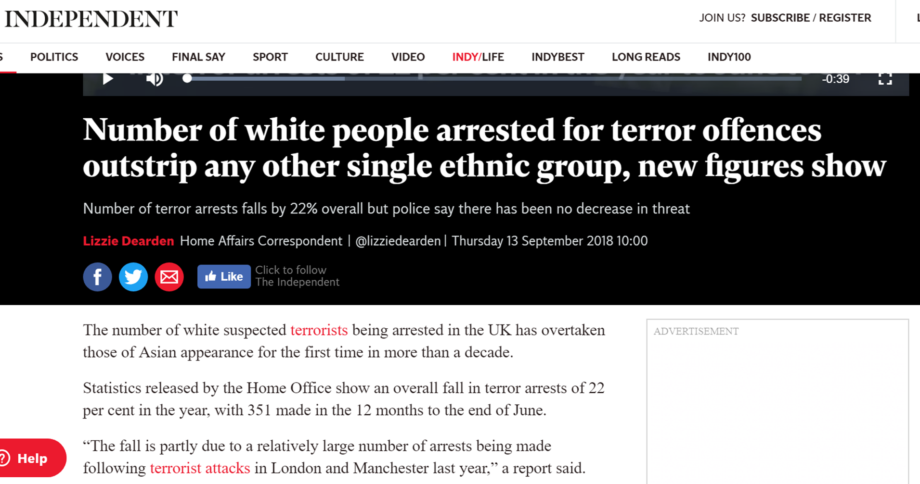
Notes:
TUTOR
In the discussion groups ask the students to consider the headlines
What do they know about the far right?
Do they know the far right are active in NPT and Powys ? What do they know about it?
Did they think that more white people would have been arrested than other ethnic groups?

Slide 11
Islamist extremism Islamophobia Islam
What is the difference?
Notes:
TUTOR
Ask the students to consider the terms and to provide feedback

Slide 12
Islam is a religion, and the people who follow it are called Muslims. Almost a quarter of the world's population are Muslims and in the UK it's about 1 in 20 people. Islam is the second largest religion in the UK after Christianity
Islamist extremist
Islamophobia - is when Muslims are the victims of attacks just because of their religion
Notes:
TUTOR
Click on the hyperlink on the word islamophobia
BACKGROUND
Why are Muslims being targeted?
Some people have blamed all Muslims for recent terrorist attacks carried out by extreme groups who say they follow the religion of Islam.
But, many people say those terrorist groups have extreme beliefs of hatred and violence that have little to do with what most Muslims believe.
They say it is important not to blame a big group of people for what a small number of individuals have done.
Islamophobia can result in Muslims being targeted, whether in person or online.
They can be badly treated, insulted or even physically hurt.
Many people think Islamophobia is created when a person doesn't properly understand what Muslims do or believe, and that the best way to combat it is to have a better understanding of Muslims and Islam.

Slide 13
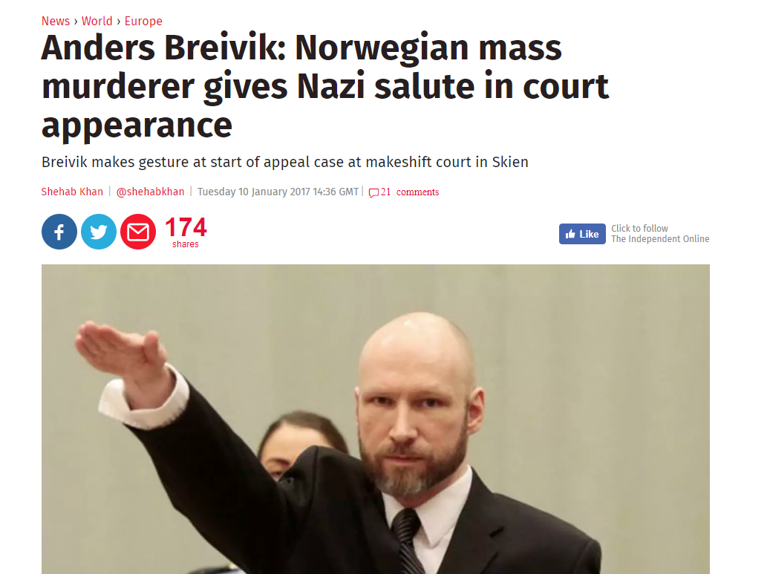
Question: Would you stereotype all white, European, Christians as terrorists based on the actions of Anders Breivik?
Notes:
TUTOR
Ask the students to consider stereotyping and explore their views

Slide 14
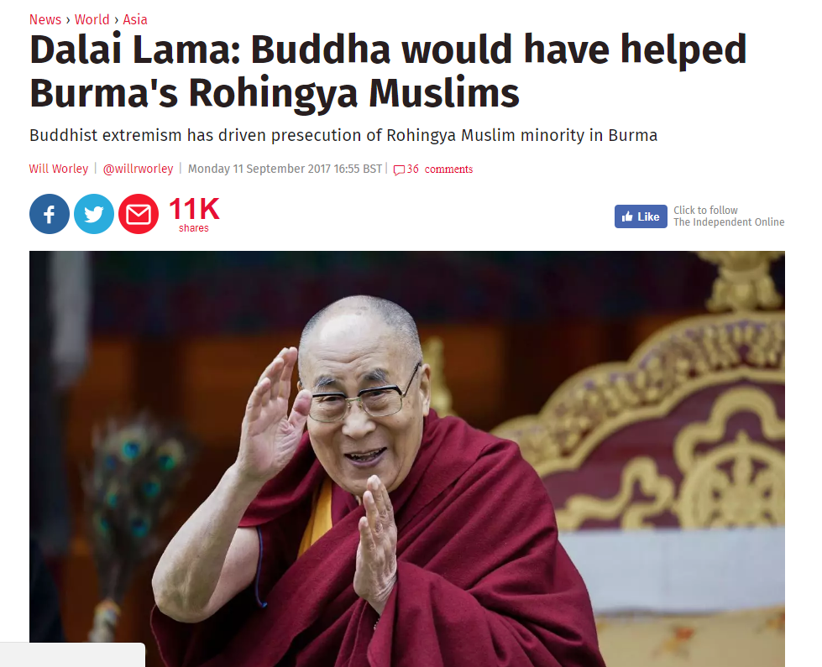
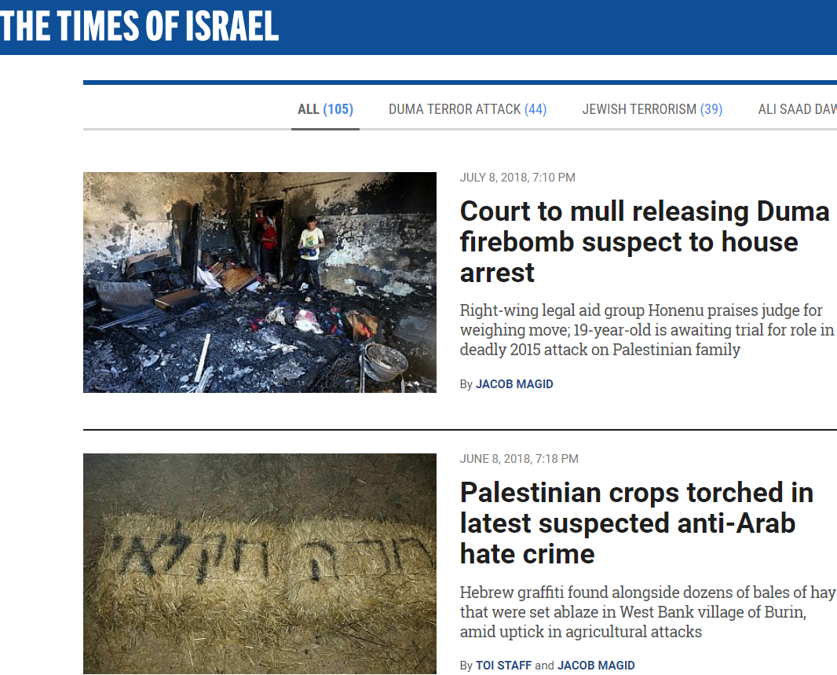
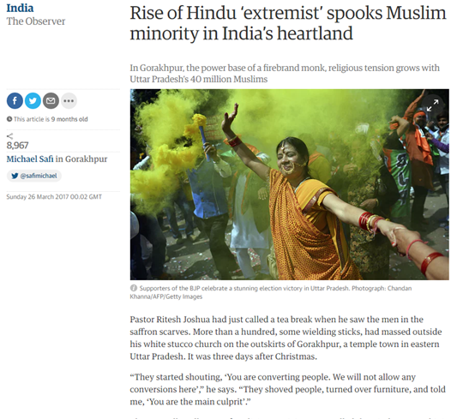
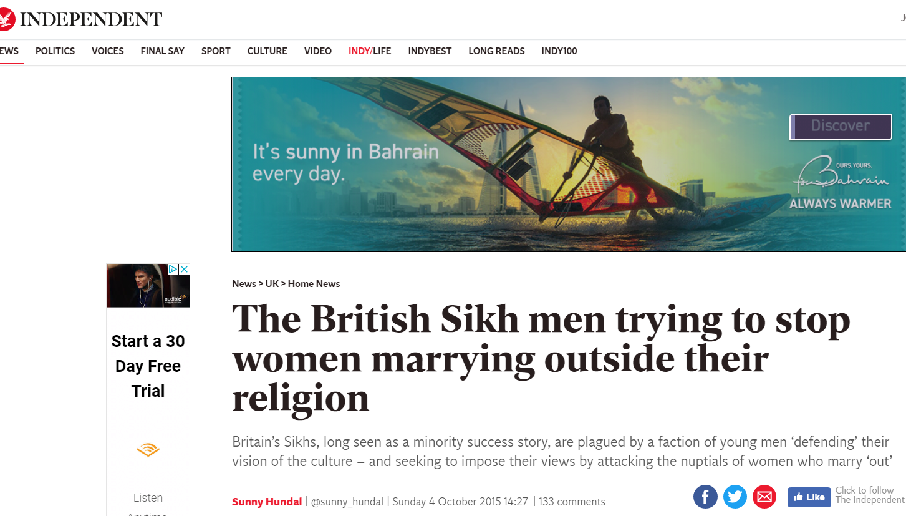
Key point:
It is possible to find examples of extremism linked to all major religions
It is important to separate the religion from the people carrying out extremists acts in the name of the religion
Notes:
TUTOR
Ask students to consider the headlines
Are they aware that extremist acts are happening all over the world with examples related to all religions

Slide 15
The murder of Jo Cox MP during the Brexit campaign was linked to far – right groups

Slide 16
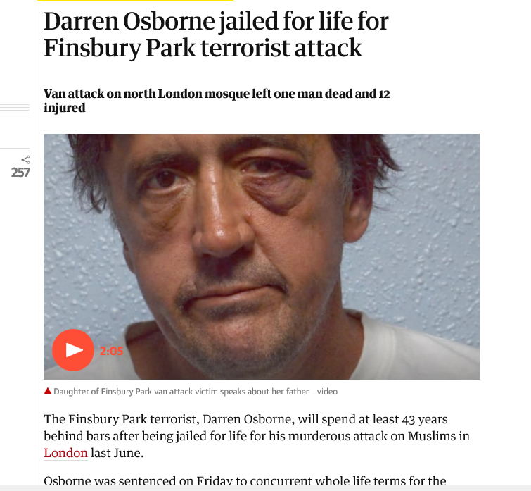
Key point:
Individuals in Wales have been convicted of extremist acts linked to far-right beliefs
Notes:
TUTOR
Ask students to consider the key point – were they aware of the fact ?

Slide 17
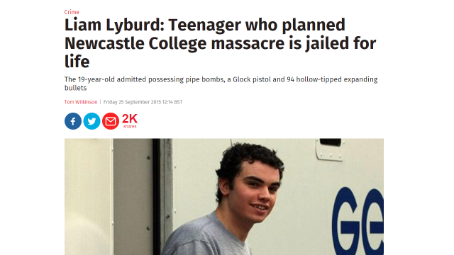
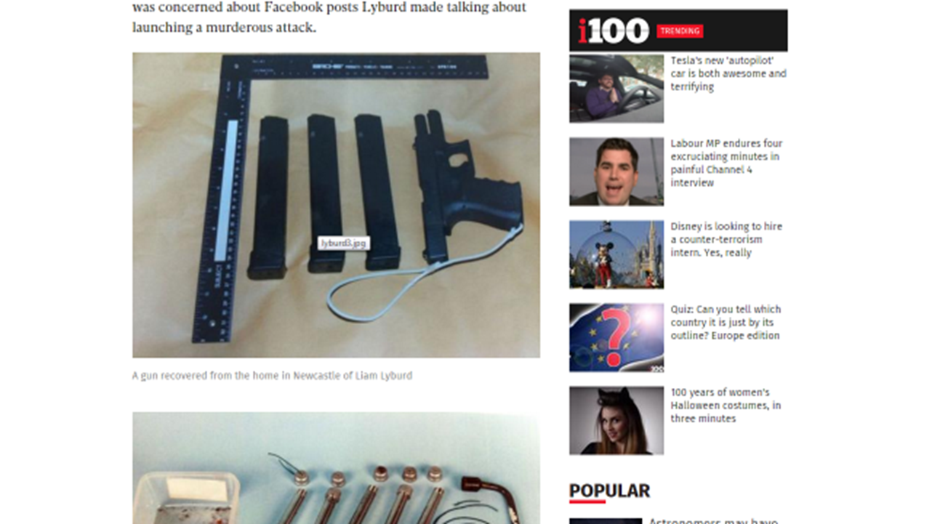
Key point: some extremist acts are committed by “lone wolves” – with no connection to political or religious groups – they have no ideology – they are referred to as Campus based incidents
Notes:
TUTOR
This is like the Campus based incidents that have happened in the United States
Ask the students what they think about these incidents

Slide 18
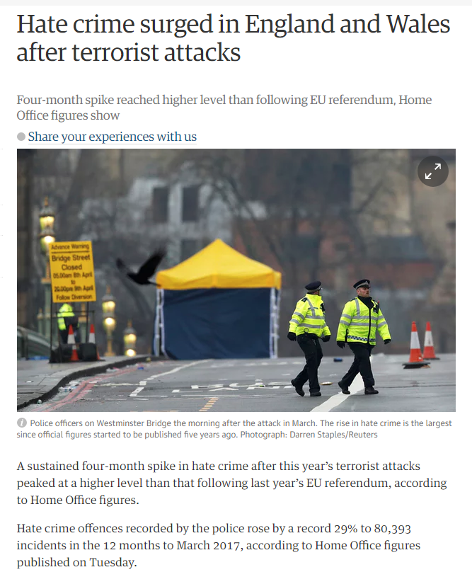
Key point:
One of the dangers of extremist acts has been to increase hate crime incidents – especially against Muslims
Notes:
TUTOR
Ask students to consider the headlines
What do students think about the facts about increased hate crime
Why do think this has happened ?

Slide 19
THE BRITISH VALUES are:
democracy
the rule of law
individual liberty
……and
mutual respect and tolerance for those with different faiths and beliefs
Key point – the prevent duty sets out the key British Values and defines extremism as acting outside these values
Notes:
Background
British values are defined as:
"democracy, the rule of law, individual liberty and mutual respect and tolerance for those with different faiths and beliefs“
Colleges are expected to encourage students to respect other people with particular regard to the protected characteristics set out in the Equality Act 2010

Slide 20
Online radicalisation:
Key points:
Many extremist groups target people online and recruit people to carry out extremist acts
https://www.ltai.info/staying-safe-online/
Many extremist groups also put out propaganda online to incite hatred
Notes:
TUTOR
Ask the students to consider if they have been approached on line

Slide 21
Keeping you safe from radicalisation
Radicalisation is defined under prevent as:
“the process by which a person comes to support terrorism and extremist ideologies associated with terrorist groups".
Many extremist groups target people who they think they can recruit to their cause and then use those people to carry out extremist acts.
Often this radicalisation takes place online – but groups will also use opportunities to meet people

Slide 22
Keeping you safe at College
Under the prevent duty the College has a responsibility to keep you safe - some of the ways we do this are:
Asking all students, staff and visitors to wear an identifying lanyard
Monitoring internet use – so that people aren’t becoming vulnerable to being recruited
Monitoring who comes into college – including people booking rooms or coming in to speak to groups of students
Making sure we ( students and staff ) are all aware of prevent and extremism

Slide 23
What would you do if you were caught up in an attack?
Run, Hide, Tell..........
Notes:
TUTOR
Click on the Run Hide Tell hyperlink

Slide 24
The key messages from the discussion today are:
Prevent = safeguarding
Respect and tolerance = key values
Risk – radicalisation / violent extremism
Islam – not the same as - islamist extremism
College responsibility – monitoring and reporting
Your responsibility – ask for support; report concerns
Be “aware” – not “afraid”

Slide 25
Key terms we have discussed today are:
Prevent duty
Counter-terrorism
Extremism
Radicalisation
Islamist Extremism
Far-right extremism
British Values

Slide 26
Key questions that we have discussed today are:
What is prevent?
01
What is extremism?
02
What is radicalisation?
03
What are the key British Values?
04

Slide 27
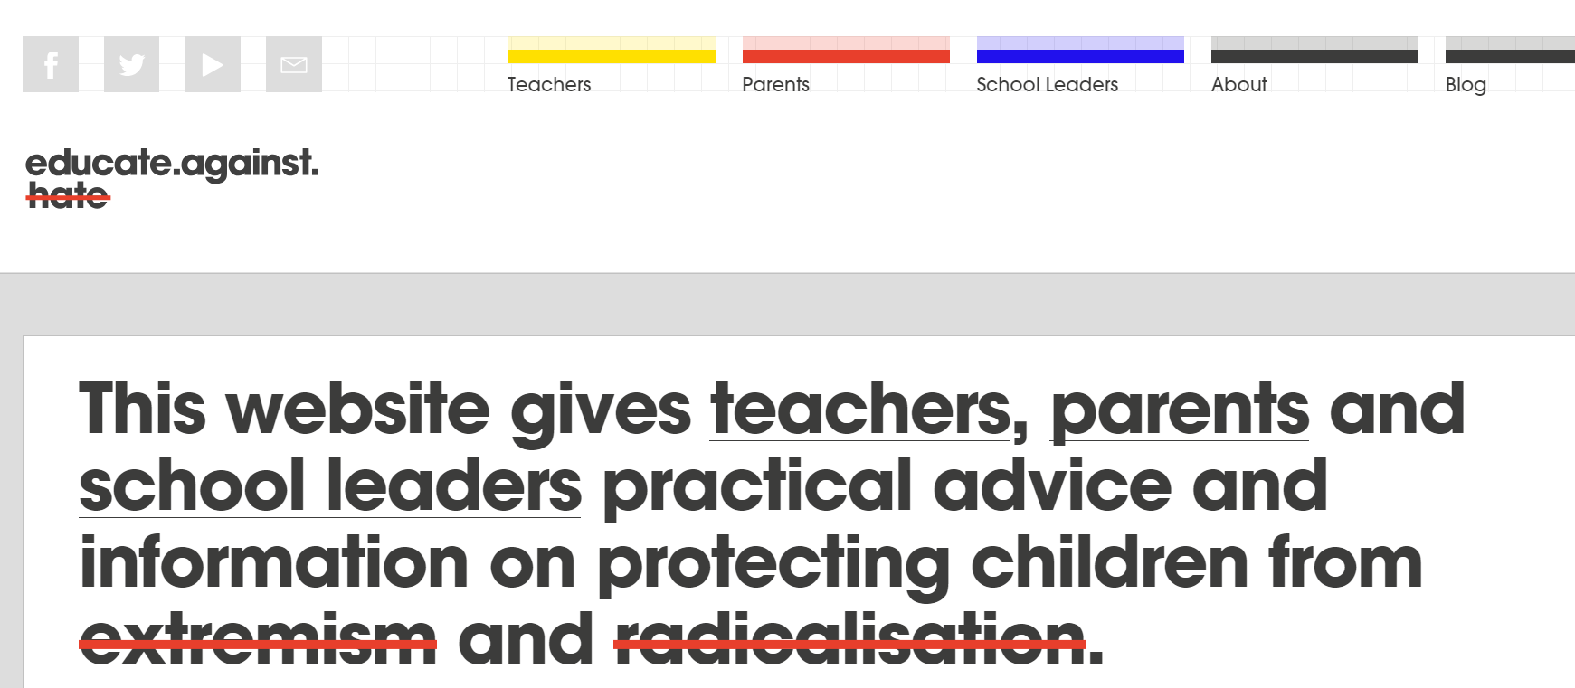
Further information is available:
https://educateagainsthate.com/

Slide 28
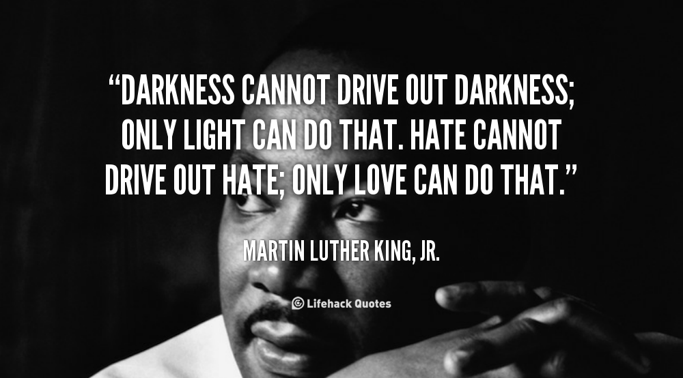
…a final thought….

Slide 29
If you would like to discuss any of the points raised in this presentation – or if you have questions, comments, feedback please contact
mandy.mellor@nptcgroup.ac.uk

