Slide 1
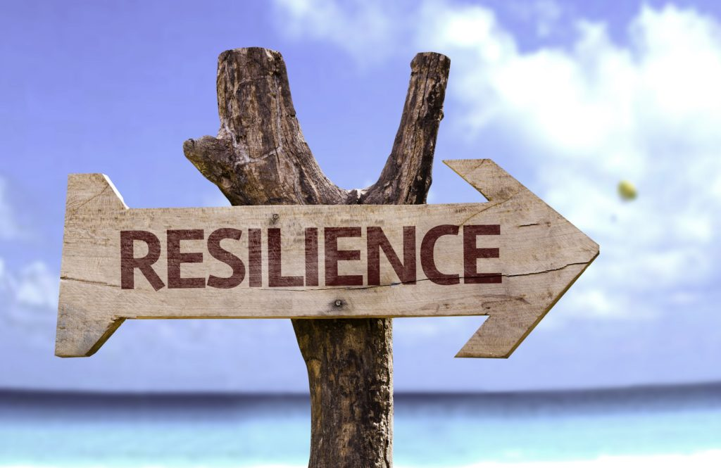
Resilience Skills
Notes:
Welcome everyone to the workshop which is about Resilience – tell them you will explain what resilience is shortly.

Slide 2
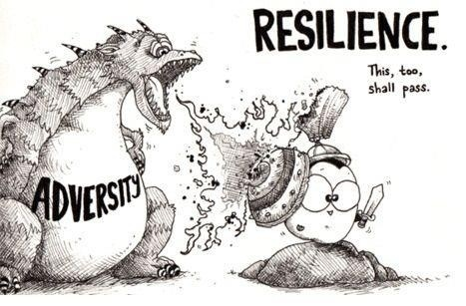
Today
What is resilience and why it is important!
Introduce the five core skills of resilience.
Give you a chance to practise being resilient.
Notes:
We are going to look at what we know about resilience and why it is important to maintain our resilience.
We will be talking about the five things that high resilient people do differently from low resilient people.

Slide 3
Find the three babies in this picture...
Notes:
Explain that they need to identify the three babies – not one, not two – but they need to be aware of other members of their team who might have found a different baby from them – work as a team, they are allowed to make noise during the competition. When they have found the three babies shout out the team name – team one, team two etc.

Slide 4
Notes:
When a team shouts out their team name – get them to identify the three babies using laser beam or by going up to the screen and pointing.

Slide 5
Find the animal in this picture...
Notes:
You must shout out your team name before you will be allowed to answer.

Slide 6
Notes:
Answer is a dolphin – sometimes someone will see it quickly sometimes it will go on for three or four minutes - let them have the time.

Slide 7
How many triangles are in the next picture?
Notes:
Next question is to decide as a team how many triangles there are on the next slide – you will show the slide for three seconds only. Then each team have to give their answer – the team that gets closest gets the points.

Slide 8
Notes:
Show the slide for three seconds, click back to previous slide then ask each team how many triangles there are. The team or teams who get closest get the points – there are no triangles in the picture.

Slide 9
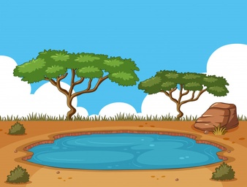
When is the lake half full?
Bacteria infest a lake.
The number of bacteria in the lake doubles every 24 hours.
The lake is completely infested by the bacteria after exactly 60 days.
On what day was the lake half full?
Notes:
Read out the instructions and leave them up on the board. Ask for every group to come up with an answer and the closest team will get the points, give them a few minutes to think it through. The answer is day 59 – working backwards the lake must have had 50% less bacteria the previous day.

Slide 10
Resilience
What it is: Psychological resilience is defined as an individual's ability to properly adapt to stress and adversity.
Why it is very important: Resilience is a major defence against developing mental health issues such as depression.
Notes:
Today’s workshop is about resilience.
Psychologists talk about resilience as your response to things going wrong in your life – things go wrong in everyone’s life – resilience is about our response.
Why does it matter – it matters because resilience has been discovered to be a major defence against mental health issues including depression and anxiety.

Slide 11
Resilience has two qualities
Bouncebackability/Recovery (psychologists)
The ability to cope with and bounce back from what life throws at you.
How quickly your emotions return to your normal state after a negative event.
Notes:
Nobody’s life is perfect – things go right but things always go wrong too!
Some people are able to deal with disasters better than others – they are very likely to be high resilient people. If you can bounce back from one disaster then you are better able to deal with the next one – if you don’t bounce back from the first disaster you could be overwhelmed by the second.
We may call it bouncebackability – psychologists call it recovery – the ability to emotionally recover from something going wrong – some people you know are very good at getting past things (high resilient behaviour), others find it much more difficult, perhaps feeling very angry and upset or holding a grudge for a long time (low resilient behaviour)

Slide 12
Resilience has two qualities
2. Stickability/Sustainability (psychologists)
The ability to persist and continue forward during difficult and stressful times
Put your head down, ignore everything else and carry on
Set and pursue goals
Solve problems
Notes:
The other side of resilience is the ability to have a dream and chase after it – being able to say I will do this and then going ahead and doing it. Some people are good at achieving their goals and their resilience is likely to be high – others find it very difficult to set or achieve goals – they give up before achieving them and find it difficult to solve problems – their resilience is likely to be low.

Slide 13
If you have both qualities, bouncebackability and stickability, then you are likely to thrive in life – not just survive.
Notes:
Resilience is therefore the ability to thrive in life – bounce back when things go wrong and chase after your vision when you can – low resilient people can’t bounce back and don’t set goals for themselves – they seem to just hang on in life like the people in Eastenders or Coronation Street.
The good news is that psychologists discovered you can learn to be more resilient.

Slide 14
Resilience
We are all born with resilience, initially it is likely to mirror our parents but:
the strength of our resilience varies from person to person.
it also varies at different times of our lives.
Notes:
Everybody is born with resilience, initially it is likely to mirror our parents.
Everyone in this room has a different level of resilience which is likely to have changed if I came back in 6 months time.
The level of my resilience varies depending on how I am feeling and what is happening in my life so it changes.

Slide 15
Two competing forces act on our Resilience.
RISK
FACTORS
Resilience
PROTECTIVE
FACTORS
Notes:
Some things make us more resilient – psychologists call these Protective Factors – they support or push up our resilience and protect your resilience.
Other things reduce our resilience – Risk Factors – they reduce or push down on our resilience and they have a negative effect on our mental health.

Slide 16
Protective Factors
Protective factors:
resources that strengthen, build up and support resilience.
e.g. having good friends
Resilience
PROTECTIVE
Notes:
Protective factors – things inside us and outside us that make us more resilient – that help us fight back when things go wrong or help us to keep climbing towards our goals. One example of a protective factor is having good friends – someone who you can talk to when things go wrong.

Slide 17
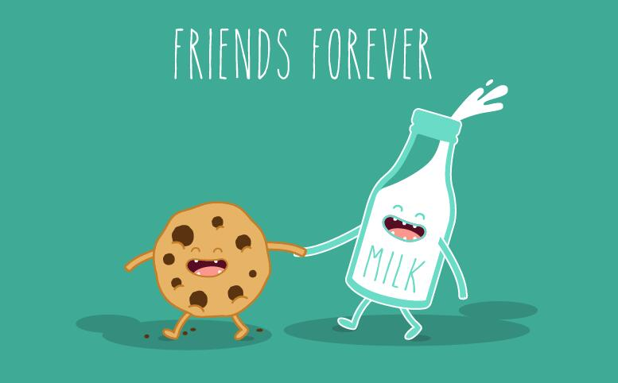
Protective Factors
In groups list as many protective factors as you can.
Notes:
Working in groups, can you come up with one list per table of things that build up our resilience – things that make us better able to deal with things going wrong or the inner strength to achieve a big challenge.
Give them a few minutes to complete their lists – then ask each group for one example of a Protective Factor.
Always look for the protective factor even if initially it is hard to see – e.g. drugs – yes anti cancer drugs, anti depressants can build our resilience.

Slide 18
Protective factors identified by psychologists:
Seeking help.
Optimism – believing you will succeed without any evidence.
Goals in different parts of your life; large goals and small goals.
Supportive family and friends.
Sense of control.
Religion (strength in difficult times).
Positive emotions – motivation, self esteem, self confidence.
Notes:
Talk through each of the list of examples and expand on them if you can.
The list above was compiled by research psychologists.
(Optimism – believing you will succeed even without evidence).

Slide 19
Risk Factors
Risk factors:
things that push down, weaken and eat away at your resilience.
e.g. feeling lonely
RISK
Resilience
Notes:
Risk Factors push our resilience down – make it more difficult for us to fight back or keep going – have a negative effect on our metal health.
One example of a risk factor is feeling lonely – perhaps having no one with whom you can discuss a problem.

Slide 20
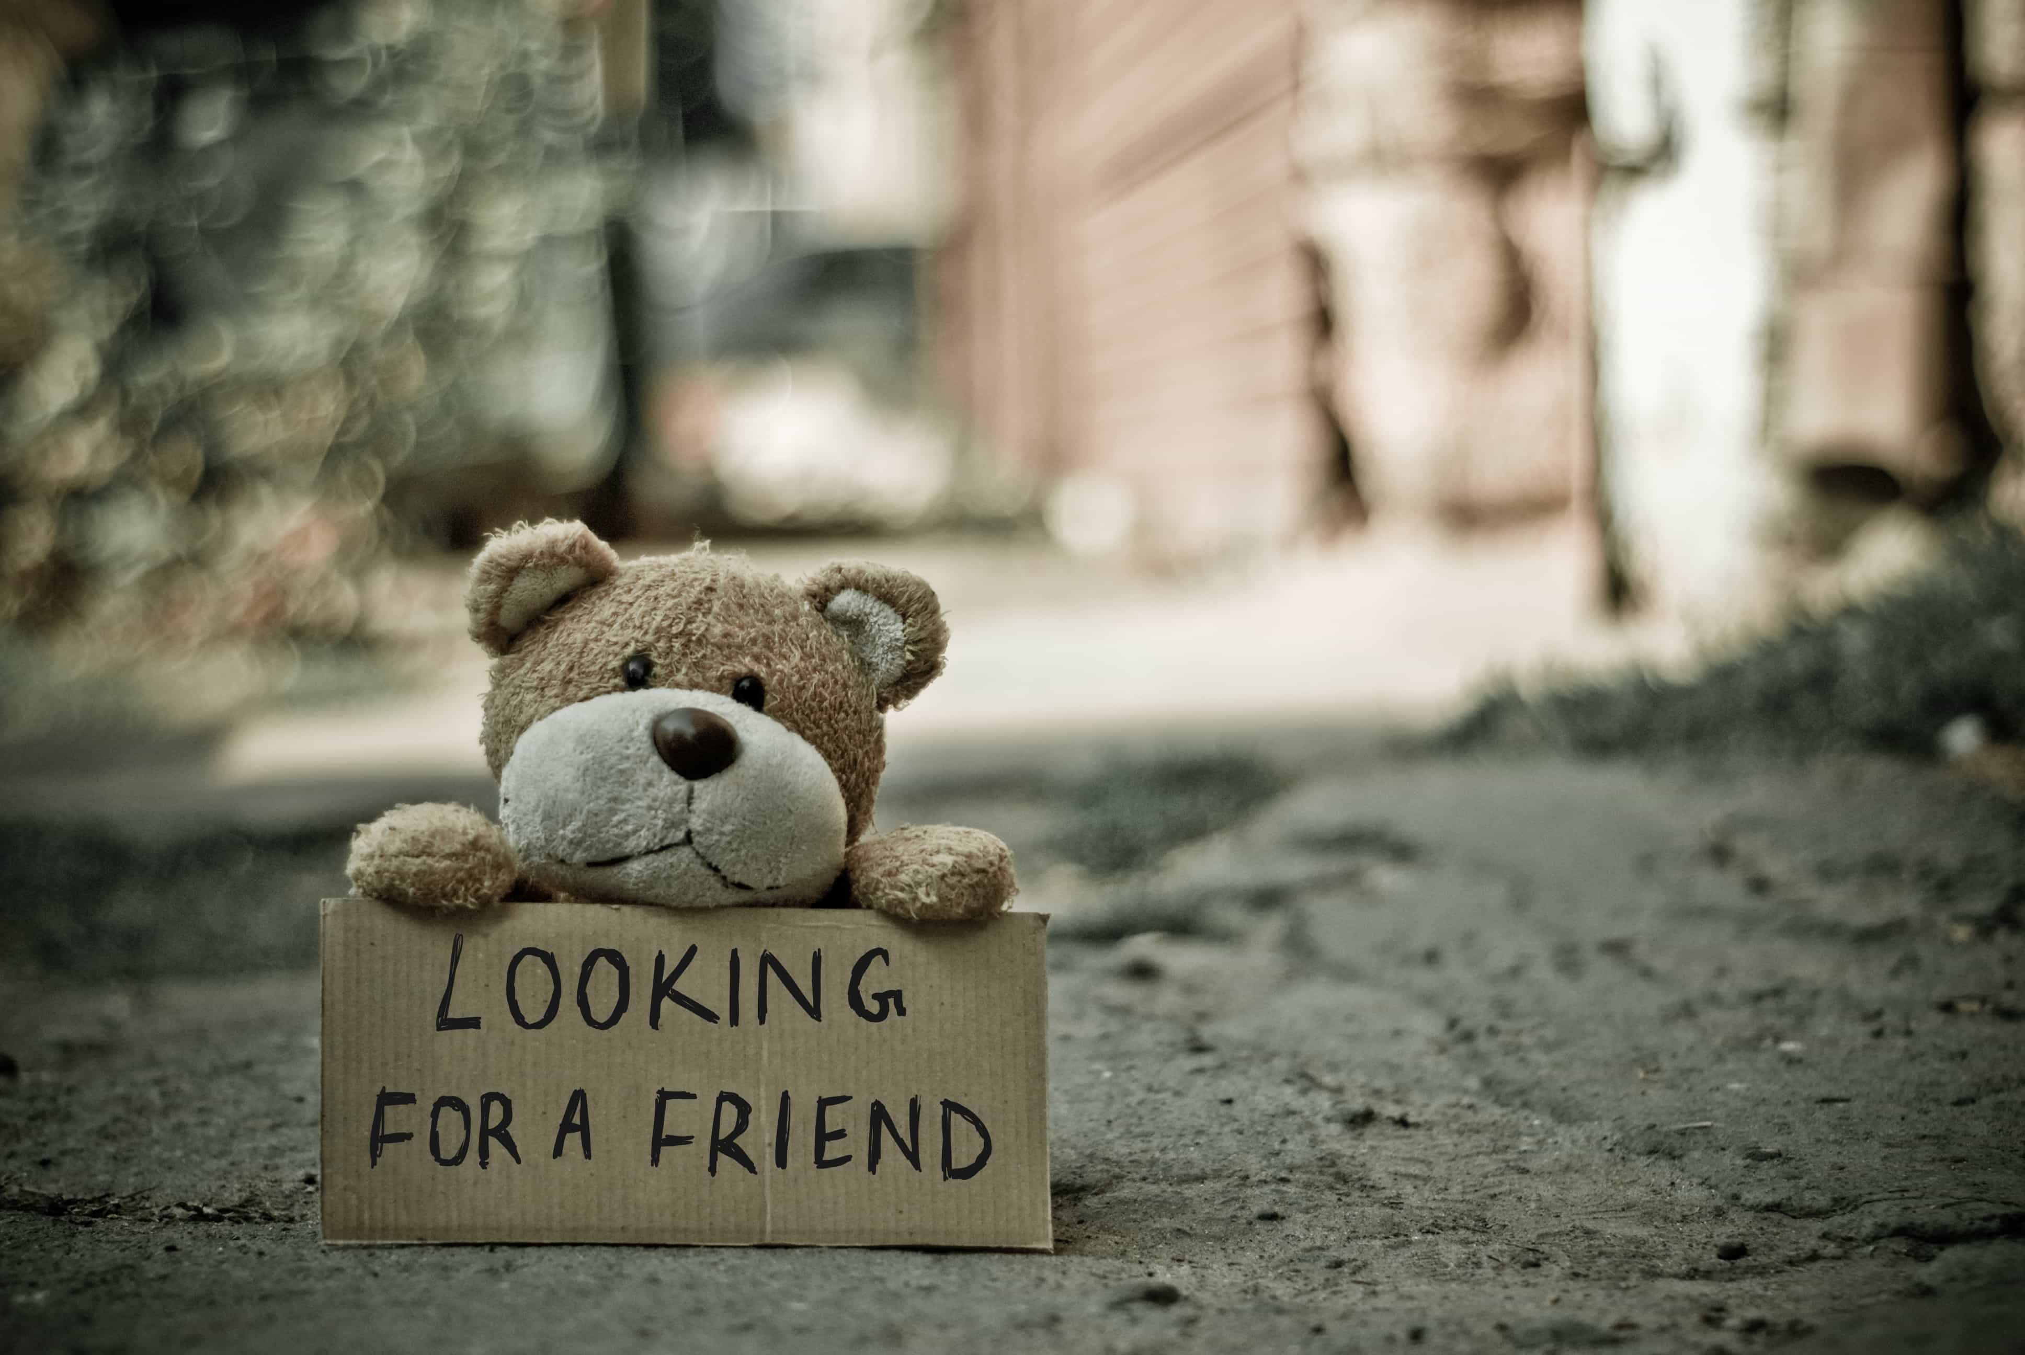
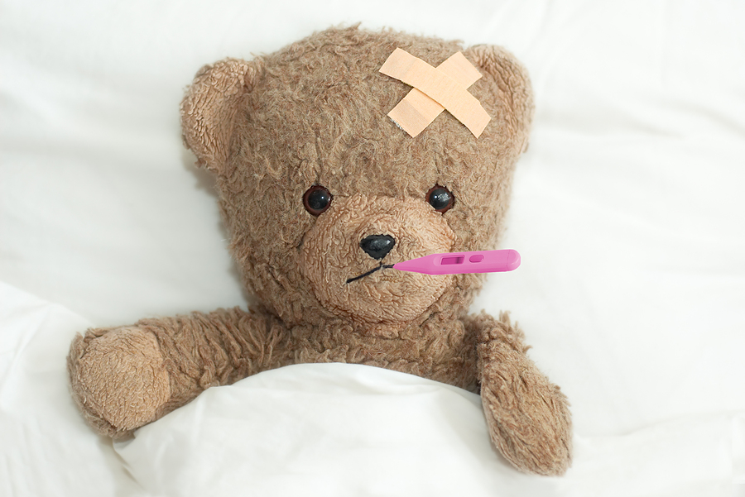
Risk Factors
In groups list as many risk factors as you can.
Notes:
Working in groups can you come up with one list per table of things that reduce our resilience – things that make it more difficult to deal with things going wrong or weaken our ability to achieve a big challenge.
Give them a few minutes to complete their lists and then ask each group for one example of a Risk Factor.

Slide 21
Risk factors identified by psychologists:
Not asking for help.
Pessimism, believing you are going to fail without any evidence.
Loneliness.
No goals or purpose in life.
Trauma, illness and stress.
Negative emotions e.g. anger, feeling overwhelmed or low self esteem.
Addictions – social media,drugs, alcohol, gambling etc.
Notes:
Talk through each of the list of examples and expand on them if you can.
(Pessimism – believing you will fail even if you have no evidence).

Slide 22
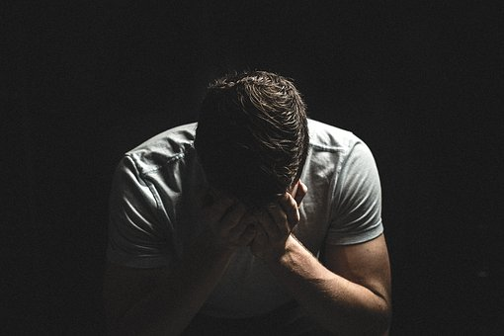
Psychologists: Major risk factors.
Alcohol use.
Drug use.
Trauma.
Stress.
Notes:
These are the major risk factors that reduce people’s resilience.
Alcohol and drug misuse affects peoples resilience – causes a lot of misery for people and their families.
A trauma such as someone being beaten up or bullied has a massive effect.
Ongoing stress wears us out – reduces our ability to deal with the things that are causing our stress.

Slide 23
Two competing forces act on Resilience.
RISK
As levels of risk and protection change our level of resilience is affected.
Resilience
PROTECTIVE
Notes:
So our resilience is not always the same – it changes depending on what is building it up and what is pushing it down.

Slide 24
Normally our Resilience is strong.
The protective factors are stronger than the risk factors.
We are unlikely to be at risk of depression.
RISK
Our Resilience
Safety
Zone
PROTECTIVE
Depression
Zone
Notes:
Most people most of the time are in the safe zone – some days we feel great some days not so great – some days we could achieve anything other days we can’t do anything right – that’s normal!!
If our protective factors are stronger than our risk factors then we are unlikely to develop depression – we bounce back to feel normal – less likely to give up.

Slide 25
If our protective factors reduce, or our risk factors increase, our resilience is weakened.
We are at an increased risk of developing depression.
RISK
Safety
Zone
Resilience
Depression
Zone
PROTECTIVE
Notes:
However, if our level of resilience drops down too far we are at risk of developing depression which is an illness. This can happen when our protective factors are very low – we have moved away from home, fallen out with friends; or when risk factors are very high – we start experimenting with drugs, we are being bullied.
It is not automatic that we become depressed. Some people will take steps to build their protective factors and ask for help to deal with the risk factors.

Slide 26
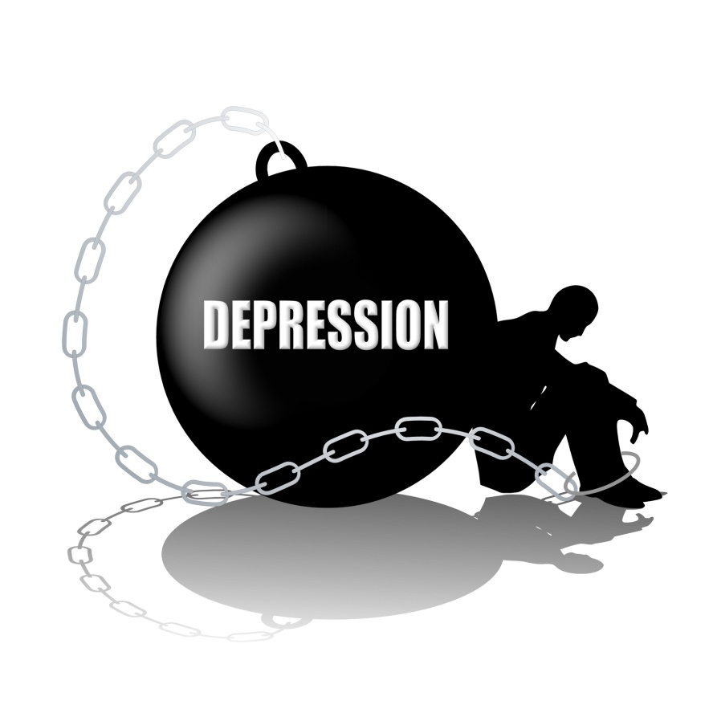
What is Clinical Depression?
Experiencing two of the following symptoms, for at least two weeks:
Low mood.
Fatigue or lack of energy.
Lack of interest or enjoyment in life.
Notes:
There is no blood test for depression – it is diagnosed by your G.P. or a counsellor based on a series of questions. Depression is treatable and most people start to recover within weeks if they get the right help. Unfortunately 3 out of 4 pupils in this school developing depression will not ask for help.

Slide 27
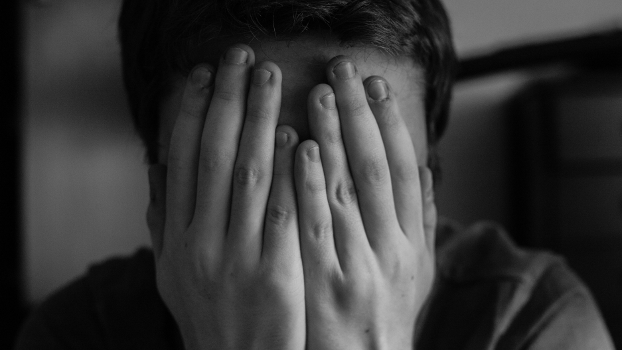
Helplessness
Worthlessness
Hopelessness
Notes:
Depression has three elements at its core – Helplessness, Hopelessness and Worthlessness.

Slide 28
Helplessness
I can’t solve these problems
I can’t change
I can’t shake off these feelings
I can’t make things ok
Notes:
Helplessness - They feel powerless to do anything to help themselves – including asking for help!
Repeat one or two speech bubbles on this slide.

Slide 29
Hopelessness
I’ll never feel happy
Things will never get better
These feelings won’t go away
My future isn’t nice
Notes:
Hopelessness - People with depression say things like this – they don’t believe the future will get any better.
Repeat one or two speech bubbles on this slide.

Slide 30
Worthlessness
I’m a total failure
I should be kicked out
I’m a waste of space
Everyone would be better off…
Notes:
Worthlessness – Most people with depression have very low self esteem and may feel that they don’t deserve any help and that will make it harder to ask for help.
Repeat one or two speech bubbles from this slide.

Slide 31
What is Anxiety?
Being overly worried about things that may happen in the future.
Being overly fearful about things that are happening now.
Being overly distressed about things that happened in the past.
Anxiety reduces the quality of your life.
Notes:
Anxiety is a different illness to depression – everybody gets anxious but the disease of anxiety is where the body and mind is over-reacting to such an extent that it is significantly impacting on a person’s quality of life.

Slide 32
Anxiety
I always feel my muscles are tensed up
I don’t know why I get so angry all the time
If my mum isn’t at home I worry about her
I wake up in middle of the night thinking about things
Notes:
People with anxiety may talk about things such as physical stress, disrupted sleep and high levels of worrying.
Repeat one or two of these speech bubbles.
The stress hormone cortisol is also the hormone that is released every morning to get you out of bed – that is why many people are grumpy first thing in the morning. If you have too high a level of cortisol in your bloodstream you may wake up in the middle of the night ready to get up – this is a sign that you may be suffering from stress and you should talk to someone.

Slide 33
Depression and Anxiety
They are different conditions.
However it is estimated that over half of people with depression will develop anxiety if they don’t get help; and vice versa.
Both conditions respond very well to treatment and support – the sooner the better!
Notes:
Emphasise both are treatable and the sooner the better – mild depression and anxiety are easier to treat than severe depression and anxiety.

Slide 34
There are two roads you can go down when you are faced with a serious problem in your life.
Low Resilient Road: leads to an increased risk of a mental health issue including depression.
High Resilient Road: allows you to thrive in life and reduces your risk of developing a mental health issue.
Notes:
There are two roads that we can travel down when we are facing a problem – the low resilient or high resilient road.

Slide 35
Can you predict what road someone will go down?
Yes – optimism vs. pessimism
Notes:
You can predict which road someone will take based on their levels of pessimism or optimism.
Researchers found that they could predict who would succeed based on their level of optimism or pessimism. Your level of optimism is a very clear predictor of how you will react to problems in your life.

Slide 36
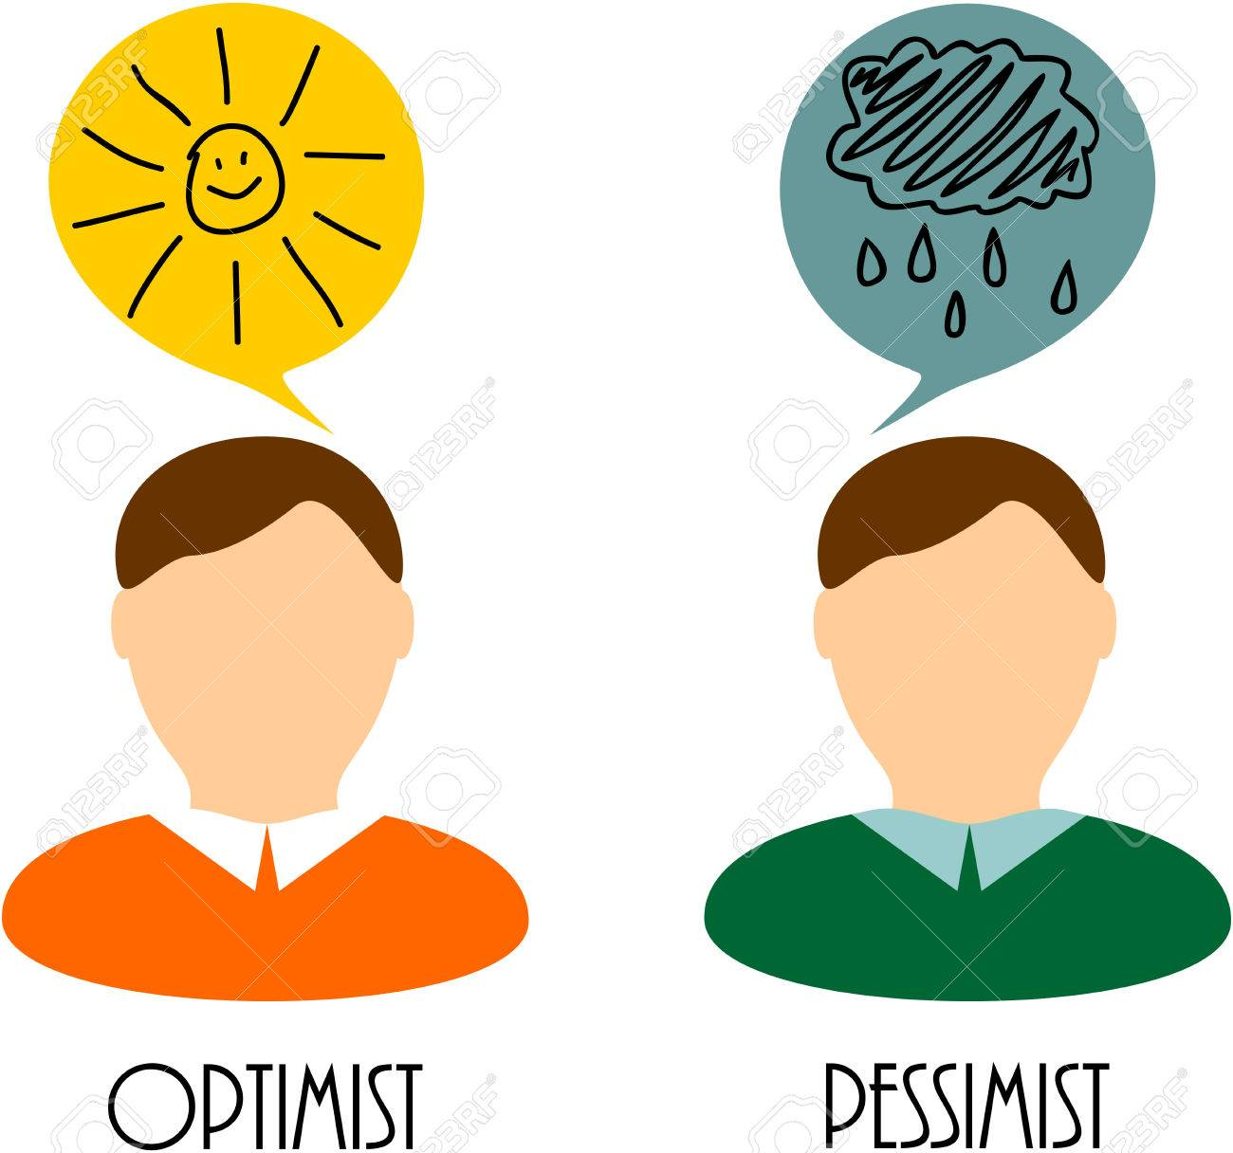
Research psychologists have found that Henry Ford’s statement is very accurate.
Optimists vs Pessimists:
Are happier
Have better relationships
Get promoted more often
Earn more money
Live longer
Notes:
They found that optimistic people benefit from all of these factors. They could not find one positive reason to be a pessimist.

Slide 37
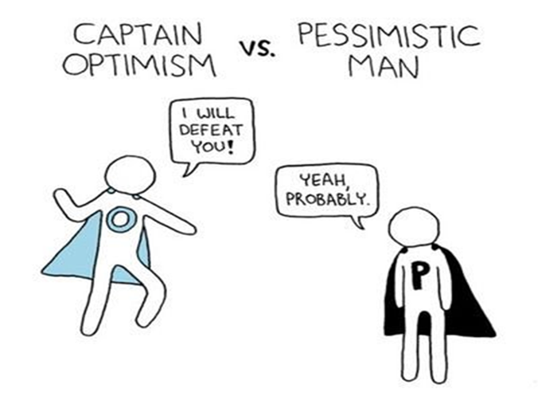
You can learn to be more optimistic!
Ask for help.
Counselling is great to understand how to challenge pessimism.
Remember pessimism is not about facts, it’s about feelings.
Notes:
If you are pessimistic you can change.
Ask for help – counsellors can help people to change their pessimistic emotions. One of the main ways is to challenge your negative emotions with evidence.
Cognitive Behaviour Therapy (CBT) has been shown to be very effective in helping people reduce their levels of pessimism – i.e. you can learn to be more optimistic.

Slide 38
Young Person with Low Resilience
Young Person with High Resilience
PROBLEM
I WILL
solve this
Optimism
I CAN’T solve this Pessimism
5
Life Skills (Learnt)
Hopelessness
Helplessness
Worthlessness
Depression/Anxiety
Self Harm
Bouncebackability
Stickability
LOW RESILIENT ROAD
HIGH RESILIENT ROAD
Notes:
When a young person with low resilience faces a problem they start off with the thought in their head that they can’t solve the problem – things won’t get better, they can’t do any thing about it and there’s no point in asking for help. If things don’t change there is the potential for that young person to develop the illness of depression – and sitting beside depression is the risk that they might harm themselves.
A young person who is high resilient has a different mind-set – they will overcome this problem – they use five life-skills differently from someone with low resilience and they are much more likely to bounce back from life’s problems and achieve their goals.

Slide 39
Low Resilient Pathway
High Resilient Pathway
PROBLEM
I CAN’T solve this
I WILL
solve this
30% currently
5
Life Skills (Learnt)
Hopelessness
Helplessness
Worthlessness
Depression
Self Harm
Bouncebackability
Stickability
Notes:
About 30% of people seem to be currently immune to depression – they are so resilient at this time in their life that they seem to be able to bounce back from almost anything.

Slide 40
Low Resilient Pathway
High Resilient Pathway
PROBLEM
I CAN’T solve this
I WILL
solve this
5
Life Skills (Learnt)
Hopelessness
Helplessness
Worthlessness
60%
HELP
currently
Depression
Self Harm
Bouncebackability
Stickability
Notes:
About 60% of people- that’s most people in this room – when something very negative happens in their life will start to develop depression but after a period of time they will start to recover – their level of resilience means it takes time to recover – so as long as nothing else happens before they have recovered they are unlikely to be at risk.
Most people benefit from getting help – either they ask for help or someone spots they aren’t doing well and intervene to get them the help they need. That is why family, friends and school staff can be critical for support – someone else can help you get help – and you can get help for someone else – and then they can recover.

Slide 41
Low Resilient Pathway
High Resilient Pathway
PROBLEM
I CAN’T solve this
I WILL
solve this
10%
5
Life Skills (Learnt)
Hopelessness
Helplessness
Worthlessness
currently
hide
Depression
Self Harm
Bouncebackability
Stickability
Notes:
Currently about 10% of people will not be able to bounce back and may develop clinical depression and will be at a higher risk of self harm or worse. They will not ask for help and they will hide so therefore no one else knows to step in and help them.
Sadly many people hide that they are not doing well and either people don’t notice or don’t get them help. We want to change that – if you notice somebody isn’t doing well get them help – we will talk about this in the last section of the programme.

Slide 42
Resilience skills you can learn
Skill 1: I am a good listener.
Skill 2: I am a good problem solver.
Skill 3: I am good at managing my emotions.
Skill 4: I am good at working with other people.
Skill 5: I am good at accessing help.
During the next session we will be looking at each of these resilience skills and provide an opportunity for you to practise being resilient.
Notes:
When psychologists examined resilience in families they discovered that high resilient people did five core things differently from low resilient people – and also that low resilient people could learn to become more resilient by learning these core life skills.
One of the first things they found was that high resilient people were better listeners than low resilient people and we are going to look at listening skills very shortly.
The second life skill was the ability to solve problems – high resilient people were better problem solvers so we are going to look at problem solving. They also found that high resilient people used their skills together – so listening helps solve problems etc.
The third skill seen in high resilient people was that they were better able to manage their emotions – low resilient people’s heads kept exploding – a bit like Eastenders. One of the main reasons people lose control of their emotions is stress so we will look at that.
High resilient people are much more likely to work successfully in teams – working together to solve problems or achieve success – low resilient people tend to work on their own – and fail on their own – so we will look at team-working.
Finally they found that high resilient people were the first to ask for help – they knew that getting help was a good thing – low resilient people were less likely to ask for help even though they were the people most likely to be struggling- they thought asking for help was a sign of weakness.

Slide 43
