Slide 1
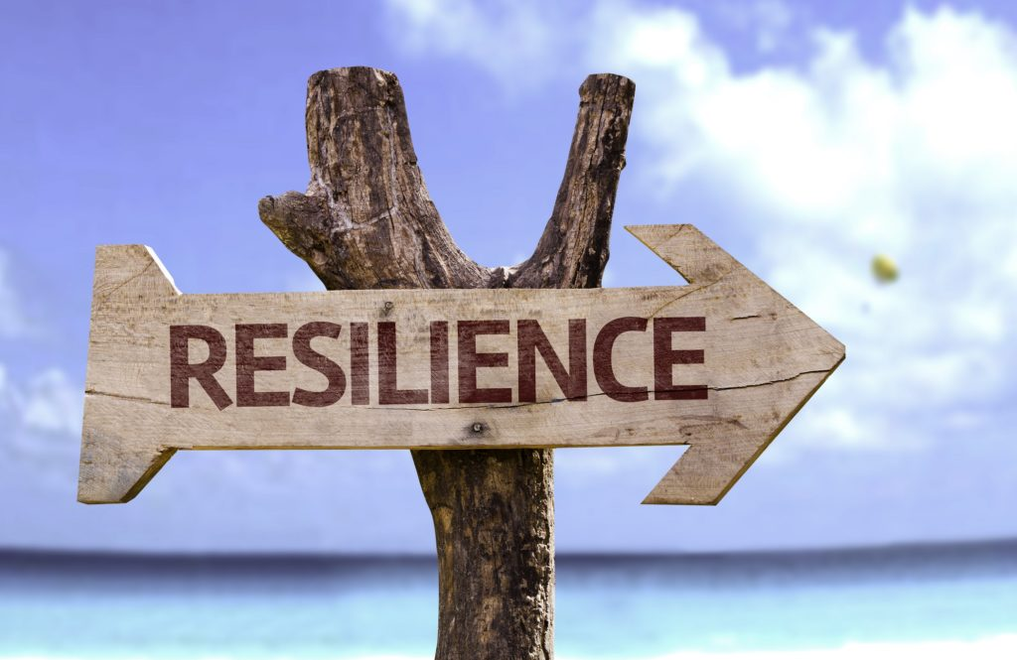
Resilience Skills – Part 2

Slide 2
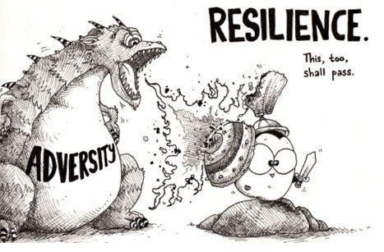
Thinking back to September, what does it mean to be resilient?
Notes:
Quick discussion – some of which should lead to the 5 resilient skills on the following slide

Slide 3
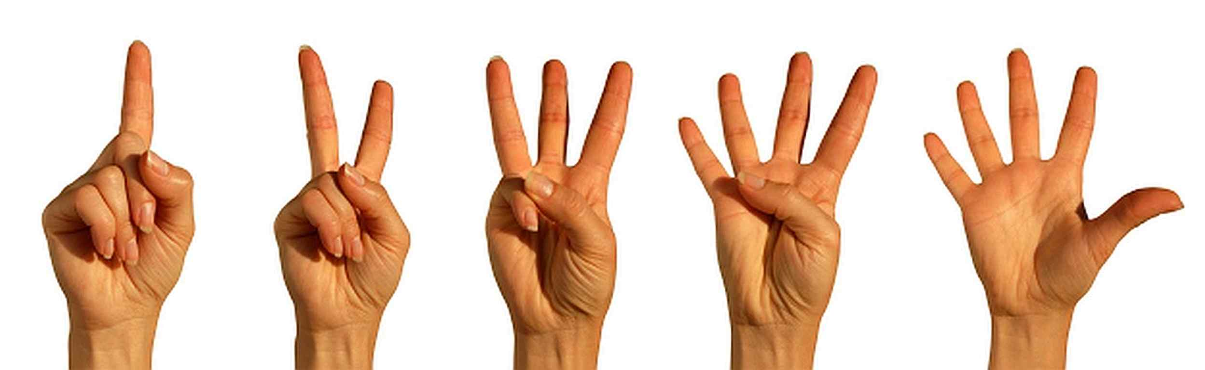
Resilience skills you can learn.
Skill 1: I am a good listener.
Skill 2: I am a good problem solver.
Skill 3: I am good at managing my emotions.
Skill 4: I am good at working with other people.
Skill 5: I am good at accessing help.
Notes:
When psychologists examined resilience in families they discovered that high resilient people did five core things differently from low resilient people – and also that low resilient people could learn to become more resilient by learning these core life skills.
One of the first things they found was that high resilient people were better listeners than low resilient people and we are going to look at listening skills very shortly.
The second life skill was the ability to solve problems – high resilient people were better problem solvers so we are going to look at problem solving. They also found that high resilient people used their skills together – so listening helps solve problems etc.
The third skill seen in high resilient people was that they were better able to manage their emotions – low resilient people’s heads kept exploding – a bit like Eastenders. One of the main reasons people lose control of their emotions is stress so we will look at that.
High resilient people are much more likely to work successfully in teams – working together to solve problems or achieve success – low resilient people tend to work on their own – and fail on their own – so we will look at team-working.
Finally they found that high resilient people were the first to ask for help – they knew that getting help was a good thing – low resilient people were less likely to ask for help even though they were the people most likely to be struggling- they thought asking for help was a sign of weakness.

Slide 4
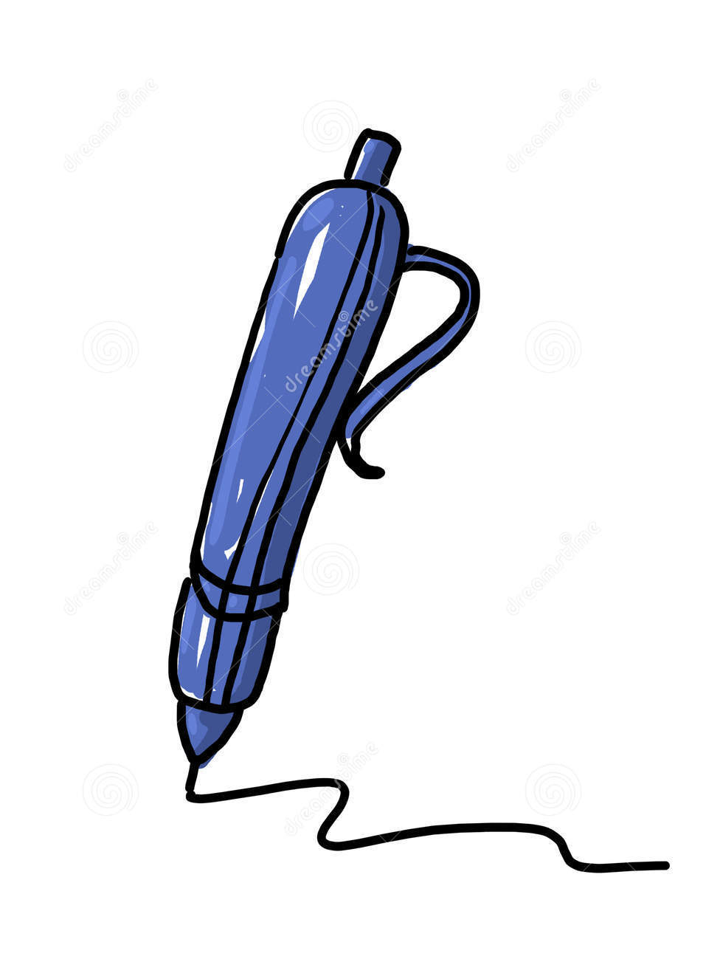
Word Association Game
Everybody needs a scrap of paper and a pen.
I have a word on the next slide.
On your own, list all the words you associate with the word on the next slide.
Don’t start.
Notes:
Follow the instructions on the slide carefully, if you don’t it can be easy to lose track of the game.

Slide 5
The word is DOG
If I was doing the task I might start with Bark, then a long list of all the words I associate with DOG.
Don’t use Bark , don’t copy your neighbour.
Afterwards, we will compare everyone’s words and see how many words there are in common across the whole group.
Team Prediction: 5,10,15?
I will ask everyone to stop when half of you have slowed down.
START!!
STOP!!!
Notes:
Follow the instructions on the slide carefully, if you don’t it can be easy to lose track of the game.

Slide 6
Count your number of words, write the figure on your page.
How many words does each person have starting here on my left.
Now what is the maximum number of words we could have in common as a group?
Yes it is the smallest number – if someone has four words it is impossible as a group to have five or more.
Please give me your first word – put your hand up if you DON’T have this word.
Notes:
Follow the instructions on the slide carefully, if you don’t it can be easy to lose track of the game.

Slide 7
Please give me your first word – put your hand up if you don’t have it
How many words did you actually have in common as a group?
NONE!!
Notes:
Just repeat the point on this slide and emphasise that we had NO words in common.

Slide 8


WHY?
Because we all use words differently, we are not dictionaries on legs!!
We need to ASK to check that we understand what the person means.
Notes:
If you don’t understand the word DOG how can we understand what someone is trying to tell us – you can guess, which low resilient people do – or you can ask questions, which high resilient people do.

Slide 9
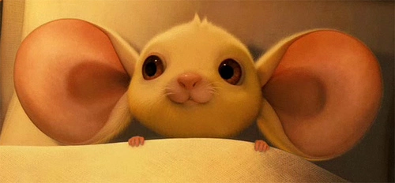
Active Listening
We can all do this when we choose to focus, pay attention and ask questions.
God gave you two ears and one mouth for a reason.
Notes:
Everybody can do it if they choose – ask more questions and you are a better listener and more resilient.

Slide 10
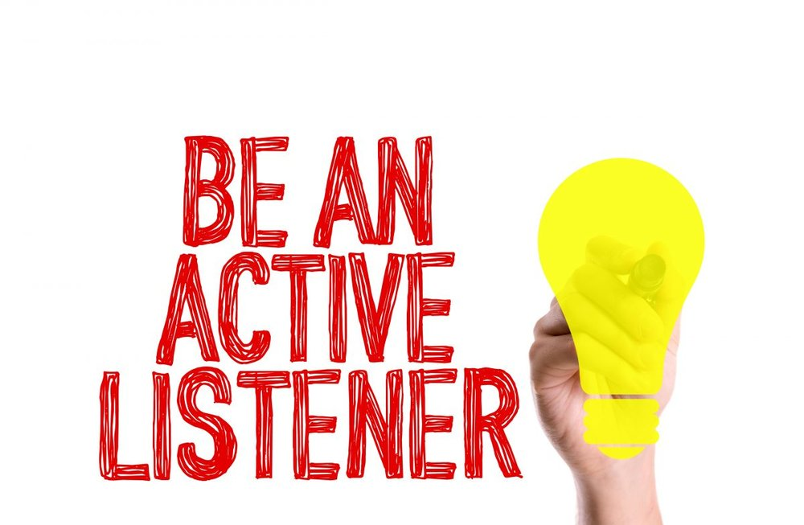
Active Listening.
Listen; ask a question; listen to the answer; ask a question about the answer; repeat.
Notes:
Active listening is based on linking questions to answers – listen to the words someone speaks, ask them a question that is based on what they said; listen to their answer and ask them again about the words they used. If you ask about the words they used they will very quickly pick up that you are actually listening to them.

Slide 11
Active Listening.
ASK
LISTEN
Notes:
If anyone goes on to become a counsellor they will learn active listening skills. If you learn to use this Active Listening model you will become a very competent listener. It’s simple – ask a question - keep quiet – listen to the words the other person uses and ask a second question about what they said. Go round and round until you understand the other person – that’s listening – you can’t listen if you are talking.
I want you to use the Active Listening model to solve the Who Am I game.

Slide 12

Resilience skill 2:
I am a good problem solver.
Notes:
The second thing they found that high resilient people did better than low resilient people was problem solving – and they linked this skill with other skills e.g. using listening skills to help understand what the problem was.

Slide 13
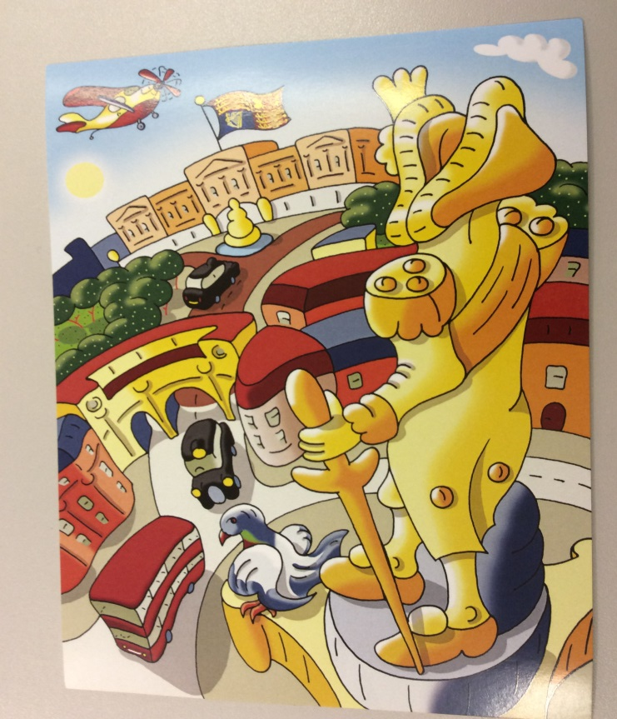
How do they manufacture jigsaw puzzles?
They take the picture and they chop it up!
Notes:
Ask how do they manufacture jig saw puzzles. Award a point when someone says they start with the picture and then chop it up.

Slide 14
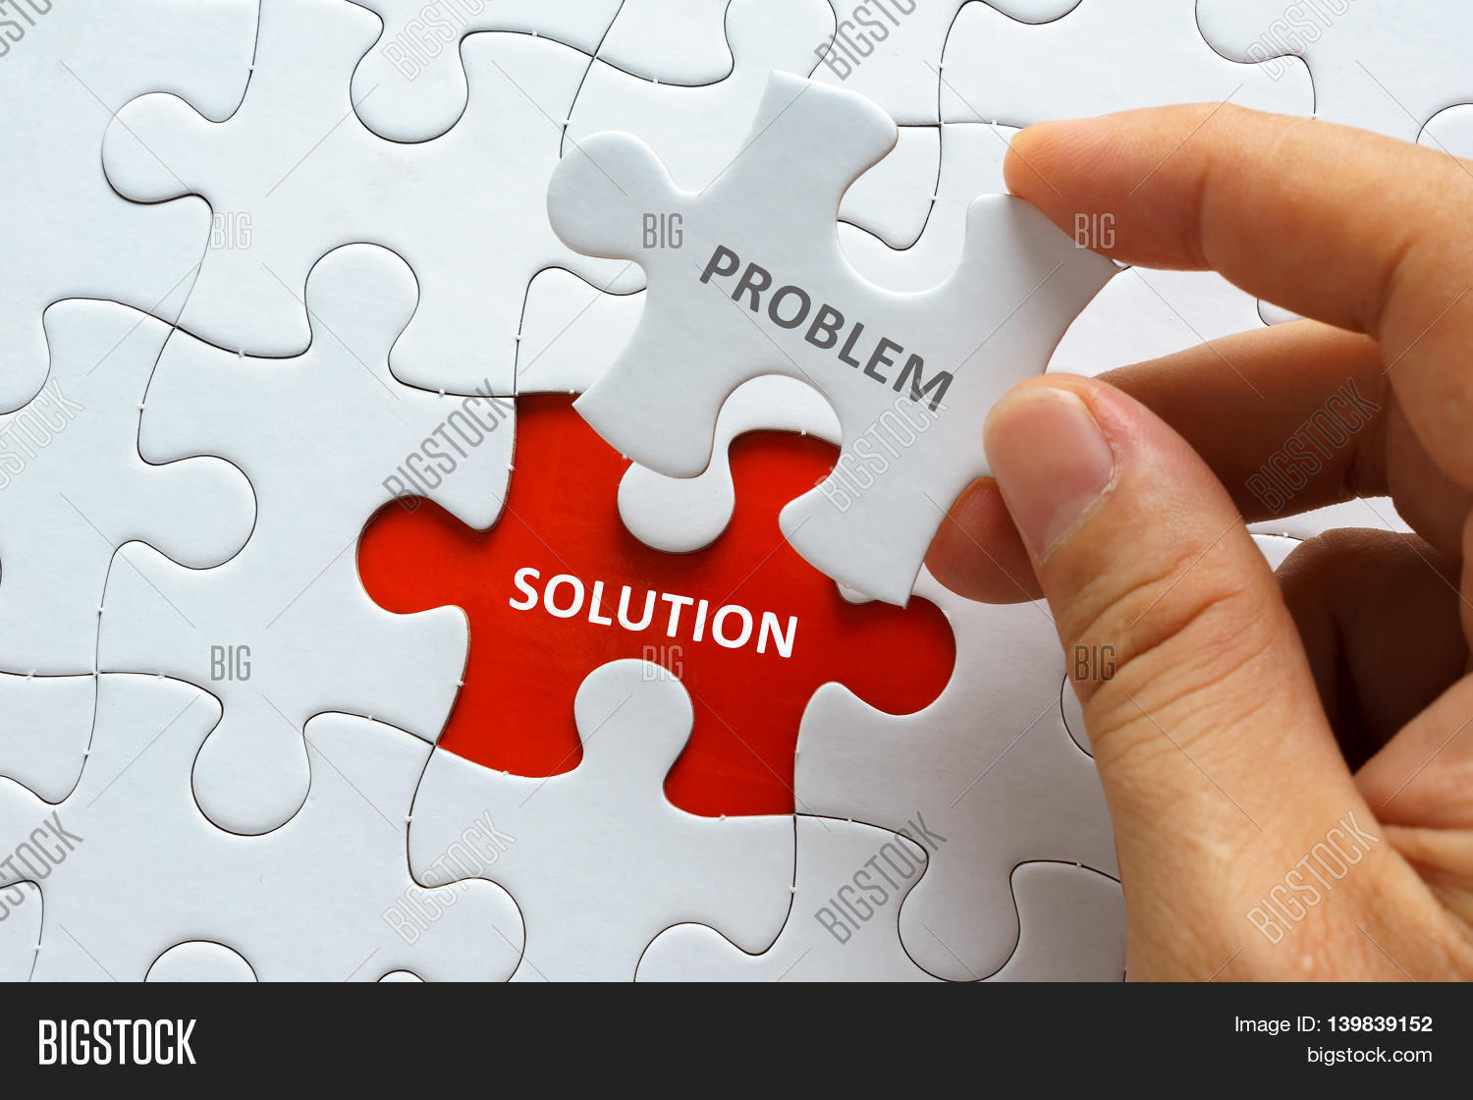
How do you solve a problem?
Make a jigsaw of it.
Start with the completed picture and then chop it up.
Notes:
High resilient people have a jigsaw with all the bits needed to solve the problem – they start with the end – a picture of success and then chop it up!
This is optimism in practice – they believe they are going to succeed so they spend time focused on what it will look like when they succeed.
Unfortunately low resilient people are much more likely to be PESSIMISTIC – they see themselves failing even before they start.

Slide 15
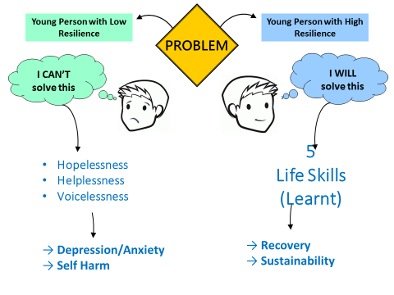
Start with success.
Have a film in your mind of what it is like when you succeed.
That will help to send you down the high resilient pathway.
Notes:
High resilient people have a film in their heads of what it will be like when they succeed - optimism; low resilient people see all the problems that mean they are going to fail - pessimism.
This mindset is very important in determining which road a person goes down – the high resilient or low resilient road.

Slide 16

Who is in this video clip and what is he talking about?
They are 32 words that changed the world.
Notes:
Tell the group you are going to show a 3 second clip of a video – who can tell who it is and what he is talking about – JFK and the space programme.
Click on to the next slide the video starts automatically – play video for a count of three then click backwards – make sure you have returned to this slide.

Slide 17
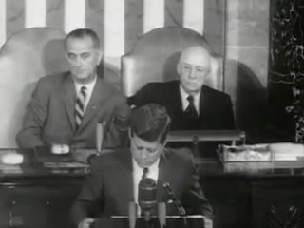
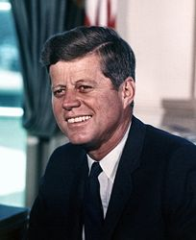
Vision of Success.
“First, I believe that this nation should commit itself to achieving the goal, before this decade is out, of landing a man on the moon and returning him safely to the earth”.
Notes:
The space programme changed our world – laptops, mobile phones – thousands and thousands of things we take for granted came from the space programme – because so many problems needed to be solved. But Kennedy didn’t talk about the problems he talked about success – high resilient people do the same. If Kennedy had listed all the problems that needed solved the American people would have said no thanks!

Slide 18
Start with success – Vision.
Landing a man on the moon and returning him safely to earth
Notes:
So JFK starts to build his jigsaw backwards – starting with his vision of success – he wants to have man landing on the moon

Slide 19

To get someone to the moon, JFK needed a strategy of how he would implement this
Notes:
However having a Vision is not enough – you also need a strategy or plan of how to achieve that vision. If all you have is a Vision you are a dreamer and are unlikely to succeed.

Slide 20
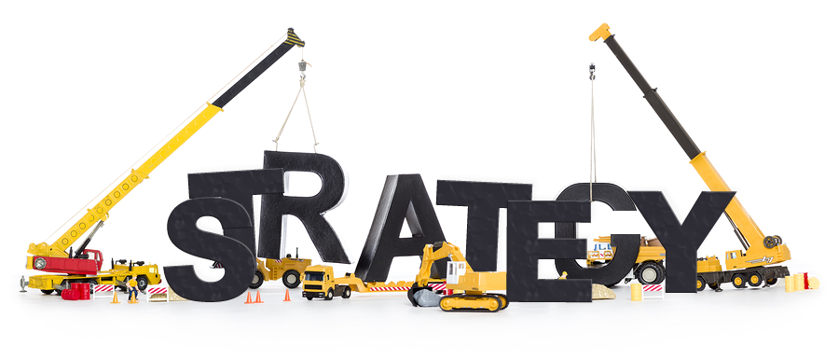
Build a strategy that leads to your success
Do it back to front like manufacturing a jigsaw.
Start at the end, a vision of your success, and then chop it up.
Notes:
Start with your vision of success, then step backwards and identify the problems you have to overcome to achieve that success – high resilient people start at the end and work backwards – low resilient people start with the problems and get lost.

Slide 21
JFK’s problems that stood in the way of him achieving his Vision.
A rocket needs to be built.
He needs to find someone willing to travel to the moon.
He needs to make sure that this person is returned to earth safely.
Notes:
Some problems that JFK may have faced…

Slide 22
Then you need to think about the actions you can take to solve these problems.
Notes:
Having identified the problems he can think about each one and decide the actions he can take to get past them.

Slide 23

Highly resilient people are great at getting help.
Two important questions:
Who can help me? (Team)
What can help me? (Resources)
Notes:
High resilient people want to succeed – so they will partner with other people and use resources to achieve success.
So JFK is high resilient and right from the start he plans in what help he needs to achieve his Vision – NASA, Apollo 11, Neil Armstrong, Buzz Aldrin

