Slide 1
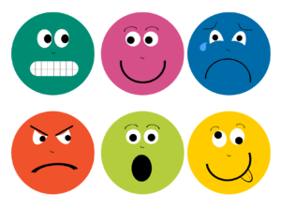
Resilience skill 3:
I can manage my emotions.
Notes:
Ok so Skill One is Listening; Skill Two is problem solving. Skill 3 is that high resilient people are better at managing their emotions. The next video clip is of people who were unable to manage their emotions.

Slide 2
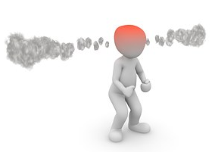
Stress can make you angry.
Notes:
Show this clip: https://www.youtube.com/watch?v=OIiLTrcqY2s
The problem for the people in the video is that they became stressed and that affected their emotions – they lost control because they were stressed – they became very angry.
What did they get from their actions – nothing except more problems!!!

Slide 3
The video shows people who lost control of their emotions due to stress.
What is stress?
Notes:
Both videos showed people who lost control of their emotions because of stress. To understand how to manage stress we need to understand what stress is. This is a video which explains where stress came from.

Slide 4

Notes:
(After video has played)
So stress is a physical reaction to danger which affects our emotions. It was very useful when we lived in caves and were likely to be eaten by bears – our bodies reacted instantly to a threat – our survival depended on not thinking rationally but rather reacting physically – in other words we didn’t engage our brains we just reacted. Not a lot of use these days.
But our bodies release hormones that make us want to run away and climb a tree! Not much use if you are trying to do an exam!!

Slide 5
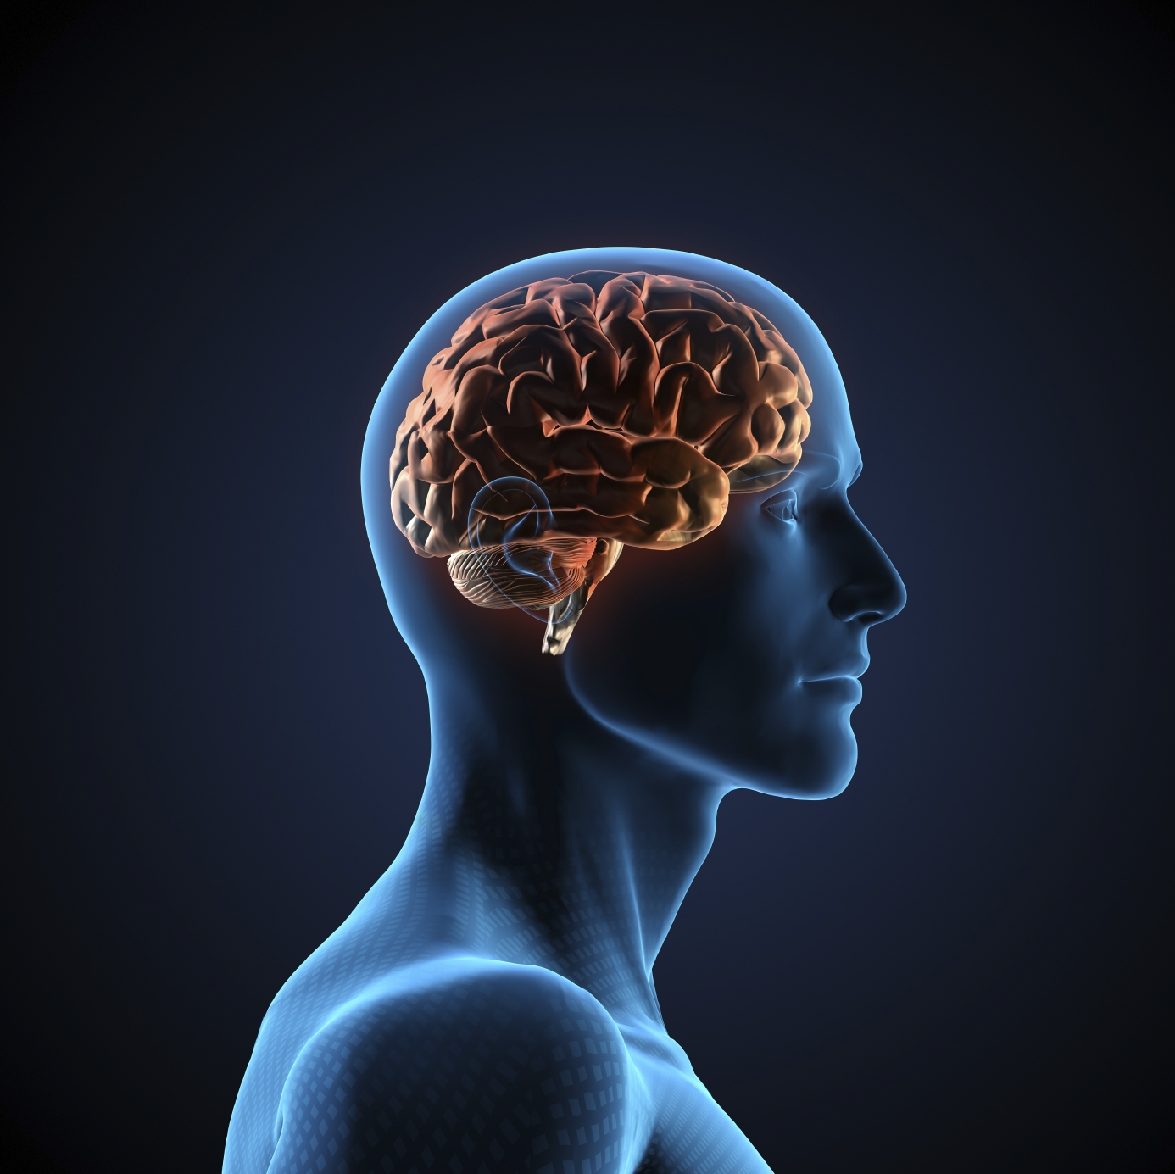
Stress makes us less effective
When your body thinks it’s in danger it produces the stress hormone Cortisol.
Cortisol affects memory and ability to make logical decisions.
Notes:
The body releases two hormones Cortisol and Adrenaline into the blood stream when it senses danger. Your heart speeds up to drive oxygen to your muscles, glucose is released to your muscles and parts of your brain are inhibited – you don’t need to remember what type of bear it is just run, don’t think of a solution just run – so in effect stress makes you temporarily stupid – your memory disappears and your ability to make good decisions is gone. No wonder the people in the video acted so weird. What can you do – exercise burns off the hormones and breathing exercises such as 5/7 breathing calms your heart and turns your brain back on (breathe in for a count of 5 breathe out for a count of 7). So before you go in to an exam walk around in circles and then sit and do 5/7 breathing and stop trying to remember things.

Slide 6
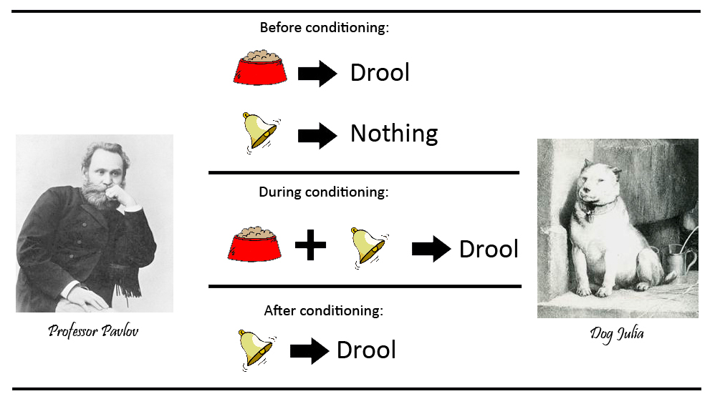
Stress makes us act like Pavlov’s dog.
Stimulus React
Poor Julia got nothing out of it!!
Notes:
Pavlov noticed that his dog Julia salivated every time he brought a bowl of food towards her. She even salivated if there was no food in the bowl. So he was able to train his dog to salivate when he rang a bell – the stimulus and reaction – bell and salivate.
Poor Julia got nothing out of salivating when Pavlov rang the bell!
Humans do the same when they are stressed – they don’t think ; they react – emotionally like the people in the videos. What did the people in the videos get – nothing except more problems.

Slide 7
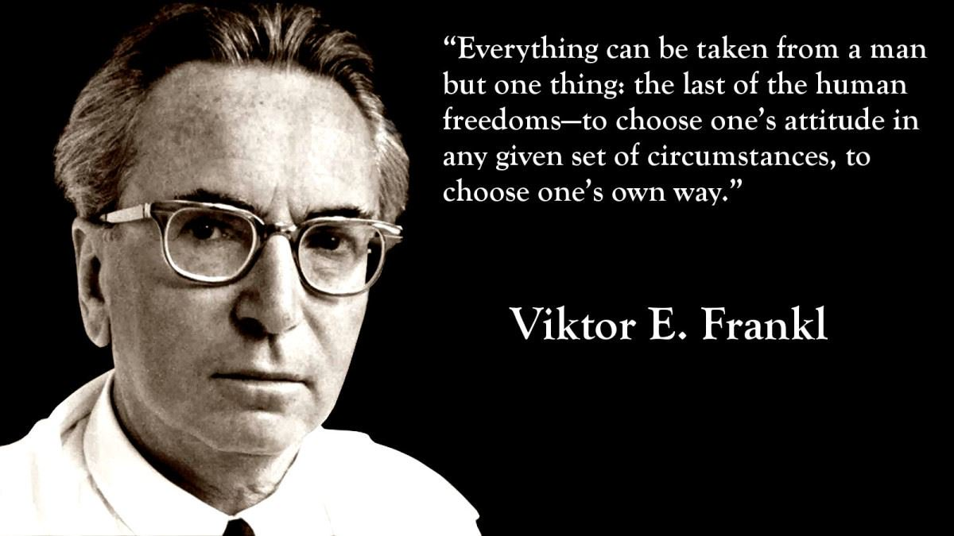
Do we need to react like Pavlov’s dog?
Viktor Frankl
Psychiatrist
Survivor of Auschwitz
Notes:
We don’t have to act like Pavlov’s dog.
Victor Frankl was a very famous psychiatrist and survivor of Auschwitz concentration camp. He was a member of a labour gang being marched back to camp – anyone who couldn’t walk any further was shot. He was thinking that there was no reason to go on – life was unbearable. The man beside him whispered to him one word – ‘wife’ – and Victor began to think of his wife – he thought how much he loved her and his children and happy times they had shared – he found himself smiling. In one of the worst circumstances a human being could find themselves he found he was feeling happy.
He realised that even in the most extreme circumstances we can choose our response – we are not Pavlov’s dog!!

Slide 8
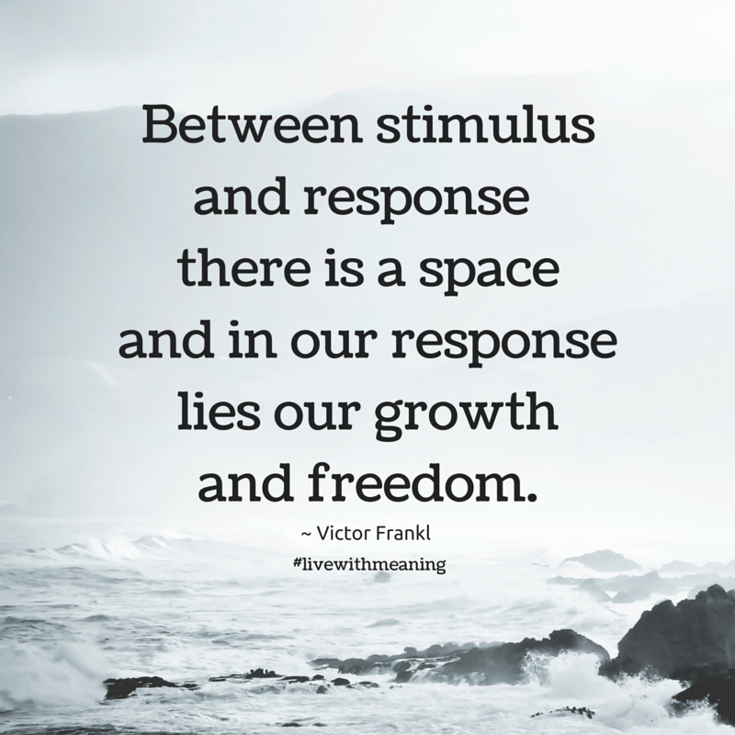
Notes:
No matter what the Nazi’s did to him he realised that he had one last freedom they couldn’t take away – he could choose his response. In one of the most horrific places in history his response was happiness.
If we can use the space to think before we respond we are more resilient.

Slide 9
Stimulus
Reaction
Low Resilient People.
Stimulus
Think
Respond
High Resilient People.
Notes:
So low resilient people will tend to react emotionally to events – getting angry , feeling sorry for themselves – doing things and saying things that they later regret.
High resilient people tend to stop and think abut what they should do next – they think about their response which means they have more control over what happens next.
One example of this is if you delay eating a sweet for 25 seconds you are more likely to choose a healthier alternative.

Slide 10
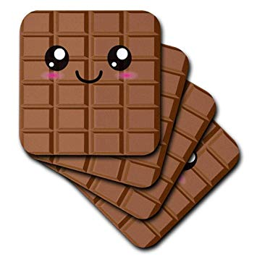
Using Viktor’s Space
Saying to yourself you will eat a chocolate bar in ten minutes if you still want to.
Not punching someone before you have thought about it.
Not saying something very hurtful without thinking it through.
Not making bad decisions until severe emotional distress.

Slide 11
Sometimes the space disappears.
If our resilience is very low the space to choose our response can disappear.
We start to react emotionally, usually negatively, to almost everything.
NATS – Negative Automatic Thoughts Syndrome.
Notes:
The space can become very small and possibly disappear if people become too stressed or ill.
Psychologists have noticed that many people with depression react to any stimulus with negative thoughts. It helps us spot someone who is depressed or badly stressed – you may have a friend who always reacts negatively – maybe they need help – we will talk about that in skill 5.
e.g. You say to your friend great it’s Friday and they reply – oh no it means we are nearer to Monday.

Slide 12
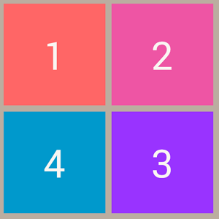
We have broadly four main emotional heads.
Notes:
One way we can identify when we are reacting rather than responding is identifying our emotional heads.
Very simply decide which head you have on – and if you spend too much time with a negative head on – this could indicate that your resilience is very low and you are not bouncing back.
Spotting that your friend has their negative head on all the time, can act as an early warning signal that they need help.

Slide 13

Chilled Head
Not stressed.
Physically relaxed.
We should be able to be in this emotional state everyday.
Notes:
The first emotional head we might have on is our chilled out head – this person is contemplating the beautiful sunset – no stress, no actions – just relaxation.
A great head to have on – one that all of us need to have on at some stage of the day or we can become exhausted. Unfortunately in the modern world some people have great difficulty chilling out – they are worried about what has happened, or they are worried about what is going to happen – they simply can’t really relax. There is a programme called Mindfulness which teaches people how to chill out and enjoy the moment.
But we can’t be chilled out all the time no matter how nice it is – we have to achieve things.

Slide 14

Super Head
Not overly stressed (some stress can be good).
Active.
Focused.
Achieving.
Mo Farah.
Notes:
So if we want to get something done we need to take off our Chilled Head and put on our Super Head. We aren’t that stressed, a little stress can be good and we are more active than when we are chilled out.
Sometimes we need to have our Super Head on and sometimes we need to have our ‘Chilled Head’ on, or we will burn ourselves out. People with positive emotional/mental health change their heads constantly.
Unfortunately, if we are badly stressed, it is very difficult to have your Super Head on. Mo Farrah recently had to withdraw from a race, for which he was fully physically prepared, because he became very stressed over allegations that his coach was involved in using banned substances. He pulled out of an important race because he couldn’t think straight because he was so stressed – he had no chance of winning.

Slide 15
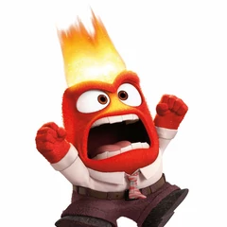
Angry Head
Highly stressed.
Active.
Reacting not responding.
Losing control of the situation.
Notes:
Everybody gets angry sometimes, if someone tries to bully us or our friend it would be very natural. Unfortunately, when we are emotionally upset, we are more likely to do something which we later regret.
It’s normal to get angry some time but unfortunately some people are angry far too often, or can’t control their anger – and stress is one of the main factors. Some people get so bad they have to attend anger management classes.
Everybody has an angry head – but some people are badly stressed and can’t take their angry head off – if your friend, or you, are always angry you could be suffering from stress and you need to talk to someone.
Being stuck with your angry head on is a sign that your resilience is low – you are having trouble bouncing back to normal. It is also very likely that your anger is stopping you achieving things in your life – think about the people in the first video smashing up things at work.

Slide 16
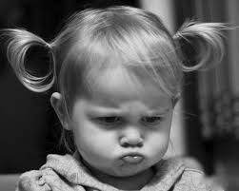
Sulky Head
Highly stressed.
Not active (passive aggressive).
Not achieving anything, not resolving anything.
Notes:
The fourth head we all have is the sulky head – I have seen them already when I didn’t give some people the points they wanted.
It’s normal to go into a sulk every so often, it’s sometimes appropriate to feel sorry for yourself. But it’s not healthy to be sulky too often – some people do get stuck in a sulk – again stress plays a big part. If you or your friend are always feeling sorry for your selves you may need to talk to someone.
Being stuck with your sulky head on could be a sign your resilience is low – you are unable to bounce back. It is also likely that your emotional state of feeling sorry for yourself is stopping you achieving things in your life – like Ian in the Great British Bake Off.

Slide 17
Everyone has all four heads and we move between them.
Super Head
Angry Head
Chilled Head
Sulky Head
Notes:
So we all have four emotional heads – everybody has them and someone with positive mental health changes from one to another as is appropriate.

Slide 18
High resilient people
Super Head
Angry Head
Chilled Head
Strong Bouncebackability
Sulky Head
Notes:
High resilient people are better able to manage their emotions and their reaction to stress.
When something goes wrong they may well become angry, or sulk, but because they have bouncebackability they will move to Super or Chilled Head.

Slide 19

Low resilient people
Super Head
Angry Head
Chilled Head
Low Bouncebackability
Sulky Head
Notes:
We can actually tell someone is stressed or even depressed because they are always angry or upset. They need help – the pastoral care team (or equivalent name) can help!!
Being stuck with anger or sulking is a sign that you have low levels of bouncebackability.

Slide 20
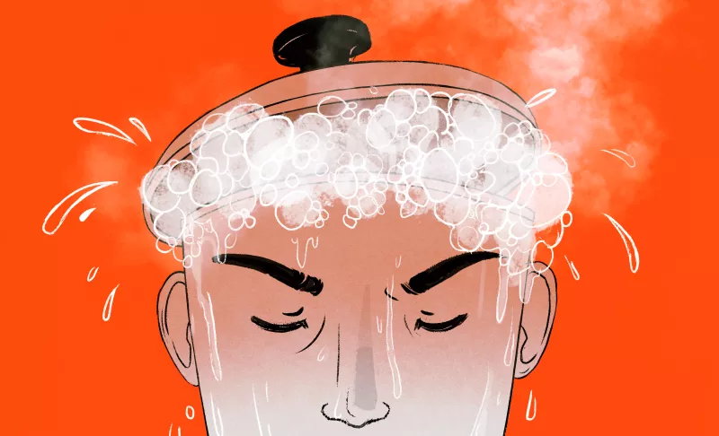
Recognise that you are stressed.
Moodiness or short temper.
Feeling everything is getting on top of you, seeing only the negative in things.
Feel sick, off your food, headaches.
Sleeping problems.
Memory problems.
Notes:
If you get stuck with feeling angry or resentful all the time it could be that you are stressed, and could be at risk of developing a mental health condition such as depression. Clues that you are distressed include:
If you are eating the face off everyone, it sounds like you are stressed.
If you always feel overwhelmed, and only see negatives everywhere you look, sounds like you are stressed.
Stress can make people physically ill – if someone has a headache constantly it could well be stress.
If you are stressed you could be waking up in the middle of the night – Cortisol (the stress hormone) is the hormone that gets you out of bed in the morning – that’s why many people are grumpy first thing in the morning.
What’s the one thing your parents can’t find if you are late in the morning – yes their keys – it’s not that they are suddenly daft, it’s they are stressed!!

Slide 21

Take action to reduce the stress.
Avoid what is causing the stress.
Exercise and breathing exercises.
Think about your response (Viktor)
Meditation, mindfulness, yoga etc.
Ask for help.
Notes:
Sometimes easier said than done – exams are part of your life, but there will be situations where you get stressed that you can avoid – e.g. just not getting involved in an argument because you choose not to.
Exercise burns up the stress hormones, breathing 5/7 will return your heartbeat and brain functions to normal.
Think about the space between stimulus and response – there are training programmes such as Mindfulness which can help.
The number one way of improving your resilience is ask for help!!!!

Slide 22

Dots challenge
Join all of the dots using four straight lines.
Your pen must not leave the paper and you can’t go backwards.
Notes:
OK now I am going to get you all stressed - we will give you out a sheet each – on the sheet there are 9 dots – your task is to join all the dots using only 4 straight lines. Once you start you cannot lift your pen off the page and you cannot go backwards.

Slide 23
Notes:
If people can’t solve it ask them what they should do – yes keep trying etc. but asking for help is a high resilient thing to do – so when someone eventually asks for help award them a point and then say to everyone to watch and show them the first line – repeat until some one solves it.

Slide 24
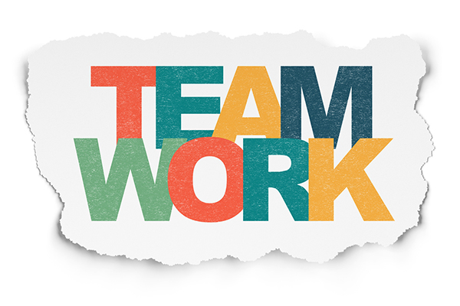
Resilience skill 4:
I am good at working with other people.
Notes:
Skill 1 is Listening; Skill 2 is Problem Solving; Skill 3 is Managing my Emotions.
The fourth thing we know about high resilient people is they are much more likely to work successfully in teams; low resilient people are more likely to struggle on their own and fail on their own.
Here is a video about working together

Slide 25
Working Animals
There are four basic ways people work in teams.
Everybody uses all four, but we are more comfortable with one or two.
It helps us to work in a team if we understand which animal we are; and also which animal everyone else is.
Notes:
People are different – that’s why sometimes people don’t get on. But the opposite is also true – because people are different they bring different skills to the team.
Most successful teams are a mixture of different personality types.
Knowing what animal you are helps you work with other people – it is also useful to understand their animals. They are different by nature – they are not doing things to annoy us, it’s just natural to them but maybe not to us.
High resilient people are better able to make links with people – including people who are different to them. Low resilient people tend to form closed networks perhaps with people with whom they share similar personalities.

Slide 26
Eager Beaver
Focused on what needs to be done now.
If you want something done, do it yourself.
Gets things done quickly.
Busy, busy, busy.
Great person to have on your team.
Buying a mobile phone.
Does this sound like you?
Notes:
The first animal is the eager beaver. They love getting things done, can’t wait to get started.
Eager beavers are great to have on a team – they get things done! Without an eager beaver on your team you won’t get things done – you will run out of time.
If they needed to buy a new mobile phone they would rush to car-phone warehouse – pick the first phone that seems good and in stock and be back home ready to do all the other things on their to do list.
Are you an Eager Beaver?

Slide 27
Wise Owl
Gets things done properly.
If it’s worth doing, it’s worth doing well.
Everything is planned.
Everybody has a job to do.
Great person to have on your team.
Buying a mobile phone.
Does this sound like you?
Notes:
The Wise Owl is a great person to have on your team – they see all the steps that need to happen to get something done.
A great person to have on a team – they develop a plan that everyone can work to!!
Without a Wise Owl on your team everyone will be doing their own thing – chaos.
If they needed a new mobile phone they would get on the internet and identify all the different phones and their features, and pick the best one at the best price for their needs.
Are you a Wise Owl?

Slide 28
Clever Fox
Focused on doing things better.
Is always thinking of how to do things differently.
Brilliant new ideas.
Lets move on to the next thing - change is good!!
Great person to have on your team.
Mobile phone.
Does this sound like you?
Notes:
The Clever Fox is also a great animal to have on your team – they often come up with great ideas – better ways of solving problems or doing things.
They might be the type to buy the latest phone or iPad.
A great person to have on the team – great ideas!! Without a clever fox on your team you will just keep doing the same thing – you won’t make great leaps forward.
If they need a new mobile phone it needs to be the newest. When Apple launches its new iPhone these are the people queuing up outside.

Slide 29
Friendly Dolphin
A dolphin is a ‘people person’.
Enjoys being involved and feeling needed.
Pulls team together in a crisis.
Solves problems through talking.
Great person to have on your team.
Mobile phone.
Does this sound like you?
Notes:
A friendly dolphin loves working with other people – they are the glue that keeps a team together, they are the communicators on the team.
A dolphin is a great person to have on your team – they keep everyone happy and make sure everyone is part of the team – without a dolphin on your team people will start to fall out with each other.
If they need a new mobile phone they will ask all their friends what phone they should get and maybe they all go for a trip in to get the phone.

Slide 30
Working Animals
Everyone choose their animal
Notes:
Every one has one, possibly two, of the animals which are dominant – it helps you know why you do things your way if you know which animal or animals you are. It also helps you to understand what animal other people are – you can then understand why they want to do things their way – which might not be your preferred way.

Slide 31
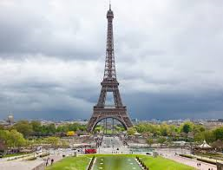
Task – Paper Tower
Build a free standing paper tower from the sheets of paper and tape provided, tallest free standing tower wins.
Your tower must stand stable and unaided for three seconds – it cannot be falling over during those three seconds.
Notes:
Free standing means not taped to table, no bottle inside, no leaning against anything etc. - it must stand still for a count of three – not falling over for a count of three.
Use all the animals in your team to help you win the task!!!

Slide 32
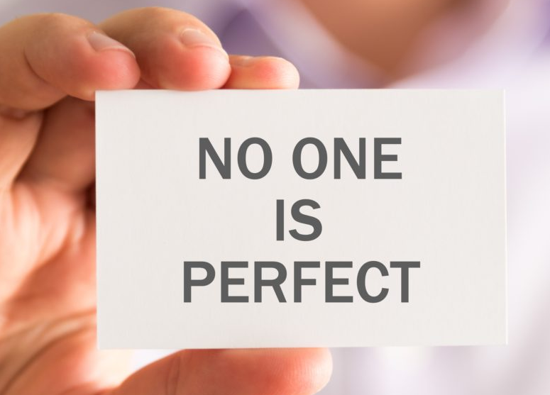
Working Animals
Which animal is best?
Notes:
No one animal is perfect or the best – all have their positives and negatives!

Slide 33
Eager Beaver
Jumps in – feet first.
Is too busy to talk.
May want to work on their own – don’t bother I’ll do it.
Headless chicken.
You do not want a team of only eager beavers.
Mobile phone bill.
Notes:
Nobody is perfect – each animal has its negatives.
If you had only eager beavers on your team they wouldn’t have any plan, they would keep doing the same thing and they wouldn’t talk to each other. They would run off and do what they think should be done.
The eager beaver gets a bill for £250 at the end of the first month – why? - because they didn’t do their homework and signed up for the wrong plan.

Slide 34
Wise Owl
If it’s not broken, don’t fix it - we could still be using the typewriter.
Under pressure may make decisions on their own.
May want to stick to the plan even if it’s not working.
You do not want a team of only wise owls.
Missed the offers on the mobile phone!
Notes:
Negatives of the Wise Owl.
If you only had owls on your team you mightn't get things done on time because you spent too much time planning rather than doing, you might not move your ideas forward and people might have their own bits of plans they don’t share. Also they tend to stick with the plan even if it’s not working!!
They missed the great offer on the mobile phone because they took too long to decide!!

Slide 35
Clever Fox
Always changing their mind.
May not be able to tell a good idea from a bad idea.
Detail bogs them down.
You do not want a team of only clever foxes.
iPhone 8 is the best thing ever – until the iPhone X is announced and then it is for the bin!!
Notes:
Negatives of the Clever Fox.
The plan constantly changes so things that have been done are wasted, sometimes people only want to talk about their own ideas – people often can’t tell their great ideas from their ridiculous ideas.
So they got the only phone in the world they wanted and think it’s the best thing they ever owned – right up until the newer model is about to be launched – then they want to throw their phone in the bin!!

Slide 36
Friendly Dolphin
Poor follow through – doesn’t always walk the walk.
Easily dissuaded.
Meetings seem to over run, go round in circles.
May get too many people involved.
You do not want a team of only friendly dolphins!
Did they ever get their mobile phone?
Notes:
Negatives of the Friendly Dolphin.
Maybe too much time is spent on talking about things rather than agreeing what is the plan and who needs to get on and deliver it. Might love all the new ideas of the fox as they can talk about them! Also because they listen to everyone they tend to be influenced by the last person they talked to!
So when they needed a mobile phone did they go ahead or did they go round in circles with all their friends giving them different advice and because they didn’t want to hurt anyone they stuck with the phone they had – or they all went off and had so much fun they never got to the mobile phone shop.

Slide 37
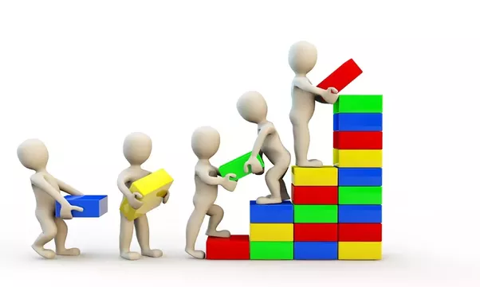
As no one animal is perfect, you need a combination of all four to be most effective.
That’s why you need to be able to work with other people – people who are different!!
Notes:
You need all four skills to succeed – if you work with other people with different skills that’s high resilient behaviour.
If you work on your own and keep telling yourself you have to be able to do everything you are more likely to become stressed.
Make an effort to accept that people are different – try and see past what annoys you about someone and see the advantage of their different approach.

