Slide 1

Resilience skill 5:
I can access help.
Notes:
Skill 1 was Listening
Skill 2 was Problem Solving
Skill 3 was Managing my Emotions
Skill 4 was Team Working
Skill 5 is Accessing Help – it is a strange thing but low resilient people are the last to ask for help; they are struggling and think it is a sign of weakness or failure to ask for help – high resilient people are the first to ask for help – they want to succeed!!

Slide 2
Steve Jobs talking about asking for help.
Notes:
Now I am going to play a short video where Steve Jobs explains why it is important to ask for help.

Slide 3
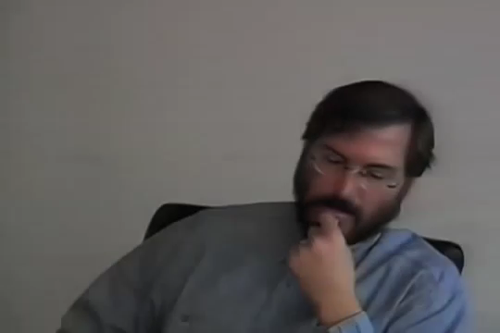
Helper’s high.
Notes:
Many people find it difficult to ask for help; low resilient people need help most but are unlikely to ask for help – they see it as a sign of weakness, they can’t find the right words, they have become isolated or they have been told to get on with it, stiff upper lip – asking for help is high resilient behaviour.
Steve Jobs was 12 years old and phoned the co-founder of HP Computers and asked for help – very high resilience behaviour. It wasn’t that surprising that Bill Hewlitt helped him – it’s called Helpers High – when you do an act of kindness for someone you feel happier. Most people want to help.

Slide 4
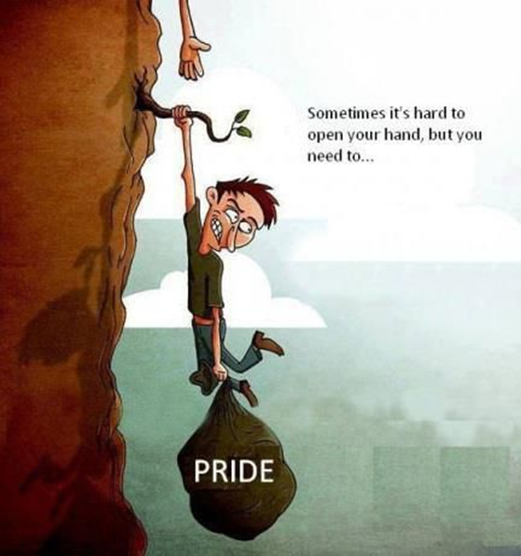
Is it easy to ask for help? Not always and not for everyone.
It is estimated that 3 out of 4 people struggling with depression will not ask for help.
e.g. Pride stops
people asking
for help.
Notes:
Three out of four pupils feeling down in this school will hide their feelings rather than ask for help but studies show that 80% of people suffering from depression will start to feel better within 4 or 5 weeks if they are given the right help and support.

Slide 5

Team Exercise
Why wouldn’t someone at this college, who is feeling very down, ask for help?
Notes:
Ask participants to work in groups on this question – one list per table.
Give them about 5 minutes to work.
Get feedback one reason at a time from each team – you can award a point for each reasonable answer (have never heard an unreasonable example) that has not already been mentioned.
This round can be negative because they are genuine barriers to getting help – so don’t be challenging things said – try and make them non-personal but acknowledge the barrier.
Do not give examples of how to overcome the barriers – you do that in the next slide.

Slide 6
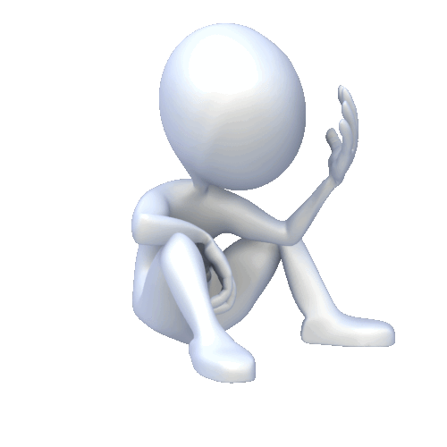
Barriers that stop people asking for help
don’t know
gossip
where to turn
not taken seriously
embarrassed
think no one
worried family
can help them
will find out
Notes:
This time talk about the pathway to help without dismissing concerns – which can feel like a physical barrier to getting help.
Things can build up until it’s like a brick wall which people can’t get past.
Not taken seriously – this school will take every mental health issue very seriously.
Family – not every issue needs to be discussed with your family – usually the earlier you ask for help, the less chance your family need to be informed. If you are at risk your family will need to be informed but many young people have said that the family being made aware turned out to be very positive.
Don’t know where to turn – every adult in the school has received child protection training – they will link you into the pastoral care team.
Gossip – your issues are confidential and people, including teachers, will be informed on a need to know basis.
No one can help me – this sounds like depression – helplessness – 80% of people show improvement within weeks.
Embarrassment – it’s difficult but remember the pastoral care team have dealt with similar problems many times before – they will not be embarrassed and will try not to embarrass you.

Slide 7
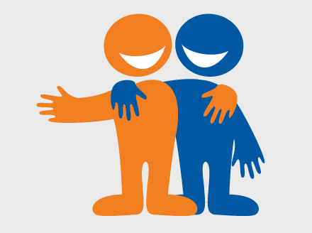
Now we are going to show you how to help your friend.
Notes:
Your friend may simply be unable to ask for help – but needs someone to do it for them!
The next slide is corny but true!!

Slide 8



Super Friend!
Notes:
A super friend gets them the help they need!

Slide 9
Step 1
Step 2
Step 3
LOOK
LISTEN
LINK
Watch out for signs that your friend may be unable to bounce back.
Listen and ask.
Link them, and yourself, to the help that is there.
Notes:
Follow the steps : Talk through each step
Emphasise that you don’t need to have answers to your friends problems to help them, they will feel better if you listen to them and get them the help that will allow them to recover.

Slide 10
Step 1
LOOK
Notes:
First step is to look for the signs your friend’s resilience is very low.

Slide 11

Signs that your friend may have low resilience.
Don’t seem to care about anything anymore.
Say they can’t tell you how they feel.
Are always angry or upset.
Threaten to or are hurting themselves.
Disclose worrying content on social media.
Withdraw from friends and family.
Are not able to sleep or are sleeping all the time.
Have dramatic mood changes.
Notes:
These are the warning signs….
Most are common sense.
ALWAYS take it seriously if someone says they feel suicidal.
Follow your instinct if you have a gut feeling that there is something wrong – you are more than likely right.

Slide 12
Step 2
LISTEN
Notes:
Step 2 – after you have LOOKed and seen a warning sign – is to listen – it is not to jump in with inappropriate solutions.

Slide 13
Active Listening
ASK
LISTEN
Notes:
An important part of ACTIVE Listening is asking questions – it’s a 2 way conversation.

Slide 14

Your friend may find it hard to talk.
Ask a nice easy question.
‘How are you feeling?’
Notes:
Remember voicelesssness – help you friend talk, it can be very positive.

Slide 15
They might answer:
What do you mean by a bad time?
I’m having a bad time....
My friends...
What’s the problem with your friends?
Notes:
Just ask them what they mean – use their words – if you change their words they might tell you that is not what they said!

Slide 16

Asking questions shows:
That you are listening
That you care
That you are taking them seriously
Notes:
If the person feels that you care and you are listening they are more likely to open up and take your advice.

Slide 17

Step 3
LINK
Notes:
Step 3 – LINK. Link them to the help that they need.

Slide 18
LINK
You must tell someone; LINK to the College.
Silence is not an option, too many people will be at risk.
Talk to an adult who will take responsibility.
Encourage your friend to stick with the help they are receiving.
Notes:
It is too dangerous to keep what you know a secret – protect your friend and yourself – get them help!

Slide 19
However, my friend doesn’t want me to tell anyone.
You wouldn’t keep a broken leg a secret.
They need help or they may get worse.
If you keep it a secret you are putting yourself at risk.
Get advice, let someone else with more experience make the decision.
Getting your friend the help they need, makes you feel better about yourself.
Notes:
Imagine if your friend came round the corner hopping along, crying their eyes out telling you they have broken their leg, indeed you can see the broken bone sticking out – and they say don’t tell anyone. You would say no chance and go off to call an ambulance. It’s exactly the same with a mental health crisis except you can’t see it.
If you don’t treat a broken leg it will get far worse. It is the same with mental health, the longer the issue goes untreated the worse it becomes.
You have the right to protect yourself – if they refuse to get help, you need to get help for yourself.
Let someone with more experience, training and resources make the decision – take the load off you.
Doing the right thing makes you feel better about yourself in very stressful circumstances.

Slide 20

Resilience Recap
Skill 1: I am a good listener.
Skill 2: I am a good problem solver.
Skill 3: I am good at managing my emotions.
Skill 4: I am good at working with other people.
Skill 5: I am good at accessing help.
Notes:
When psychologists examined resilience in families they discovered that high resilient people did five core things differently from low resilient people – and also that low resilient people could learn to become more resilient by learning these core life skills.
One of the first things they found was that high resilient people were better listeners than low resilient people and we are going to look at listening skills very shortly.
The second life skill was the ability to solve problems – high resilient people were better problem solvers so we are going to look at problem solving. They also found that high resilient people used their skills together – so listening helps solve problems etc.
The third skill seen in high resilient people was that they were better able to manage their emotions – low resilient people’s heads kept exploding – a bit like Eastenders. One of the main reasons people lose control of their emotions is stress so we will look at that.
High resilient people are much more likely to work successfully in teams – working together to solve problems or achieve success – low resilient people tend to work on their own – and fail on their own – so we will look at team-working.
Finally they found that high resilient people were the first to ask for help – they knew that getting help was a good thing – low resilient people were less likely to ask for help even though they were the people most likely to be struggling- they thought asking for help was a sign of weakness.

Slide 21
