Slide 1
Mindfulness

Slide 2
Mindfulness Therapy
What is Mindfulness?

Slide 3
Mindfulness Therapy
A First Taste of Mindfulness
Follow the instructions that your teacher reads out to you

Slide 4
What is Mindfulness?
A form of brain training
We can fall into automatic negative habits
Mindfulness helps keep us retrain these to think in a more positive way

Slide 5
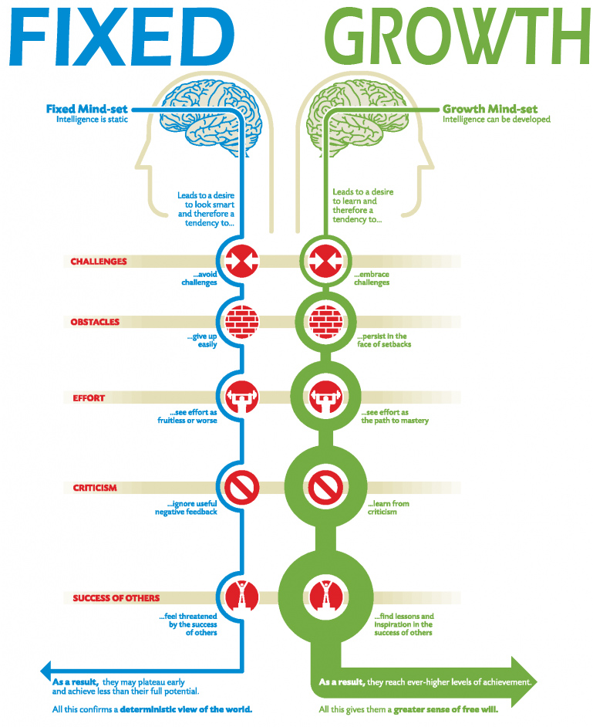
Changing our Mind-Set
Carol Dweck says we need to develop a growth mind-set

Slide 6
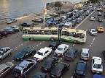
Some of us....
Focus on the PAST: What were they saying about me? What should I have done differently?
Focus on the FUTURE: What will happen next? How will I cope if....... What happens if.......
The plane crashes
There is a traffic jam and I am late for work

Slide 7
Mindful Breathing
Your teacher will take you through a breathing exercise
Video https://www.youtube.com/watch?v=Uxbdx-SeOOo 4-7-8 breathing
https://www.youtube.com/watch?v=5PIBMLvcAzc

