Slide 1
GUIDE TO REVISION
By
Donna A Watson

Slide 2
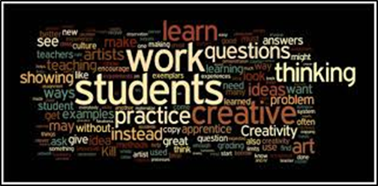

Slide 3
Aims and objectives
Aims / Nodau
Develop student’s revision tool box
Objectives / Amcanion
Practice with different techniques

Slide 4
Topics
Create the Perfect Revision Space
Take a Study Break
What to Eat and Drink When you are Revising
Revision Tips for Different Types of Learners
Revision Tools to Help You Pass Your Exams
Why Past Papers Are The Best Way to Revise
Effective Exam Techniques
Organisations to Help Your Health During Exams

Slide 5
Create the perfect revision space
Get rid of clutter
Keep distractions away
Get comfy
Let there be light
Set the noise levels
Personalise it
Make it easy to manage your time
Get your supplies ready
Maintain it
Remember: there are more important things

Slide 6
How to take a study break
Get active
Get away from your workspace
Have something to eat and drink

Slide 7
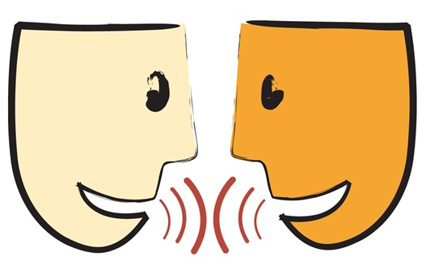
How to take a study break
Avoid Napping
Get human contact

Slide 8
How to take a study break
Stick to your schedule
Do something you enjoy
Don’t be too hard on yourself

Slide 9
What to eat and drink when you are revising
Regularly
Occasionally
Water
Fruit and veg
Fish
Eggs
Nuts
Sugary treats
Fast food
Coffee
Snacks
Alcohol

Slide 10
Revision tips for different types of learners
What learning style are you?

Slide 11
Visual learner
Create colourful revision notes.
Vary the layout – consider trying cartoons, flow charts, graphs, bullet points, timelines and sketches.
Mind maps.
Writing notes by hand.

Slide 12
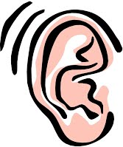
auditory learner
Try recording key learning points on your phone.
Similarly you could try playing your recordings back to yourself.
Why not create rhymes, raps or a song to help remember key points?
Study with a partner.
Try podcasts – lots of free ones available on iTunes.
Background music can be soothing and help aid concentration.
Similarly some people need quiet for concentration so seek out those quiet spots.

Slide 13
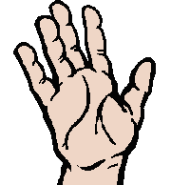
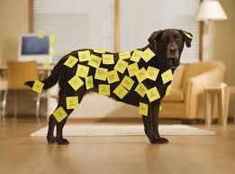
Kinaesthetic learner
Sticky notes are your friend.
Colour coding
Active study

Slide 14
Revision tools
Revision Timetables
Sticky Notes
Flashcards
Moodle
Podcasts
Mind Maps
Past Papers
York Notes
Study Guides
YouTube

Slide 15
Why past papers are the best way to revise
You can practice your timing
You will learn the patterns
You can identify your weaknesses
They simulate stress
You get to see how they are marked
You will know what came up last year

Slide 16
Power hour
Where students go wrong:
Power Hour:
Spend too much time revising and not practicing technique.
Use revision techniques that don’t work.
Revise for too long in one sitting and lose focus.
Use passive revision techniques.
Balance the time between learning and practicing.
Stops sitting too long on a revision technique that is not effective.
You don’t revise for too long.
Active revision technique.

Slide 17
Power hour
Also can:
Feedback.
Help you to think about how to improve your grade – motivator!
Makes you repeat your learning in different ways.
Highlights gaps and weaker areas.

Slide 18
Power hour

Slide 19
Sporting mindset
Embrace nerves
Simulate exam
Analyse your performance
Feedback – collaborate
Rehearse the situation
Mock exam
Anticipate the unexpected
Discuss your reaction in situations

Slide 20
Effective Exam Techniques
Read the question then READ AGAIN.
Identify the questions that are worth the most marks – spend the most time on them.
Keep calm and carry on.
Plan your answers in advance.
If you are running out of time and have more than one question left to do, then just answer the first part of each of them.
Read your answers at the end.
Never leave an exam early.
Drink plenty of water – stay hydrated.

Slide 21
Don’t spend ages making your notes look pretty – wasting time!
Ensure that diagrams contain relevant detail.

Slide 22
Don’t put it off

Slide 23
Don’t just read your notes you have to write stuff down

Slide 24
Organisations that can help your health during exams
https://mind.org.uk/information-support/tips-for-everyday-living/student-life
https://www.nhs.uk/Livewell/studenthealth/Pages/Mentalhealth.aspx
Student Services – on campus
Lecturer, Tutors, Study Skills Coaches

Slide 25
Aims and objectives
Aims / Nodau
Develop student’s revision tool box
Objectives / Amcanion
Practice with different techniques

Slide 26
Any questions?

