Slide 1
Creating and Formatting a Spreadsheet
Pauline Greenaway

Slide 2
Learning Objectives
Create a spreadsheet using Microsoft Excel
Use the SUM formula to calculate totals.
Print spreadsheet and formulae used
Apply formatting to the spreadsheet.

Slide 3
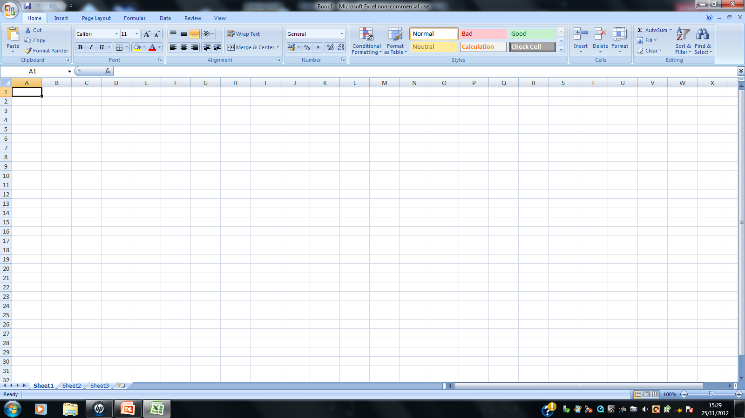
What is a Spreadsheet?
A collection of cells organised in columns rows used to carry out mathematical calculations.
Menu Bar
Ribbon
Formula Bar
Active Cell Address
Worksheet

Slide 4
Creating a Spreadsheet
Here is a spreadsheet that has been created to record Gelliafan Hospital Ward Admissions for the first quarter of 2012.
Autofill can be used to insert February and March in C3 and D3.
Merge and Centre can be used to centre the title from A1 to E1

Slide 5
Using Formulae and Functions
Formulae and functions are used in Excel to carry out calculations.
All formulae must start with =
Formulae use mathematical operators. Here are some examples:
=b1+b2 (Addition of 2 cells)
=b1-b2 (Subtraction of 2 cells)
=b1*b2 (Multiplication of two cells)
=b1/b2 (Division of two cells)

Slide 6
Functions
The SUM function is used to add up a range of cells.
B2 and B7 are the cells that start and end the range to be totalled.
‘Equals’ sign to start a formula/function
=SUM(B2:B7)
The colon : separates the start and end cells of the range to be totalled.
SUM shows that a range of cells will be totalled.

Slide 7
Functions
Functions are calculations which have been preset within Excel.
SUM totals a range of cells.
AVERAGE calculates the average value of a range of cells.
MIN finds the minimum value in a range of cells.
MAX finds the maximum value in a range of cells.

Slide 8
Using Autosum
Autosum can be used to calculate the totals of the columns and rows (instead of using SUM).
Autosum
The formula can be copied across the row and down the column by using Autofill/Replicate.

Slide 9
Using Autosum
Autosum can also be used for calculating other functions such as Average, Min and Max in the same way as Sum.

Slide 10
Formatting the Spreadsheet
The same features as Microsoft Word are applied in Excel to format a spreadsheet:

