Slide 1
Welsh Heritage

Slide 2
Landscapes of Welsh Legend
Pen-y-fan in the Brecon Beacons, once known as Cadair Arthur - Arthur’s seat
A Neolithic Cromlech, called Coetan Arthur – Arthur’s Quoit (Pembrokeshire)

Slide 3
Symbols of Wales

Slide 4
Naming Wales

Slide 5
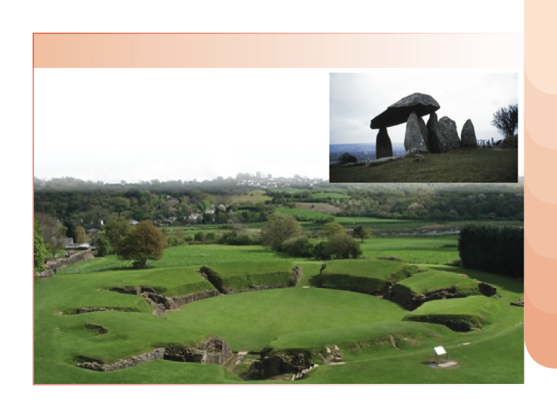
Ancient Roots of Wales
Caerleon
Pentre Ifan

Slide 6
Christian Roots of Wales
Carew Cross
Llanrhychwyn Church
Patricio Screen
Soar y Mynydd

Slide 7
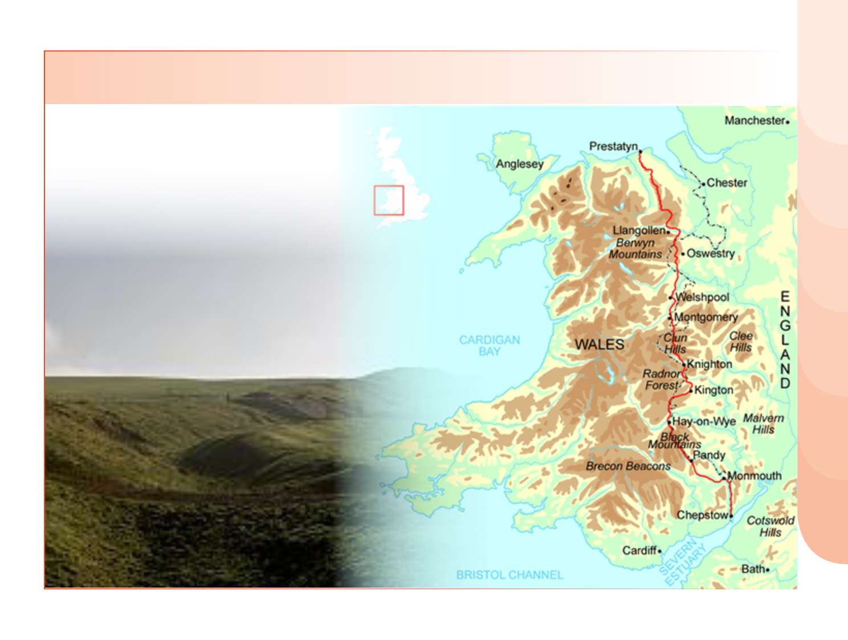
Not just a Ditch - Offa’s Dyke / Clawdd Offa
Today’s footpath follows the line of the Saxon dykes that bounded Cymru

Slide 8
Conquerors’ Castles in Wales
Caernarfon
Llansteffan
Carmarthen
Conwy

Slide 9
Castles of the Princes
Castell Carreg Cennen
Dinas Bran
Dolwyddelan
Dinefwr

Slide 10
Paradoxes of Welsh History
Llywelyn the last, Prince of Wales, was killed at Cilmeri in 1282 (memorial opposite)…
…but, until the establishment of the National Assembly for Wales in 1999, his title was the only Welsh contribution to the British constitution.

Slide 11
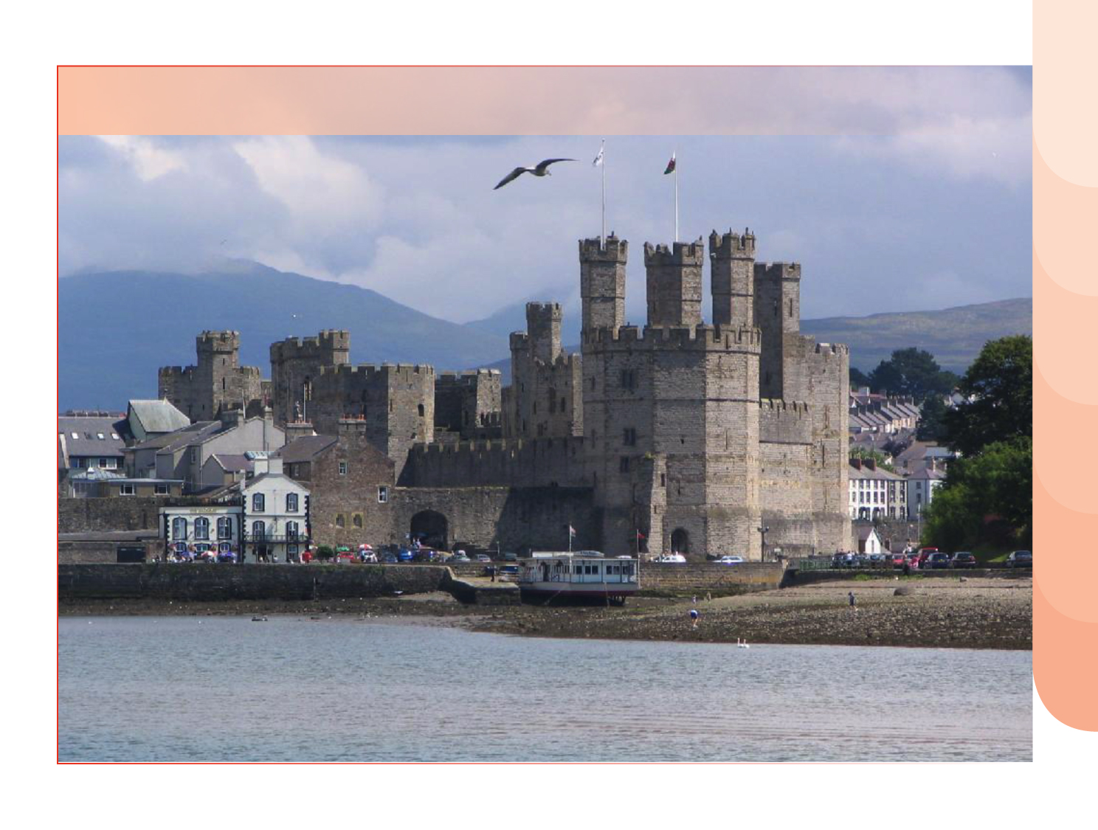
Paradoxes of Welsh History
Caernarfon – where Welsh people were forbidden to live – is now the ‘Welshest’ town in Wales.
Did the Welsh lose the wars and win the peace?

Slide 12
New Life for a Language
Ty Mawr Wybrnant, birthplace of William Morgan, translator of the Bible into Welsh.
An Act of Parliament in 1563 commanded the translation of the Book of Common Prayer and the Bible into Welsh of the highest quality. Note the royal Tudor coat of arms with Red Dragon

Slide 13
New Icons in the Welsh Landscape - Chapels
People develop a new culture, based on the democracy of the congregation.

Slide 14
Transforming Wales 1
Pontcysyllte
Menai Suspension Bridge
Britannia Rail Bridge
Cyfarthfa Ironworks

Slide 15
Transforming Wales 2
Industry and population changed everything…

Slide 16
Wales in Revolt
1795 Food riots
1816 Merthyr Tudful
1822-35 The Scotch Cattle
1831 Merthyr Tudful
1839 Newport Rising
1839-43 Rebecca Riots
1869 Mold Riots
1887-95 The Tithe War
1900-03 Slate Industry
1910 Tonypandy riots
1911 Llanelli riots

Slide 17
Awakening Wales
Evan a James James memorial Pontypridd – author and composer
The National Anthem, 1858

Slide 18
Awakening Wales
The first National Institutions1872 >
National University 1872
National Museum 1907
National Library 1907

Slide 19
Depressed Wales 1914-39
35,000 dead in WWI
300,000 emigrate

Slide 20
Rekindling Wales
1922 Urdd Gobaith Cymru
1946 Welsh National Opera
1948 Council of Wales
1948 Welsh Folk Museum
1951 Minister of State for Wales
1953 Welsh Broadcasting Council
1955 Cardiff Capital of Wales
1964 Secretary of State for Wales
1964 The Welsh Office

Slide 21
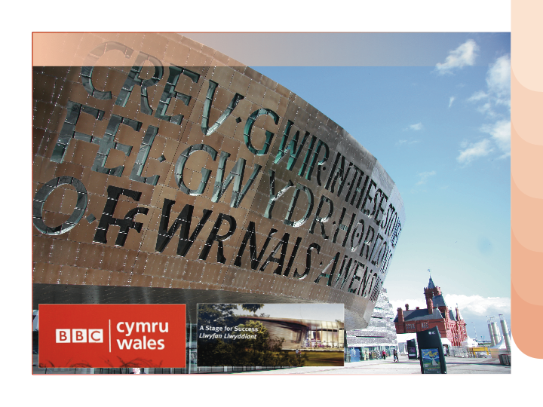
The Arts in Wales

Slide 22
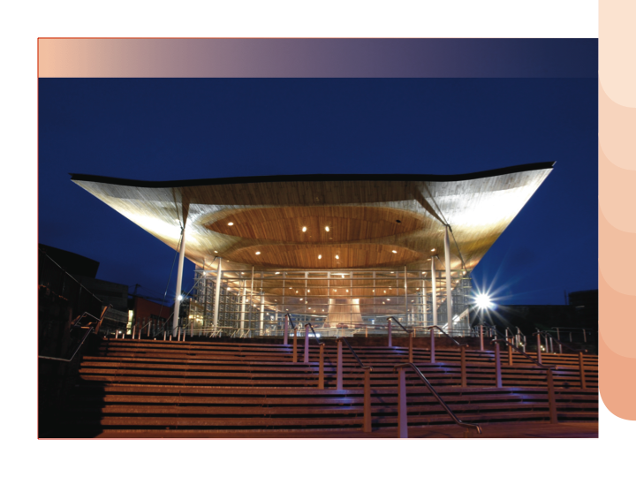
Hesitant Wales
1979 Wales rejects devolution government
1997 Wales favours devolution government
1999 National Assembly of Wales begins

