Slide 1
Polymorphism
Java

Slide 2
Polymorphism
Polymorphism is the ability of an object to take on many forms.
The most common use of polymorphism in OOP occurs when a parent class reference is used to refer to a child class object.
It is important to know that the only possible way to access an object is through a reference variable.
A reference variable can be of only one type. Once declared, the type of a reference variable cannot be changed.
The reference variable can be reassigned to other objects provided that it is not declared final.
The type of the reference variable would determine the methods that it can invoke on the object.
A reference variable can refer to any object of its declared type or any subtype of its declared type. A reference variable can be declared as a class or interface type.
Eg.
public interface Vegetarian{}
public class Animal{}
public class Deer extends Animal implements Vegetarian{}

Slide 3
Polymorphism
Animal
Horse
Cat

Slide 4
Polymorphism
Horse
Cat

Slide 5
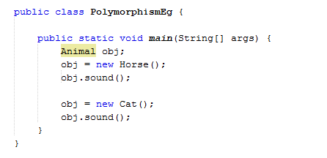
Polymorphism
Horse
Cat

Slide 6
Polymorphism Exercise
Create a new Project in Net Beams polymorphismEg
Add a Class to the project (Animal)
Add a string variable (AnimalSound)
Create a Public Void Method (Sound)
Set the animal sound to null string
Output the animal sound
Add a Class to the project (Horse)
Extend the class to include Animal
Include the @Overide clause
Create a Public Void Method (Sound)
Set the animal sound to Neigh
Output the animal sound

Slide 7
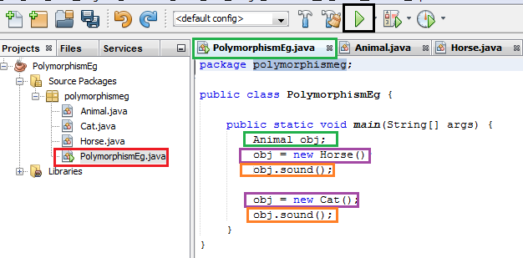
Polymorphism Exercise
Add a Class to the project (Horse)
Extend the class to include Animal
Include the @Overide clause
Create a Public Void Method (Sound)
Set the animal sound to Meow
Output the animal sound
Select The polymorphismEg Tab
Select the Main Method
Declare an object (OBJ the Animal
Set OBJ to w equal New Horse()
Invoke the Sound() method
Set OBJ to w equal New Horse()
Invoke the Sound() method
Run Project

