Slide 1
Abstraction
Java

Slide 2
Abstraction
As per dictionary, abstraction is the quality of dealing with ideas rather than events.
E.g. when you consider the case of e-mail, complex details such as what happens as soon as you send an e-mail, the protocol your e-mail server uses are hidden from the user. Therefore, to send an e-mail you just need to type the content, mention the address of the receiver, and click send.

Slide 3
Abstraction
Likewise in Object-oriented programming, abstraction is a process of hiding the implementation details from the user, only the functionality will be provided to the user.
In other words, the user will have the information on what the object does instead of how it does it.
In Java, abstraction is achieved using Abstract classes and interfaces.

Slide 4
Abstraction Rules
A class which contains the abstract keyword in its declaration is known as abstract class.
Abstract classes may or may not contain abstract methods, i.e., methods without body ( public void get(); )
But, if a class has at least one abstract method, then the class must be declared abstract.
If a class is declared abstract, it cannot be instantiated.
To use an abstract class, you have to inherit it from another class, provide implementations to the abstract methods in it.
If you inherit an abstract class, you have to provide implementations to all the abstract methods in it.

Slide 5
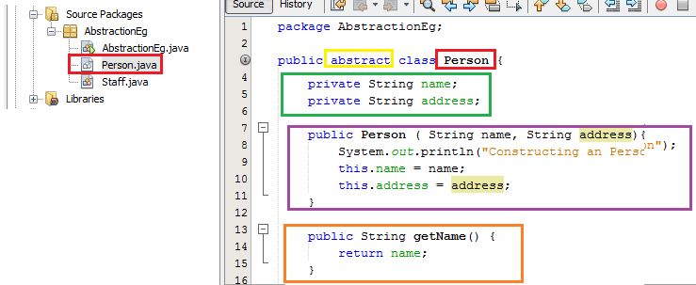
Abstraction Example
Create NetBeans project Abstraction
Create a class Person within the Abstract package.
Add class modifier abstract to the class declaration .
Add two private variables Name, Address.
Create the person method and include the code listed
Create a getname() method and include the code listed.
Create a class Staff within the Abstract package.
Add class modifier Extends person to the class declaration.
Add one private variables salary.
Create the salary Method and include the code listed.
Create a getsalary() Method and include the code listed

Slide 6
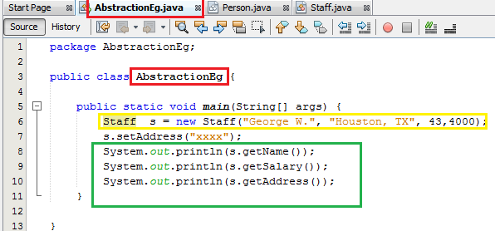
Abstraction Example
Return to the AbstractEg class
Instantiate the staff class and add the parameters listed
Use println to out the values

Slide 7
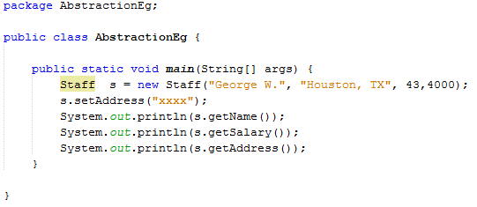
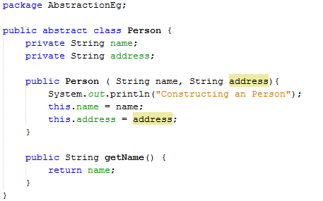
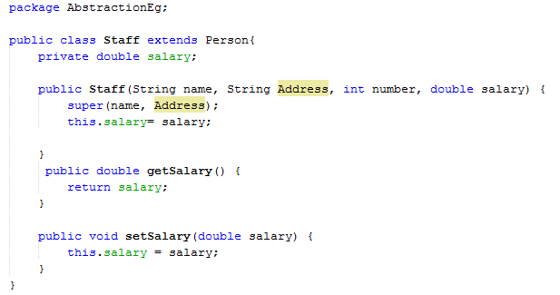
Abstraction
Here, you cannot instantiate the Employee class, but you can instantiate the Salary Class, and using this instance you can access all the fields and methods of Employee class.
If you want a class to contain a particular method but you want the actual implementation of that method to be determined by child classes, you can declare the method in the parent class as an abstract

