Slide 1
Class Structure
Java

Slide 2
What is a Class
In object-oriented programming:
a class is a blueprint for creating objects
providing initial values for state (variables),
and implementations of behavior (methods).

Slide 3
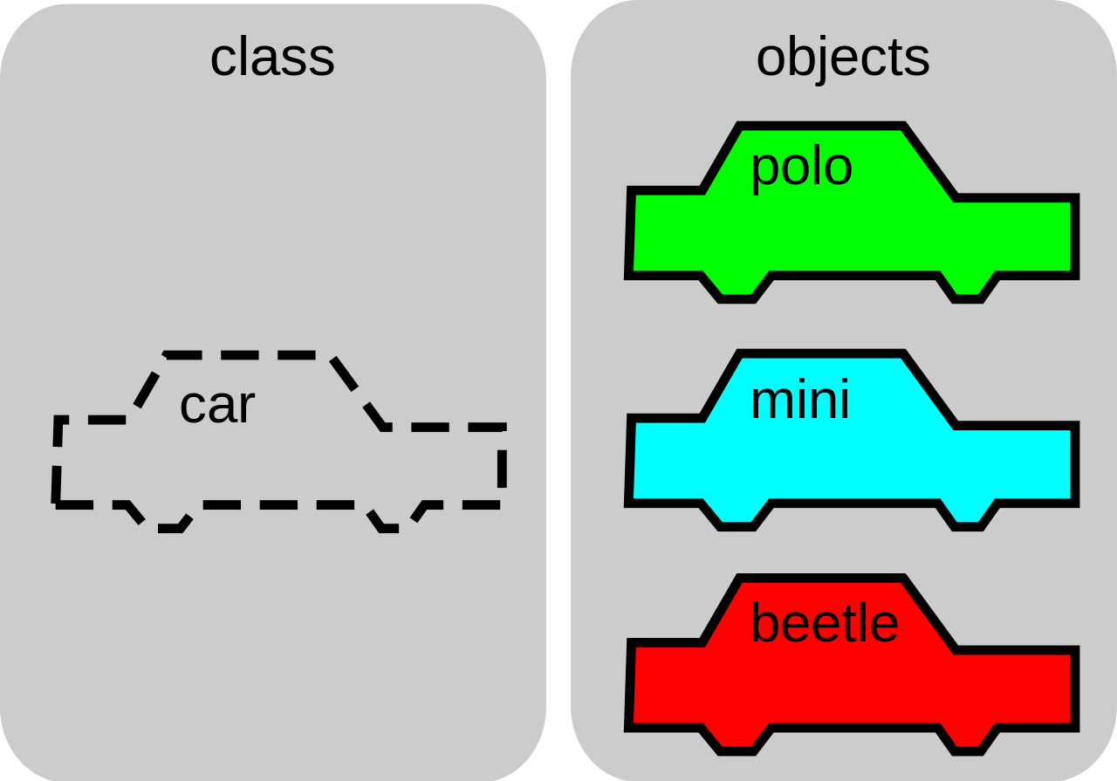
What is a Class
The objects are created using the class keyword.
The class is a blueprint that defines a nature of a future object.
An instance is a specific object created from a particular class. .
Classes are used to create and manage new objects and support inheritance: a key ingredient in object-oriented programming and a mechanism of reusing code.

Slide 4
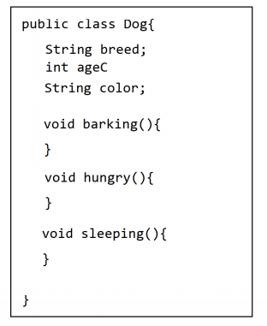
What makes up a class
Class components include:
Class name: How the class name is identified
Comments: Comments to document your code
Variables: Variables for use in the class
Constructors: Special methods used to properly initialize a class
Interface: Methods that are used to control access to private variables

Slide 5
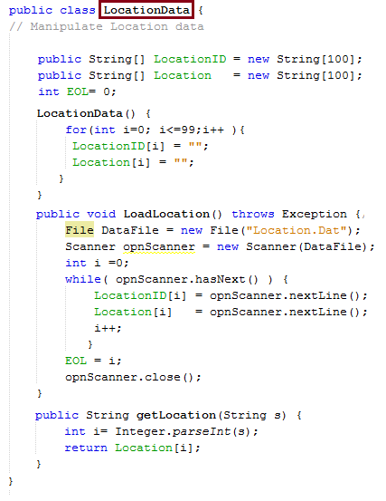
What makes up a class
Class components include:
Class name: How the class name is identified.

Slide 6
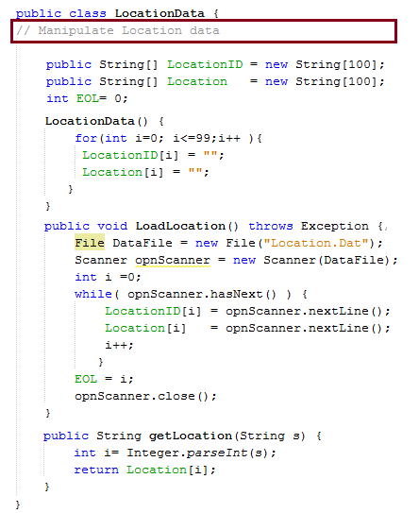
Components
Class components include:
Comments: Comments to document your code.
// used for single line comments
/*
Used
For multi-line
Comments
*/

Slide 7
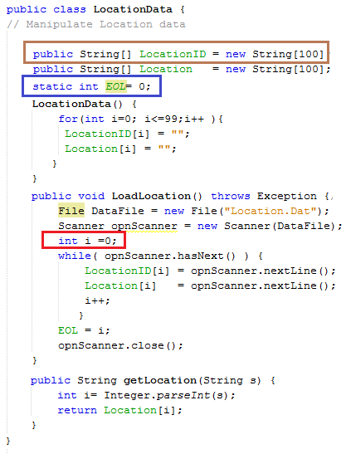
Variables
Variables: Variables for use in the class
A class can contain any of the following variable types.
Local variables: Variables defined inside methods, constructors or blocks are called local variables. The variable will be declared and initialized within the method and the variable will be destroyed when the method has completed.
Instance variables: Instance variables are variables within a class but outside any method. These variables are initialized when the class is instantiated. Instance variables can be accessed from inside any method, constructor or blocks of that particular class.
Class variables: Class variables are variables declared within a class, outside any method, with the static keyword.

Slide 8
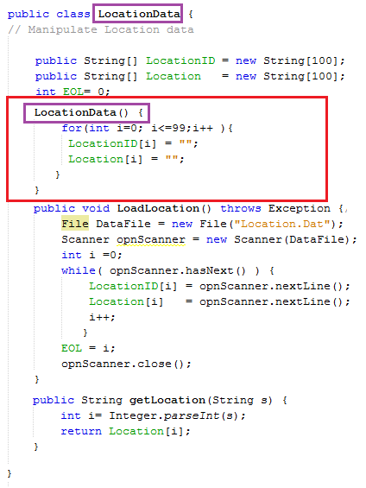
Constructors
Class components include:
Constructors: Special methods used to properly initialize a class
Every class has a constructor. If we do not explicitly write a constructor for a class, the Java compiler builds a default constructor for that class.
Each time a new object is created, at least one constructor will be invoked.
The main rule of constructors is that they
Should have the same name as the class.
A class can have more than one constructor.

Slide 9
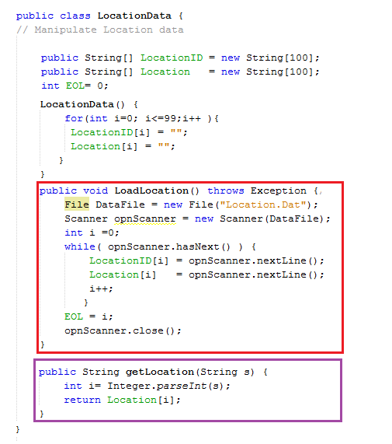
Methods
Class components include:
Interface: Methods that are used to control access to private variables
A method is a set of code which is referred to by name and can be called (invoked) at any point in a program simply by utilizing the method's name.
Think of a method as a subprogram that acts on data and often returns a value.
Each method has its own name. When that name is encountered in a program, the execution of the program branches to the body of that method.
When the method is finished, execution returns to the area of the program code from which it was called, and the program continues on to the next line of code.

